Slide 1
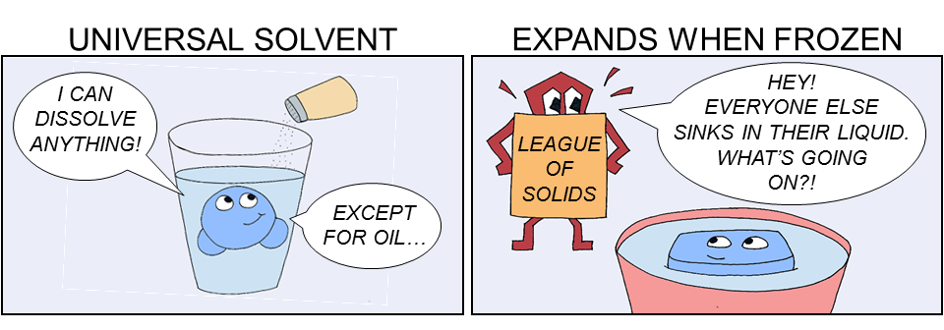
The importance of water

Slide 2
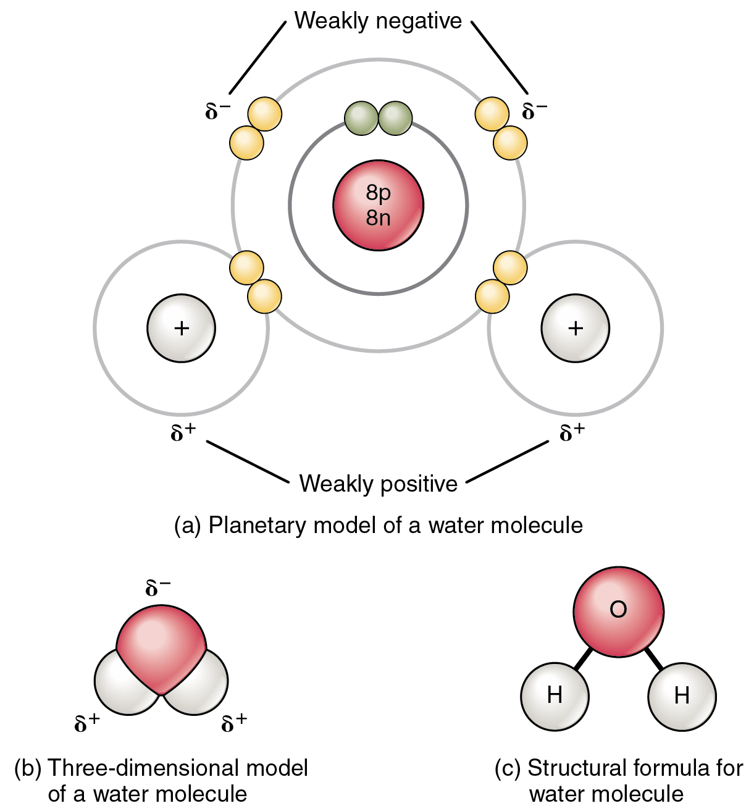
Water is weird
Water is made up of two hydrogen atoms bonded to one oxygen atom
  H₂O
  Hydrogen molecules have 1 electron in their outer shell
  Oxygen has 6 electrons but needs two more to be complete
    Therefore, Water is made up with Polar covalent bonding

Slide 3
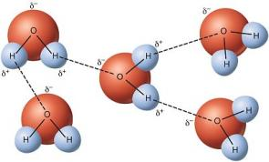
Water bonding
Water also bonds with other water molecules due to hydrogen bonding

Slide 4
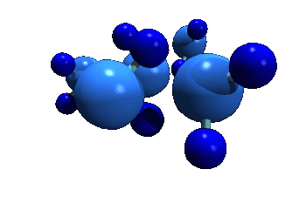
Properties of Water
Water is the most abundant compound in most living things. Nearly 70% of your body is made of water (about 2/3) .

Slide 5
Cohesion
Cohesion- an attraction between molecules of water
The result:
  Water molecules stick to each other
  Surface tension: Water molecules are difficult to break apart, therefore it appears as though water molecules create a film on the surafce

Slide 6

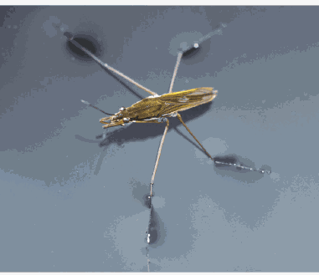

Slide 7
Adhesion
Adhesion- an attraction between molecules of different substances.
The result:
  Water molecules stick to glass of graduated cylinder forming the meniscus.
  Capillary Action- Force that draws water up against gravity in roots of plants.

Slide 8
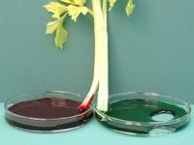
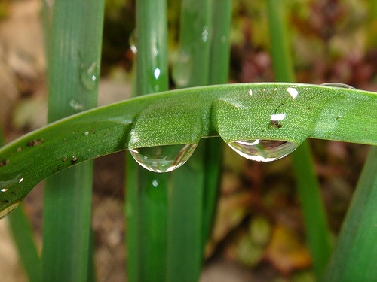
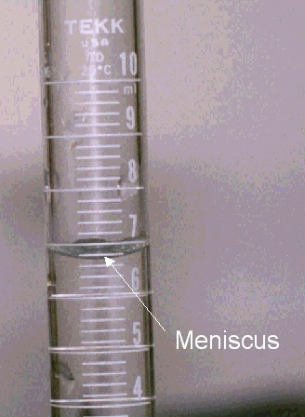
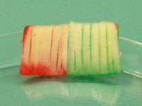

Slide 9
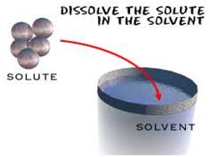
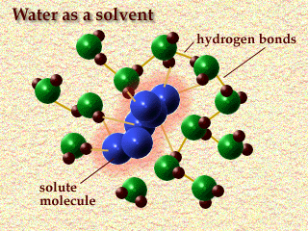
Universal solvent
Due to its polar nature, water is the universal solvent
  Solvent: dissolves matter
  Solute: matter that gets dissolved

Slide 10
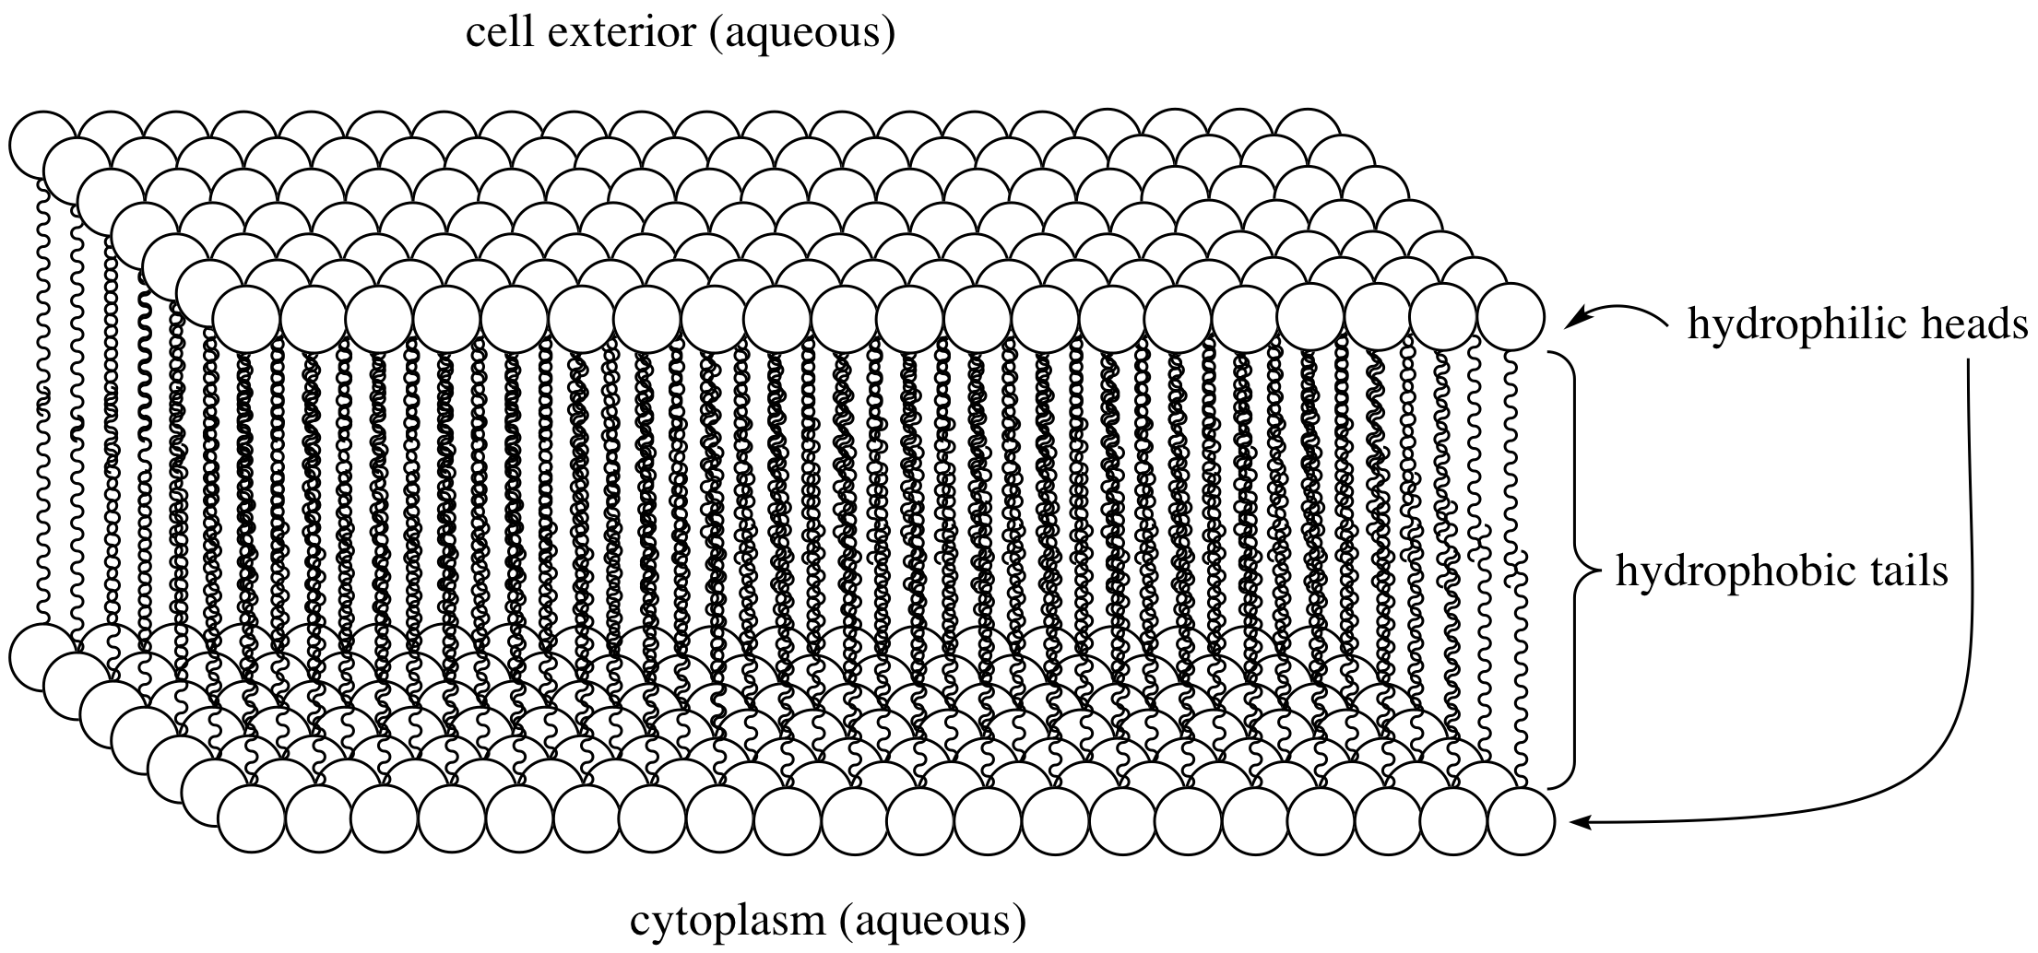
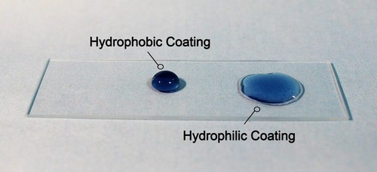
Affinity for water
Hydrophobic: Molecules that are not attracted to water
Hydrophilic: Molecules that are attracted to water

Slide 11
soap
soap

Slide 12
solution
When a solute is dissolved in water, we call it an aqueous solution
Some solutions are stronger than others
  Concentrations of solutions are measured in molarity
  Mole (mol) is equal to the molecular weight of a substance
  6.02 x 10₂₃ is Avogadro's number- the number of molecules in a mole
  Molarity = moles of solute per liter of solution

Slide 13
Hydrogen bonding: Specific heat
Specific heat: the amount of energy needed to raise the temperature of 1 gram of a substance by 1 degree Celsius
Water has the highest specific heat, it takes the most energy to raise the temperature of liquid water
When heat is added to water molecules, instead of the energy being used to raise the temperature of the water molecule, the heat is being used to break the hydrogen bonds

Slide 14
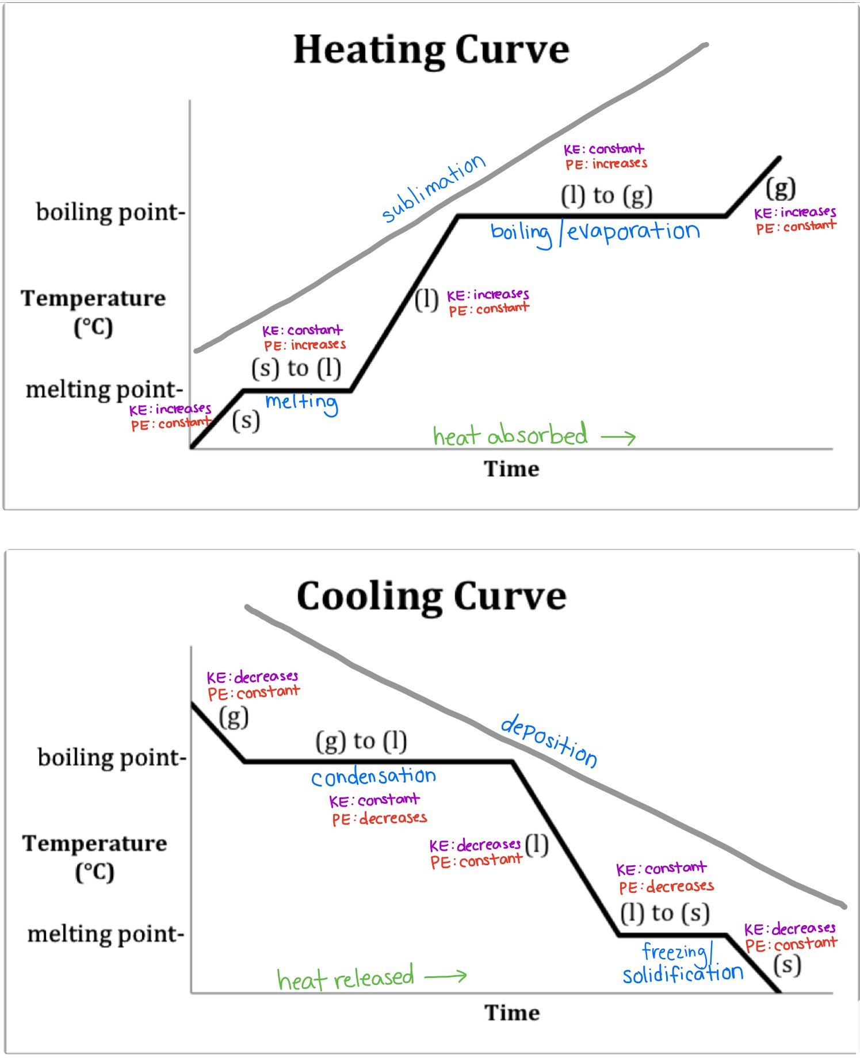
When energy (heat) is added to water, the kinetic energy increases
Kinetic energy is measured in terms of temperature
Heat absorption is either used to raise the temperature of a molecule or to change the phase of the molecules

Slide 15
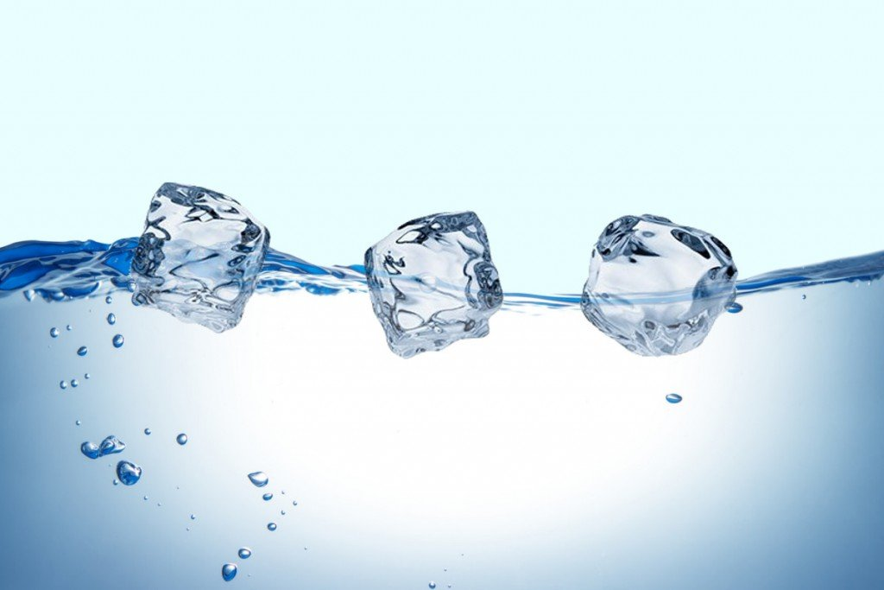
Hydrogen bonding: water is weird
When enough energy is released from water molecules, they will solidify
Most elements are most dense when solid
Water is less dense as a solid because the hydrogen bonds keep the molecules far apart enough that the volume of water expands instead of contracts when froze

Slide 16
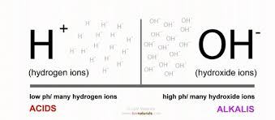
Breaking the bonds
When water breaks down into hydrogen and oxygen, each element contains a slight charge
  H⁺ hydrogen ion
  OH⁻ hydroxide ion

Slide 17
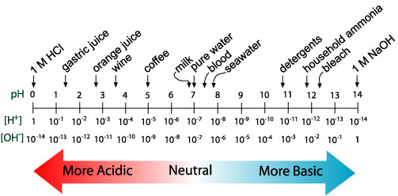
pH
acids increase the concentration of hydrogen ions
- adding h+ to the solution
-removing oh- from the solution
Bases increase the concentration of hydroxide ions
- adding OH- to the solution
-removing H+ from the solution

Slide 18
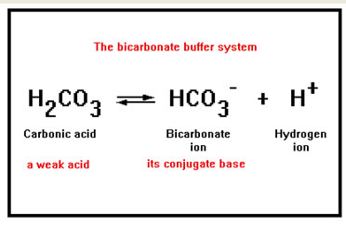
Weak acids and bases
Chemical equations move forward and backward by accepting and releasing hydrogen ions
ex:

Slide 19
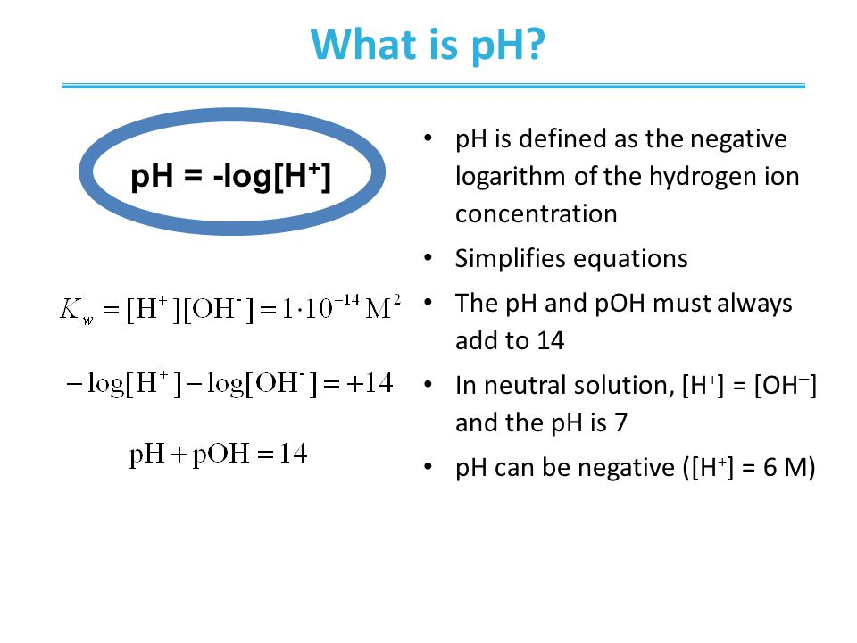
pH equation

Slide 20
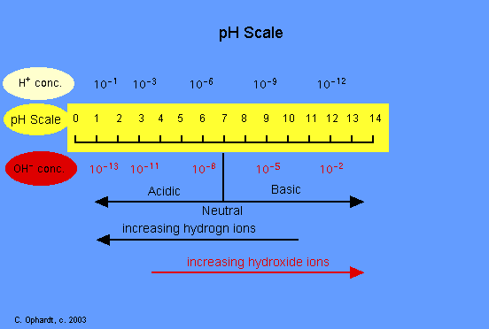
The pH Scale
Each pH unit is 10 times as large as the previous one
A change of 2 pH units means 100 times more basic or acidic
x10
x100

Slide 21
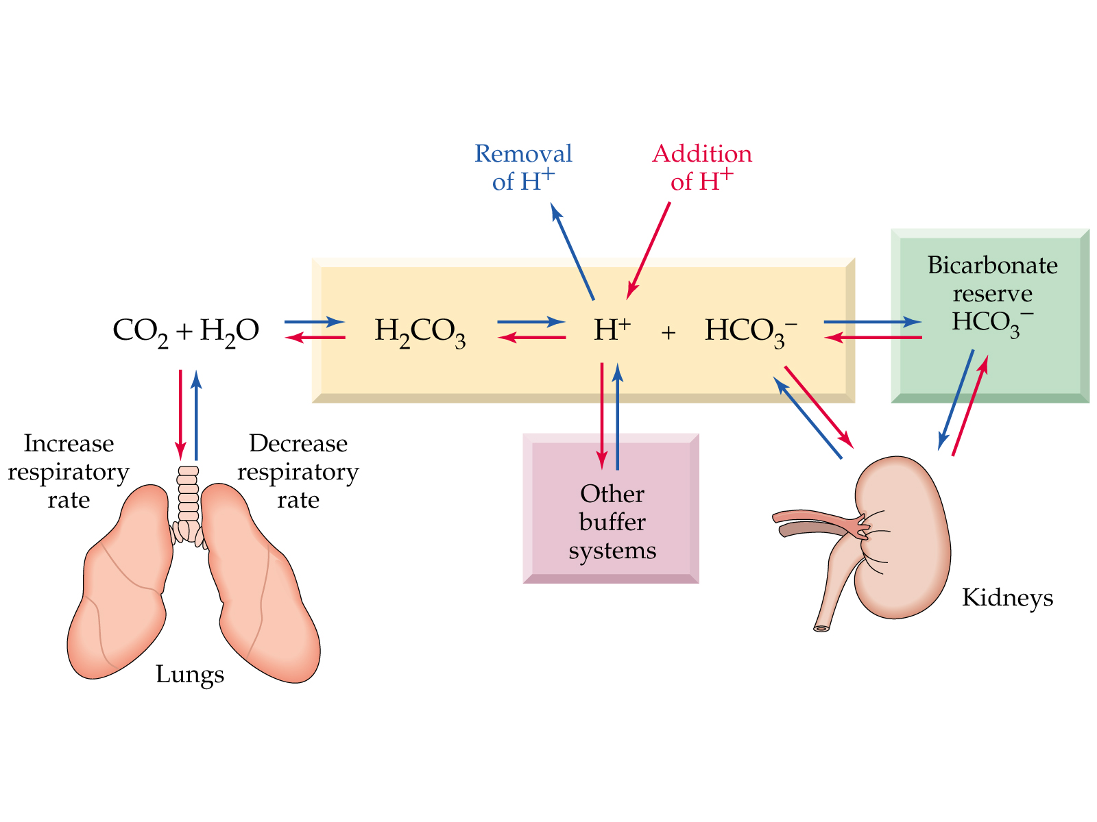
Ph as it pertains to organisms
Ph of most cells is 7 (Neutral)
Buffers minimize changes to the concentrations of H+ and Oh- ions
Buffers accept or donate H+ ions depending on what is needed
Bicarbonate Ion is the most important buffer in human blood

