Slide 1
Speciation
Chapter 24

Slide 2
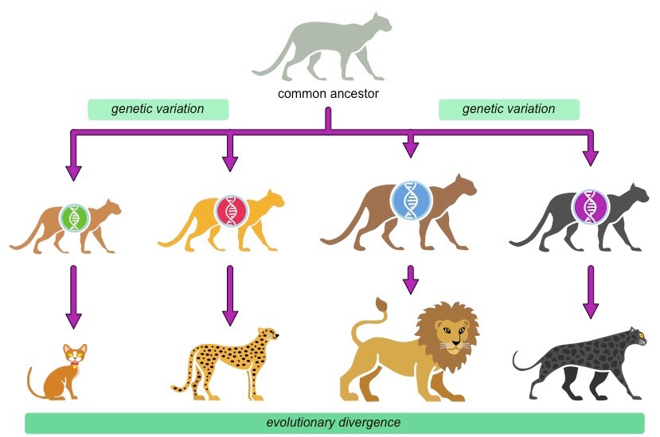
How does one species become another?
Descendants of a common ancestor will share many characteristics and thus DNA similarities
Microevolution: changes in allele frequency within a population
Macroevolution: changes in species
Species: organisms that can interbreed
And produce viable, fertile offspring
Evolution occurs because there is gene flow between populations
http://ib.bioninja.com.au/_Media/speciation_med.jpeg

Slide 3
What causes barriers?
prezygotic
postzygotic
Habitat- one species might be in water/one on land
Temporal- species that breed at different times (daily, yearly etc.)
Behavioral- species act different ways to attract mates
Mechanical- species physically cannot mate
Gametic- sperm/egg are unable to survive in different species
Reduced hybrid viability- hybrids are born- but do not survive to breed
Reduced hybrid fertility- hybrids are born sterile
Hybrid breakdown- first generation hybrid okay, but future generations do not survive

Slide 4
Other definitions
Morphological- species are recognized by their appearance (subjective)
Ecological – species are recognized by there niche
Phylogenetic – smallest group of individuals with a common ancestor

Slide 5
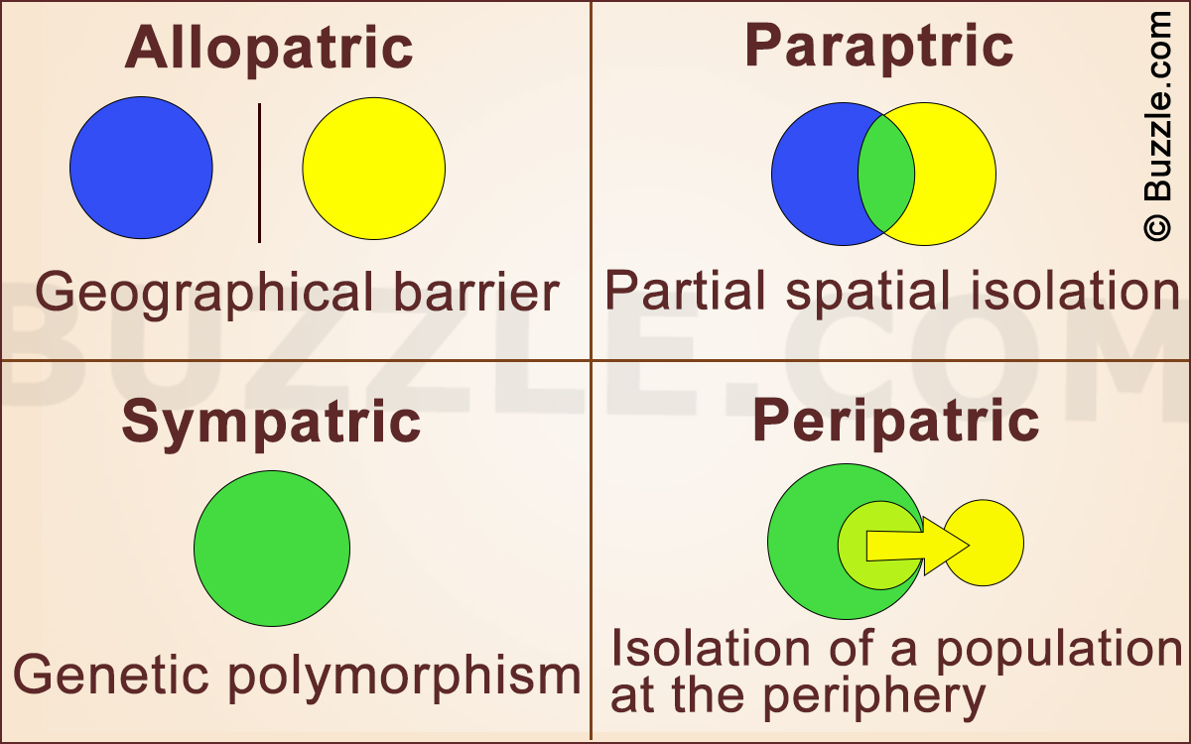
https://pixfeeds.com/images/30/598178/1200-598178-4-basic-modes-of-speciation.jpg

Slide 6
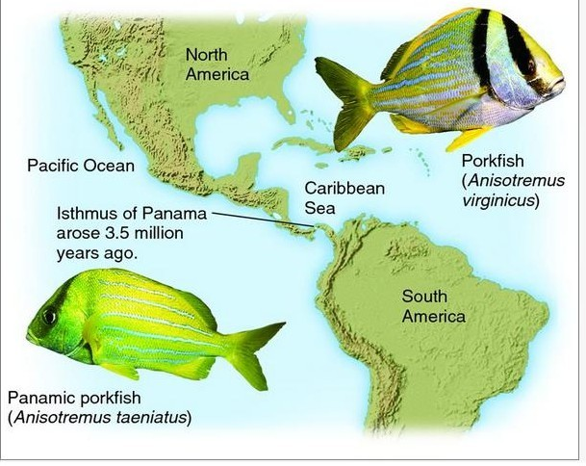
Allopatric Speciation
Allopatric: a geographic barrier isolates a population from the original population
Organisms that are more motile are less likely to be affected by geographic barriers
https://vignette.wikia.nocookie.net/dragonflyissuesinevolution13/images/7/7f/Untitled.jpg/revision/latest?cb=20131111185754

Slide 7
Sympatric Speciation
Reproductive barriers form without a geographic separation
Polyploidy- extra chromosomes as a result of a random accident
Common in plants
Autopolyploid: an individual with extra sets of chromosomes as a result of failed cell division leading to a tetraploid
Plants that are tetra can self pollinate creating fertile offspring, or can mate with other tetras also creating fertile offspring
Tetraploids can become their own species
Allopolyploid- an infertile hybrid can reproduce asexually, or can mate with other allopolyploids to make a new species
Sexual selection- mate choice can create new species by creating a reproductive barrier
Habitat selection- different habitats are used by a sub-population

Slide 8
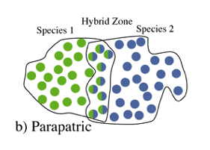
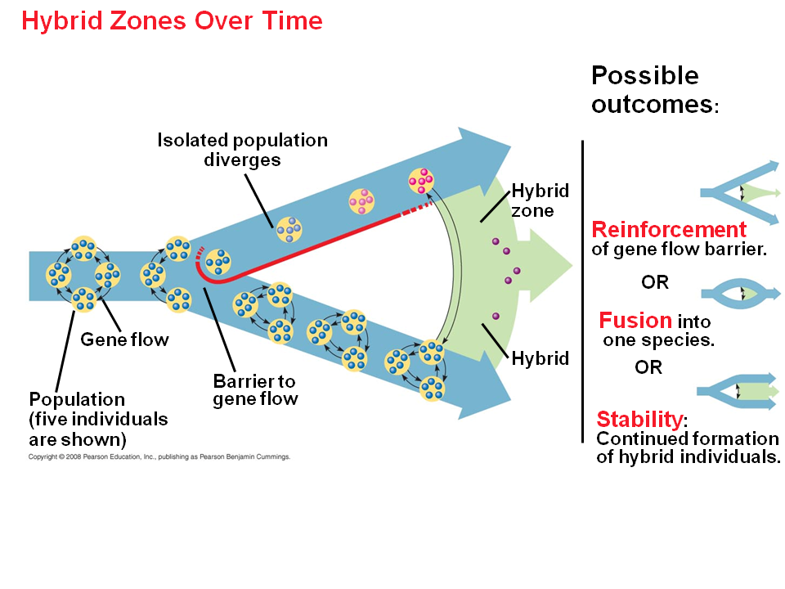
Hybrid Zone: Members of different species mate producing mixed ancestry DNA
Located where both species meet
Hybrids have a low viability
Reinforcement: reproductive barriers will be stronger in sympatric species, because reproducing a hybrid causes a decrease in survivability of genes
https://classconnection.s3.amazonaws.com/392/flashcards/2785392/png/screen_shot_2012-01-29_at_7_38_37_pm1327894766183-thumb4001363030524472-thumb400.png
http://www.sliderbase.com/images/referats/1466b/(32).PNG

Slide 9
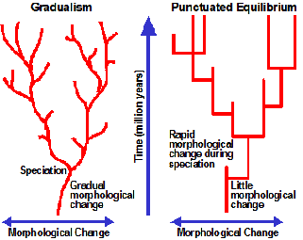
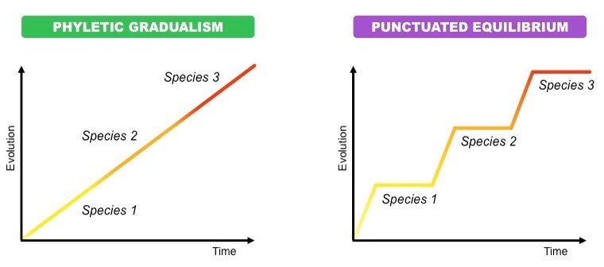
Speciation Rates
Punctuated Equilibrium: stable periods, followed by brief sudden change
http://ib.bioninja.com.au/_Media/pace-of-evolution_med.jpeg
https://12fujima.files.wordpress.com/2011/08/time_a6.gif

Slide 10
Assignment
Based on the number assigned to you in class
Create a google slide that gives examples of (not from the textbook!!!)
Allopatric speciation
Sympatric speciation
A prezygotic barrier example in organisms
A postzygotic barrier in organisms
A hybrid zone

