Slide 1
Proteins

Slide 2
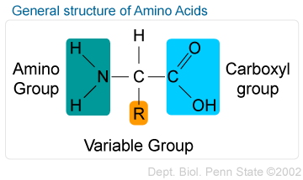
Amino Acids
Monomers of proteins
20 different varieties
Contain different “R” groups (side chains)
Side chains determine the function of the amino acid
Joined together to form a peptide bond
Polypeptide- 3 or more amino acids

Slide 3
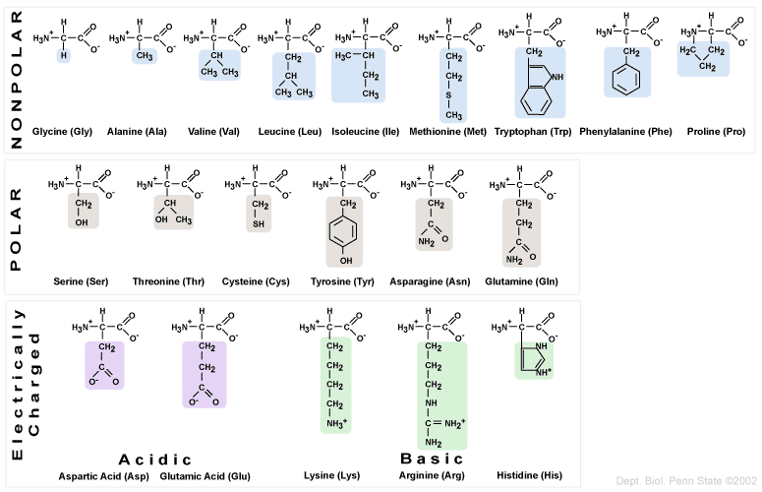

Slide 4
Proteins
Building blocks for all organic material made up of 20 different amino acids arranged in all different patterns
Polymers are created using peptide bonds
FORM FITS FUNCTION
Speed up reactions
Defense
Storage
Transport
Communication
Movement
Structure

Slide 6
Primary Structures
Simple chains of amino acids
Each amino acid is like a letter in a word arranged in a specific order
One single substitution of an amino acid can result in a totally different protein (mutation)
Ex: sickle cell anemia

Slide 7
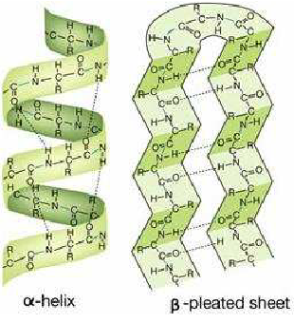
Secondary Structure
Protein structure with folds and coils
Hydrogen bonds throughout structure
Examples
Alpha Helix: DNA
Beta Pleated Sheet: Spider silk

Slide 8
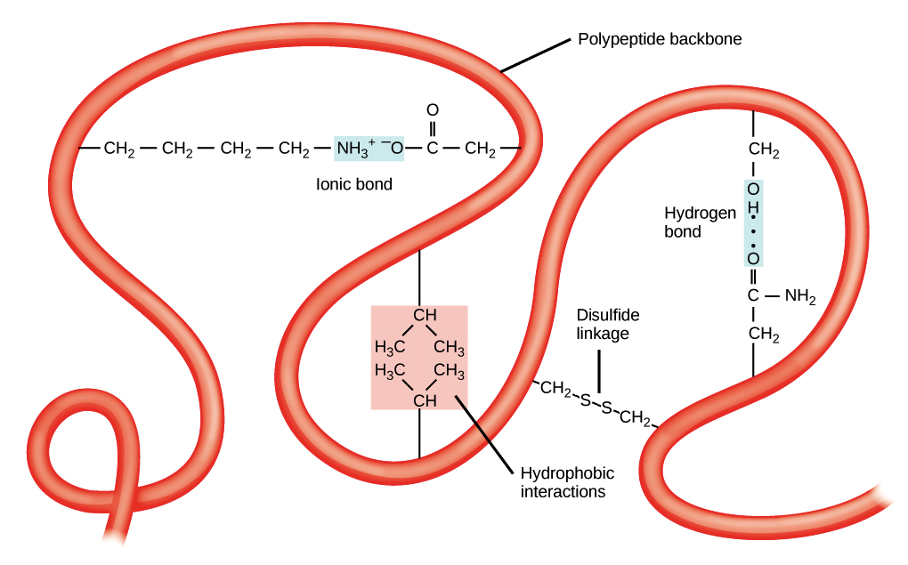
Tertiary Structure
Irregular folds of a secondary structure
Hydrophobic interactions on the amino acids toward the center of the coil
Covalent bonds called disulfide bridges keep the structure’s shape

Slide 9
Quaternary Structure
Large macromolecule consisting of two or more polypeptide chains
EX: Collagen: coiled protein into a triple helix whose function is to maintain structure of tendons and ligaments and keeping your hair/skin/ and nails looking beautiful!
EX: Hemoglobin: globular protein with four subunits allowing for the binding to oxygen

Slide 10
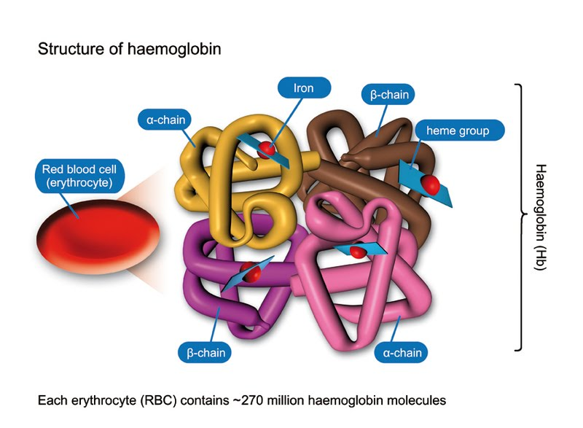

Slide 11
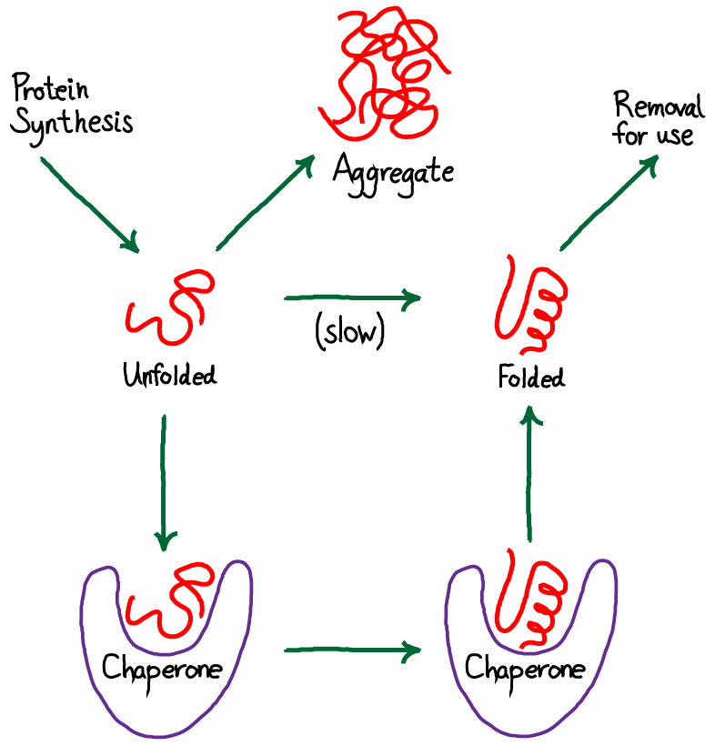
Chaperone Proteins
Proteins that assist in the folding of other proteins

Slide 12
Proteins (check up)
Provide 40% mass of the cells in your body
Form fits function
Composed of amino acids
Arranged in four types of structure patterns
Environment of formation determines the proteins shape and behavior
Temperature, pH, ion concentration etc. can affect the ability of a protein to function by changing it’s shape (DENATURE)

Slide 13
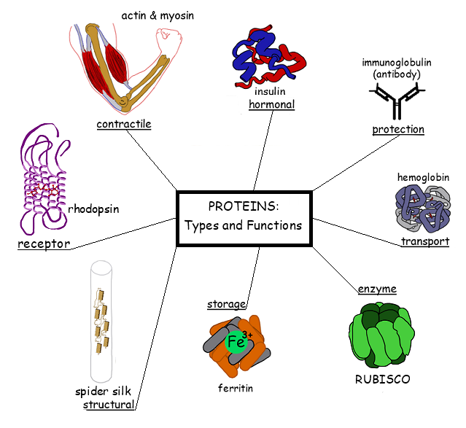

Slide 14
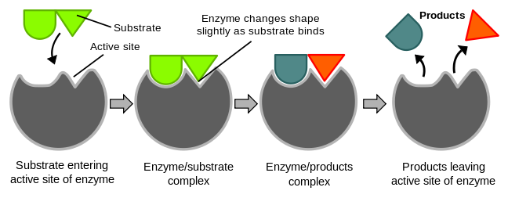
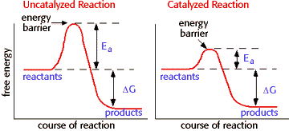
Enzymes
Proteins that are catalysts
Speed up reactions by lowering the activation energy
Reusable
Form fits function

Slide 15
Structural Proteins
Maintain structural components of organisms such as keratin, collagen and spider silk.

Slide 16
Storage Proteins
Help with nutritional needs of organisms
EX: Ovalbumin (egg whites), Casein (milk), Seeds

Slide 17
Transport Proteins
Assist in moving molecules across the cell membrane (fluid mosaic model)
EX: Hemoglobin

Slide 18
Hormonal Proteins
Used for maintaining homeostasis within the endocrine system
EX: Insulin regulates blood sugar

Slide 19
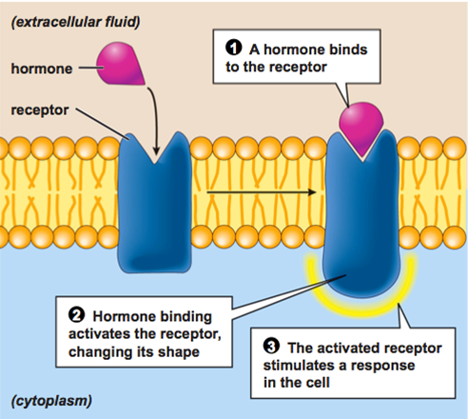
Receptor Proteins
Used to accept a messenger
Nerve signal
Hormone
Located on cell membrane

Slide 20
Contractile Protein
Responsible for moving muscles
muscle contraction
Actin
Myosin
Move cilia and flagella in single celled organisms

Slide 21
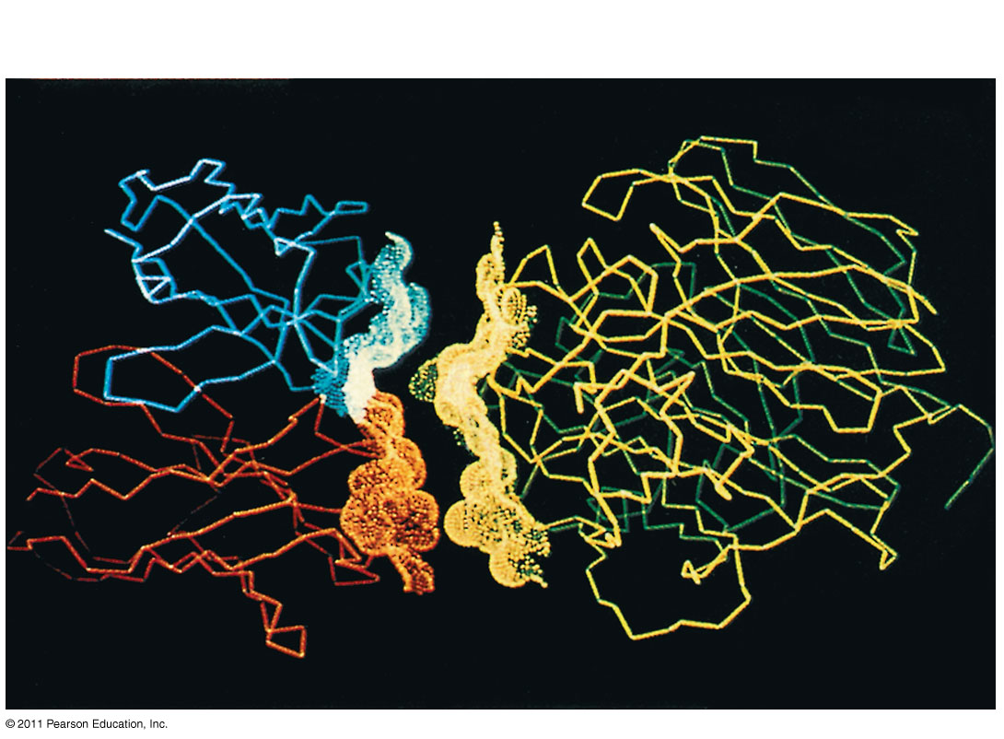
Figure 5.19
Defensive Proteins
Antibody protein
Protein from flu virus
Notes:
Figure 5.19 An antibody binding to a protein from a flu virus.

Slide 22
Protein Crystallagraphy

