Slide 1
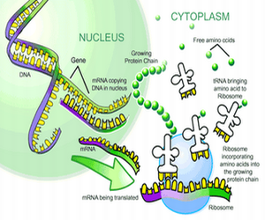
Protein synthesis
http://www.proteinsynthesis.org/wp-content/uploads/2014/09/what-is-protein-synthesis.png

Slide 2
From gene to protein (Vocabulary)
Gene Expression – the process of using the instructions (DNA) on a gene to synthesize proteins
Transcription – Synthesis of RNA using DNA
Translation – synthesis of a peptide using mRNA (ribosome)

Slide 3
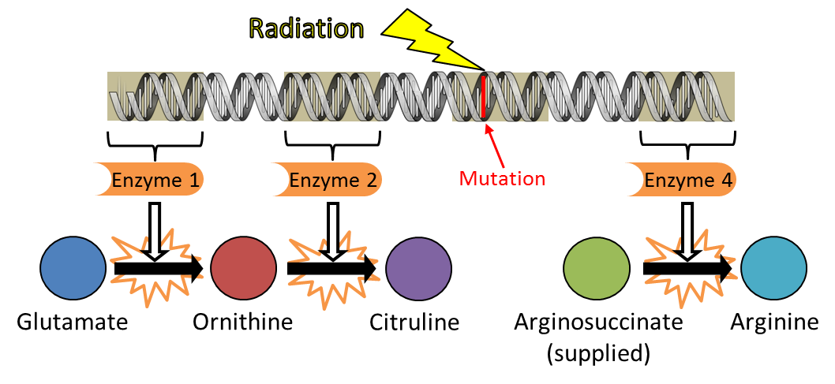
Neurospora
Beadle and Tatum expose bread mold to X-ray radiation, genetic mutations occurred- mutant mold was pulled out
Wild type mold had simple nutritional needs, mutant mold was unable to produce molecules it needed unless given the 20 essential amino acids needed
One Gene- One Enzyme- function of a single gene is to create a specific enzyme
-Not all proteins are enzymes
One Gene- One Protein
- proteins have more than one peptide chain
One Gene- One Polypeptide
https://www.matrix.edu.au/wp-content/uploads/2017/10/Blog-Biology-6-Difficult-Concepts-to-Master-for-the-HSC-Biology-Exam-Beadle-and-Tatum-3.png

Slide 4
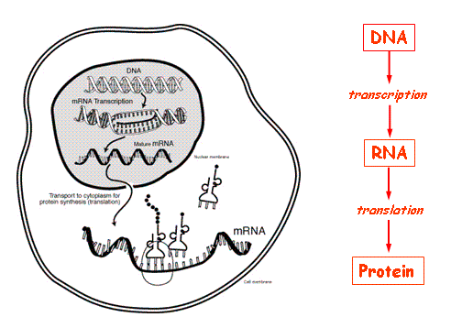
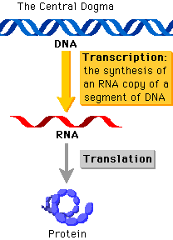
Central Dogma
https://www.ncbi.nlm.nih.gov/Class/MLACourse/Modules/MolBioReview/central_dogma.html
https://www.google.com/url?sa=i&source=images&cd=&cad=rja&uact=8&ved=2ahUKEwiAgePJiZTfAhVhTt8KHeQfBL8QjRx6BAgBEAU&url=http%3A%2F%2Fwww.phschool.com%2Fscience%2Fbiology_place%2Fbiocoach%2Ftranscription%2Foverview.html&psig=AOvVaw0_koZkVAXwzfH5UxnBbmyb&ust=1544490345176711

Slide 5
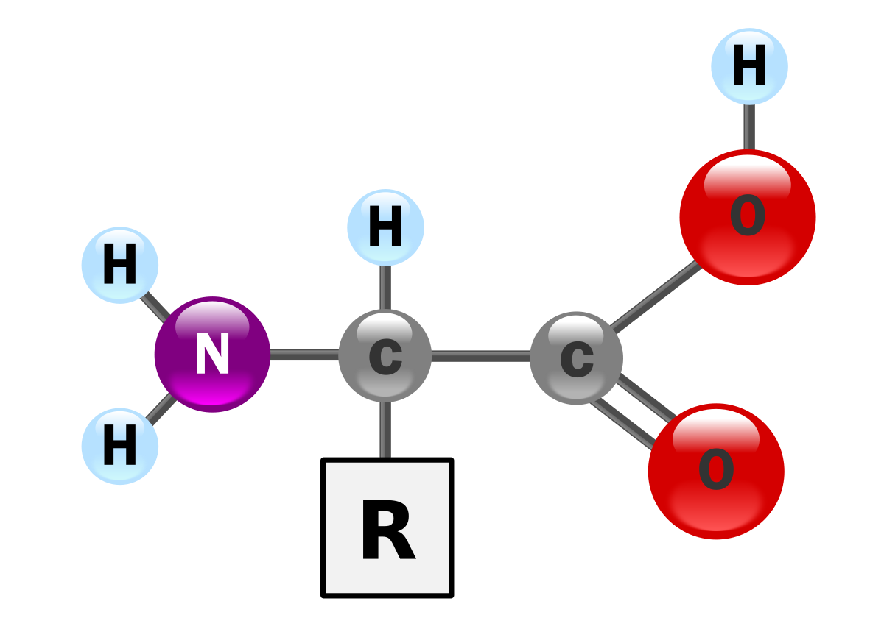
Amino Acids
Nucleotides 4³ (64) possible code words (Triplet Code)
One strand of DNA (template strand) provides the template for RNA transcription (mRNA)
Remember that U replaces T*
Codon – the DNA nucleotide triplets on the non-template strand (or the mRNA strand)
Translation – a sequence of amino acids is added to become a polypeptide (5’ – 3’) strand
https://upload.wikimedia.org/wikipedia/commons/thumb/c/ce/AminoAcidball.svg/1200px-AminoAcidball.svg.png

Slide 6
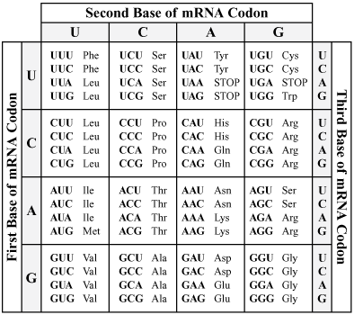
https://oli.cmu.edu/repository/webcontent/d159c5ce80020ca601c70e9d42523679/_u880_molecular_genetics/_m2_gene_expression/webcontent/image1.jpeg
http://www.doe.mass.edu/mcas/images/2017/316891_08_genetic_code.png

Slide 7
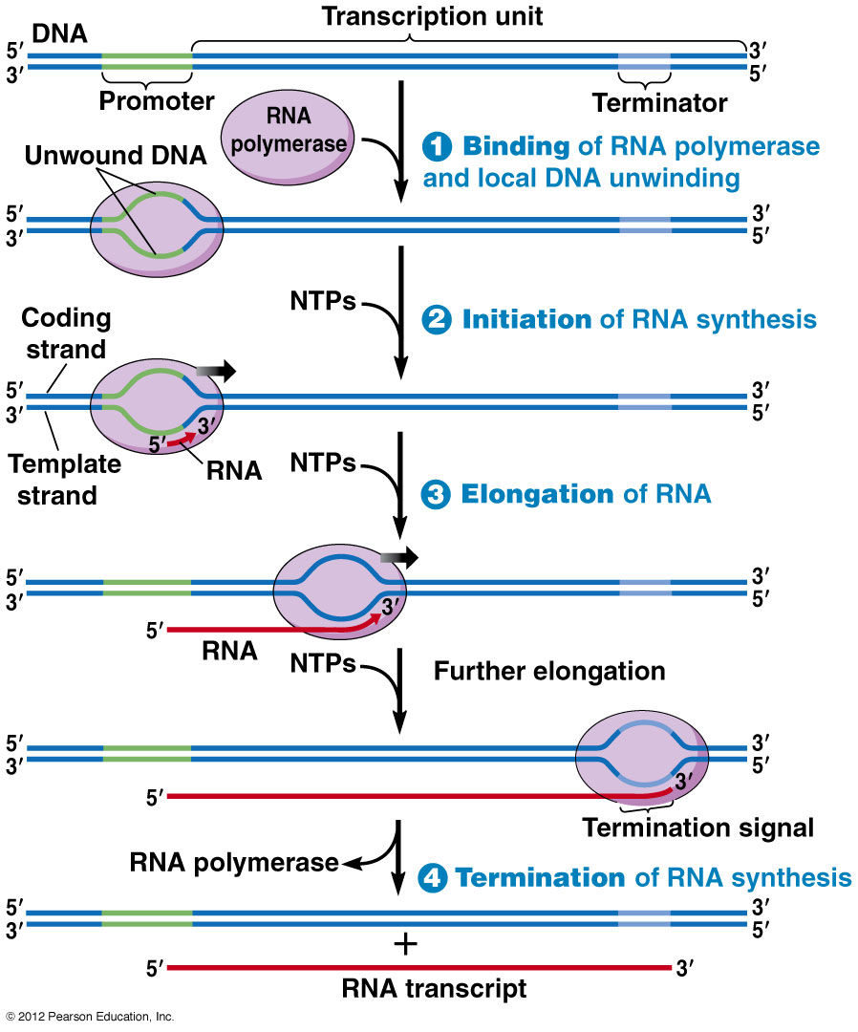
DNA is read 3’-5’
RNA polymerase binds in the 5’ – 3’ direction, and does not need a primer
RNA polymerase attaches to the promoter and ends at the terminator
Bacteria RNA polymerase makes mRNA, rRNA,

Slide 8
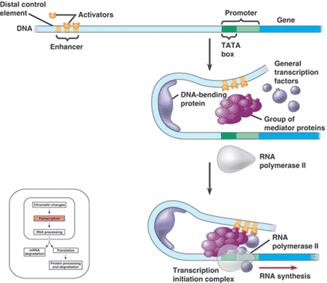
Initiation
Promoter (the area where RNA synthesis actually begins)
Transcription Factors proteins that bind RNA polymerase to start transcription
Transcription Initiation Complex – TATA box (transcription factors and RNA polymerase II attached to the promoter region)
https://www.quia.com/files/quia/users/lmcgee/genetics/APchapter19-EukaryoticGenome/activators_transcriptioncom.gif

Slide 9
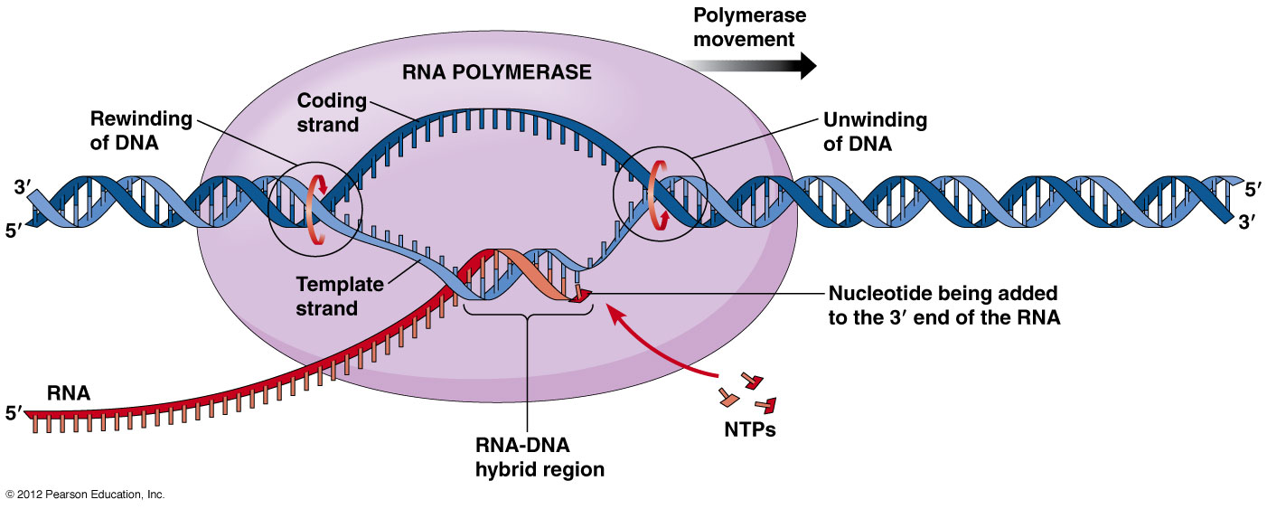
Elongation
RNA polymerase untwists the double helix and adds nucleotides to the 3’ end, creating a strand in the 5’ to 3’ direction
http://www.mun.ca/biology/desmid/brian/BIOL2060/BIOL2060-21/21_09.jpg

Slide 10
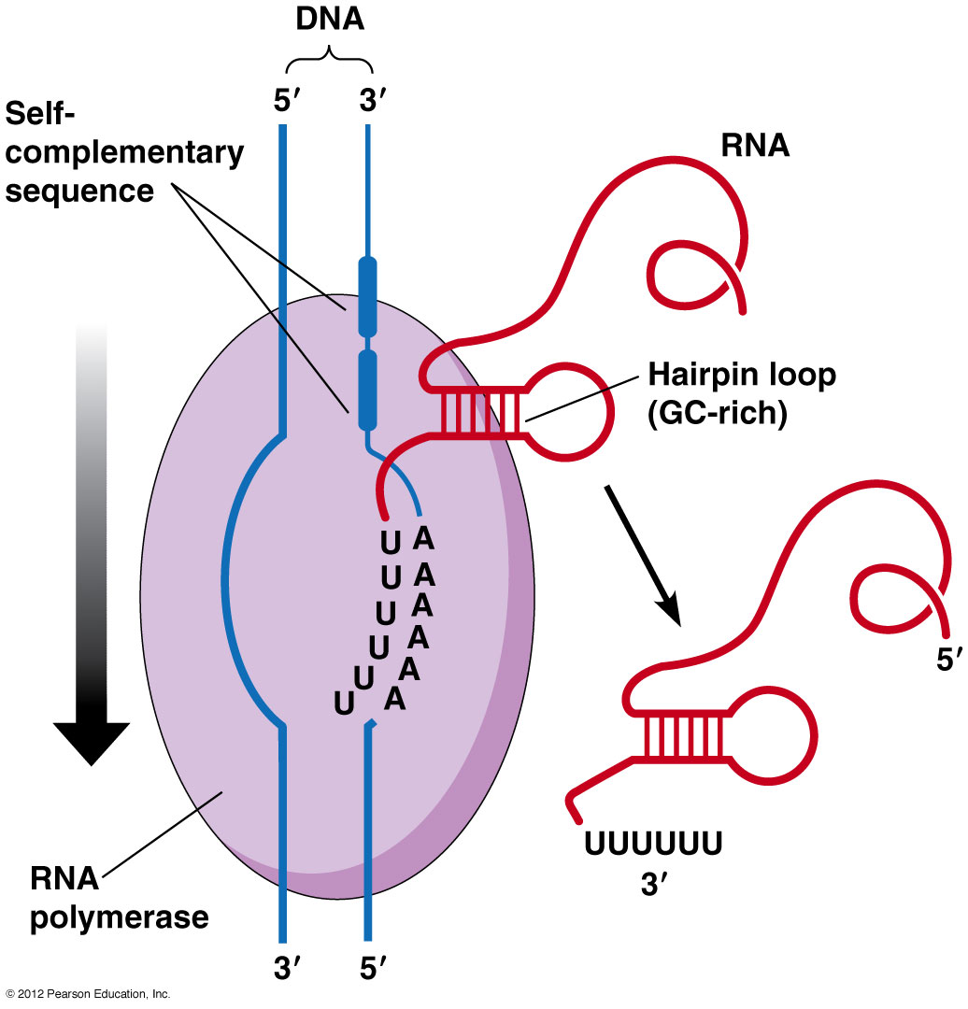
Termination
Bacteria: specific DNA sequence codes for an RNA sequences that causes the polymerase to detach from DNA
Eukaryotes: RNA polymerase II transcribes AAA polyadenylation which releases the polymerase
http://www.mun.ca/biology/desmid/brian/BIOL2060/BIOL2060-21/21_10.jpg

Slide 11
From pre mRNA to MRNA
DNA read 3’-5’
Pre mRNA made 5’-3’, including exact alternative strands
RNA Polymerase II transcribes both introns and exons
Not all sequences code for genes or proteins
RNA splicing, edits pre mRNA, removing introns (non coding sections)
EXONS are attached (Expressed codes)
Spliceosome (small RNA units) release introns
Ribozyme (RNA units that function as enzymes (not proteins)
Alternative RNA splicing- number of proteins higher than the number of genes
Domains- different regions of proteins, that act in different ways (hence more proteins that genes)

Slide 12
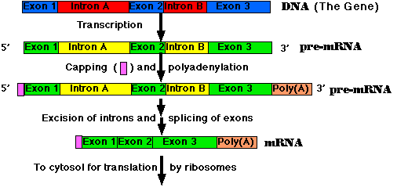
http://www.cbs.dtu.dk/courses/genomics_course/roanoke/pre-mrna.gif

Slide 13
T RNA
Transfer RNA takes the mRNA and creates proteins in the form of a polypeptide (chains of amino acids)
tRNA molecules are anti codons with amino acids floating in the cytoplasm
tRNA – 80 nucleotides in a single strand, folded in the shape of a T (2D) or an L (3D)
Made in the nucleus from DNA template
Anti codons located on the loop, amino acids located on the 3’ end

Slide 14
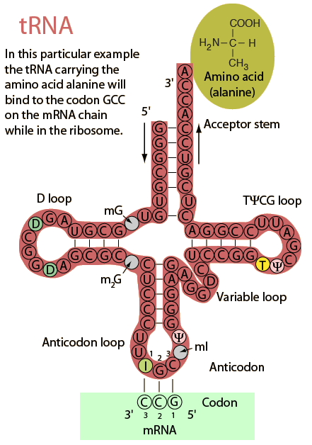
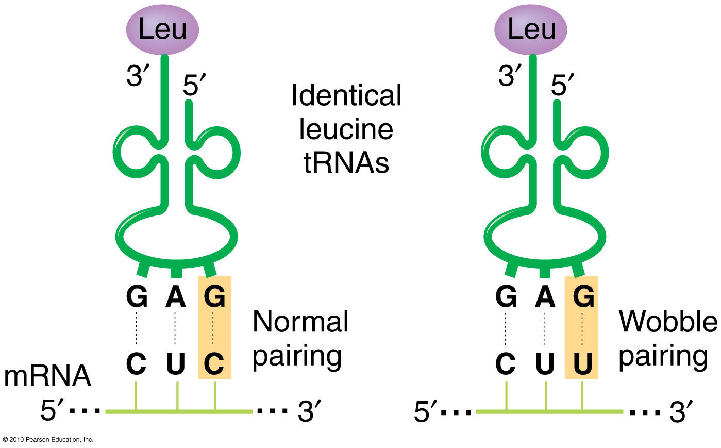
https://i.stack.imgur.com/43ars.jpg
http://hyperphysics.phy-astr.gsu.edu/hbase/Organic/imgorg/trna4.gif

Slide 15
From mRNA to TRNA to Amino Acid
Aminoacyl- tRNA synthetases bind amino acid to tRNA
(20 enzymes- 1 for each amino acid)
Hydrolysis of ATP helps to catalyze the reaction- creating a covalent bond
tRNA’s can bind to more than one codon
Wobble- the third nucleotide can bind to multiple nucleotides

Slide 16
Ribosomes- Protein Factories
Ribosomes are where protein synthesis occurs
Two parts (large and small subunits) made up of proteins and rRNAs
Three parts A, P and E
A- aminoacyl-tRNA binding site
P- peptidyl- tRNA binding site
E exit site

Slide 17
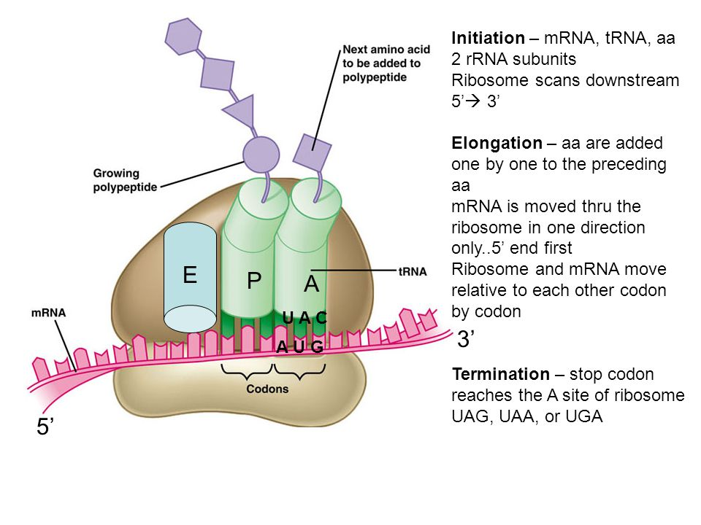
https://images.slideplayer.com/13/3882652/slides/slide_25.jpg

Slide 18
Translation three stages
Initiation: brining mRNA and tRNA together (AUG start codon)
Initiation Factor proteins and energy from GTP form the initiation complex
Elongation: Amino acids are added at the C-terminus of growing chain
Elongation Factor proteins work in a three step cycle
Codon recognition- Peptide bond formation – Translocation
Termination: a stop codon UAG, UAA or UGA is read
Release Factor proteins binds at the A site and adds water to the polypeptide

Slide 19
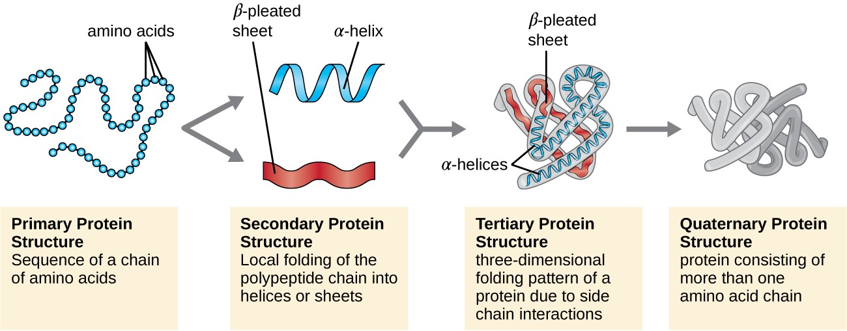
From Translation to Functional Protein
Chaperone Proteins help the protein to fold, after termination
Enzymes or other modifications to the protein can occur after termination
https://s3-us-west-2.amazonaws.com/courses-images/wp-content/uploads/sites/1094/2016/11/03164018/OSC_Microbio_07_04_proteinstr.jpg

Slide 20
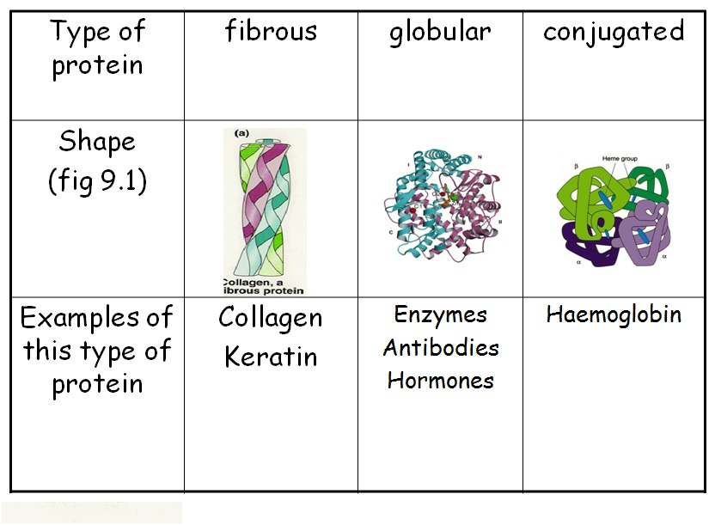
Two types of proteins
Free ribosomes make proteins for cytoplasm
ER ribosomes make proteins for the nuclear envelope, Golgi, lysosomes, vacuoles and plasma membrane (endomembrane bound system)
One signal peptide tells a ribosome to be bound to the ER (20 amino acids long), recognized by SRP signal recognition particle
Acts as an escort to bring the ribosome to the ER
https://mrsmatheson.files.wordpress.com/2013/01/types-of-protein-2.jpg

Slide 21
mutations
Changes in the genetic information of a cell
Point mutations: one nucleotide change
Substitution: nucleotide pairs are replaced
Silent mutation: no change in amino acid synthesized
Missense: change one amino acid into another but does not affect the protein function
Insertion/deletion: additions or losses of nucleotides
Frameshift: when the insertion or deletion messes with the triplet

