Slide 1
Population Ecology
Chapter 53

Slide 2
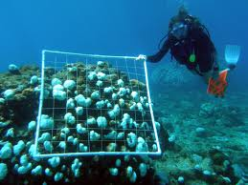
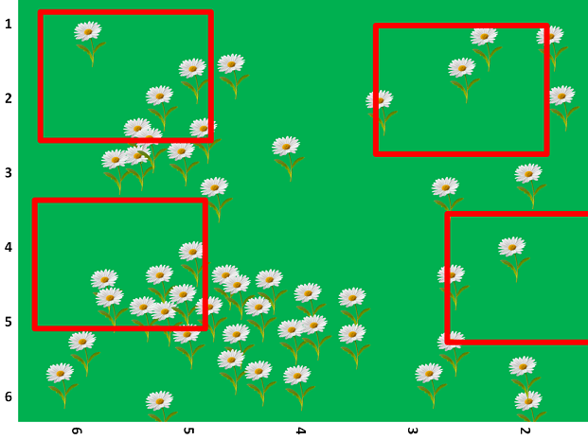
What is ecology?
Ecology is the study of organisms and their interactions with each other and their environment
Abiotic Factors: light, water, nutrients, minerals, space etc.
Biotic factors: mates, food, canopy cover, offspring etc.
Population ecology studies how population numbers and locations change
Recall that a population is a group of individuals of a single species in a specific area
Ecologists define specific boundaries either natural or manmade
Density measures how many individuals in a given area, for example how many trout in a square meter of lake
Counting every organism can be daunting, so ecologists often take a sample
Mark and Recapture (Fig. 53.2)
Quadrats
https://www.oceanmatters.org/wp-content/uploads/2012/04/quadrats1.jpg
https://d1e4pidl3fu268.cloudfront.net/7f3aeae5-00f1-4189-8674-34335ff02369/quadrat.crop_621x465_42,0.preview.png

Slide 3
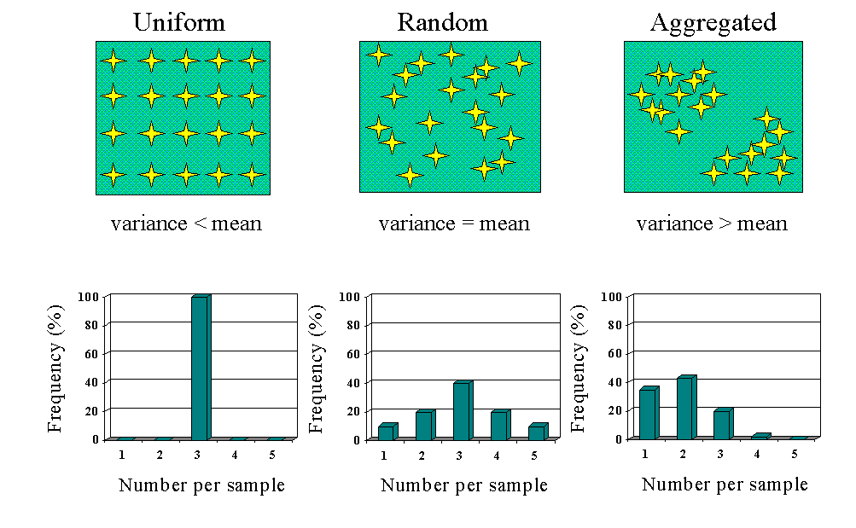
Populations are Dynamic
Emigration and Immigration cause populations to be fluid
Population density can help scientists to determine where the best habitats are
Clumping shows individuals in patches
Ex: Fungi
Uniform shows individuals evenly spaced (can also show territory)
Random shows no pattern in spacing
Demography: The study of population statistics over time
Life tables show how individuals survive at each age
Cohort: a group of the same age
http://nemaplex.ucdavis.edu/images/sampln1.gif

Slide 4
Population Graphs
Know these general curves and what they mean

Slide 5
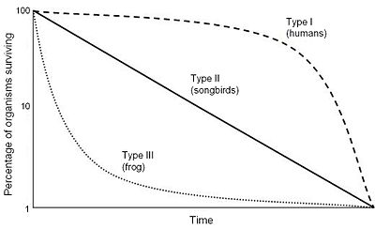
Survivorship Curves
Type I- provide care
Type II- provide less care
Type III- provide little to no care
https://upload.wikimedia.org/wikipedia/commons/thumb/c/c4/Survivorship_Curves.jpg/400px-Survivorship_Curves.jpg

Slide 6
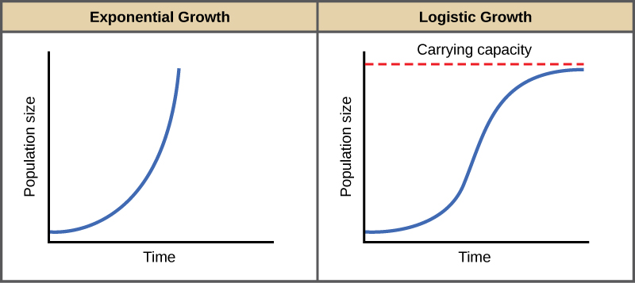
https://archive.cnx.org/resources/64522a7f22df9f70dca059bff0d746c9e40be33f/Figure_45_03_01.jpg

Slide 7
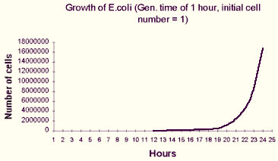
Change in Population = Births+ Immigrants – Deaths - Emigrants
N = population size
t = time
B = Births
D = Deaths
b = per capita birth rate
m = per capita death rate
r = per capita rate of increase
r _{inst} = instantaneous per capita rate of increase
Exponential Growth Equation
dN/dt = r_{inst} N
J Shaped Curve
http://ccnmtl.columbia.edu/projects/biology/lecture1/images/image31.gif

Slide 8
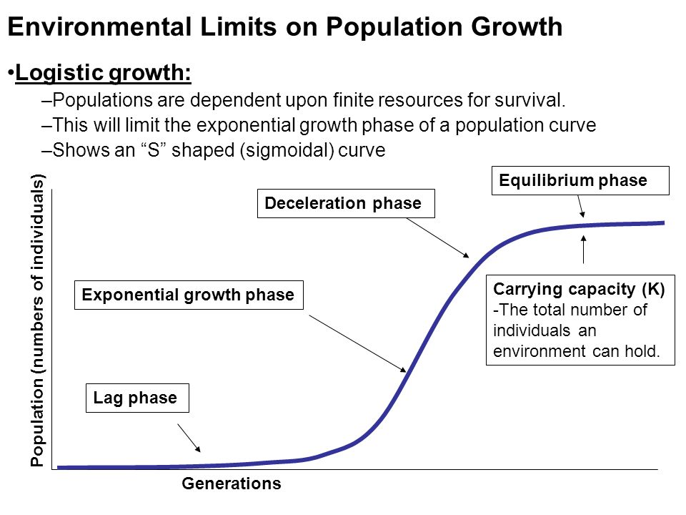
Logistic Model
Carrying Capacity: The maximum population size that a particular environment can sustain
K
Factors such as food, shelter, nutrients (abiotic and biotic factors) control K
Logistic Growth Equation
dN/dt = r _{inst} N ((K-N)/K)
S Shaped Curve
https://slideplayer.com/slide/9815581/32/images/2/Environmental+Limits+on+Population+Growth.jpg

Slide 9
Life History Diversity
Organisms vary a how often and at what age they reproduce
Some organisms reproduce once “semelparity”, some reproduce multiple times “iteroparity”
The variability depends on the offspring survival rate and the likelihood that the adult will reproduce again
Unstable conditions lead to semelparity
Stable conditions lead to iteroparity
K selection: density dependent selection
disease, resources, predation, territory, intrinsic factors, wastes
R selection: reproductive success selection

Slide 10
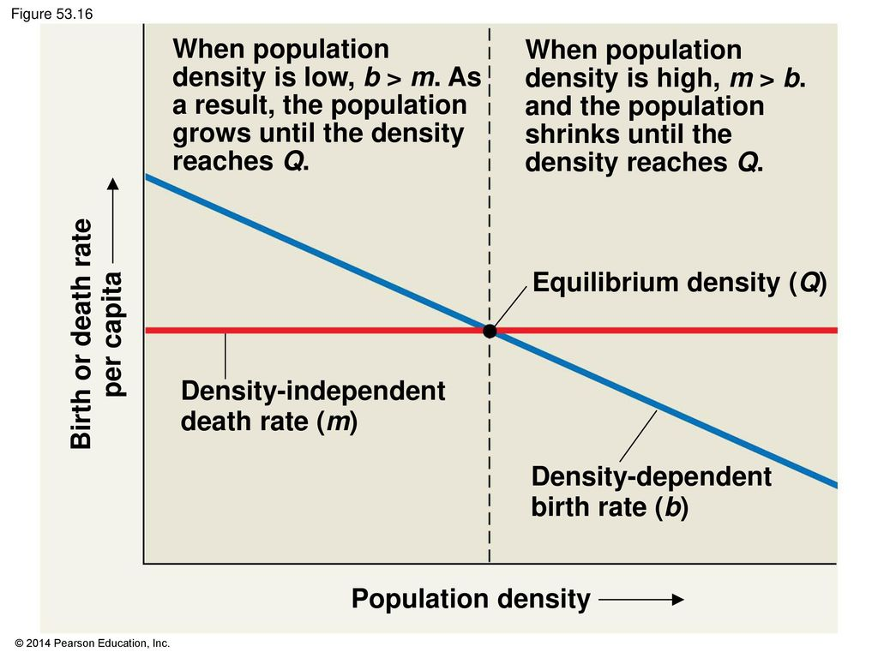

Slide 11
Human Population

Slide 12
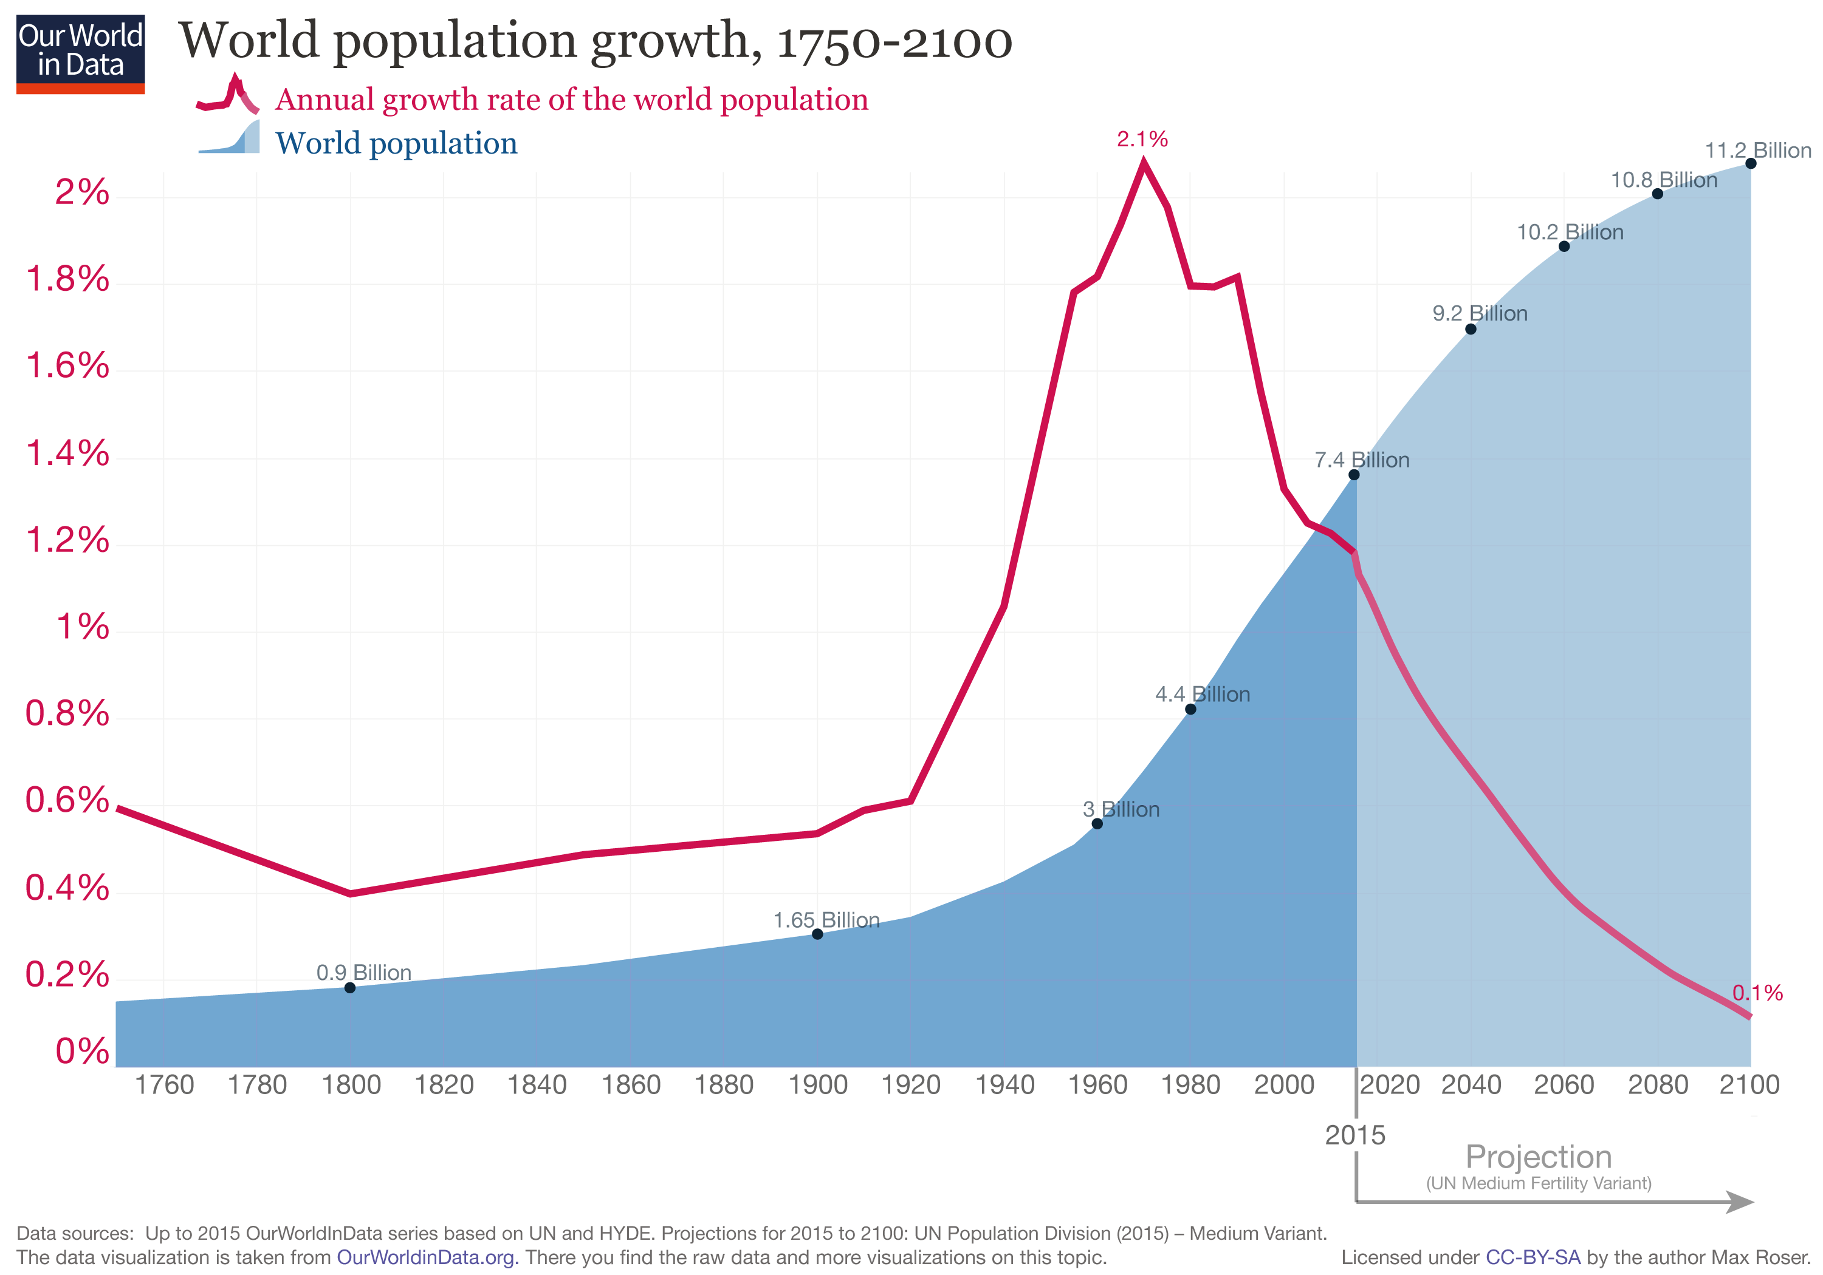
https://ourworldindata.org/uploads/2013/05/updated-World-Population-Growth-1750-2100.png

Slide 13
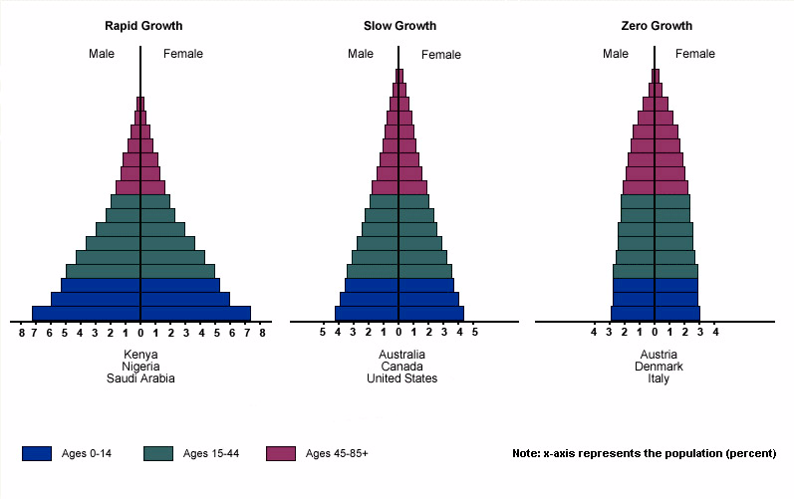
http://www.algebralab.org/img/fba2228e-1ba1-47a7-b6a2-8e9399ad21c5.gif

Slide 14
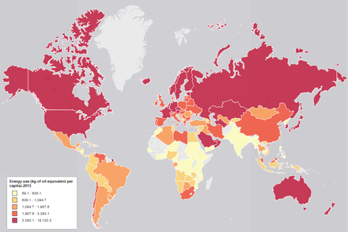
https://upload.wikimedia.org/wikipedia/commons/thumb/5/5a/World_Map_-_Energy_Use_2013.png/440px-World_Map_-_Energy_Use_2013.png

