Slide 1
Population Evolution
Chapter23

Slide 2
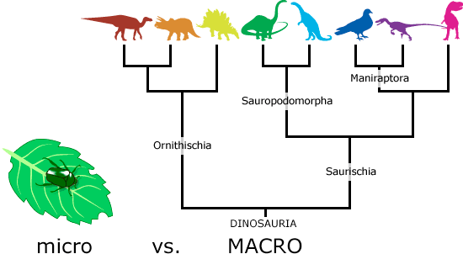
Microevolution
Smaller scale gene changes from one generation to the next is microevolution
Genetic Diversity comes from all discoveries via Mendel (etc.)
Independent assortment
Crossing Over
Random Mating
New alleles (mutations)
Some changes are “neutral” or “nonsense”
Some accumulate over time
https://evolution.berkeley.edu/evolibrary/images_pamphlets/dino_tree.gif

Slide 3
Hardy Weinberg
Population: group of individuals of the same species, in the same area, that interbreed
Gene Pool: copies of every type of allele at every locus in all members of the population
*Different from Punnett Squares- because we assume all genes and alleles, not just two individuals*

Slide 4
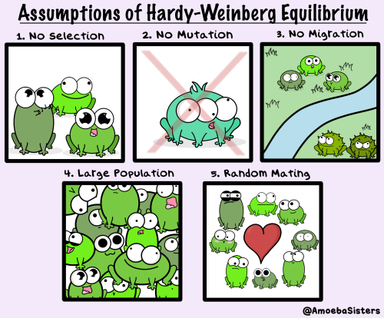
HW Conditions
No mutations
Random Mating
No Natural Selection
Large Population
No gene flow (migration)

Slide 5
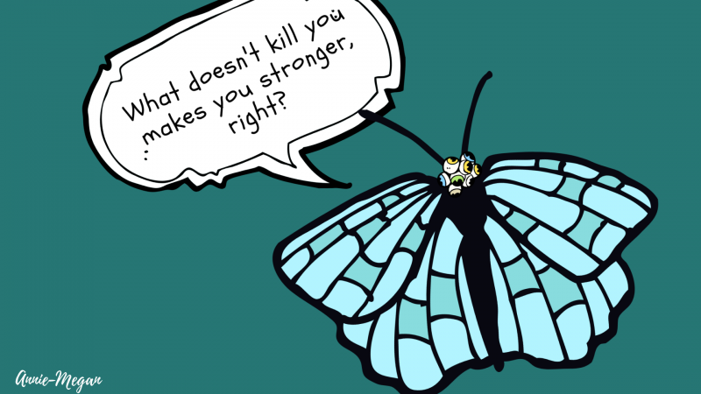
Opposite of HW: Natural Selection
There is differential success in the ability for organisms to survive and reproduce
Different traits are better suited for the environment
Adaptive evolution: organisms are better matched for their environment
https://researchmatters.in/sites/default/files/styles/large_800w_scale/public/igs_-_part_10_6.png?itok=oHe9f5T5

Slide 6
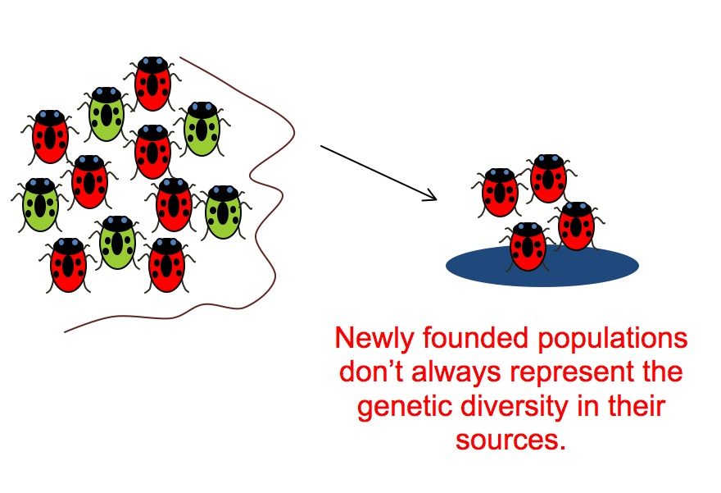
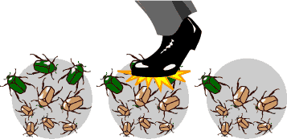
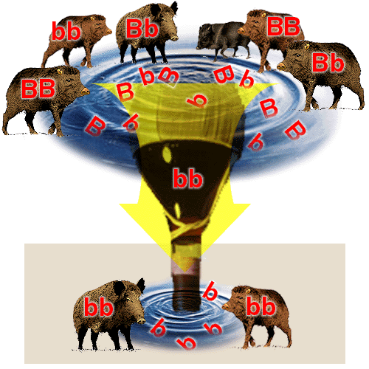
Genetic Drift
Small populations that can change unpredictably from one generation to the next
Founder Effect: Small group of the population becomes isolated, and a new gene pool forms different from the original population
https://evolution.berkeley.edu/evolibrary/images/evo/beetles_mech3.gif
http://beacon-center.org/wp-content/uploads/2012/01/Fig1.jpg
Bottleneck Effect: A reduction in population size due to a natural disaster
http://www.brooklyn.cuny.edu/bc/ahp/LAD/C21/graphics/C21_Bottleneck_2.GIF

Slide 7
Genetic Drift
Small populations are more at risk
Allele frequencies can change at random
Genetic variation can also decrease within populations
Some less beneficial alleles can survive regardless

Slide 8
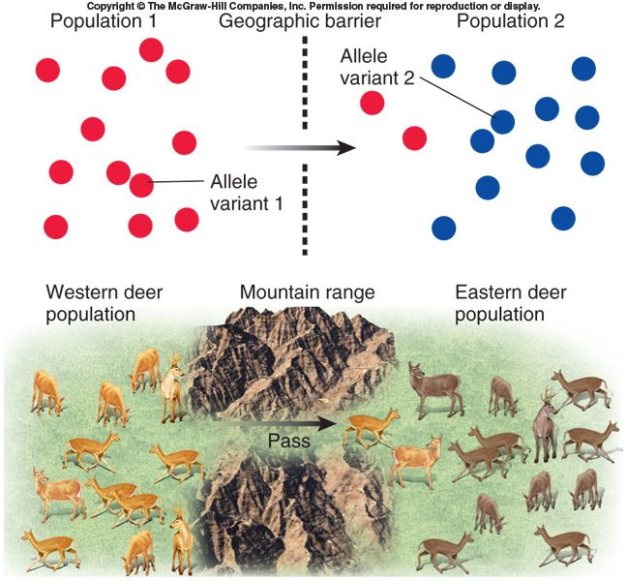
Gene Flow: Migration between populations
https://i.pinimg.com/originals/6f/cf/82/6fcf825ca5ebc6f894dbd67524d1f6f0.jpg

Slide 9
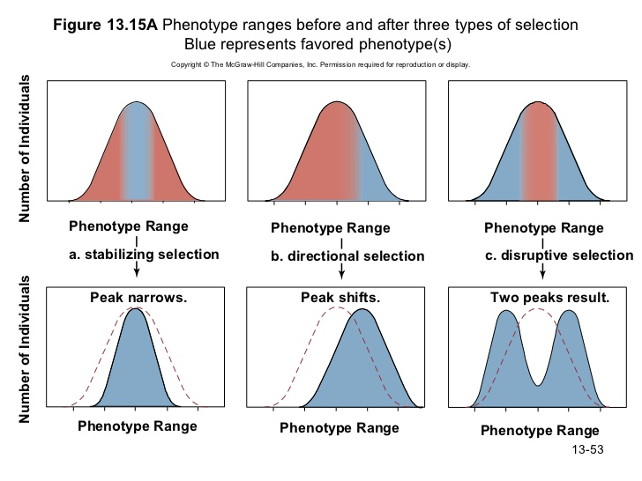
Natural Selection
Due to genetic variation, different organisms are more “fit”, better adapted to their environment, therefore more likely to survive and reproduce
Selection acts on phenotypes!
https://www.google.com/url?sa=i&source=images&cd=&cad=rja&uact=8&ved=2ahUKEwjli9jN-ZbgAhUQNd8KHXR-C4gQjRx6BAgBEAU&url=https%3A%2F%2Fwww.mauriciolemus.com%2Finstall_modes_of_selection_mcgraw-hill.php&psig=AOvVaw0GA7LUgVsJ2kKGX1L1cOzq&ust=1548987272504969

Slide 10
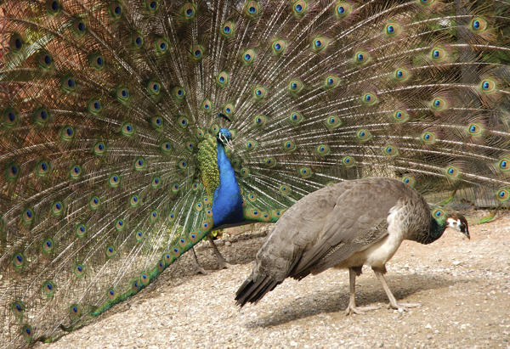
Sexual Selection
Ability for organisms to choose mates, resulting in sexual dimorphism, differences in appearance, behavior, size etc. between sexes
Intrasexual selection: same sex competition
Ex: Male “peacocking”
Intersexual selection: Mate choice
Females usually select mates
https://media.buzzle.com/media/images-en/gallery/birds/peacock/600-123612513-peacock-and-peahen.jpg

Slide 11
Balancing Selection
Being a heterozygote has an advantage (genotype advantage)
EX: Sickle Cell Anemia
Frequency Dependent Selection:
https://slideplayer.com/slide/7843572/25/images/15/Frequency+dependent+selection.jpg

Slide 12
Why is the “perfect” organism not there?
Evolution cannot predict the environment and cannot act on “future” variations
Evolution cannot rebuild the past
Every advantage might come with a disadvantage (Little Mermaid)

