Slide 1
Phylogenetics
Chapter 26

Slide 2
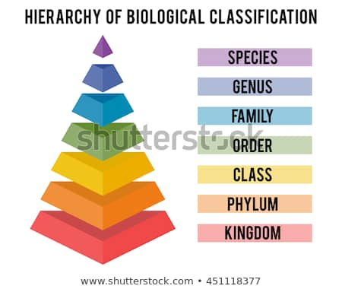
Phylogeny and Systematics
Phylogeny – evolutionary history of a species or organism
Systematics – the study of phylogeny and classification
Binominal Nomenclature: Carl Linnaeus- Genus Species scientific name, names must have a Latin ending
Taxon- hierarchy level of grouping
https://image.shutterstock.com/image-vector/hierarchy-biological-classification-major-taxonomic-450w-451118377.jpg

Slide 3
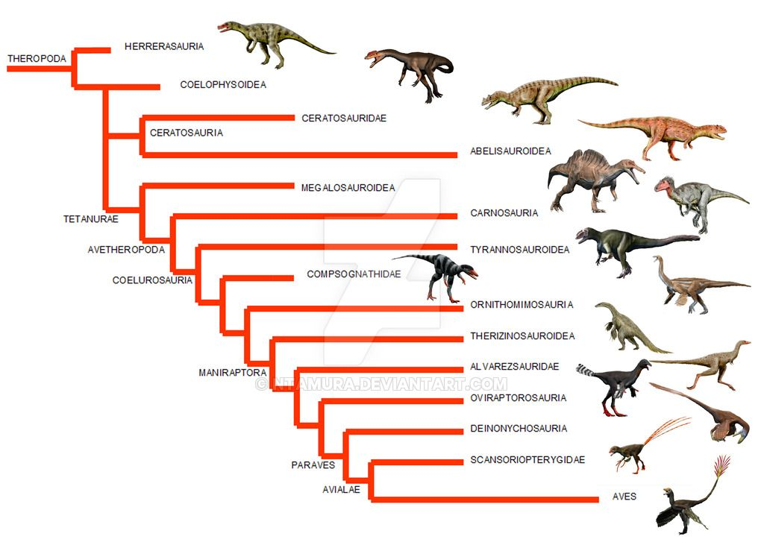
https://i.pinimg.com/originals/ab/ee/a7/abeea73b20265b07e247019db4abb472.jpg

Slide 4
Phylogenetic trees
Trees contain branch points which are locations where a taxa diverged
Sister taxa are groups of organisms that share an immediate common ancestor
A tree is rooted when it contains the most recent common ancestor of all of the organisms/species
Basal Taxon is the lineage that diverges earlier in history
A polytomy is where two different groups emerge but the evolutionary relationships are unclear
*** Phylogenetic trees are used to show evolutionary relationships- not phenotypic similarities***
** Trees do not show ages- just evolutionary branching**
* Using the most recent branch points tells evolutionary relationships*

Slide 5
How to make a phylogenetic tree
Using Molecular and morphological similarities
Remember
Analogous = convergent evolution, same function, different development
(homoplasy)
Homologous = same structure, different function

Slide 6
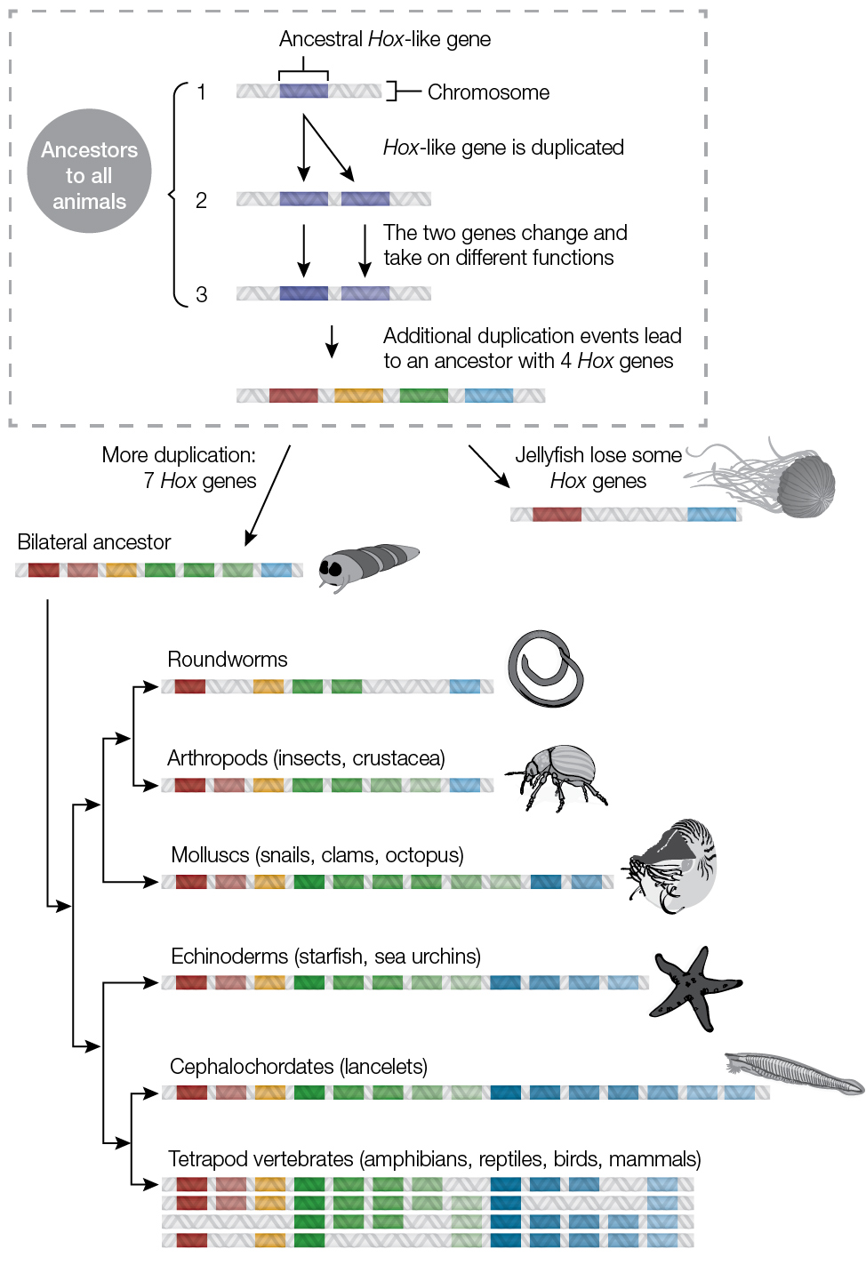
https://learn.genetics.utah.edu/content/basics/hoxgenes/

Slide 7
Cladistic Vocabulary
Cladistic: the study of common ancestry to classify organisms
Clades: groups of species which include the ancestor and all descendants
Monophyletic: the idea that a taxon= clade if it has an ancestor and all of its decedents
Paraphyletic: a group that consists of an ancestor and some of its decedents
Polyphyletic: a group which includes distantly related species but not their most recent common ancestor

Slide 8
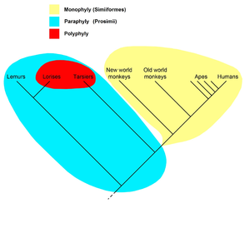
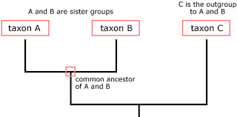
https://upload.wikimedia.org/wikipedia/commons/thumb/9/97/Monophyly%2C_paraphyly%2C_polyphyly.png/300px-Monophyly%2C_paraphyly%2C_polyphyly.png
https://evolution.berkeley.edu/evolibrary/images/phylogenetics/clade.gif

Slide 9
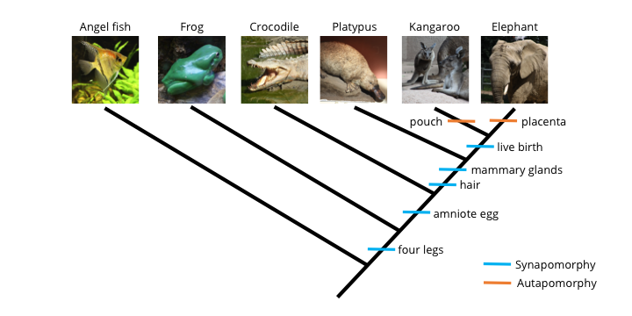
https://www.digitalatlasofancientlife.org/wp-content/uploads/2017/07/MoreTaxa-Matrix.png
Shared ancestral characteristics are characters that originated in the ancestor
Shared derived characteristics are characters that are new to a group

Slide 11
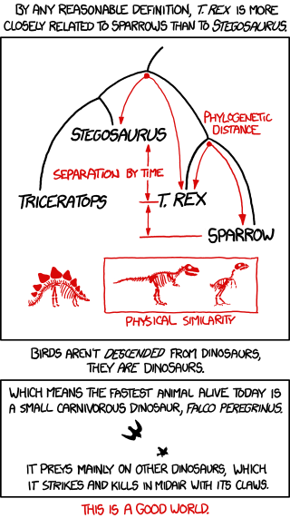
Parsimony
Occam’s razor after William Occam the idea that the simplest explanation is correct
Phylogenetic trees are based on parsimony (fewest DNA base changes)
Maximum likelihood- the approach to making trees with given DNA data and based on certain probability rules
http://imgs.xkcd.com/comics/birds_and_dinosaurs.png

Slide 12
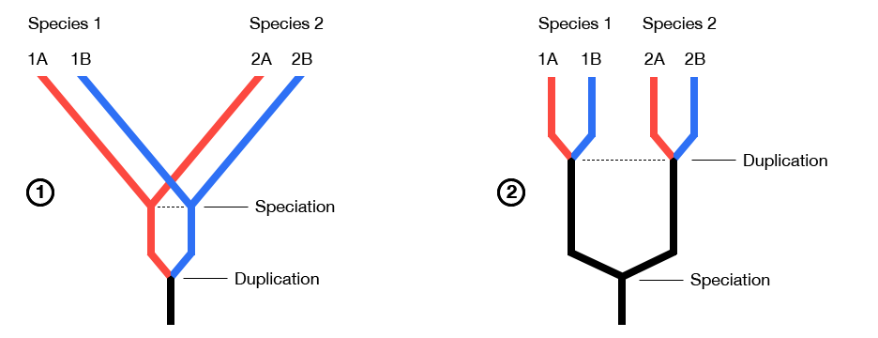
Genomic Evolution
RNA changes slowly and is useful in identifying long ago relationships
Fungi are more like animals than plants
mtRNA changes fast and could be used within species or sub species
Orthologous genes (homologous genes) that are from a common ancestor but distinguished in a speciation event
Paralogous genes (homologous genes) are a result of gene duplication
http://ecoevo.unit.oist.jp/lab/wp-content/uploads/2013/08/GeneHomology_II.png

Slide 13
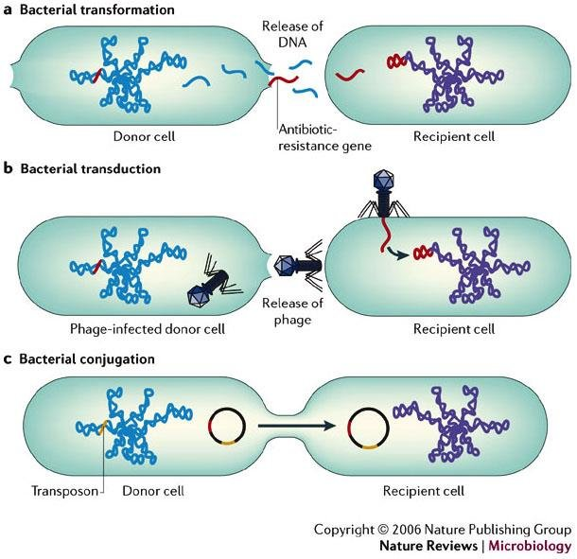
Molecular Clocks
Determining absolute time based on gene and genome changes
Scientists look at amino acid/nucleotide changes to determine the rate of change
HIV/AIDS as a molecular clock
HIV spread to humans multiple times in a variety of strains
HIV-1M in 1959, 1930, and 1910
Horizontal Gene transfer- genes transferred through transposons, plasmids and viral infections
https://www.researchgate.net/profile/Seyed_Alireza_Zamani_Dahaj/publication/277076640/figure/fig2/AS:613444222992397@1523267908252/4-Schematic-of-three-process-of-Horizontal-Gene-Transfer.png

