Slide 1
Nucleic acids

Slide 2
2 Types of Nucleic Acids
Polymer- Nucleic Acids
Monomer- Nucleotide
RNA- Ribonucleic Acid
DNA- Deoxyribonucleic Acid
Tells amino acids what to do and what to build

Slide 3
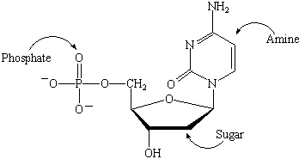
dna
Deoxyribonucleic Acid
Five carbon sugar
(pentose-Ribose)
Phosphate
1-3 phosphates, during phosphorylation, 2 are lost
1 of 4 nitrogenous bases
Adenine
Guanine
Cytosine
Thymine

Slide 4
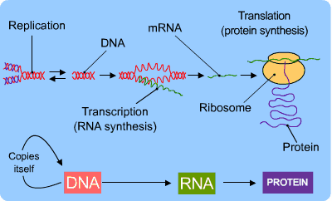

Slide 5
Nitrogenous bases
There are Four nitrogenous bases
They act as bases because the nitrogen atoms attract the H+ ions causing the solution to act like a base
Purines: Large six sided sugars fused to a five ring sugar (Adenine and Guanine)
Pyrimidine: Six membered sugar including Cytosine, Thymine (DNA) and Uracil (RNA)

Slide 7
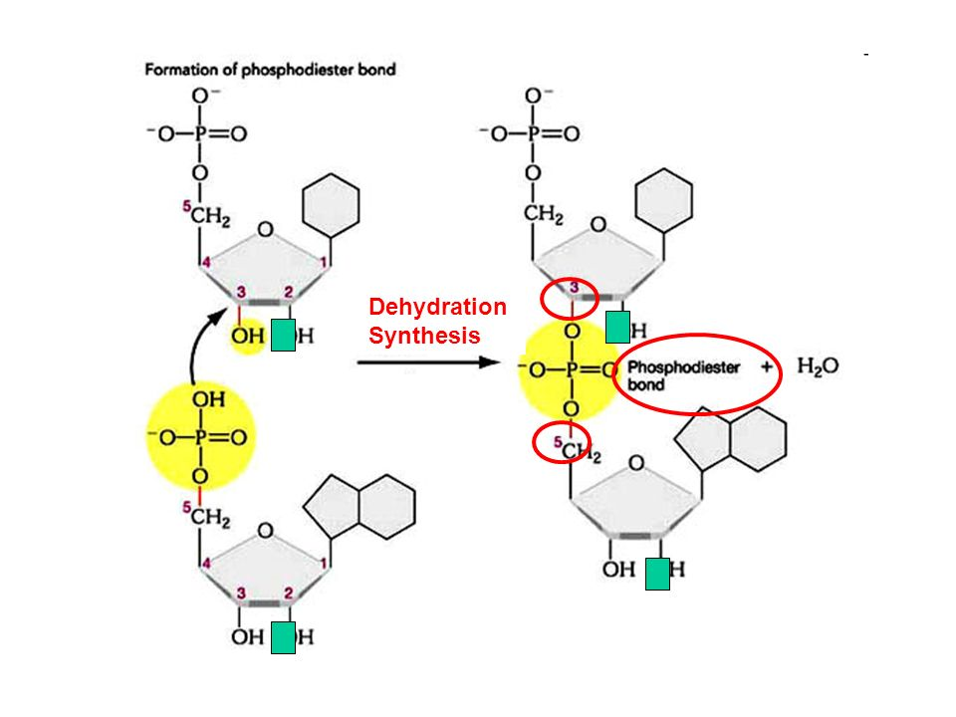
Dehydration synthesis
Monomers become polymers through a phosphodiester bond, where the phosphate connects the sugars of the nucleotides
This linkage creates a pattern with a 5’ and a 3’ end based on the carbon they are attached to
When we discuss the genetic code
And DNA sequence we say either a
5’ or 3’ end such as
5’ ATTGAC 3’
3’ TAACTG 5’

Slide 8
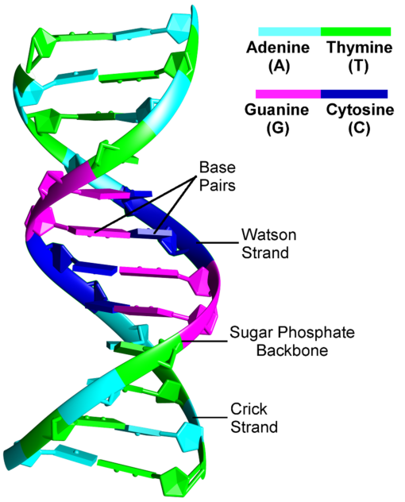
Double Helix
DNA consists of two strands that are antiparallel (opposite)
Backbones are on the outside and the nitrogenous bases are connected in the middle by hydrogen bonds
Weak bonds allow for the strands to be easily separated for protein synthesis
Complimentary base pairs A-T and C-G

Slide 9
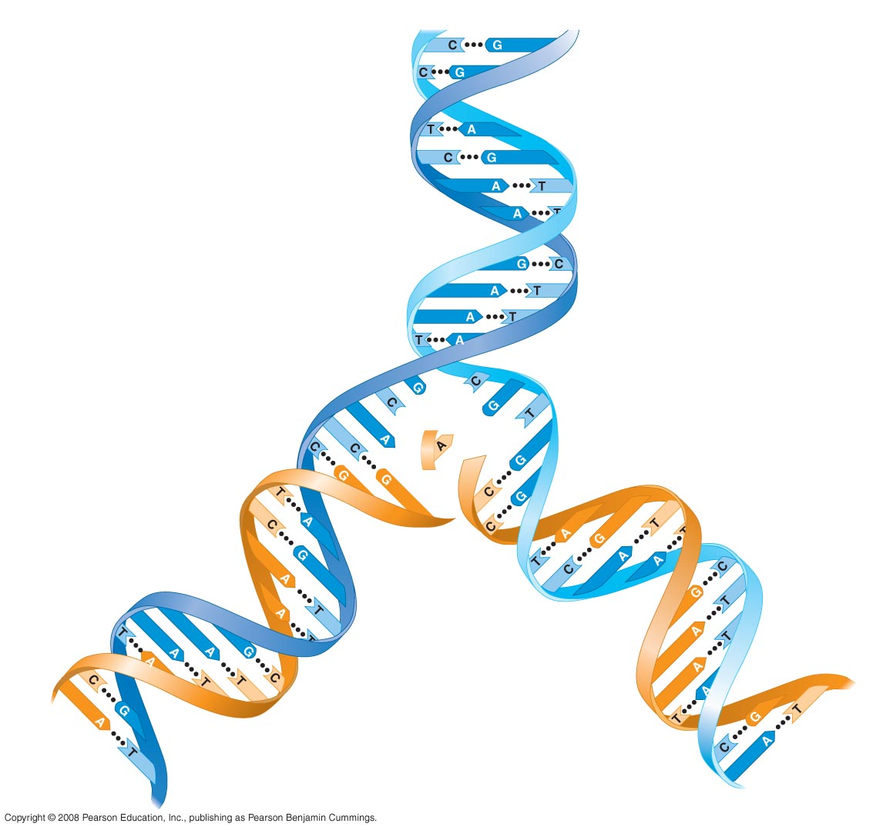
Fig. 5-28
5' end
3' end
Sugar-phosphate
backbones
Base pair (joined by
hydrogen bonding)
Old strands
Nucleotide
about to be
added to a
new strand
3' end
5' end
New
strands
3' end
5' end
5' end
3' end
Notes:
Figure 5.28 The DNA double helix and its replication

Slide 10
Rna
RNA is a single stranded nucleic acid
RNA can base pair with itself allowing them to take a 3-D structure
Comes in different forms
Transfer RNA- brings amino acids to ribosome
Messenger RNA- transcribes DNA into RNA

