Slide 1
Mitosis

Slide 2
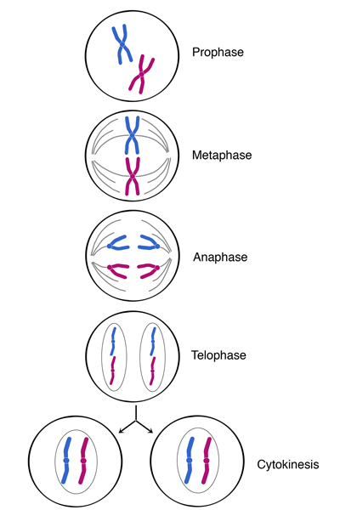

M-Phase of the Cell Cycle
I (PMAT)
Prophase
Metaphase
Anaphase
Telophase
http://www2.nau.edu/lrm22/lessons/mitosis_notes/mitosis.png

Slide 3
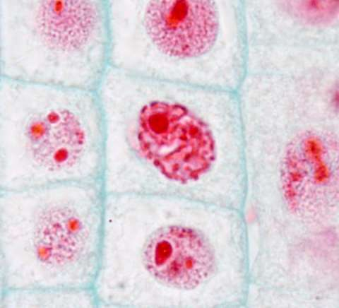
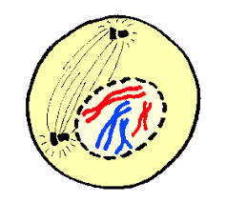
Prophase
Mitotic Spindle develops (composed of centrosomes and microtubules)
Chromatin becomes coiled into chromosomes
Nucleoli disappear
https://encrypted-tbn0.gstatic.com/images?q=tbn:ANd9GcSJ196XXLkLQYnwrKgBQxUGtOMjlji36rxwAtqKo4cAIPa2JBKG

Slide 4
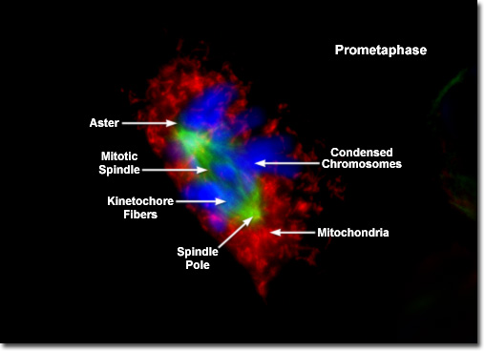
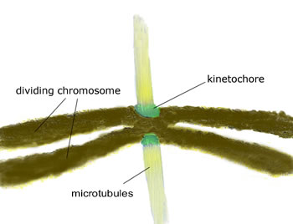
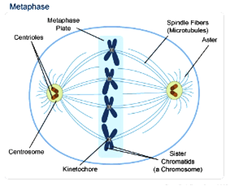
metaphase
After the microtubules move into the nuclear area and chromosomes condense, kinetochores develops and attaches to the microtubules
Centrosomes pull to opposite poles of the cells
Chromosomes line up in the middle of the cell
https://www.google.com/search?q=metaphase&safe=strict&rlz=1C1CHBF_enUS750US750&source=lnms&tbm=isch&sa=X&ved=0ahUKEwi2-qeJ-rreAhXQhOAKHdmUCQAQ_AUIEygB&biw=1422&bih=644#imgrc=Co9SSds_YTnjwM:

Slide 5
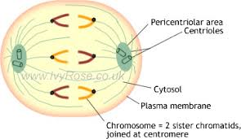
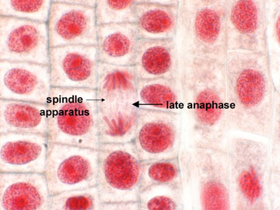
anaphase
Shortest Stage
Cleavage of Cohesin proteins
Chromatids suddenly part
Daughter chromosomes move to opposite ends
Cell elongates
Non-kinetochore microtubules lengthen
Equal chromosomes
https://encrypted-tbn0.gstatic.com/images?q=tbn:ANd9GcRvslisCThDqEVEYNDnGBMAFLkmp9NT_Z7cPgSYejCNOFIyNTKq

Slide 6
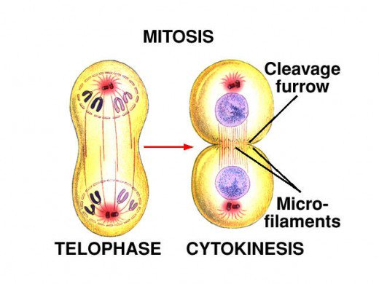
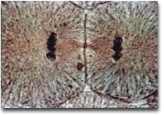
Telophase and cytokinesis
Two daughter nuclei form
Nuclear envelope develops and nucleoli reappears
Chromosomes un-condense
Cytokinesis where division of cytoplasm occurs
  Animal cells have a cleavage furrow
https://usercontent1.hubstatic.com/9757416_f520.jpg

Slide 7
Cytokinesis
Animals
    cleavage furrow forms
    splits cell in two
    like tightening a draw string
Plants
  cell plate forms
    vesicles line up at equator and fuse
Notes:
Division of cytoplasm happens quickly.

Slide 8
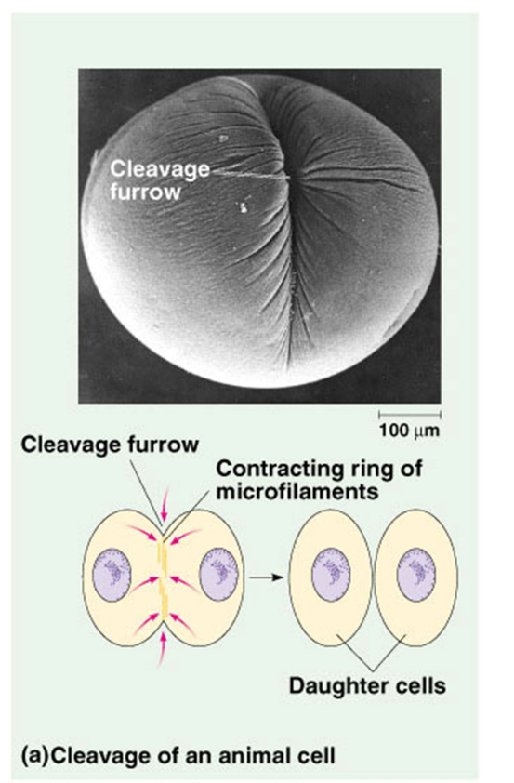
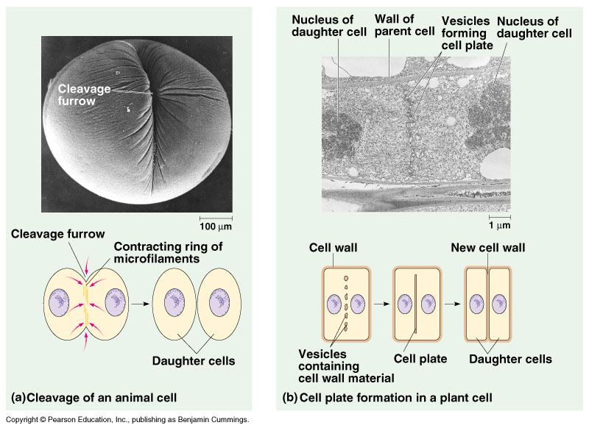

Slide 9
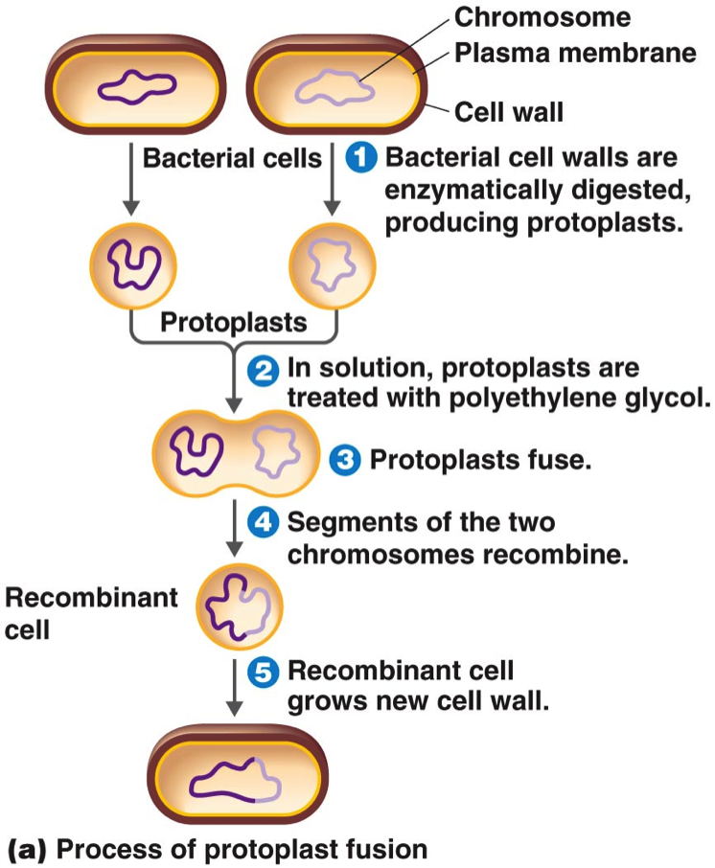
Bacteria and mitosis
Prokaryotes and archaea reproduce through binary fission
  Asexual reproduction
  Circular DNA
Process begins on a specific location on the chromosome known as the origin of replication
https://s3.amazonaws.com/classconnection/638/flashcards/2955638/png/protoplast_fusion-14CB9CE1DB4557BDE16.png

Slide 10
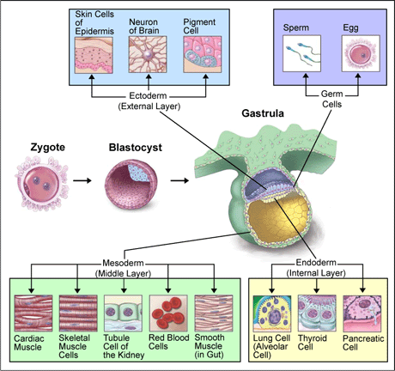
Differentiation
Specialization and division of labor.
Pre-differentiation are stem cells
Totipotency: ability of a cell to divide and produce all the differentiated cells in an organism
Each cell has all the instructions (DNA) to produce a whole human
Nearby cells and/or the external environment triggers differentiation
Ensures efficiency in multicellular organisms
Groups of cells differentiate to form tissues and organs
http://www.pbs.org/wgbh/nova/sciencenow/3209/04.html

Slide 11
Cell cycle control systems

Slide 12
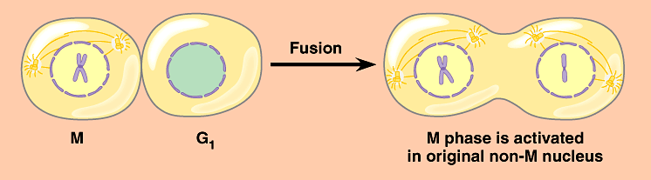
Activation of cell division
How do cells know when to divide?
  cell communication signals
    chemical signals in cytoplasm give cue
    signals usually are proteins
      activators
      inhibitors

Slide 13
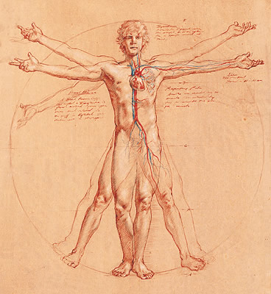
Coordination of cell division
A multicellular organism needs to coordinate cell division across different tissues & organs
  critical for normal growth,
  development & maintenance
    coordinate timing of
    cell division
    coordinate rates of
    cell division
    not all cells may have the
    same cell cycle

Slide 14
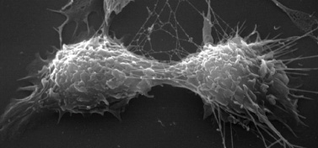
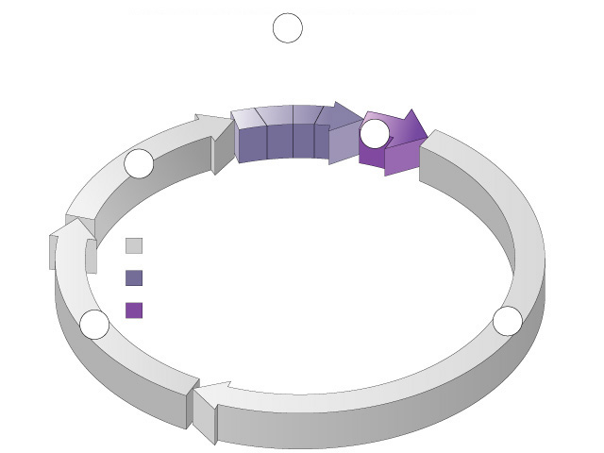
Frequency of cell division
Frequency of cell division varies by cell type
  embryo
    cell cycle < 20 minute
  skin cells
    divide frequently throughout life
    12-24 hours cycle
  liver cells
    retain ability to divide, but keep it in reserve
    divide once every year or two
  mature nerve cells & muscle cells
    do not divide at all after maturity
    permanently in G₀
M
metaphase
anaphase
prophase
telophase
C
G₂
interphase (G₁, S, G₂ phases)
mitosis (M)
S
cytokinesis (C)
G₁

Slide 15
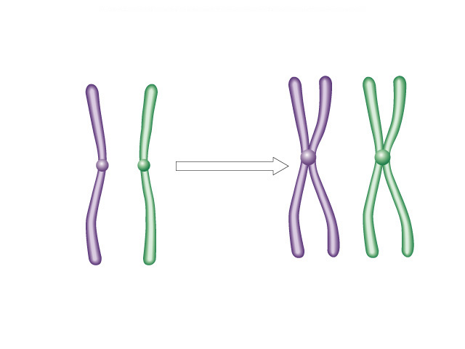
Overview of Cell Cycle Control
Two irreversible points in cell cycle
  replication of genetic material
  separation of sister chromatids
Checkpoints
  process is assessed & possibly halted
sister chromatids
✓
✓
centromere
single-stranded
chromosomes
double-stranded
chromosomes

Slide 16
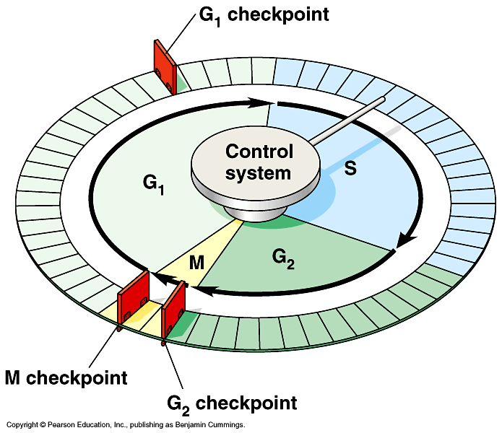
Checkpoint control system
3 major checkpoints:
  G₁
    can DNA synthesis begin?
  G₂
    has DNA synthesis been completed correctly?
    commitment to mitosis
  M
    are all chromosomes attached to spindle?
    can sister chromatids separate correctly?

Slide 17
G₀ phase
G₀ phase
  non-dividing, differentiated state
  many human cells in G₀ phase
liver cells
  in G₀, but can be “called back” to cell cycle by external cues
nerve & muscle cells
  highly specialized
  arrested in G₀ & can never divide

Slide 18
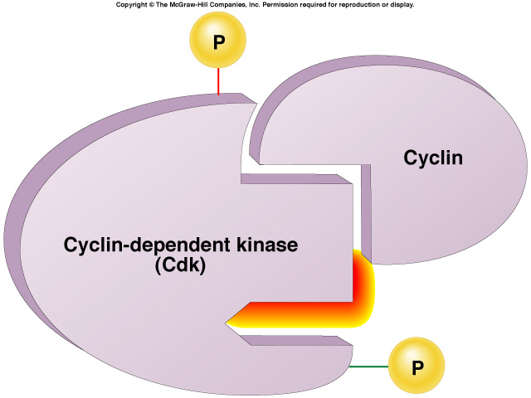
“Go-ahead” signals
Protein molecules that promote cell growth & division
  internal signals
    “promoting factors”
  external signals
    “growth factors”
Primary mechanism of control
  phosphorylation
    Use of kinase enzymes
      Which either activates or inactivates cell signals by adding a phosphate
Notes:
We still don’t fully understanding the regulation of the cell cycle. We only have “snapshots” of what happens in specific cases.

Slide 19
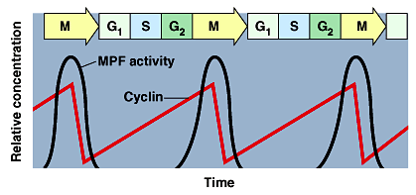
Cell cycle Chemical signals
inactivated Cdk
Cyclins
  regulatory proteins
  levels cycle in the cell
  Cdk’s
  cyclin-dependent kinases
  phosphorylates cellular proteins
    activates or inactivates proteins
Cdk-cyclin complex
  Forms MPF complex
  Triggers movement into next phase
activated Cdk
Notes:
CDK-cyclin is the combo of cyclins and CDK’s
Phosphate

Slide 20
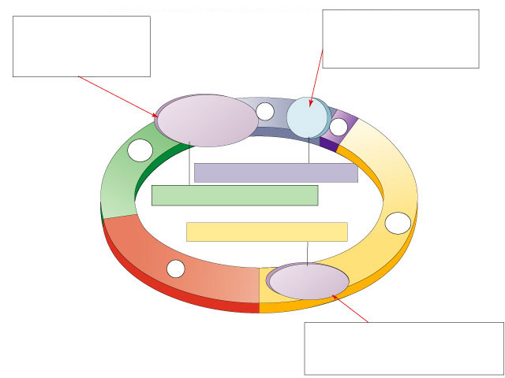
M checkpoint
G₂ checkpoint
Chromosomes attached at metaphase plate
Replication completed
DNA integrity
Inactive
Active
Active
Inactive
Cdk / G₂
cyclin (MPF)
M
cytokinesis
C
G₂
mitosis
G₁
S
Cdk / G₁
cyclin
Inactive
MPF = Mitosis Promoting Factor
Active
G₁ checkpoint
Growth factors
Nutritional state of cell
Size of cell

Slide 21
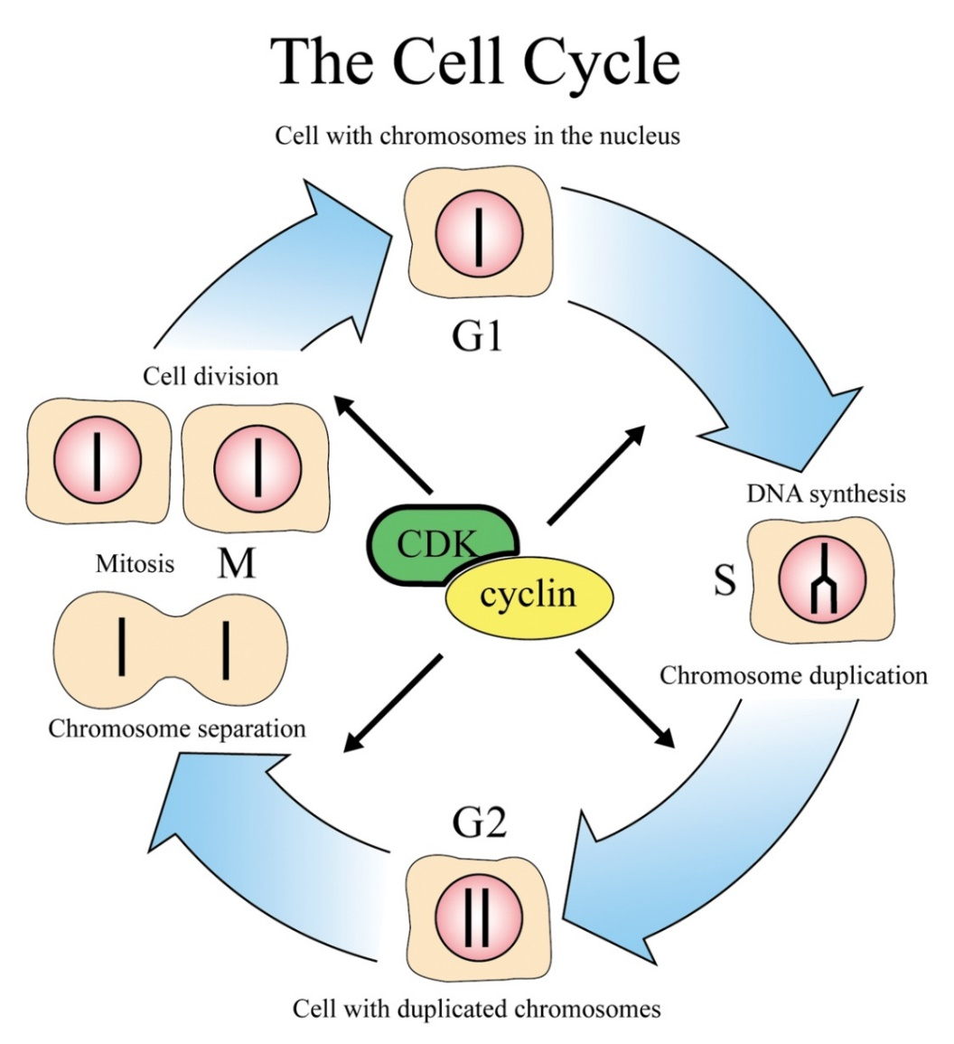
Cyclin & Cyclin-dependent kinases
CDKs & cyclin drive cell from
one phase to next in cell cycle
proper regulation of cell cycle is so key to life that the genes for these regulatory proteins have been highly conserved through
evolution
  the genes are basically the same in yeast, insects, plants & animals (including humans)
Notes:
CDK and cyclin together form an enzyme that activates other proteins by chemical modification (phosphorylation). The amount of CDK molecules is constant during the cell cycle, but their activities vary because of the regulatory function of the cyclins. CDK can be compared with an engine and cyclin with a gear box controlling whether the engine will run in the idling state or drive the cell forward in the cell cycle.

Slide 22
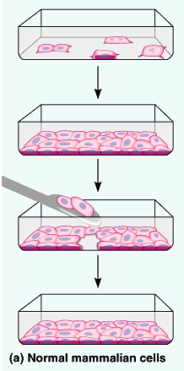
External signals
Growth factors
  coordination between cells
  protein signals released by body cells that stimulate other cells to divide
    density-dependent inhibition
      crowded cells stop dividing
        When not enough growth factor left to trigger division in any one cell, division stops
    anchorage dependence
      to divide cells must be attached to a substrate or tissue matrix
        “touch sensor” receptors

Slide 23
Cell Cycle regulation
Growth factors
  Cyclins control the cell cycle , causing movement from G1 to S or G2 to M
  Cdk (cyclin dependent kinase) work with cyclins
  MPF (Maturation Promoting Factor) includes CdK and cyclins
  p53 blocks cell cycle if DNA is damaged.
Density-dependent inhibition
Anchorage dependence

Slide 24
cancer
Cells that do not respond to “normal signals” (mostly due to a mutation in genes)
  Could make their own growth factor
  or do not need a growth factor
  or they have an abnormal pathway or control system
Cancer cells can grow indefinitely
  EX: HeLa cells
Tumors
  Benign- tumors that do not move to other areas
  Malignant- tumors that spread (Metastasis)

