Slide 1
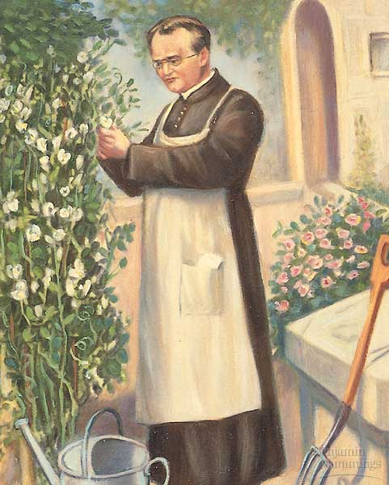
Mendelian genetics

Slide 2
Genetics Vocabulary
Phenotype: an organism’s traits
Genotype: an organism’s genetic makeup
Allele: alternate forms of a gene at a specific loci
Character: heritable feature
Dominant: allele that is expressed regardless of the second allele.
Recessive: only expressed when the second allele is the same.
Homozygous: pair of identical alleles
Heterozygous: two different alleles for a gene
Punnett square: predicts the results of a genetic cross between individuals of known genotype
Testcross: cross a recessive homozygote with a dominant phenotype (but unknown genotype) to determine said unknowns genotype

Slide 3
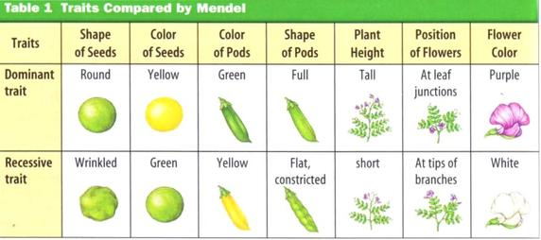
1. Mendel took true breeding parent plants (P generation) and crossed them
2. The hybrid F₁ generation cross pollinated with other hybrids creating the F₂ generation
http://www.thinksciencemaurer.com/wp-content/uploads/2015/12/TraitsPeaPlants.jpg

Slide 4
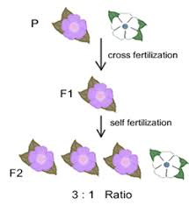
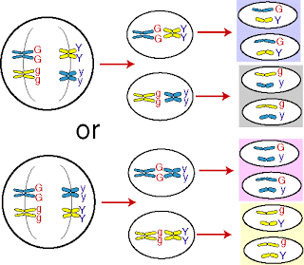
Mendel Discoveries
There are variations in genes
Organisms contain two alleles for one gene
There are dominant and recessive alleles
LAW OF SEGREGATION:
During meiosis, alleles separate, ending up in different gametes
P Generation- Purple and White
F1 – all purple
F2 – 3:1 Purple : White
(Monohybrid- test crossing one trait)
Mendel found the same pattern for six other characteristics
https://encrypted-tbn0.gstatic.com/images?q=tbn:ANd9GcROnPWZwIBx3joMAHiOnpiC1O8GPQCmWgcqze7Y3-3oSbk-gVKaIw
http://1.bp.blogspot.com/_-X2F27OTLv0/SkMES5GoSsI/AAAAAAAAAB8/boTV09Vrsts/s320/law+of+segregation.gif

Slide 5
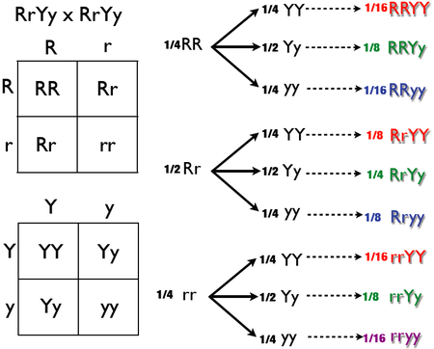
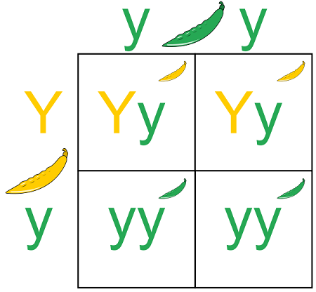
Punnett Squares
Test Cross
Breeding and unknown with a recessive phenotype can determine the genotype
https://biologydictionary.net/wp-content/uploads/2016/11/Punnett-Square.png
https://upload.wikimedia.org/wikipedia/commons/thumb/7/7d/Dihybrid_Cross_Tree_Method.png/450px-Dihybrid_Cross_Tree_Method.png

Slide 6
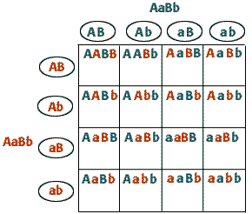
Dihybrid Cross
Do genes come as a package?
9:3:3:1 ratio
Independent Assortment- only works for alleles on separate chromosomes or alleles far apart on the same chromosome

Slide 7
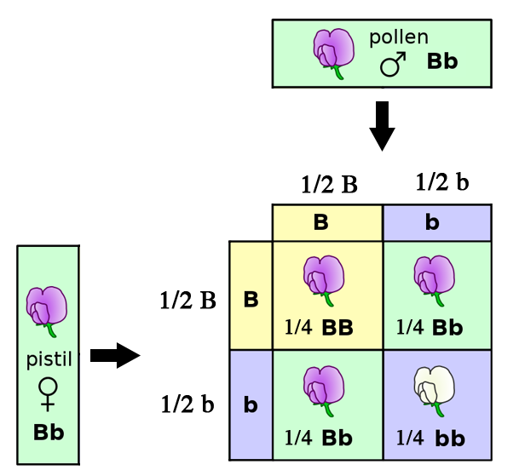
Mendelian Genetics and Probability
Tossing a coin- each time the probability is 50% heads 50% tails and each toss is an independent event
Multiplication Rule: Two independent events- multiply the probability each event (ex: ½ heads x ½ heads = ¼ heads or 25% heads)
Ex:
Addition Rule
Determining the probability of two mutually exclusive events is determined by adding each event.

Slide 8
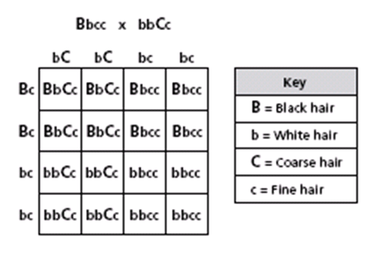
 | B | b
b | Bb | bb
b | Bb | bb
 | c | c
C | Cc | Cc
c | cc | cc
What probability will have Black Coarse Hair? ½ Bb x ½ Cc = ¼
What probability will have white coarse hair? ½ bb x ½ Cc = ¼
https://www.google.com/url?sa=i&source=images&cd=&ved=2ahUKEwjQpOCM8-reAhUkWN8KHajtBzwQjRx6BAgBEAU&url=https%3A%2F%2Fwww.proprofs.com%2Fquiz-school%2Fstory.php%3Ftitle%3Dblock-4group-2&psig=AOvVaw2H5W-WWhhQZER86h0-jZpP&ust=1543075664163648

Slide 9
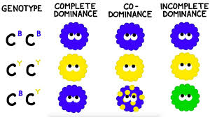
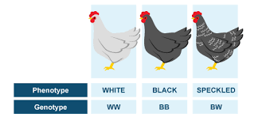
Beyond Mendel
Incomplete Dominance - blending of genes
Codominance – Both alleles can be expressed
http://www.bbc.co.uk/staticarchive/54354e073e9f5a0f2b32eb7c95408ee99c0353ed.png

Slide 10
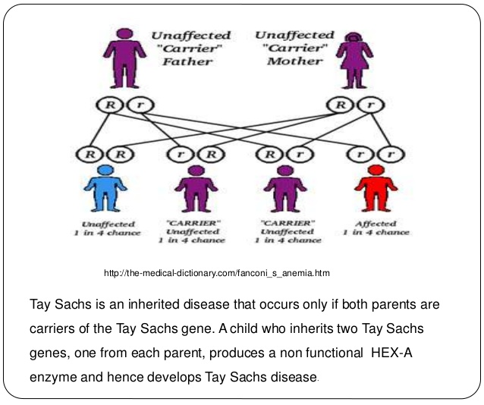
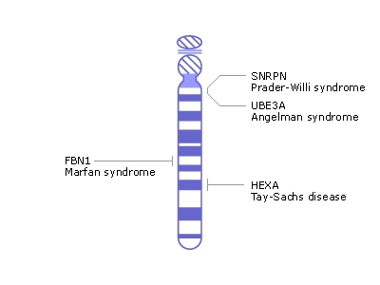
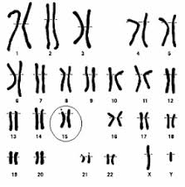
Tay Sachs Disease
Genetic Disorder that causes brain disfunction (blindness, seizures, young death)
Incomplete dominance at molecular level (“normal” gene is healthy enough to metabolize lipids)
https://encrypted-tbn0.gstatic.com/images?q=tbn:ANd9GcTPN-nhYb_GLmjysx7mLX4uIqvfp2r_CF3QOJ_kqAn5QSlY9-vv
https://upload.wikimedia.org/wikipedia/commons/b/be/Human_chromosome_15_from_NCBI_Bookshelf.jpg

Slide 11
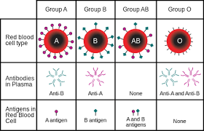
Blood Types
Multiple Alleles – three alleles control blood type I^{A}, I^{B}, and I (genotype); A, B, O (phenotype)

Slide 12
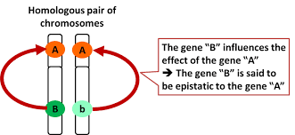
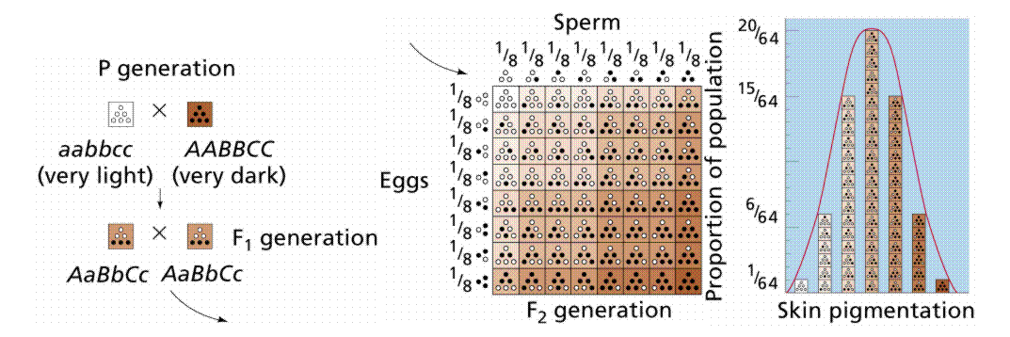
Pleiotropy – alleles that affect multiple phenotypes
Epistasis- One phenotype at a loci, affects a second loci
Polygenic Inheritance-
Quantitative characteristics- phenotypes expressed due to a variety of genes (ex. Skin color)
Multifactorial- environmental and genetics affecting phenotype
https://www.google.com/imgres?imgurl=http%3A%2F%2Fwww.groupe-esa.com%2Fladmec%2Fbricks_modules%2Fbrick05%2Fres%2FZBO0505.jpg&imgrefurl=http%3A%2F%2Fwww.groupe-esa.com%2Fladmec%2Fbricks_modules%2Fbrick05%2Fco%2FZBO_Brick05_17.html&docid=-x08o0LYDJWI8M&tbnid=MwbBeMbmsZmEAM%3A&vet=10ahUKEwiagfOd-ereAhWFhOAKHVi-ANgQMwiIASgUMBQ..i&w=1024&h=472&safe=active&bih=644&biw=1422&q=epistasis&ved=0ahUKEwiagfOd-ereAhWFhOAKHVi-ANgQMwiIASgUMBQ&iact=mrc&uact=8
https://13morima.files.wordpress.com/2012/02/e382b9e382afe383aae383bce383b3e382b7e383a7e38383e38388efbc882012-02-26-17-03-21efbc89.png

Slide 13
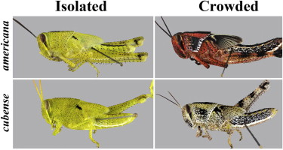
Phenotypic Plasticity
https://ars.els-cdn.com/content/image/1-s2.0-S0022191013001881-fx1.jpg

