Slide 1
Molecular Genetics
Chapter 15

Slide 2
Review of Mendelian Genetics
Law of Segregation- two alleles separate during gamete formation
Law of Independent Assortment – Alleles of non homologous chromosomes sort independently
In the early 20th century, scientists along with Thomas Hunt Morgan began to study chromosomal inheritance.
Morgan worked with fruit flies because they produce hundreds of offspring and contain only 4 pairs of chromosomes

Slide 3
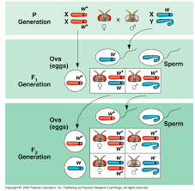
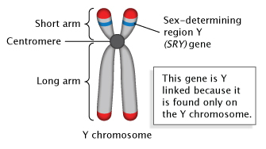
http://www.nature.com/scitable/content/ne0000/ne0000/ne0000/ne0000/117894590/7_2_1.jpg
SRY gene- sex determining region of Y- turns on gene to produce gonads, without SRY- ovaries develop
https://encrypted-tbn0.gstatic.com/images?q=tbn:ANd9GcRB9zp-b0lXUrC_JH4HvSZw05BITGixw_plscESYupfekh4aXFdhw

Slide 4
https://slideplayer.com/slide/6085384/18/images/3/Sex-Linked+Disorders+Defined%3A+Inherited+conditions+found+on+X+chromosome.+Usually+recessive.+Females%3A+XX+chromosomes..jpg

Slide 5
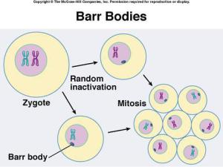
X inactivation
Barr Body –
inactive X chromosome in females
located inside the nuclear envelope
Genes of Barr Body not expressed
Genes reactivated to form eggs in the ovaries
https://itsnotwhatitswhy.files.wordpress.com/2017/02/barr-bodies.jpg?w=300&h=225
Genes called XIST activate the Barr Body
https://slideplayer.com/slide/4890954/16/images/13/X-Inactivation+Barr+body+%3D+inactive+X+chromosome%3B+regulate+gene+dosage+in+females+during+embryonic+development..jpg

Slide 6
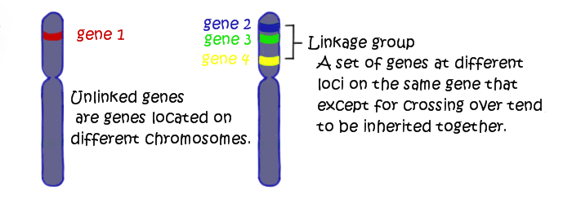
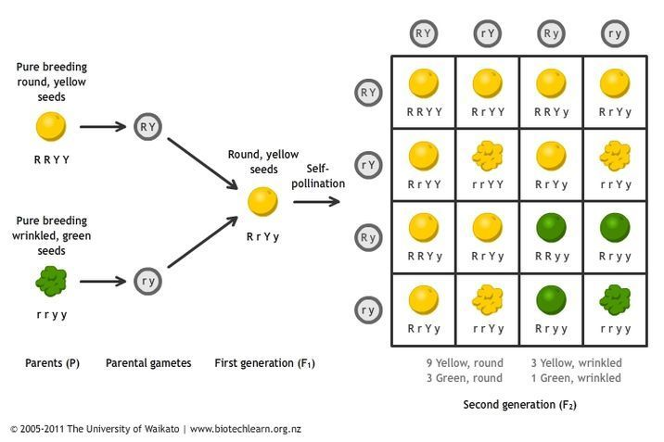
Linked Genes
http://ibbiologyhelp.com/Genetics/linkedgenes.png
Parental Types- same as linked gene
Recombinant- show evidence of crossing over

Slide 7
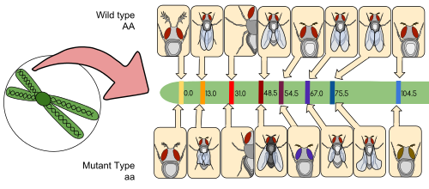
Genetic Map
Morgan’s student- Sturtevant hypothesized- the farther the two genes are, the more likely they are to show crossing over
https://upload.wikimedia.org/wikipedia/commons/thumb/4/46/Drosophila_Gene_Linkage_Map.svg/500px-Drosophila_Gene_Linkage_Map.svg.png

Slide 8
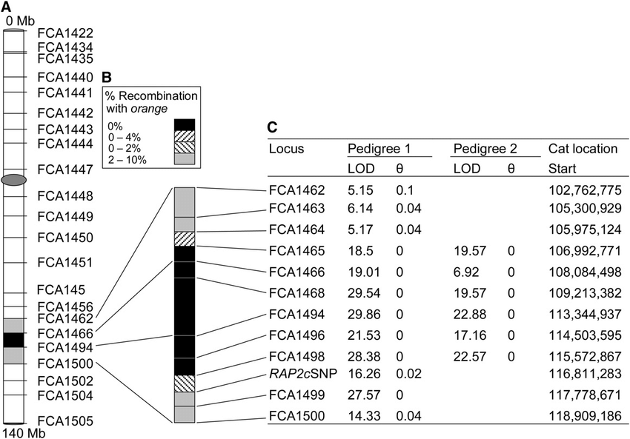
-Genetic linkage mapping of the orange locus on the cat X chromosome. (A) The majority of the markers of the linkage map are represented on the domestic cat X chromosome. (B) Markers used for fine mapping (FCA1462-FCA1500) are represented on the magnified chromosome section. Solid areas and hatched areas represent the candidate region (0% recombination and transition between 0% and 2 or 4%, respectively). (C) Specific recombination values are represented. Optimal recombination fractions (u) between the markers and the O locus are shown in columns 3 and 5. LOD scores at the optimal u (LOD) are represented in columns 2 and 4. Values are given for pedigree 1 (columns 2 and 3; Nestlé Purina PetCare) and for pedigree 2 (columns 4 and 5; spinal muscular atrophy and LGD combined) when available. The position of each locus is represented in column 6 (determined using ABCC Get Trace Mapping Info, ABCC trace-centric tools; http:/ /www.abcc.ncifcrf.gov/Genomes/Cat/ index.php).
Schmidt-Kuentzel, Anne & Nelson, George & David, Victor & Schaffer, Alejandro & Eizirik, Eduardo & Roelke, Melody & Kehler, James & Hannah, Steven & J O'Brien, Stephen & Menotti-Raymond, Marilyn. (2009). A Domestic cat X Chromosome Linkage Map and the Sex-Linked orange Locus: Mapping of orange, Multiple Origins and Epistasis Over nonagouti. Genetics. 181. 1415-25. 10.1534/genetics.108.095240.

Slide 9
Chromosomal Mutations
Non-disjunction- failure of chromosomes (or chromatids) to separate during meiosis
Aneuploidy- abnormal number of chromosomes
Monosomic- receiving one copy
Trisomy- three copies
Polyploidy- more than two sets
Deletion- loss of a chromosomal pieces
Duplication- extra piece on a sister chromatid
Inversion- chromosome reverses orientation
Translocation- chromosome moves to a different non-homologous chromosome

Slide 10
https://image3.slideserve.com/6380198/slide2-n.jpg

