Slide 1
Lipids
Fats, Oils and Waxes

Slide 2
Lipids can be used to store energy.
Some lipids are important parts of biological membranes and waterproof coverings..
If each carbon atom in a lipid’s fatty acid chain is joined to another carbon atom by a single bond, the lipid is said to be saturated.
If there is at least one carbon-carbon double bond in a fatty acid, the lipid is said to be polyunsaturated

Slide 3
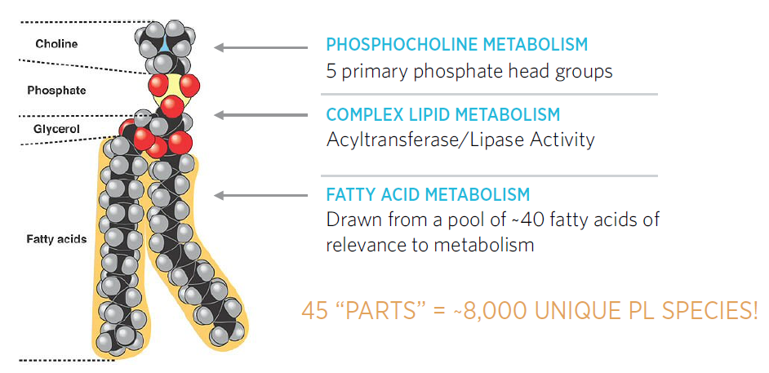
Chemical Composition- Carbon and Hydrogen atoms
Function- Used to store energy for later use. 1 gram of fat has 2x more energy than starch.
Usually not soluble! *dissolved in water
Examples: fats, oils and steroids
Structure: 3 fatty acids and a glycerol

Slide 4
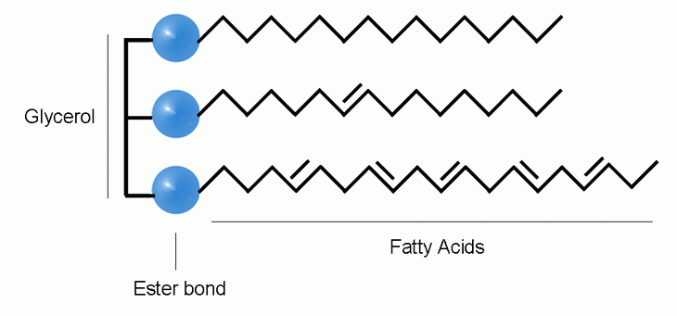
Fats
Triacylglycerol
Large monomers
Composed of 3 fatty acids and a glycerol
Fatty Acid: a carbon skeleton (16-18 carbons long)
Glycerol: a functional group consisting of a carboxyl group
Hydrophobic because of the non-polar tails

Slide 5
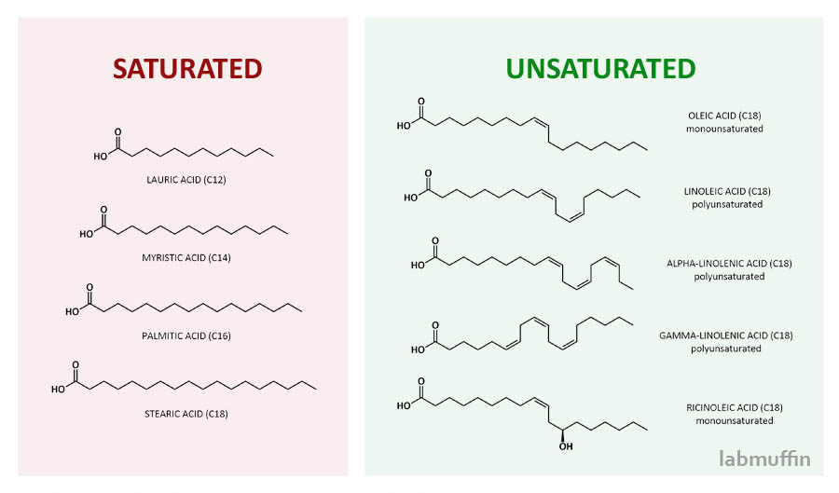
Types of Fats

Slide 6
Bad Fats
Good Fats

Slide 7
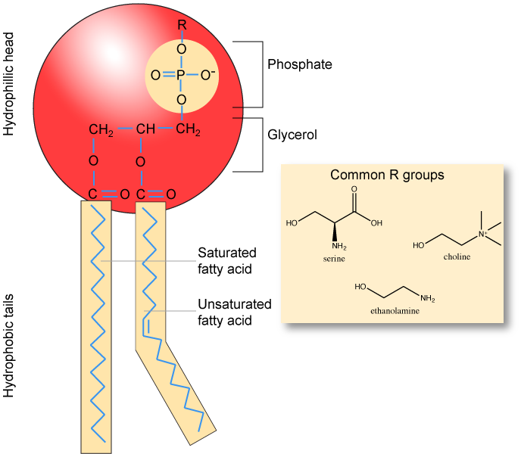
Phospholipids
Two fatty acids joined to a carboxyl group causing a negative charge
Hydrophobic tail
Hydrophilic head

Slide 8
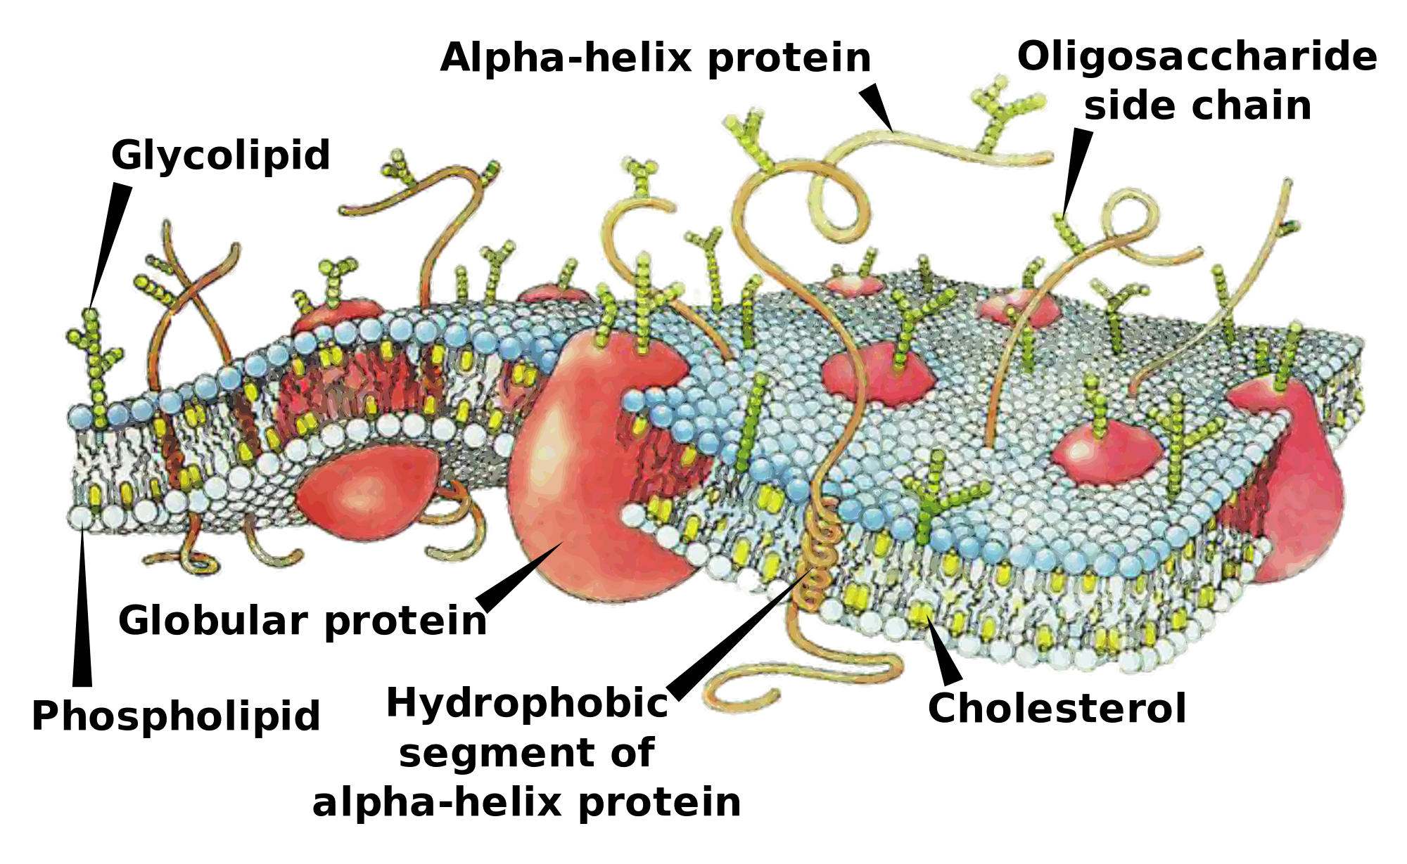

Slide 9
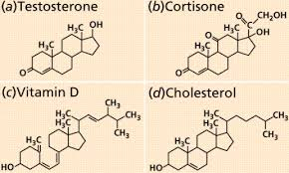
Steroids
Four carbon ring structures
Hormones secreted by the endocrine system to maintain homeostasis

Slide 10
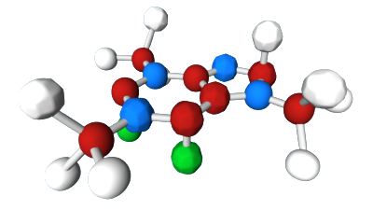
Stop and Think
When we eat too much why do we gain weight? (Think about the function of a lipid.)

