Slide 1
History of Life
Chapter 25

Slide 2
Evidence of Evolution comes from the fossil record
Early Earth was much different than it is today
Oxygen was not present until 2-3 billion years ago
Cells were produced in 4 stages (hypothesized)
Abiotic organic molecules were synthesized
Molecules combined to form proteins and nucleic acids
Protocells formed from these combined molecules
These molecules were able to self-replicate producing possible inheritance

Slide 3
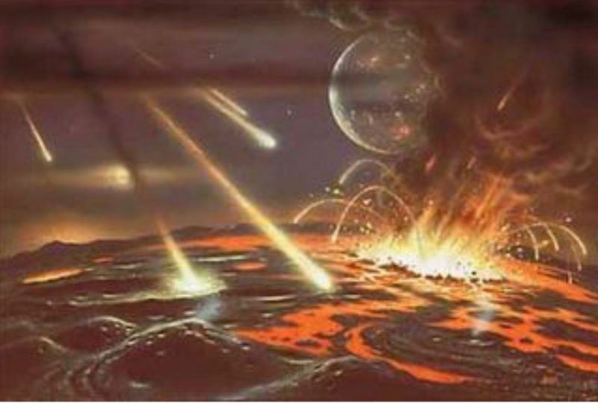
http://en.es-static.us/upl/2018/08/meteorite-bombardment-early-earth-e1534283827597.jpg

Slide 4
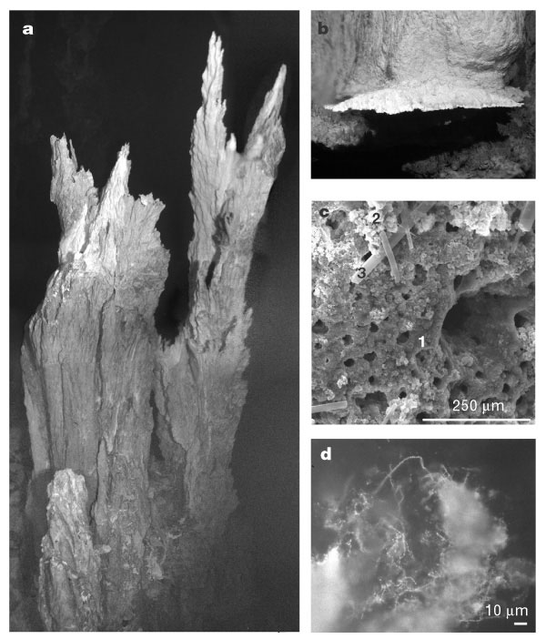
Oparin and Haldane/Miller-Urey
Earth’s early atmosphere added electrons to the atmosphere (reducing)
Lightening and UV radiation could have helped synthesize organic compounds
“Primitive Soup”
Miller and Urey tested Oparin/Haldane hypothesis and confirmed amino acids can be synthesized from the primordial soup
Hydrothermal Vents (too hot to sustain organic compounds) and alkaline vents could play a role in producing organic compounds
https://www.nature.com/scitable/content/ne0000/ne0000/ne0000/ne0000/14457123/f3_kelley_412145ab.2.jpg

Slide 5
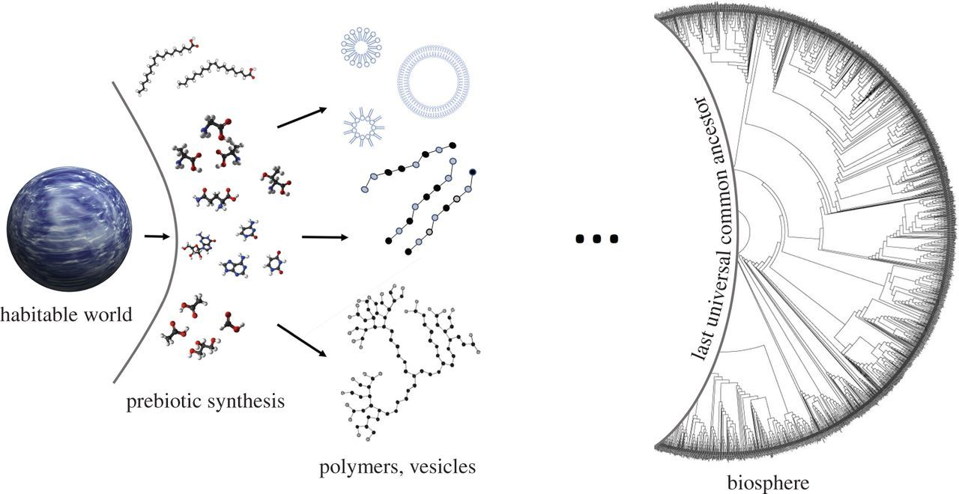
RNA World
2009 study demonstrated that abiotic synthesis of RNA monomers could spontaneously form from on molecule
Solutions of RNA and amino acids onto a hot medium (sand or clay) could produce polymers of these molecules
Enzymatic reactions are required for both reproduction and metabolism showing a need for almost co-evolution (appearance together)
RNA serves as both an enzyme catalyst and a key player in protein synthesis
Ribozymes are RNA catalysts making short strands of RNA
https://royalsocietypublishing.org/cms/attachment/7dd9dd84-032a-477c-ba39-3374aa5ff78c/rsta20160337f01.jpg

Slide 6
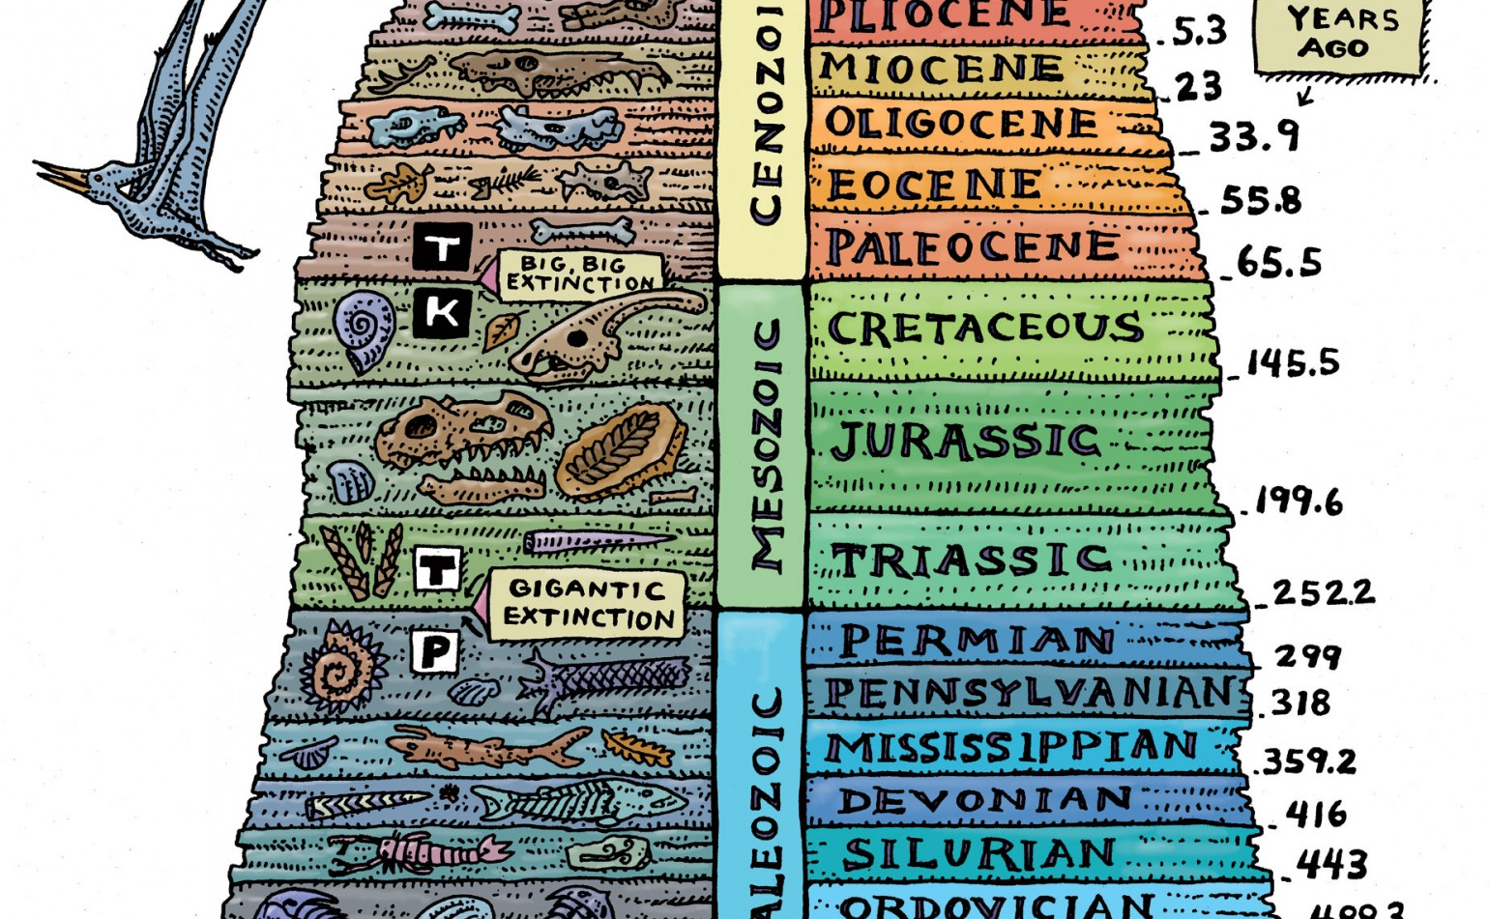
https://d2jmvrsizmvf4x.cloudfront.net/06TelM2kSVCba8v3gtPx_geologic-time-drawing-1540x951.77234152_c.jpg

Slide 7
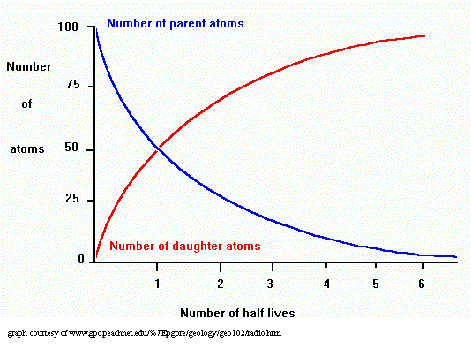
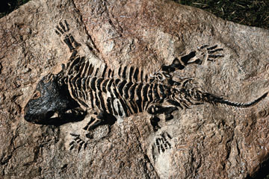
Fossils are FANTASTIC
Fossil (any remnant of a living or once living species) found in sedimentary strata (rock layers)
Relative age is determined by sequencing of strata (oldest on bottom)
Absolute age is determined by radiometric dating using isotopes such as carbon 14 (recent organic remains) which can tell you how many half lives have passed
https://s.hswstatic.com/gif/fossil-record-1.jpg
http://legacy.earlham.edu/~smithal/radgraph.gif

Slide 8
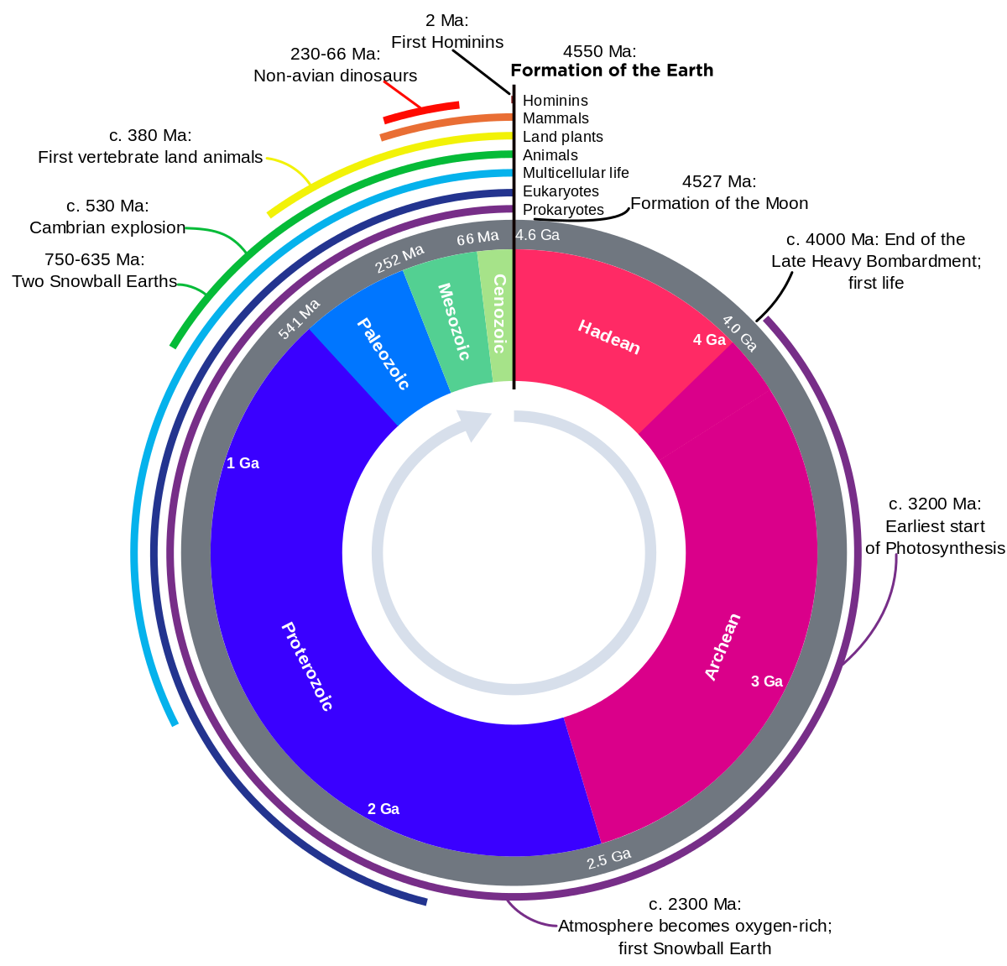
https://upload.wikimedia.org/wikipedia/commons/thumb/7/77/Geologic_Clock_with_events_and_periods.svg/1200px-Geologic_Clock_with_events_and_periods.svg.png

Slide 9
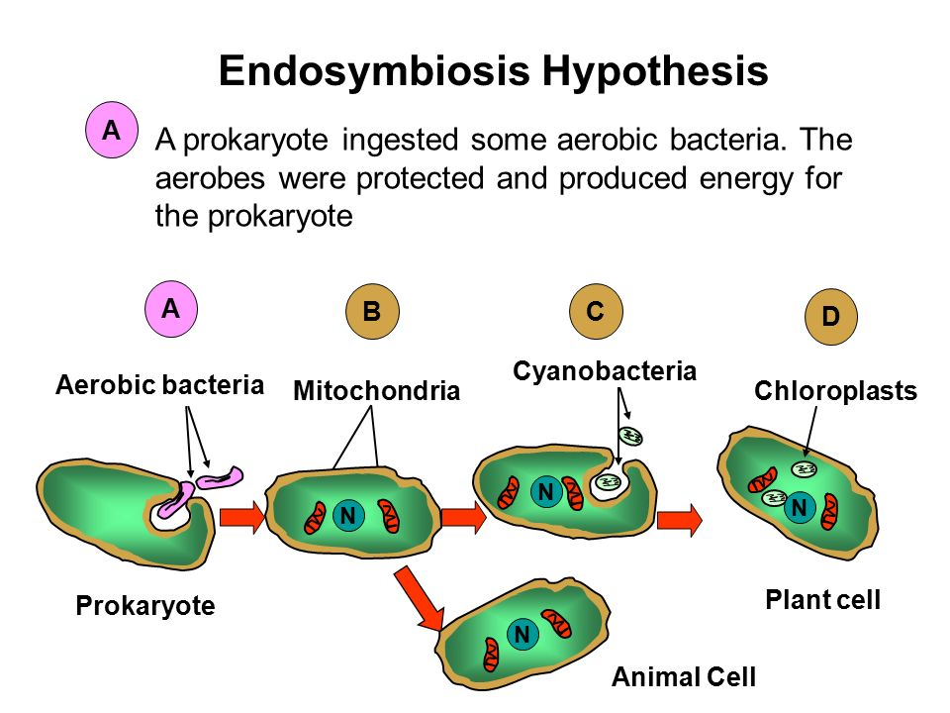
Biological life on Earth
Geologic events play a significant role in species development and survival
Geo time is broken into three eons- Paleozoic, Mesozoic and Cenozoic
Stromatolites are the first fossil evidence, forming a thin film on rocks
Oxygen did not come into play until about 2.5 BYA
Eukaryotes made an appearance 1.8 BYA
Endosymbiotic theory: mitochondria and plastids were once prokaryotes
Serial Endosymbiosis: mitochondria developed before plastids in separate events
http://images.slideplayer.com/28/9354904/slides/slide_12.jpg

Slide 10
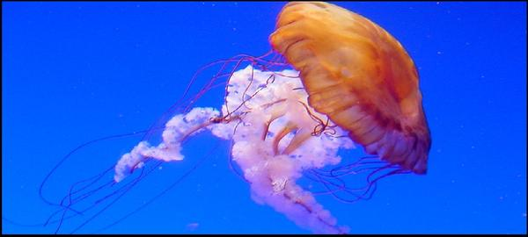
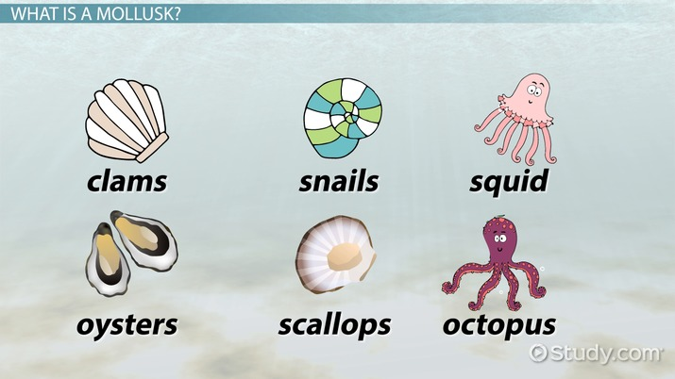
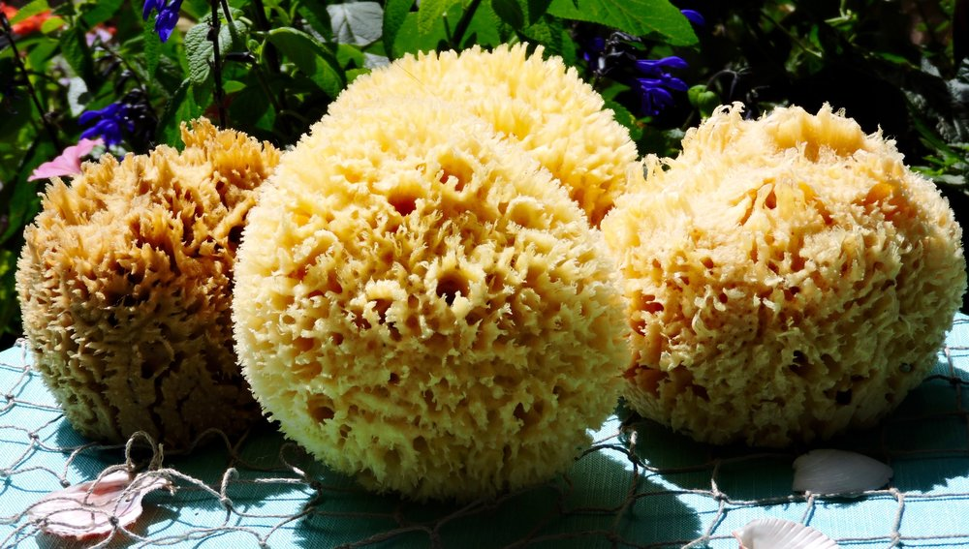
Cambrian Explosion
https://cdn.shopify.com/s/files/1/0151/8127/files/Art_Cnidarians_grande.jpg?579
~ 535 MYA Eukaryotic multicellular organisms began to take over
Sponges/Cnidarians/Mollusks evident in fossil record (even prior to CE)
https://study.com/cimages/videopreview/videopreview-full/kcu6709l9x.jpg
https://static1.squarespace.com/static/589b838a17bffcc533d6581c/t/589bdf831b10e3beb928cde3/1486610319194/IMG_0419.JPG

Slide 11
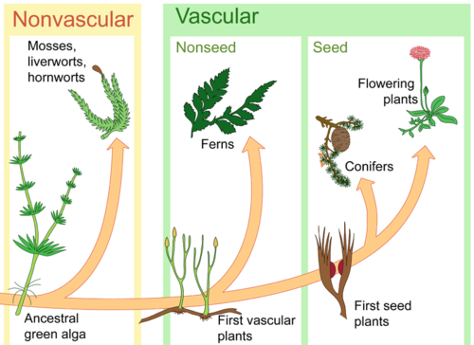
500 MYA LAND!
500 MYA plants moved from water to land
Adaptations enabled plants to prevent drying out
Vascularity
Waxy coating
Plants symbiotically worked with Fungi (mycorrhizae)
Arthropods (Insects) ~450 MYA
Tetrapods ~ 365 MYA
https://dr282zn36sxxg.cloudfront.net/datastreams/f-d%3A32ef207fee5f279c0310c63e941662cc774a731e76812448759a9213%2BIMAGE_THUMB_POSTCARD%2BIMAGE_THUMB_POSTCARD.1

Slide 12
Earth Science review
Plate Tectonics-
Earth is divided into “plates”, the crust and rigid mantle (lithosphere)
These plates ride on top of the asthenosphere (plastic mantle)
Convection currents cause plates to move
Rising magma at divergent boundaries (ex: Mid Atlantic Ridge)
Sinking magma at convergent boundaries (ex: Marianas Trench)
Continental drift
Continents on top of plates are moving, and will continue to move,
Fossils are found in places that are separated by oceans

Slide 13
Extinctions allow for new Species to take over
Evidence for changes in Earth come from the fossil record
There were five major extinction events
Permian – between the Paleozoic and Mesozoic (251 MYA)- took 96% of marine animal species
Oceans changed, insects were wiped out
Caused by extreme volcanism
Cretaceous- Saddest of them all 65.5 MYA Between the Mesozoic and Cenozoic
Dinosaurs (apex predators) wiped out
Caused by asteroid- Chicxulub Crater and iridium in rock record

Slide 14
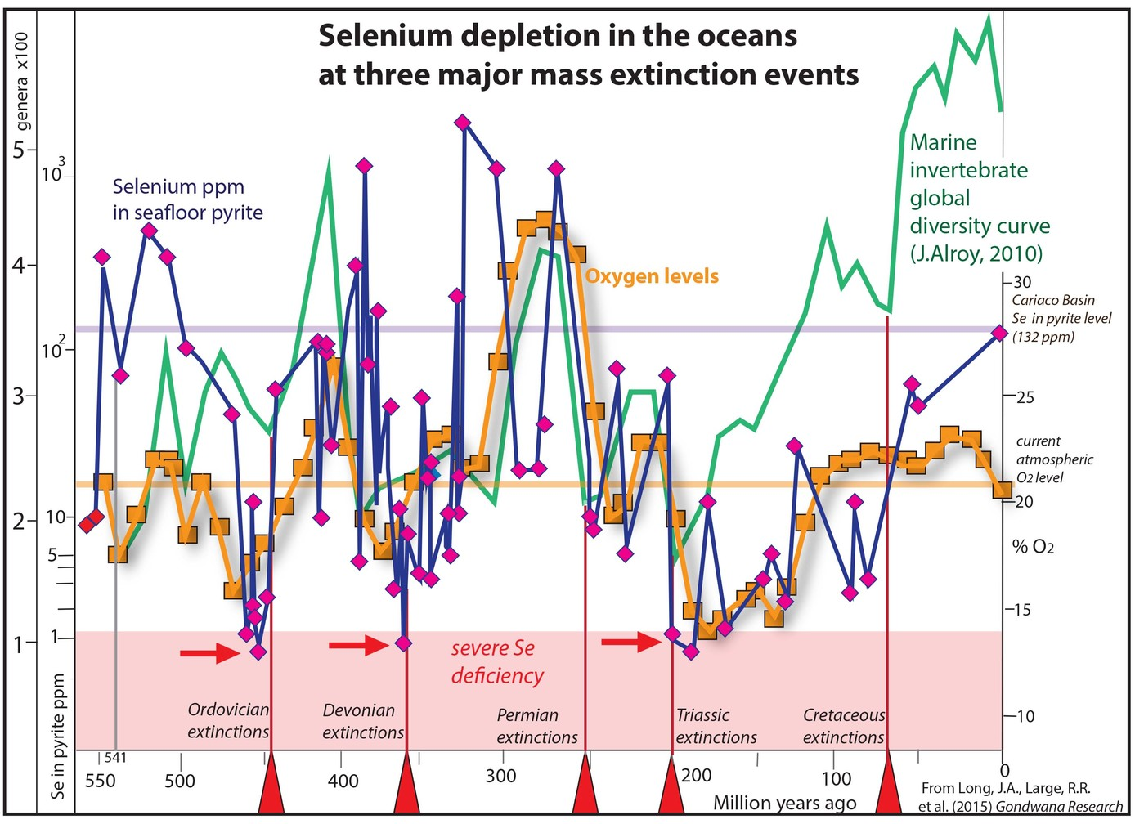
https://phys.org/news/2015-11-elementary-theory-mass-extinctions-life.html

Slide 15
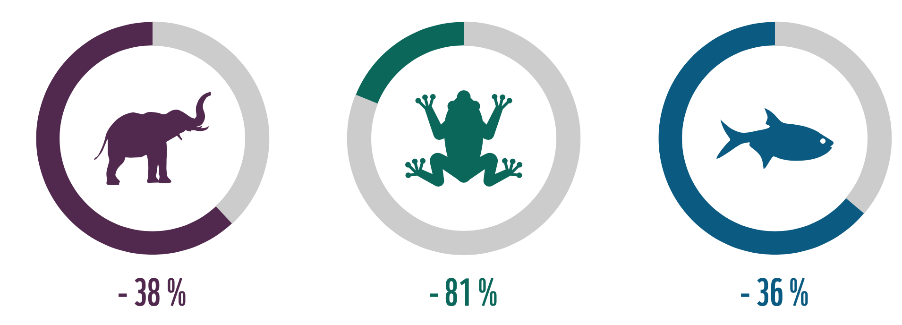
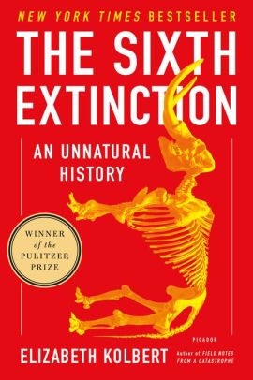
Sixth Mass Extinction
https://d2jmvrsizmvf4x.cloudfront.net/pLlO2yhHTwO19Ine5OEZ_Screen+Shot+2017-01-21+at+9.40.38+PM.png

Slide 16
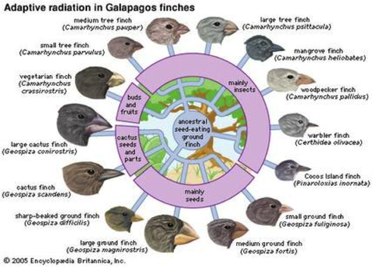
Mass Extinctions Cause Evolution
Fossil record shows that it takes 5-10 million years for biodiversity to recover after a mass extinction
Biodiversity has increased over the last 250 million years
Adaptive radiation- periods of evolution when new organisms form and fill new niches
Organisms that have innovative features such as armor and seeds were able to fill roles previously unfilled
https://some-biodiots.weebly.com/uploads/2/1/8/9/21899636/6272792.png?493

Slide 17
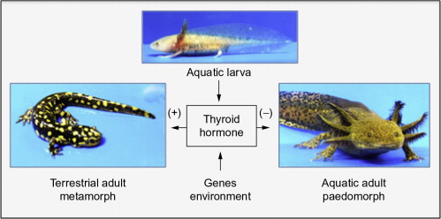
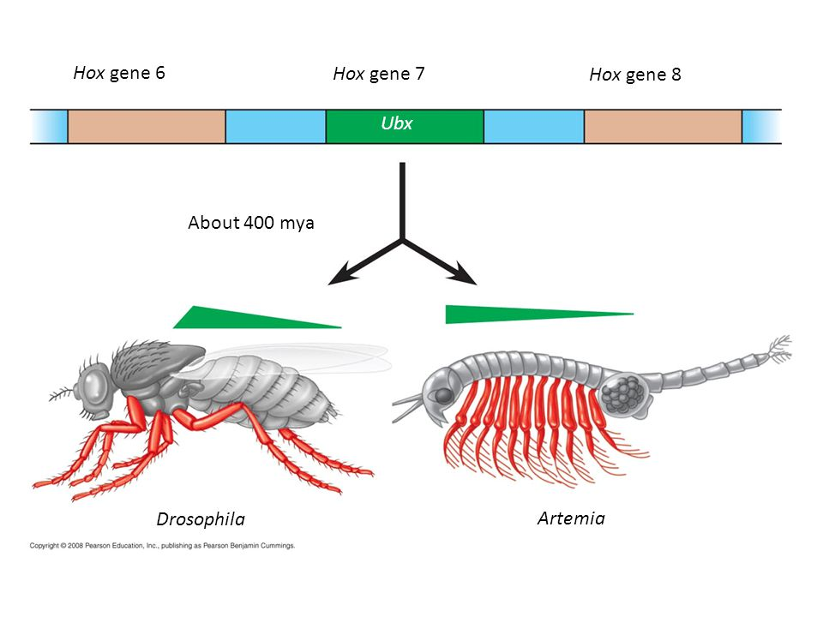
Genetics meets the Fossil Record
Heterochrony – “different” “time”, change in the rate of developmental events
Paedomorphosis- reproductive organs develop faster than other organs, species may look like juveniles but be reproductively mature
Homeotic Genes –regulatory genes can change/move turning appendages for swimming into feeding appendages
https://ars.els-cdn.com/content/image/1-s2.0-B9780123859792000083-f08-01-9780123859792.jpg
https://images.slideplayer.com/19/5833032/slides/slide_72.jpg

Slide 18
Changes in regulation of a developmental gene may have less side effects than changing the actual gene sequence (pg 540)
…
Changes in organism form could be a result of mutations on the regulation of gene expression not the gene itself
Sickle Back Experiment
Pitx1 change in sequences could reduce spines→ amino acid in both populations are the same
Pitx1 regulation could reduce spines → Gene expression is different in two species

Slide 19
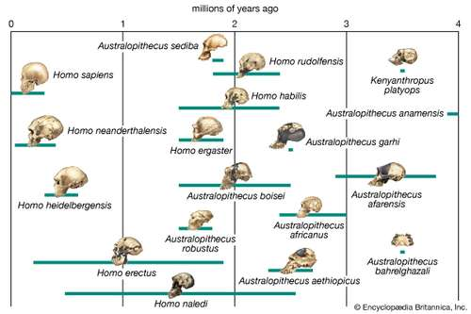
Final thoughts
Evolution does not have goals
Organisms and Species do not change to fit their environment
Exaptation's- structures that evolve in one context but are used for a different function
Not all evolution is linear
http://slideplayer.com/9633064/31/images/5/Exaptation+Also+called+preadaptation.jpg
https://cdn.britannica.com/s:500x350/92/392-004-32E989F5.jpg

