Slide 1
Evolution of Genomes
Chapter 21

Slide 2
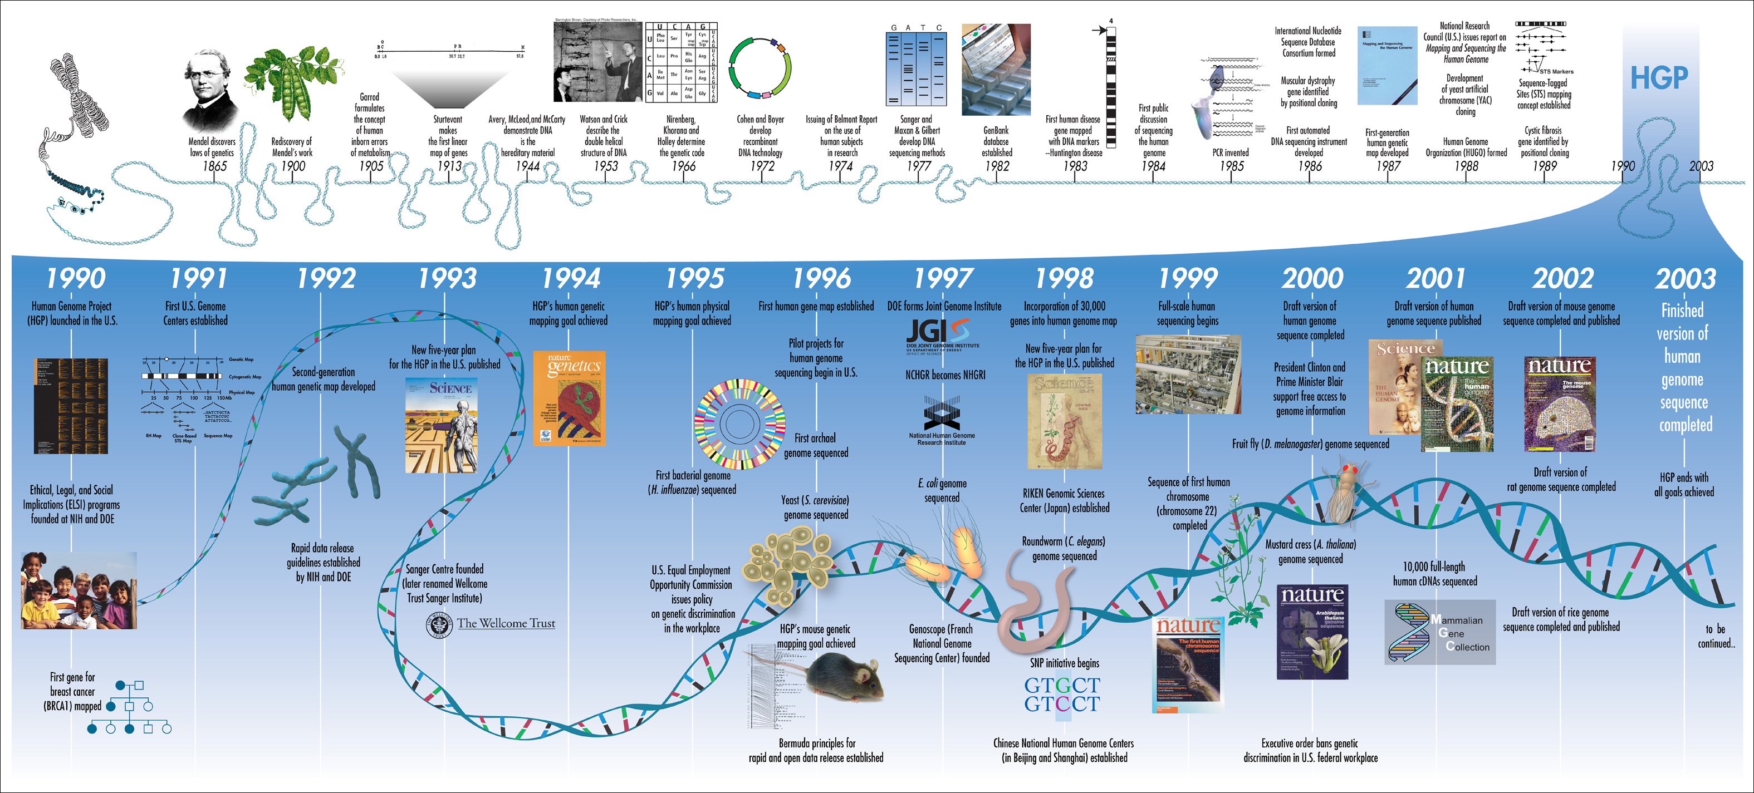
Genomics
The study of whole genomes and their interactions
Bioinformatics: computational and applications of biological data
Metagenomics: studying DNA from an entire group in an environment
https://www.ucpress.edu/blog/wp-content/uploads/2018/05/Human_Genome_Project_Timeline_26964377742.jpg

Slide 3
Bioinformatics Tools
Various databases (such as NIH) have genome data bases
Genbank from NCBI (National Center for Bio Technology Information) uses BLAST software to compare sequences
Different programs compare proteins or amino acids
These technologies allow scientists to look at specific genes instead of working backwards from the phenotype
Gene annotation: use GenBank to identify all protein coding genes
Proteomics: study of a set of proteins (to determine how the proteins interact and work)

Slide 4
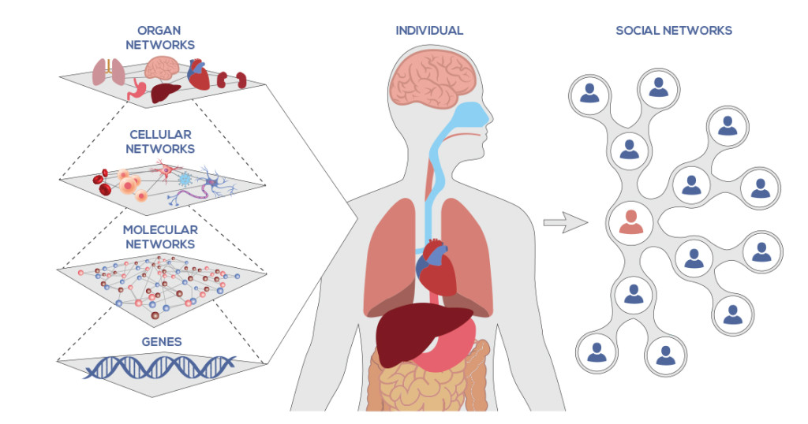
https://www.systemsbiology.org/wp-content/uploads/network-medicine-1024x538.jpg

Slide 5
Genome Variety
Domains (KPCOFGS)
Bacteria, Archaea and Eukarya genome size varies (Table 21.1)
Eukarya have a higher genome numbers but fewer genes
Bacteria vs. Eukaryotes
Most bacteria DNA is coding for proteins (a small amount can be for promoters)
Human DNA is only 1.5% coding for proteins
Pseudogenes and gene fragments – accumulation of genes or pieces of genes that no longer code for functional proteins
Repetitive DNA sequences present in multiple copies
transposable elements- genes that can move to multiple sites on DNA

Slide 6
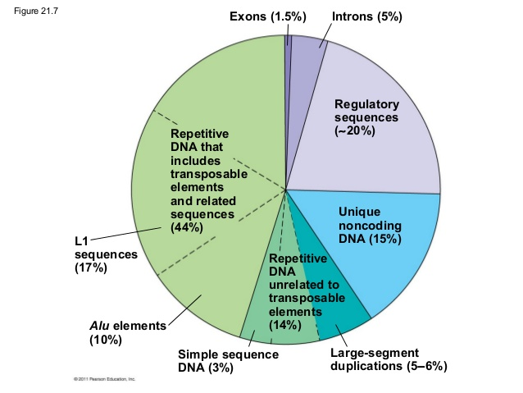
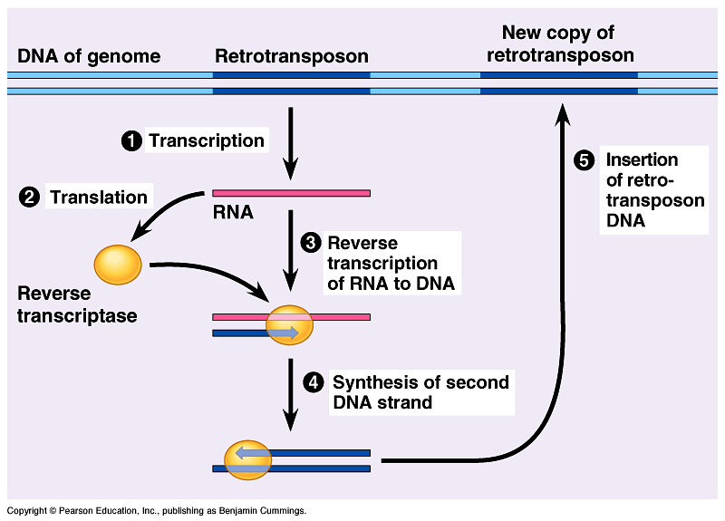
Transposons: “cut and paste” using transposase enzyme coded for by the transposon
Retrotransposons use an RNA intermediate
https://image.slidesharecdn.com/21lecturegenomeandevolution-150106205000-conversion-gate02/95/21-lecture-genomeandevolution-41-638.jpg?cb=1420599180
Line 1 and ALU elements are transposable DNA elements that encode for proteins that are not part of the normal cellular functions
http://sciworthy.com/wp-content/uploads/2014/09/19.5.gif

Slide 7
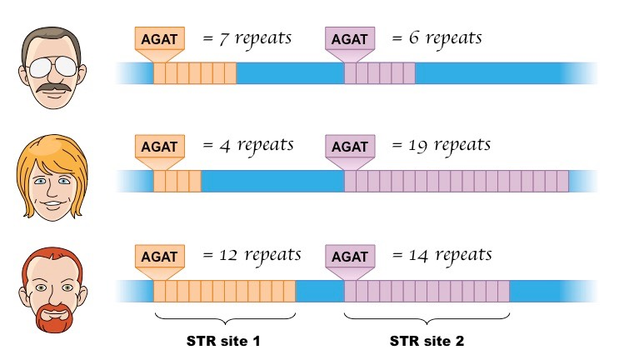
DNA…
DNA that is not transposable but repeated is most likely a result of a mistake during replication or recombination
Simple sequence DNA contains copies of tandemly repeated short sequences
STR sequences (2-5) nucleotides can be used for genetic profiles
Most of this simple DNA is found at telomeres and centromeres (possibly used for structure of chromosomes)
http://ib.bioninja.com.au/_Media/str_med.jpeg

Slide 8
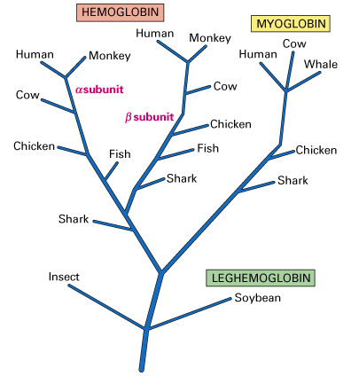
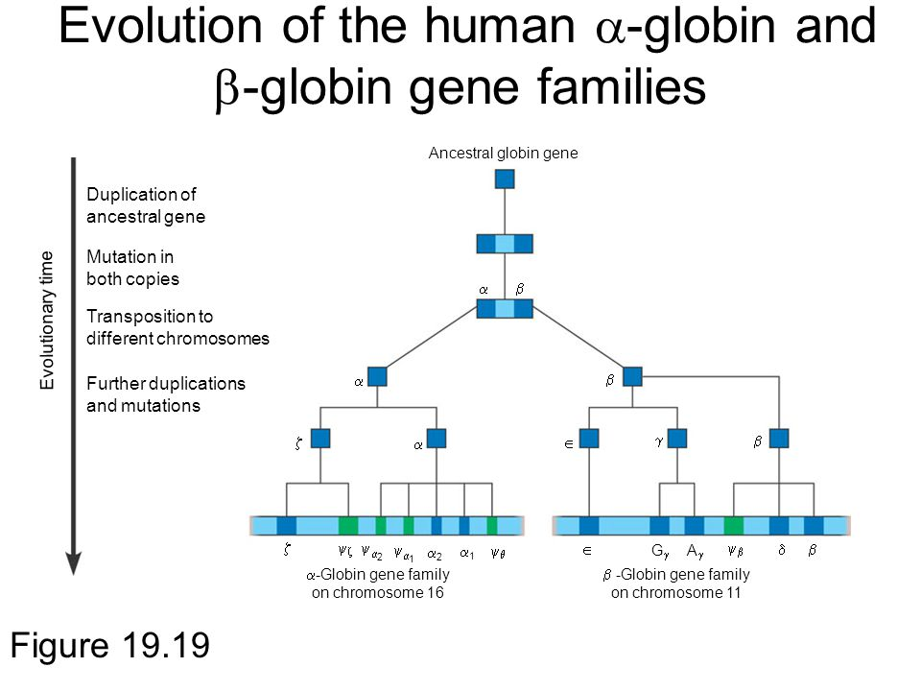
https://slideplayer.com/slide/5171017/16/images/11/Evolution+of+the+human+%EF%81%A1-globin+and+%EF%81%A2-globin+gene+families.jpg
https://www.muhlenberg.edu/media/contentassets/images/academics/biology/courses/bio152/common_ancestor_tree.gif

Slide 9
Genome evolution
https://public.ornl.gov/site/gallery/originals/Mouse_and_Human_Genetic_Similarities_-_original.jpg

