Slide 1
DNA
Part 1

Slide 2
DNA is Genetic Material
Evidence for heritability of DNA
Griffith's mouse experiment
Bacteriophages
Hershey and Chase’s work with T2 infection on E. coli
This led to the discovery that it was more than proteins which were heritable
Viruses
Chargaff
A-T, G-C
Different organisms have different amounts of specific nucleotides
Pauling, Wilkins, Franklin, Watson and Crick
Worked on the three dimensional structure
Discovered using X-Ray crystallography diffraction

Slide 3
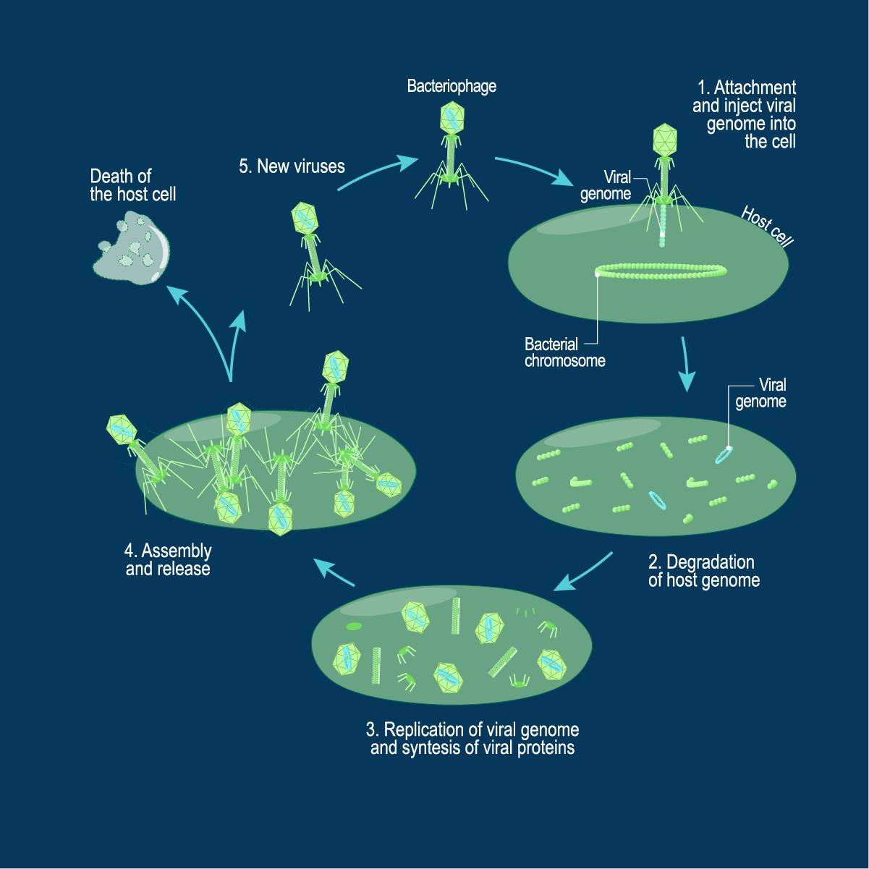
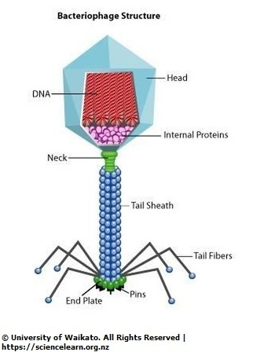
https://cdn.technologynetworks.com/tn/images/body/tn-bacteriophagelytic1535109334446.png

Slide 4
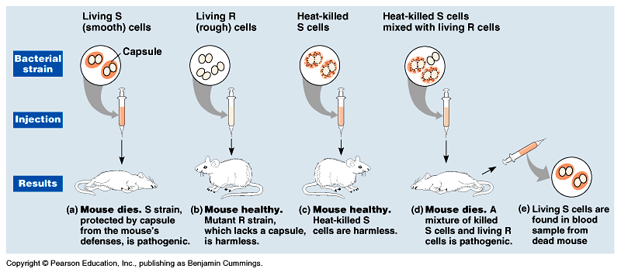
Frederick Griffith
2 forms (Streptococcus pneumoniae):
S strain (pneumonia-causing)
R strain (didn’t cause pneumonia)
Induced a nonpathogenic strain to become pathogenic.
Transforming factor that caused the change.
Transformation: change in genotype and phenotype due to assimilation of external substance (DNA) by a cell.

Slide 5
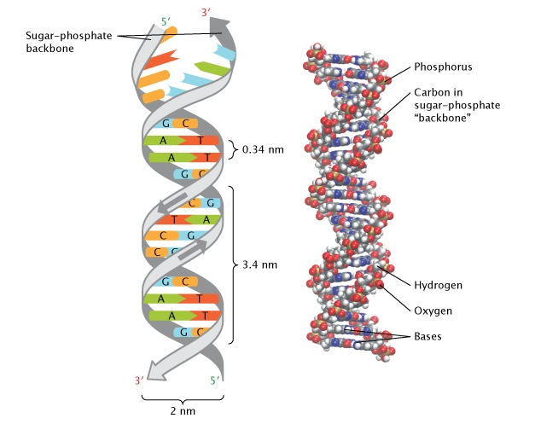
DNA is a Double Helix
Shape discovered by X-Ray diffraction
Chargaff's Rule
Cytosine and Thymine are Pyrimidines (single ring)
Adenine and Guanine are Purines (double ring)
Two strands with a pentose and phosphate backbone (antiparallel) covalently bonded to one of four nitrogenous bases which are connected via hydrogen bonds
Van der Waals interactions play a major role in the stacked molecules (same forces that allow lizards to walk on water)
https://www.nature.com/scitable/content/ne0000/ne0000/ne0000/ne0000/104944953/24263_73.jpg

Slide 6
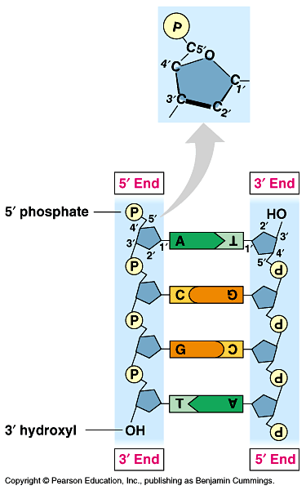
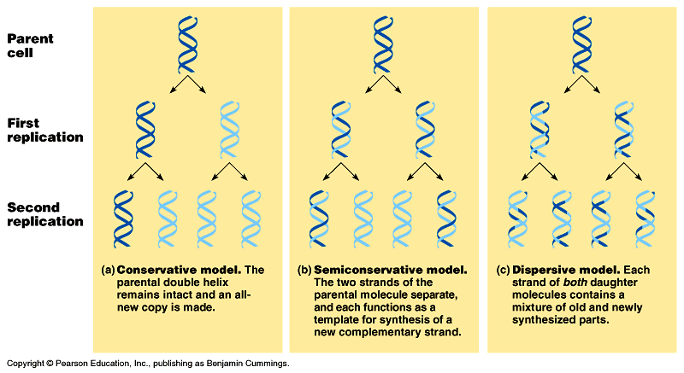
DNA Replication
Basic Model
DNA breaks apart at the hydrogen bond
Parent strands are separated and two new daughter strands form
Conservative Model- parent strands come back together
Semi-conservative Model – each parent strand is a template
Dispersive – each strand has a mix of old and new DNA

Slide 7
Conservation of DNA Replication
Similar mechanisms in both E. coli and eukaryotes
E. coli have circular DNA called plasmids
Specific sequences of bases are recognized and proteins open up the plasmid
DNA Replication is completed in both directions
*(Eukaryotes have many replication origins, whereas bacteria have one)*
A Y shaped region replication fork is where the DNA unwinds
https://pixfeeds.com/images/30/598022/1200-598022-42536260-22366354.jpg

Slide 8
Enzymes
Helicase unzips DNA
Single-Strand Binding Proteins- bind to unpaired DNA strands
Topoisomerase- helps DNA maintain its shape
Primase- creates primer (initial RNA strand created)
DNA Polymerase- catalyzes the synthesis of new DNA by adding nucleotides
DNA pol III – adds nucleotides to RNA primer or pre-existing DNA
DNA pol I – removes RNA nucleotide of primer and replaces with DNA nucleotides
DNA Ligase – Joins Okazaki fragments

Slide 9
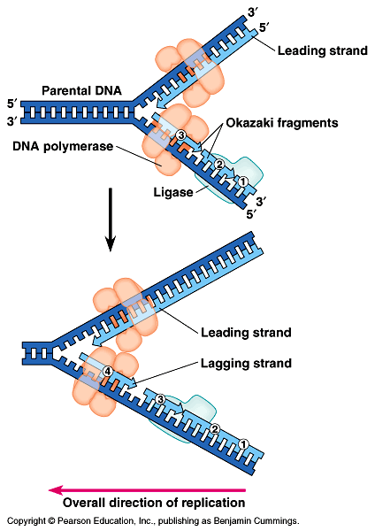
DNA Synthesis (cont.)
DNA has two ends 3’ and 5’
The strands are antiparallel
Replication only begins on 3’ end because it has the ability to release two phosphates
Leading Strand – complimentary bases added 5’-3’ direction in a single strand
Lagging Strand - synthesis happens in segments known as Okazaki fragments

Slide 10
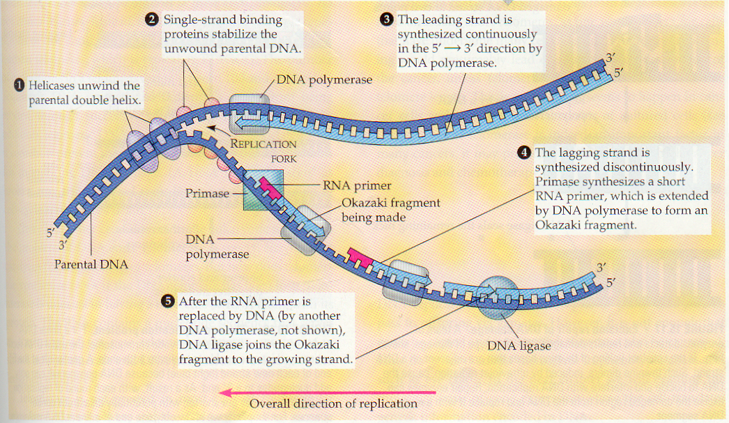

Slide 11
Proofreading and Repairing DNA
1/ 10⁵ nucleotide paring results in error
1/ 10,000,000,000 errors in full DNA strand
DNA Polymerase proofreads DNA and removes mismatch nucleotide
Mismatch Repair- other enzymes replace mismatches that DNA polymerase does not correct
DNA can change after replication due to environmental factors such as radiation
Nuclease –cuts out damaged part of the DNA strand (caused by environmental factors)

Slide 12
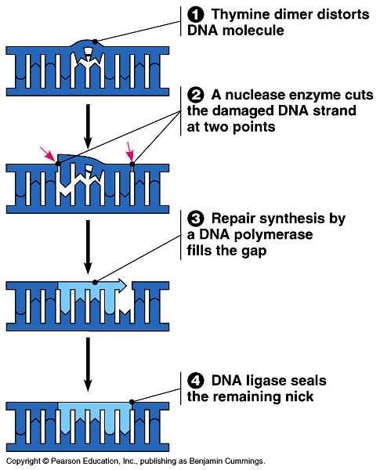

Slide 13
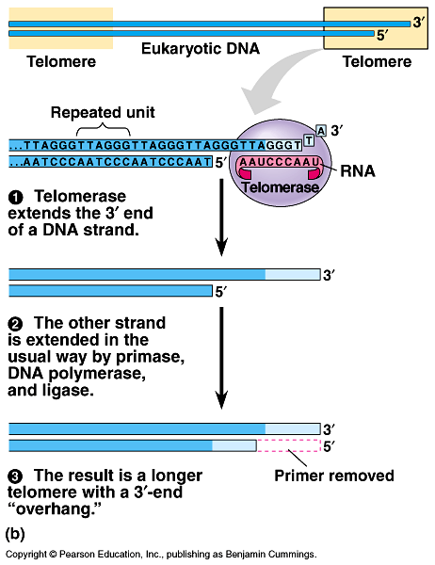
Telomeres
Telomeres located at the end of chromosomes to protect vertical fusion
TTAGGG is repeated and does not code for any genes
Every round of replication shortens the telomeres
Telomerase lengthens telomeres in germ and zygote cells (also tumor cells)

