Slide 1
Darwin’s Evolution
“decent with modification”

Slide 2
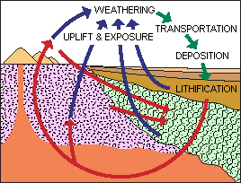
Pre-Darwin
Aristotle (BCE) believed that species were fixed, but that there was a complexity in life forms “scala naturae”
Linnaeus (18th century) – binomial nomenclature and nested order
Cuvier, Hutton, Lyell- Rock strata show different fossils- uniformitarianism
Lamarck- (19th century)- use and disuse and inherited characteristics
https://evolution.berkeley.edu/evolibrary/images/history/rockcycle2.gif

Slide 3
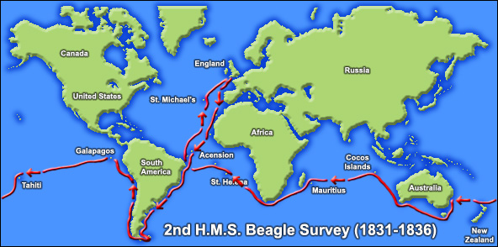
Darwin’s Beagle
https://www.aboutdarwin.com/voyage/Voyage_02.jpg

Slide 4
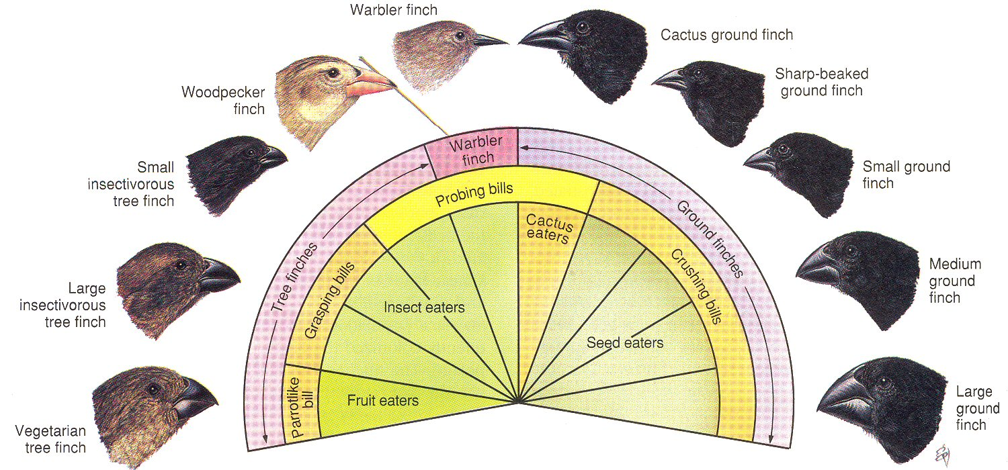
Galapagos Islands
Variation: phenotypic differences between organisms (ex: finches with different beak sizes
Adaptations: Inherited characteristics that enhance reproduction and survival
Natural Selection: Individuals with certain inherited traits reproduce and survive more because of those traits

Slide 5
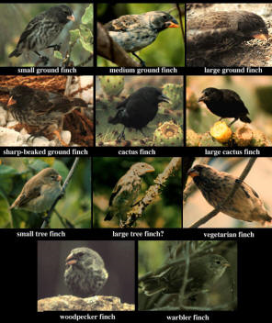
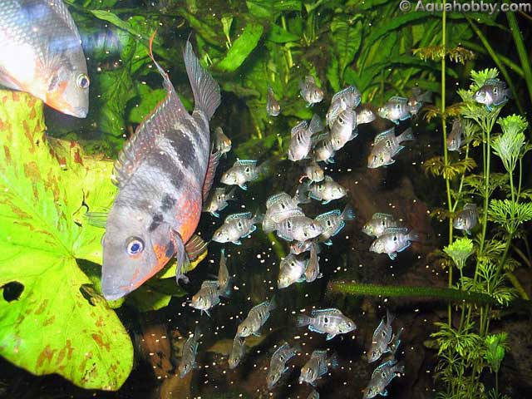
5 observations:
1. Exponential fertility
2. Stable population size
3. Limited resources
4. Individuals vary
5. Heritable variation

Slide 6
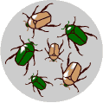
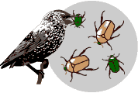
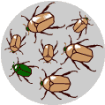
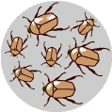
Natural selection
There is variation in traits. Some beetles are green and some are brown.
There is differential reproduction. Green beetles get eaten by birds and survive to reproduce less often than brown beetles.
There is heredity. Surviving brown beetles have brown baby beetles because this trait is genetic.
End result: The more advantageous trait, brown coloration, which allows the beetle to have more offspring, becomes more common in the population.
http://science.discovery.com/interactives/literacy/darwin/darwin.html

Slide 7
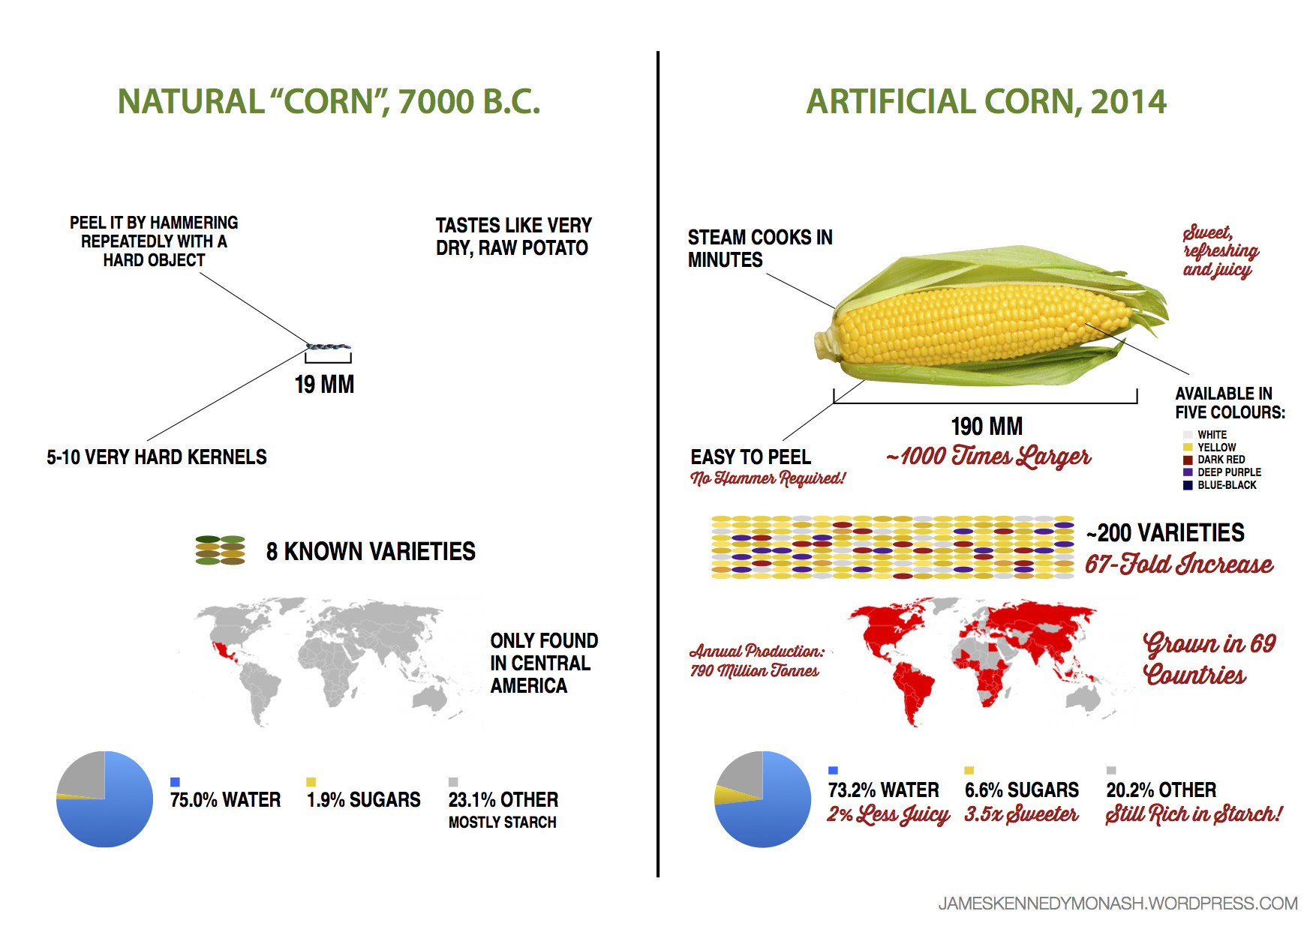
https://cdn2.vox-cdn.com/thumbor/7YpIvXYS02jNJBH75Q9Bz7FYuus=/cdn0.vox-cdn.com/uploads/chorus_asset/file/2357022/artificial-natural-corn1.0.png

Slide 8
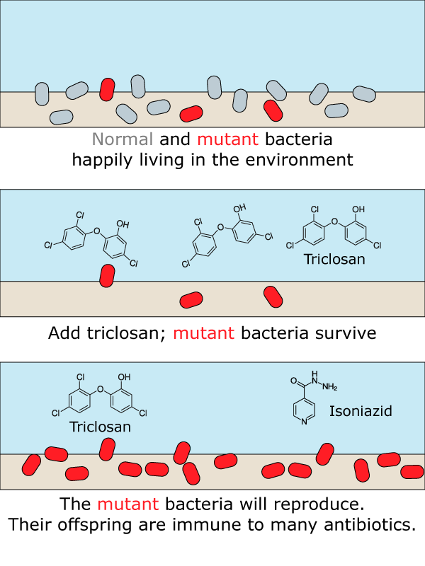
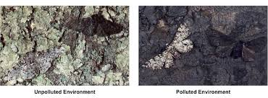
http://ib.bioninja.com.au/_Media/peppered-moth_med.jpeg
https://i2.wp.com/sitn.hms.harvard.edu/wp-content/uploads/2017/01/Figure-2.png

Slide 9
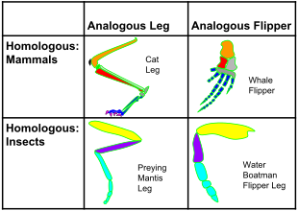
Fossil Proof
Homologous Structures: Different structures with similar morphology
Analogous Structures: Same structures but evolved differently (wings in insects and birds)
Vestigial Structures: remains of structures that are no longer useful ex: tail bone, appendix
https://upload.wikimedia.org/wikipedia/commons/thumb/0/08/Analogous_%26_Homologous_Structures.svg/310px-Analogous_%26_Homologous_Structures.svg.png

Slide 10
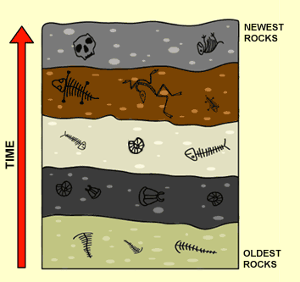
Fossil Record
The fossil record is the history of life recorded by remains from the past.
Succession of forms over time
http://www.powermediaplus.com/player.asp?mediaID=1088&segmentID=97188

Slide 11
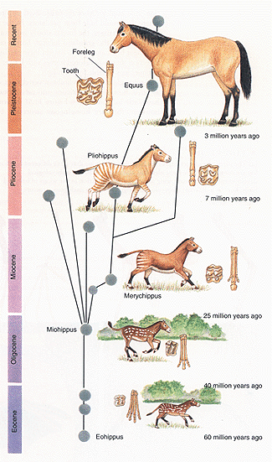
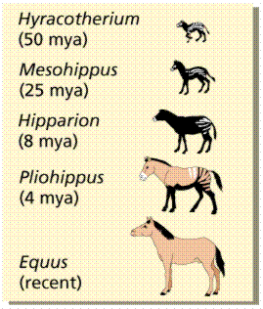
O.C. Marsh of Yale University
In 1879 conducted a study using the fossil record to trace the history of the modern-day horse Equus.
Living organisms resemble most recent fossils in the line of descent; underlying similarities allow us to trace a line of descent over time.
http://channel.nationalgeographic.com/channel/content/morphed/

Slide 12
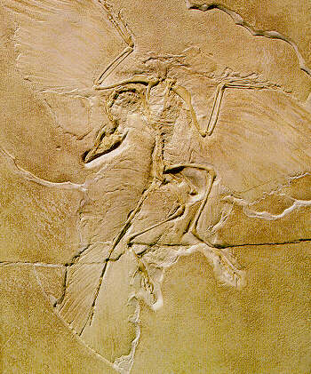
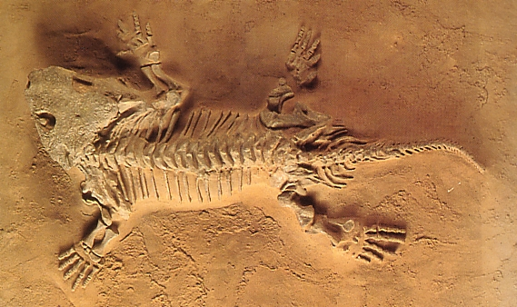
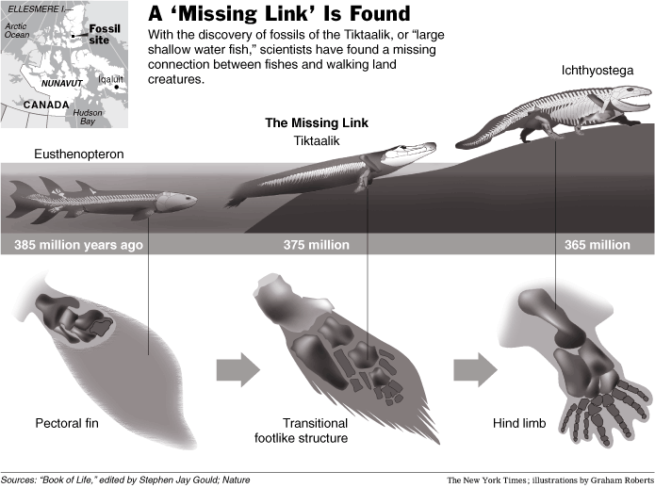
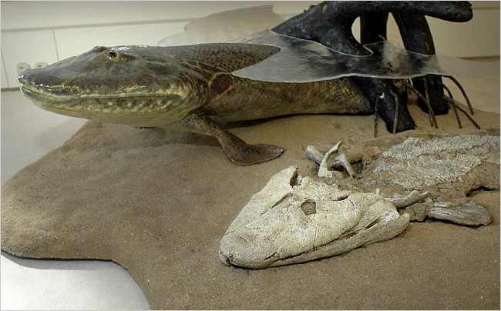
Transitional Forms
Reveal links between groups:
Archaeopteryx is between reptiles and birds
Tiktaalik large shallow water fish
Eustheopteron is an amphibious fish
Seymouria is a reptile-like amphibian
Therapsids were mammal-like reptiles.
http://www.pbs.org/wgbh/evolution/library/03/4/l_034_03.html
http://www.youtube.com/watch?v=1n0kA-eHe_0
http://www.youtube.com/watch?v=WwD98VB1zvU

Slide 13
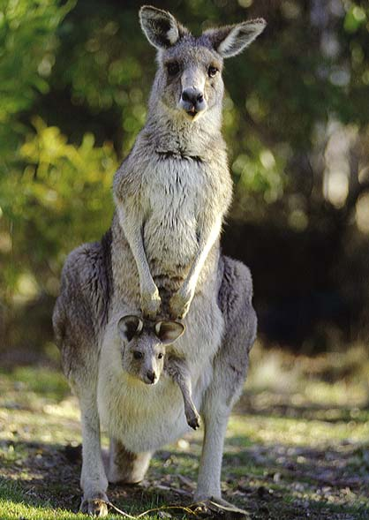
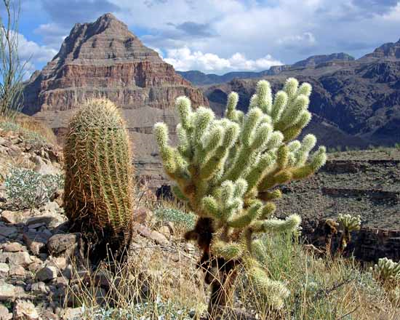
Evolution evidence: Biogeography
The unequal distribution of organisms on the earth
Each species originated only once, in one place- called the point of origin
Physical factors, such as the location of continents, determine where a population can spread.
Why are kangaroos in Australia but not elsewhere? Why are cacti in deserts of North America but not in deserts of Africa or Asia?
Marsupials arose when South America, Antarctica, and Australia were all joined Australia separated before placental mammals arose, so only marsupials diversified in Australia.

Slide 14
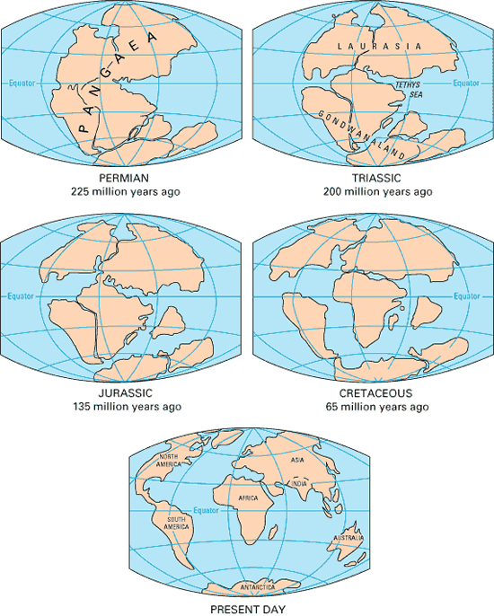

Slide 15
Embryological Development
During development, all vertebrates have a notochord and paired pharyngeal pouches.
In fishes and amphibian larvae, the pouches become gills.
In humans, first pair of pouches becomes a cavity of middle ear and auditory tube; second pair becomes tonsils, while third and fourth pairs become thymus and parathyroid glands.
This makes sense only if fish are ancestral to other vertebrate groups.
During early stages of development it is nearly impossible to determine the difference between many different organisms.

Slide 16
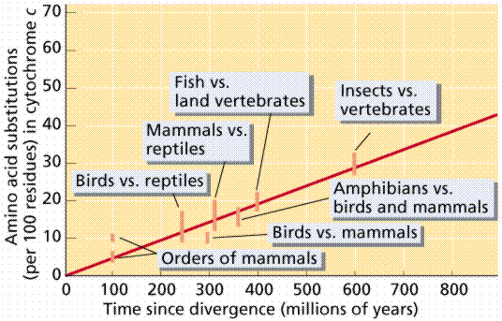
Evolution evidence: Molecular Biology
Almost all living organisms use the same basic biochemical molecules, including DNA, ATP, and many identical or nearly identical enzymes.
Organisms utilize the same DNA triplet base code and the same 20 amino acids in their proteins.
The fact that humans and chimps have 96% the same DNA sequences.
These similarities can be explained by descent from a common ancestor.
This is substantiated by analysis of degree of similarity in amino acids for cytochrome c among organisms.
http://www.pbs.org/wgbh/evolution/library/03/4/l_034_04.html

