Slide 1
Community Ecology
Chapter 54

Slide 2
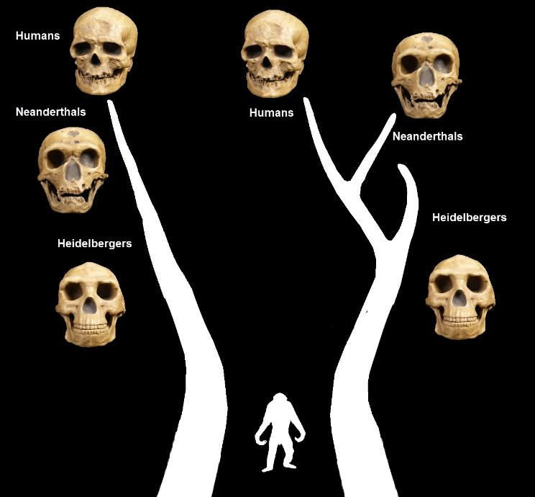
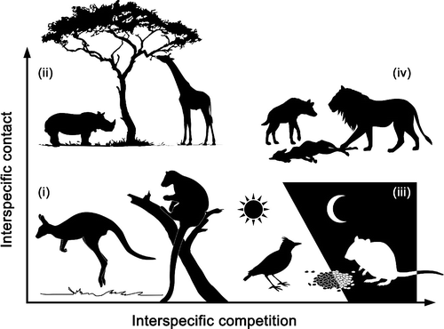
Community Interactions
Community: a group of different populations interacting in the same environment
Interspecific: Interactions among different species
Predation
Herbivory
Symbiosis
Mutualism
Commensalism
Parasitism
Competition: Both species are competing for the same resources
Competitive Exclusion: A reproductive advantage to eliminate an inferior competitor (ex: Neanderthals)
http://www.youstupidrelativist.com/sitebuilder/images/FamilyTree10-744x690.jpg
http://parklab.ecology.uga.edu/wp-content/uploads/2015/10/fg1.gif

Slide 3
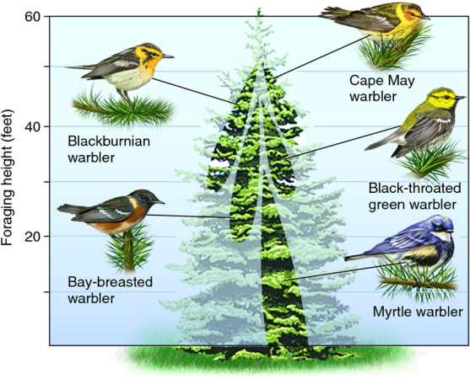
Ecological Niches
The sum of a species use of abiotic and biotic resources = Niche
Two species cannot occupy the same niche
Ex: Anolis Lizards
Fundamental is the potential niche but often not fully occupied leading to the realized niche
Resource Partitioning is the differentiation of niches
Displacement: When species are similar living in the same environments, they have similar phenotypes, in different locations they have different phenotypes
https://allyouneedisbiology.files.wordpress.com/2016/06/warblers.png?w=557&h=450

Slide 4
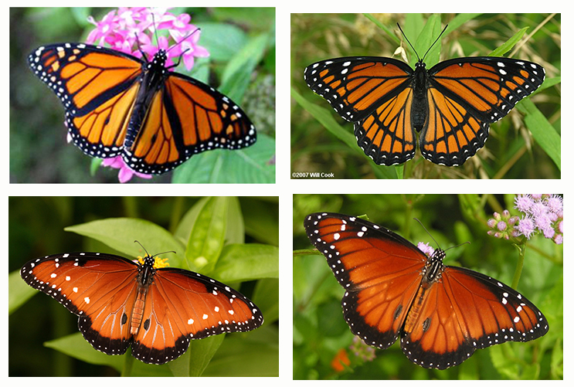
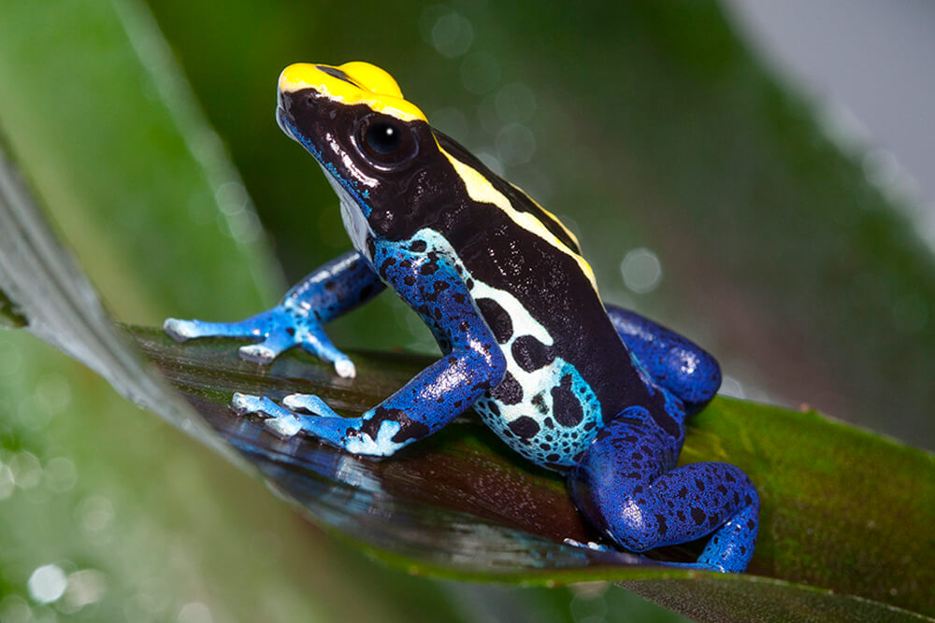
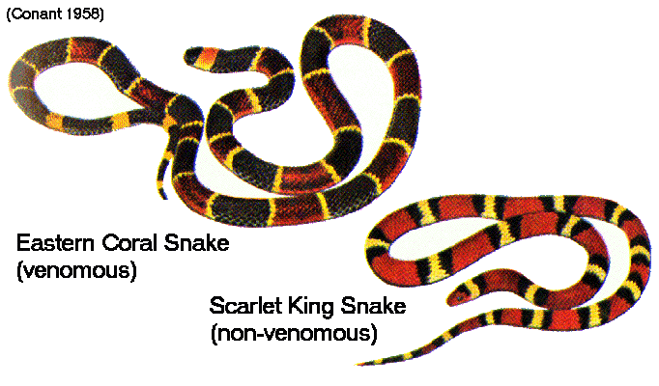
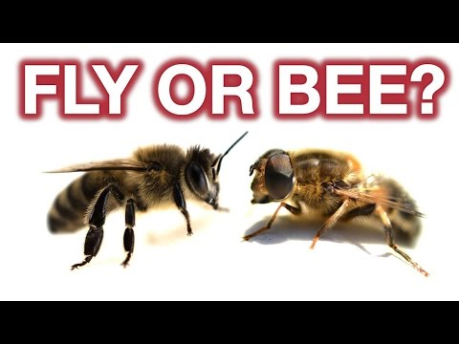
Predation
One organism benefits and another is at a disadvantage
Prey can survive due to
Aposematic Coloration –Warning coloration
Cryptic Coloration –camoflouge
Batesian Mimicry – harmless species mimics a harmful one
Mullerian Mimicry – similar appearance between species
https://animals.sandiegozoo.org/sites/default/files/2016-10/poison_frog_dyeing.jpg
http://faculty.collin.edu/dmcculloch/2406/Notes/Monarch/images/mimicry.jpg
https://i.ytimg.com/vi/n4RJRNi-t_E/hqdefault.jpg
https://d2jmvrsizmvf4x.cloudfront.net/5pSiCp2Q1Cy03qkJfl77_Coral_snake_mimics.gif.jpg

Slide 5
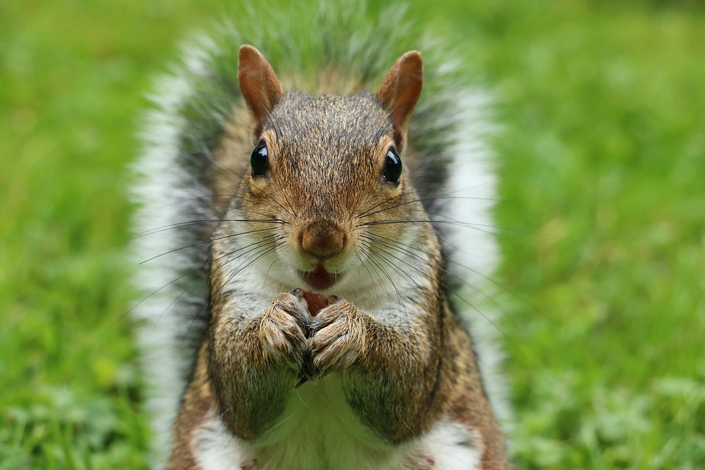
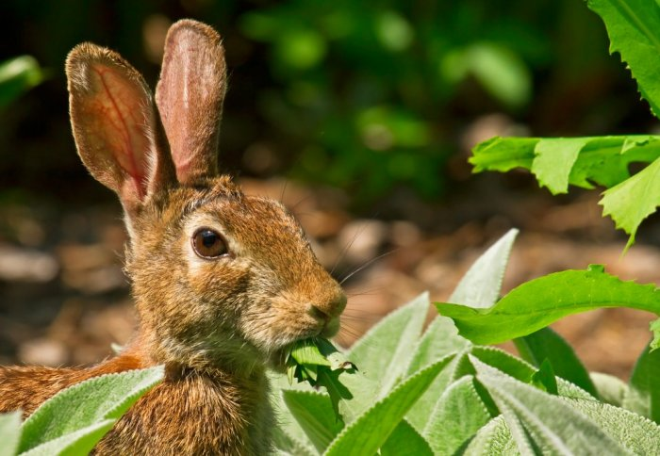
Herbivory
A positive relationship where an animal benefits and a plant/algae is eaten
Animals have specialized teeth and digestive tracks for herbivorous diets
Plants can protect themselves by being poisonous
http://www.imperial.ac.uk/news/image/mainnews2012/21577.jpg
https://encrypted-tbn0.gstatic.com/images?q=tbn:ANd9GcRl72yrnyTPunIvWs8J9GKt3cPz0rmVfEqbMMowsxmw8mr8cozHhttps://www.animalaid.org.uk/wp-content/uploads/2018/06/squirrel-2962847_960_720.jpg

Slide 6
Relationships
Symbiosis: two organisms relate with each other
Parasitism: One organism benefits and one is harmed
Endoparasites and Ectoparasites: parasites feed externally or internally
Mutualism: Two organisms benefit from each other
Obligate Mutualism: One species loses ability to survive alone
Facultative Mutualism: Both species can survive on their own
Facilitation: Positively affecting another species without direct contact (common in plant species)

Slide 7
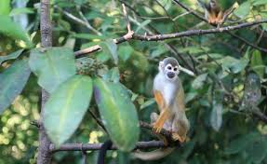
Biodiversity

Slide 8
Diversity
Species Diversity: variety of different organisms in a community
Species Richness: the number of different species in the community
Relative Abundance: the proportion each species represents in the community
Shannon Diversity- a way to measure diversity incorporating species and their abundance

Slide 9
Ecosystem Stability
More diverse ecosystems are more stable and can withstand more environmental change (ex: Tundra)
More diverse ecosystems produce more biomass
Ecosystem stability is threatened by
Invasive species: organisms brought to ecosystems either intentional (bamboo) or unintentionally (zebra mussels) have no natural predators that can exhaust ecosystem resources for native species
http://www.sliderbase.com/images/referats/655b/(6).PNG

Slide 10
Food Chains, Pyramids and Webs
Trophic Level: levels of feeding within an ecosystem
Food Chains- go in one direction (P-C-D)
Food Webs- show multiple food chains with multiple arrows (different organisms may show up at different trophic levels in a food web)
Biomass: only about 10% of energy is passed along the food chain at each trophic level, hence why food chains are short

Slide 11
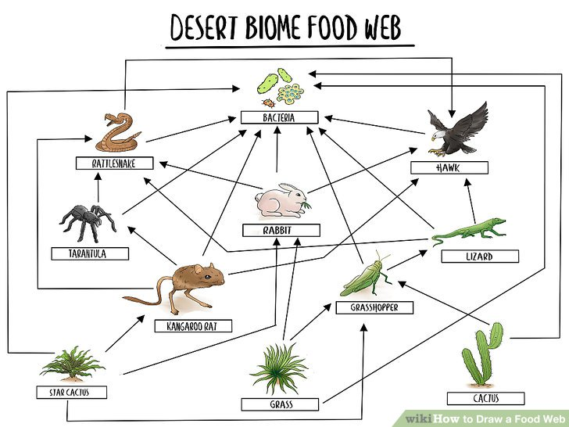
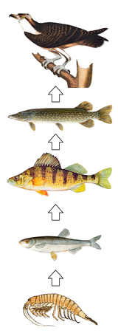
https://www.wikihow.com/images/thumb/1/13/Food-Web-Visual-Sample.jpg/aid1896284-v4-728px-Food-Web-Visual-Sample.jpg
https://upload.wikimedia.org/wikipedia/commons/thumb/9/9f/Food_chain.png/160px-Food_chain.png

Slide 12
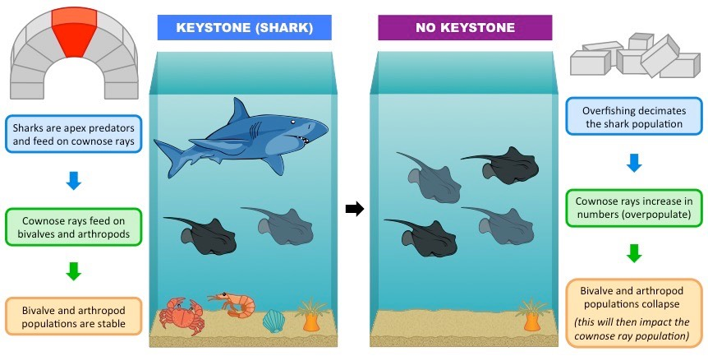
Important Organisms
Some species have more of an impact in an ecosystem
Keystone species: not usually abundant in an ecosystem (opposite of dominant organism) but play an important role nonetheless
Ecosystems engineer: species that alter the environment
http://ib.bioninja.com.au/_Media/keystone-species_med.jpeg

Slide 13
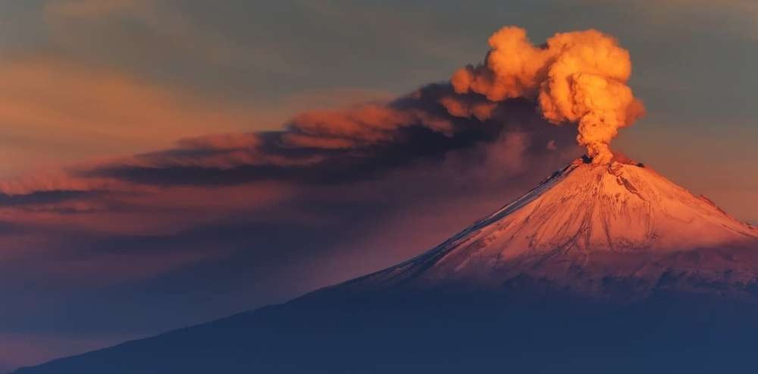
Ecosystem Disturbances and Succession
Intermediate levels of disturbances cause the species diversity to be more maintained than low or high levels of disturbances
Post a disturbance such as a fire, ecosystems face recovery and rebirth
Pathogens can affect ecosystems
Humans increase pathogen rates through travel and trade
Succession: rebirth of an ecosystem
Primary: Growth in a lifeless area such as brand new rock formations from a volcano (starts with a pioneer species)
Secondary: Soil is left after a disturbance
https://www.popsci.com/sites/popsci.com/files/styles/1000_1x_/public/images/2018/01/volcanic-eruption.jpg?itok=ZrPsPhep

Slide 14
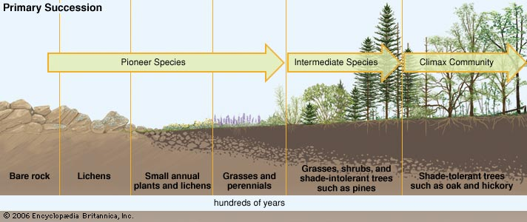
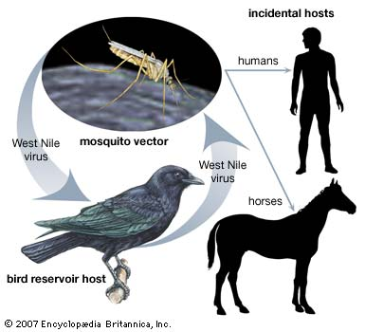
https://cdn.britannica.com/97/95197-004-7F9B8F09.jpg
https://cdn.britannica.com/96/78596-004-CBAE11F0.jpg

