Slide 1
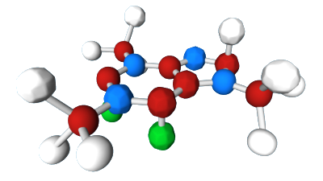
Chemistry and ap bio
Lesson 1

Slide 2
Chemistry review
Atoms are the basic component for all matter and therefore living organisms
Atoms and their bonding are what provide energy for all living organisms
Atoms are made up of sub atomic particles
Elements are substances that cannot be broken down into other substances with chemical reactions.
Ex: Carbon
Compounds are two or more elements that may combine in a fixed ratio
Ex: Carbon Dioxide, Sodium Chloride

Slide 3
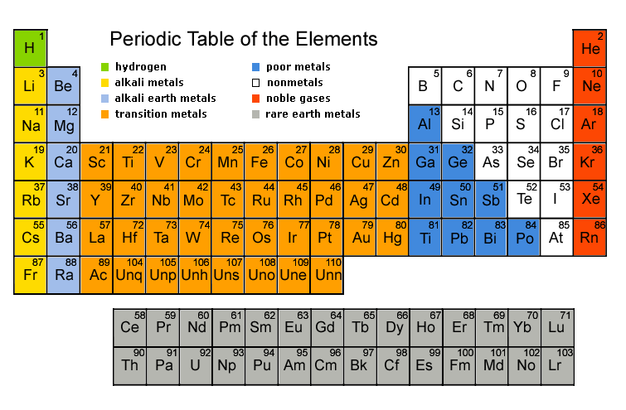
Elements
An element is a pure substance made of only one kind of atom.

Slide 4
ELEMENT:
a substance made of one type of atom.
Represented by 1 or 2 letter symbols
(ex. Na = Sodium)
Over 100 elements
4 of these make up 96% of living matter
Carbon (C)
Hydrogen (H)
Oxygen (O)
Nitrogen (N)
Four elements make up most of remaining 4%:
• phosphorus (P) • calcium (Ca) • sulfur (S) • potassium (K)

Slide 5
Subunits | Charge | Location
Protons | Positive (+) | Nucleus
Neutrons | Neutral (0) | Nucleus
Electrons | Negative (-) | Outside of Nucleus
***Atoms have an equal amount of protons and electrons***
Atomic Number: The total number of protons in an atom.
Atomic Mass: The total number of protons and neutrons in an atom.

Slide 6
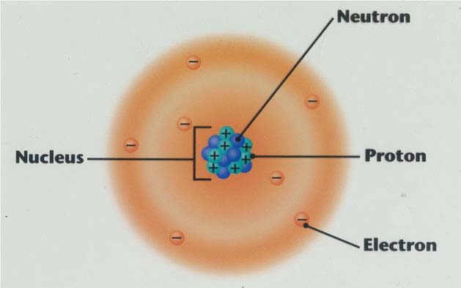
Diagram of an Atom
Atomic structure determines behavior
The number of protons in an atom determines the element
# of protons = atomic number
this also tells you # of electrons
All atoms of an element have same chemical properties all behave the same
properties don’t change
Notes:
Atom Drawing practice

Slide 7
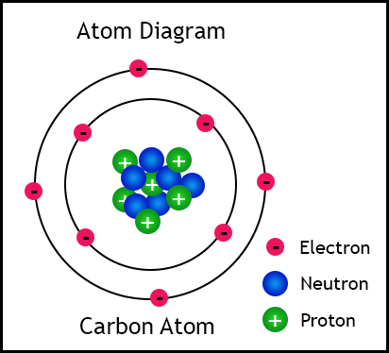
Drawing an Atom
Nucleus: center of atom, containing Protons and Neutrons
Electron Orbitals: outer shells of atoms containing electrons

Slide 8
Isotope
Radioactive form of an element that has the same number of protons, but a different number of neutrons
The normal version of carbon is Carbon 12 but the isotope version is Carbon 14. It is formed in the atmosphere due to cosmic rays being absorbed by nitrogen
Ex. Uranium 238- naturally occurring and radioactive

Slide 9
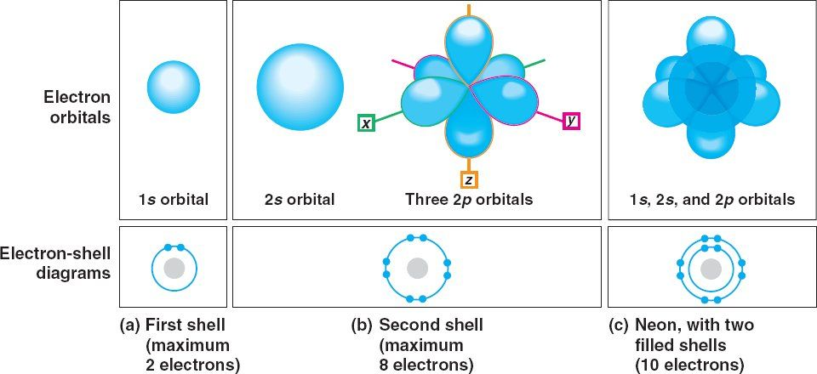
Energy and atoms
Energy: the ability to do work
Stored energy or Potential Energy of an atom is located in the electron shells
The electron shells carry different amounts of energy known as energy levels
If energy is absorbed electrons move to outer shells, if energy is lost, electrons move to inner shells

Slide 10
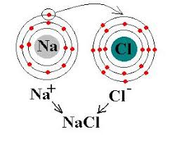
Atom behavior
Atomic behavior is determined by electron configurations
The outer most shell of an atom is the determining factor in the chemical properties of an atom
An atom with a full outer shell is stable and happy and therefore unreactive (such as the noble gases)
An atom with an incomplete outer shell will try and find another atom to bond with to become stable

Slide 11
2 Main Types of Chemical Bonds:
1. Ionic Bonds form when one or more electrons are transferred
from one atom to another
Weaker of the two types of bonds
When an atom loses an electron (-) it is then called a
positive ion (Na+)
When an atom gains an electron (-) it is then called a
negative ion (Cl-)
2. Covalent Bonds form when electrons are shared between atoms
Stronger of the two types of bonds
The electrons that are being shared now rotate around the
nucleus of both atoms.

Slide 12
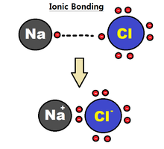
Ionic bonds
DO NOT share electrons- instead just gives electrons away from one atom to another
Forms + and – ions
Ions are charged particles
Positive ions are known as cations
Negative ions are anions
Weak bonds- such as Na⁻Cl+
Sodium chloride- dissolves easily in water

Slide 13
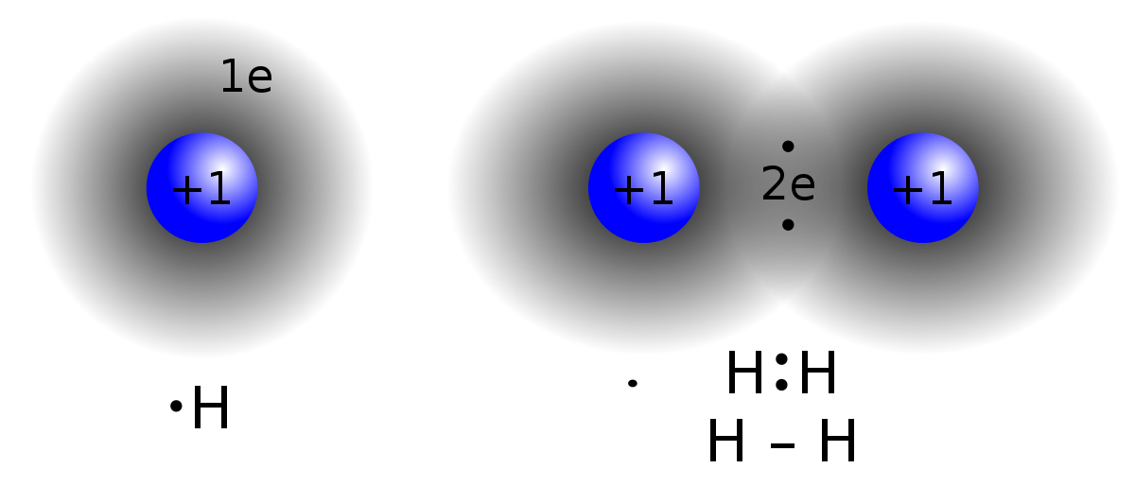
Covalent bonds
Strong bond
both atoms holding onto the electrons
Forms molecules

Slide 14
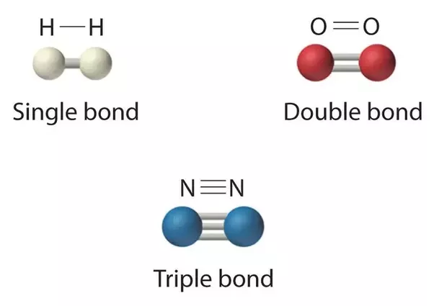
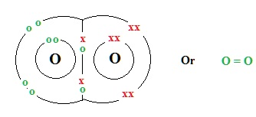
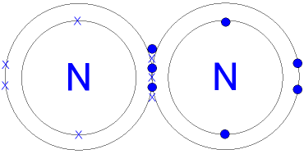
Double and Triple covalent bonds

Slide 15
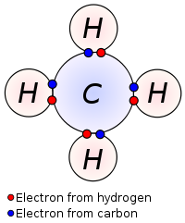
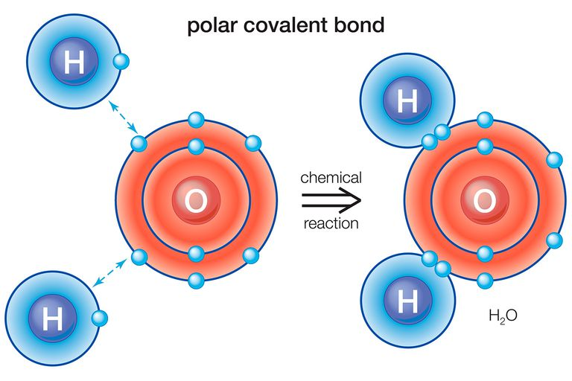
Polar vs. non polar covalent bonds
Non Polar covalent bonds share electrons equally
Polar covalent bonds do not share equally

Slide 16
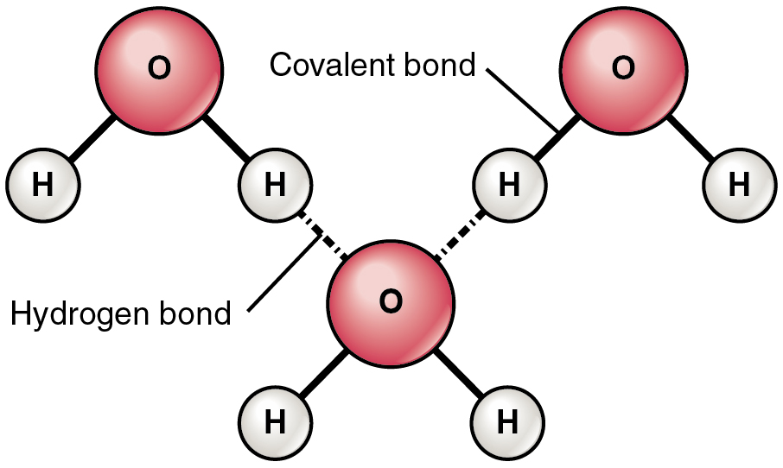
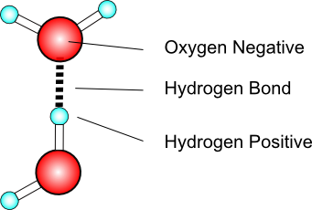
Hydrogen bonding
Hydrogen bonds are weak bonds (also found in living organisms), where hydrogen atoms share electrons (covalent bonds) with an electronegative atom that is also attracted to another electronegative atom such as H₂O or ammonia NH₃

Slide 17
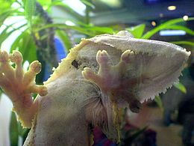
Van derWaals Forces
Interactions between nonpolar substances
Due to random variations in the electron distribution of a molecule
Very weak forces
The ability of geckos – which can hang on a glass surface using only one toe – to climb on sheer surfaces has been attributed to the van der Waals forces between these surfaces and the spatulae, or microscopic projections, which cover the hair-like setae found on their footpads.^{[18][19]} A later study suggested that capillary adhesion might play a role
Huber, Gerrit; Mantz, Hubert; Spolenak, Ralph; Mecke, Klaus; Jacobs, Karin; Gorb, Stanislav N.; Arzt, Eduard (2005). "Evidence for capillarity contributions to gecko adhesion from single spatula nanomechanical measurements". Proceedings of the National Academy of Sciences. 102 (45): 16293–6.

