Slide 1
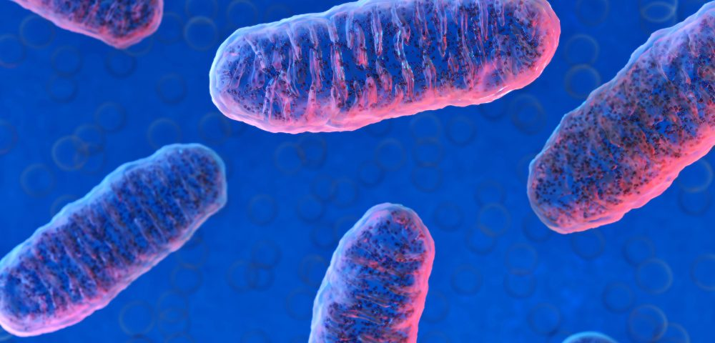
Cellular Respiration

Slide 2
LIVING ORGANISMS ARE EITHER:
__________________________________ – mainly use photosynthesis for cellular energy
__________________________________– mainly carry out cellular respiration
Autotrophs
Heterotrophs

Slide 3
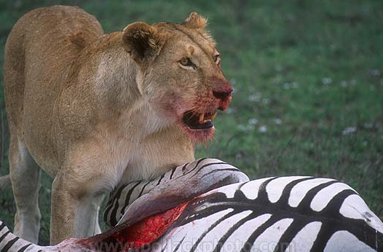
Harvesting stored energy
Energy is stored in organic molecules
carbohydrates, fats, proteins
Heterotrophs eat these organic molecules → food
digest organic molecules to get…
raw materials for synthesis
fuels for energy
controlled release of energy
“burning” fuels in a series of step-by-step enzyme-controlled reactions
Notes:
We eat to take in the fuels to make ATP which will then be used to help us build biomolecules and grow and move and… live!
heterotrophs = “fed by others”
vs.
autotrophs = “self-feeders”

Slide 4
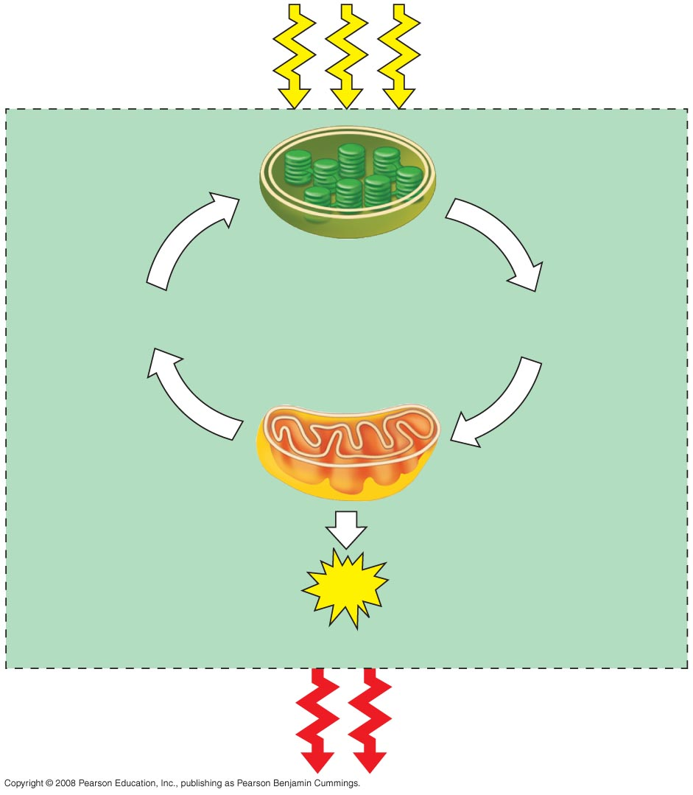
Fig. 9-2
Light
energy
ECOSYSTEM
The Flow of Energy from Sunlight to ATP
Photosynthesis
in chloroplasts
CO₂ + H₂O
Organic
molecules
+ O₂
Cellular respiration
in mitochondria
ATP
ATP powers most cellular work
Heat
energy
Notes:
Figure 9.2 Energy flow and chemical recycling in ecosystems

Slide 5
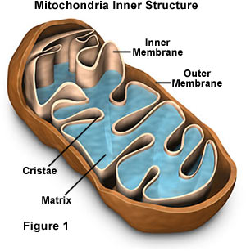
Cellular Respiration
mitochondria
Occurs in the _______________
(the power house of the cell).
Chemical energy stored in ___________ is released.
Energy made during cell respiration is used for all _________________________
Cellular Respiration either ______________ or is _______________
glucose
The matrix where 3-carbon pieces that came from carbohydrates are broken down to (CO₂ and water)
The cristae is where ATP is made
cell processes
aerobic
anaerobic

Slide 6
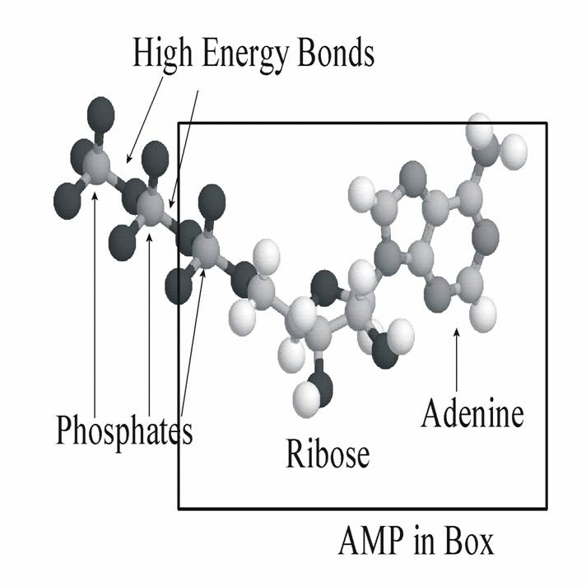
Cellular Respiration is Catabolic
Breaking down glucose releases Energy (exergonic)
Remember that energy is stored in the bonds (electrons) of compounds
Breaking down glucose releases 686 kcal per mole (- 686 kcal/mol) and happens without any extra input of energy

Slide 7
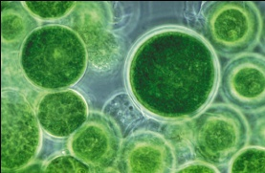
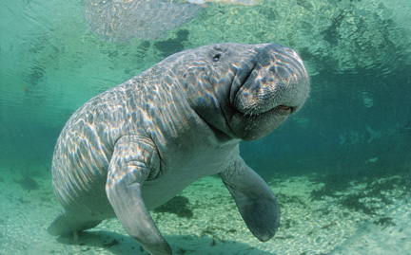
Basic Definitions You Must Know:
Aerobic Cellular Respiration: the process that releases energy by breaking down food (glucose) molecules in the presence of oxygen.
Formula: C₆H₁₂O₆ + 6O₂ → 6CO₂ + 6H₂O +~ 36 ATP
Fermentation: the partial breakdown of glucose without oxygen. It only releases a small amount of ATP.
Glycolysis: the first step of breaking down glucose—it splits glucose (6C) into 2 pyruvic acid molecules (3C each)

Slide 8
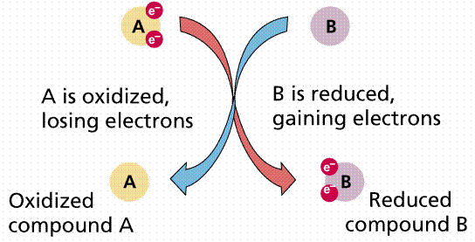
Redox Reactions of Cellular Respiration
In cellular respiration, glucose is broken down and loses its electrons in the process.
The glucose becomes oxidized and the Oxygen is reduced.
becomes oxidized
becomes reduced

Slide 9
Oxidation & reduction
Oxidation
adding O
removing H
loss of electrons
releases energy
exergonic
Reduction
removing O
adding H
gain of electrons
stores energy
endergonic
oxidation
C₆H₁₂O₆
+
6O₂
→
6CO₂
+
6H₂O
+
ATP
reduction

Slide 10
Redox reactions
Oxidation-reduction
LEO GER
OIL RIG
(adding e- reduces + charge)
Oxidation is e- loss
Reduction is e- gain
Reducing agent: e- donor
Oxidizing agent: e- acceptor
http://cwx.prenhall.com/petrucci/medialib/media_portfolio/text_images/022_REDOXREACTS1.MOV

Slide 11
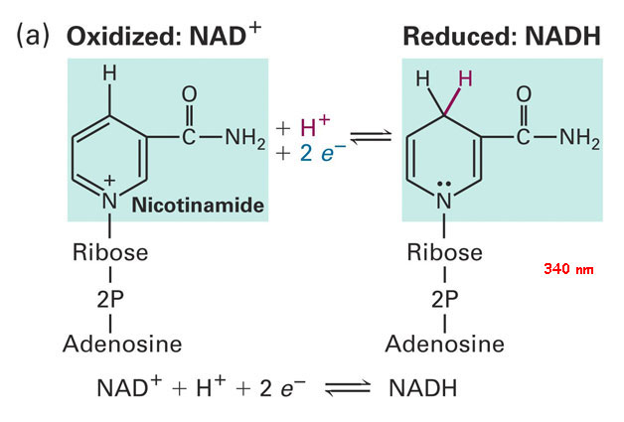
Phase 1: NAD+ as the electron transporter
To avoid burning all the of the fuel (glucose) in one shot, oxidation happens in steps.
The electrons are transported, usually with a companion proton ( H atom) with the helper NAD+ (a coenzyme used to transport electrons).
NAD+ can easily become NADH, and therefore easily losing/gaining its charge
NAD + is the oxidized electron acceptor
NADH is the reduced form

Slide 12
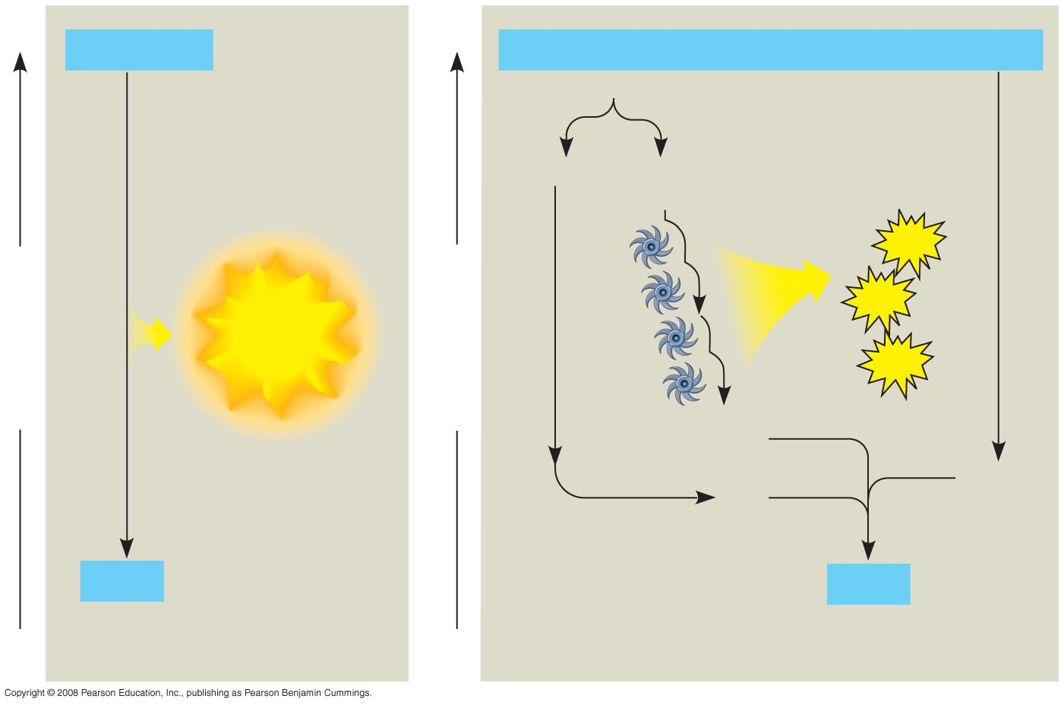
H₂ + ¹/₂ O₂
2 H
+
¹/₂ O₂
(from food via NADH)
Controlled
release of
energy for
synthesis of
ATP
2 H⁺ + 2 e–
ATP
Explosive
release of
heat and light
energy
ATP
Free energy, G
Free energy, G
Electron transport
chain
ATP
2 e–
¹/₂ O₂
2 H⁺
H₂O
H₂O
(a) Uncontrolled reaction
(b) Cellular respiration
Energy is released a little at a time, rather than one big explosive reaction:
Notes:
Figure 9.5 An introduction to electron transport chains

Slide 13
CHECK FOR UNDERSTANDING
How do electrons move during cell respiration?
Food/Fuel → digestion/enzymes → GLUCOSE→ NADH →Electron Transport Chain → Oxygen

Slide 14
Cellular Respiration
Cellular respiration has three stages.
Glycolysis The first stage of cellular respiration is called glycolysis.
Pyruvate Oxidation and the Citric Acid Cycle.
Oxidative Phosphorylation
Notes:
12

Slide 15
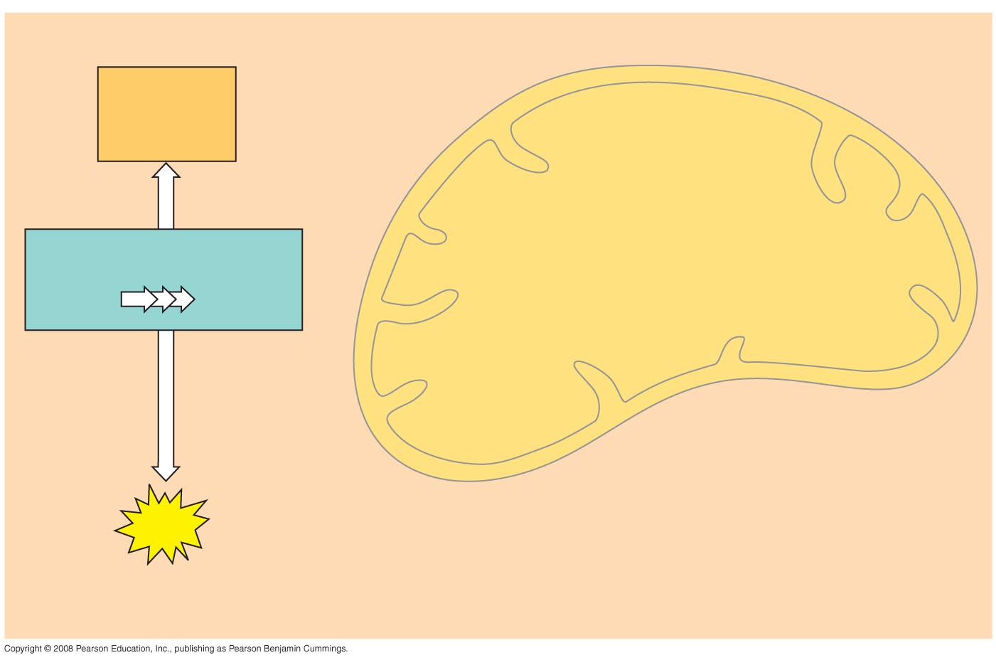
An Overview of Cellular Respiration–Part 1
Electrons
carried
via NADH
Glycolysis
Glucose
Pyruvate
Cytosol
ATP
Substrate-level
phosphorylation
Notes:
Figure 9.6 An overview of cellular respiration

Slide 16
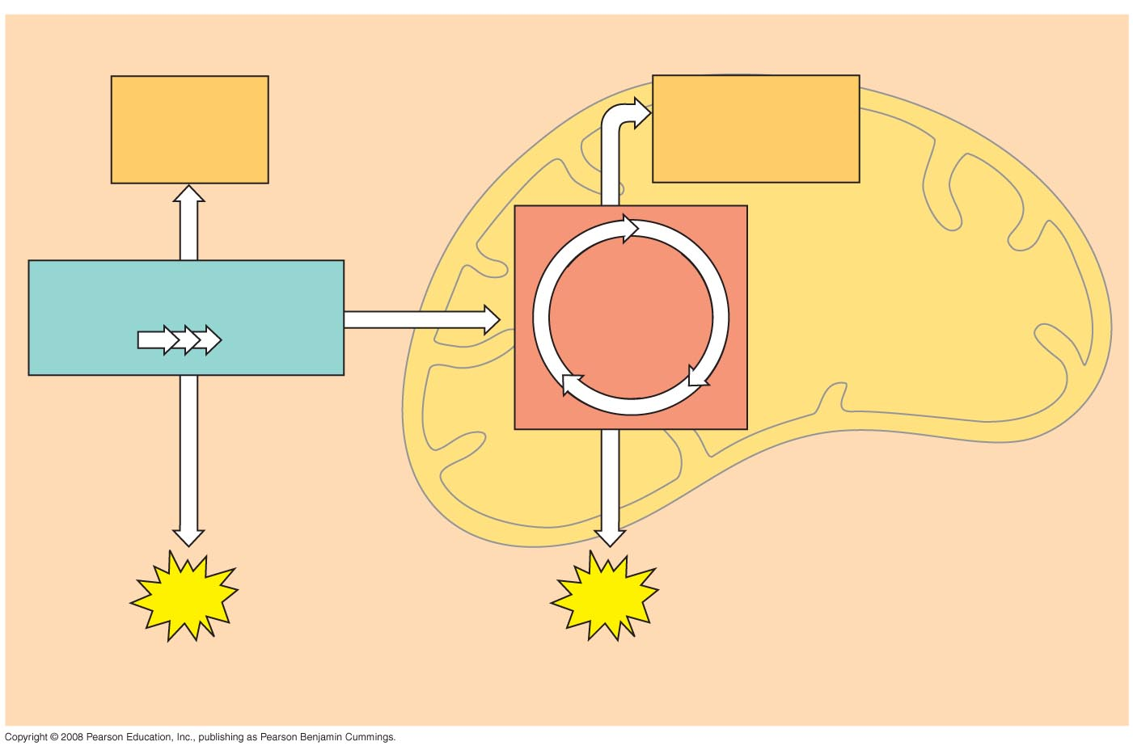
An Overview of Cellular Respiration—Part 2
Electrons
carried
via NADH
Electrons carried
via NADH and
FADH₂
Glycolysis
Citric
acid
cycle
Glucose
Pyruvate
Mitochondrion
Cytosol
ATP
ATP
Substrate-level
phosphorylation
Substrate-level
phosphorylation
Notes:
Figure 9.6 An overview of cellular respiration

Slide 17
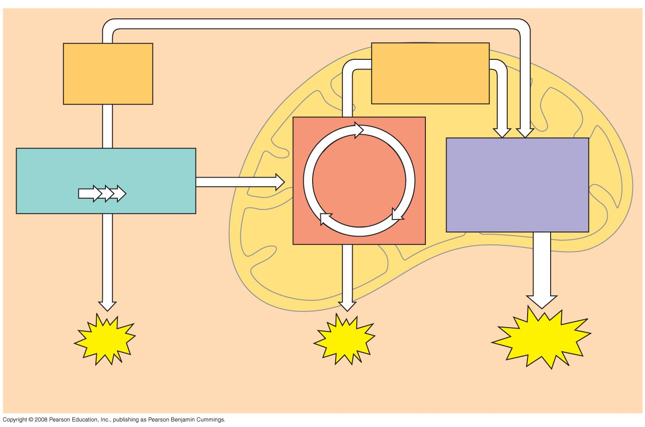
An Overview of Cellular Respiration—Part 3
Electrons
carried
via NADH
Electrons carried
via NADH and
FADH₂
Oxidative
phosphorylation:
electron transport
and
chemiosmosis
Glycolysis
Citric
acid
cycle
Glucose
Pyruvate
Mitochondrion
Cytosol
ATP
ATP
ATP
Substrate-level
phosphorylation
Substrate-level
phosphorylation
Oxidative
phosphorylation
Notes:
Figure 9.6 An overview of cellular respiration

Slide 18
Glycoloysis
Cells use 2 ATP (INVESTMENT PHASE) to add phosphates to the glucose causing the glucose to become phosphorylated and therefore charged
The result is a charged glucose + 2ADP

Slide 19
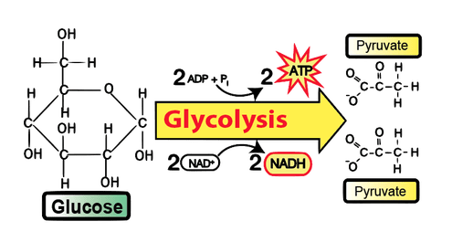

Slide 20
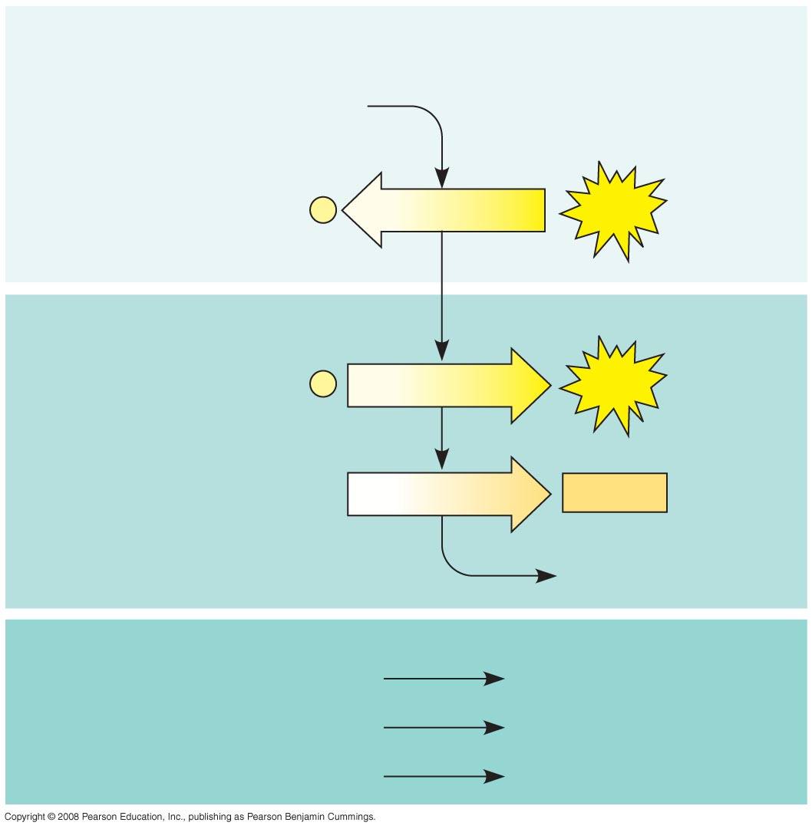
Energy investment phase
Glycolysis
Glucose
2 ADP + 2
P
2 ATP
used
Energy payoff phase
4 ADP + 4
P
4 ATP
formed
2 NAD⁺ + 4 e– + 4 H⁺
2 NADH
+ 2 H⁺
2 Pyruvate + 2 H₂O
Net
Glucose
2 Pyruvate + 2 H₂O
4 ATP formed – 2 ATP used
2 ATP
2 NAD⁺ + 4 e– + 4 H⁺
2 NADH + 2 H⁺
Notes:
Figure 9.8 The energy input and output of glycolysis

Slide 21
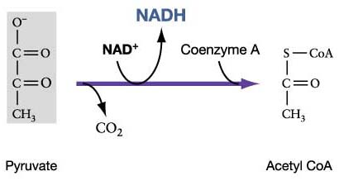
Where is the energy?
Most of the energy is still stored in the pyruvate molecules.
Aerobic Respiration in Eukaryotic cells, the pyruvate enters the mitochondria where the oxidation of glucose is complete
The pyruvate enters the mitochondria through active transport and then is converted to Acetyl Coenzyme A or acetyl CoA
Aerobic Respiration in Prokaryotes the oxidation of glucose occurs in the cytosol

Slide 22
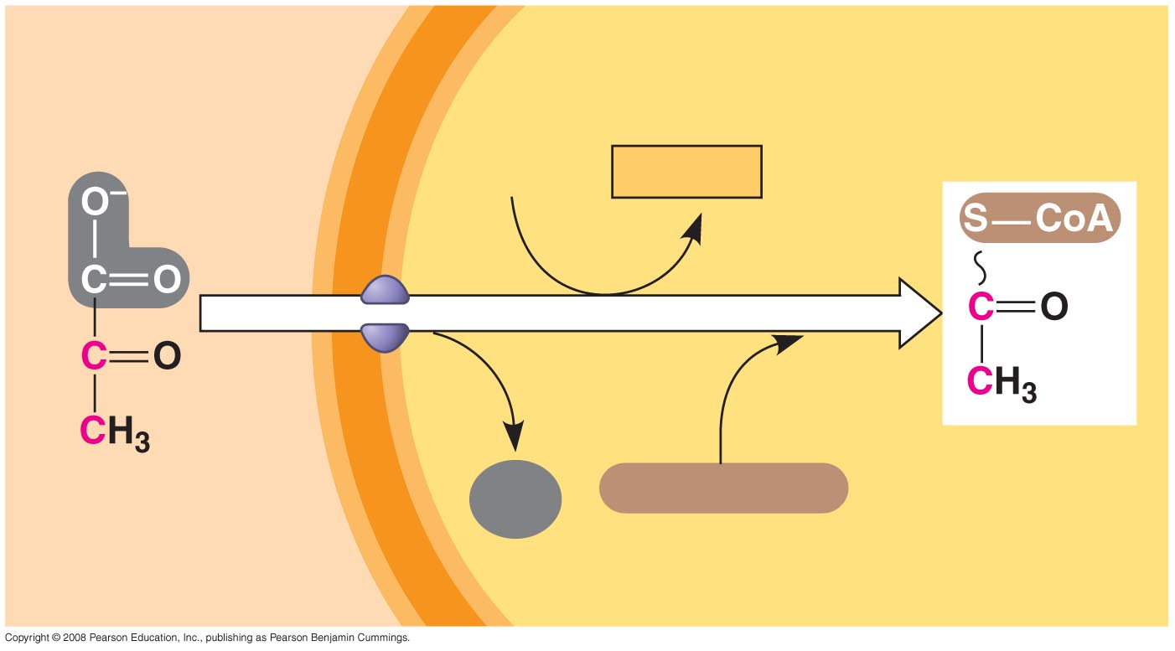
CYTOSOL
MITOCHONDRION
NAD⁺
NADH
+ H⁺
2
1
3
Acetyl CoA
Pyruvate
CO₂
Coenzyme A
Transport protein
Converting Pyruvate to Acetyl CoA:
Notes:
Figure 9.10 Conversion of pyruvate to acetyl CoA, the junction between glycolysis and the citric acid cycle

Slide 23
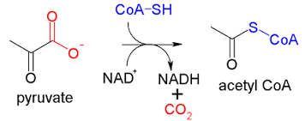
How to get to step 2- Citric acid cycle
The carboxyl group of the pyruvate is removed and gives off carbon dioxide CO₂
The remaining two carbon sections are then oxidized forming acetate (ion of acetic acid)
CoA – contains sulfur (from Vitamin B) and connects to the acetate forming Acetyl CoA.

Slide 25
The Citric Acid Cycle
The Citric Acid cycle (also called the Krebs Cycle) has eight steps, each catalyzed by a specific enzyme
The acetyl group of acetyl CoA joins the cycle by combining with oxaloacetate, forming citrate (Citric Acid).
The next seven steps decompose the citrate (Citric Acid) back to oxaloacetate, making the process a cycle
Citric Acid
Oxaloacetate + Acetyl CoA

Slide 26
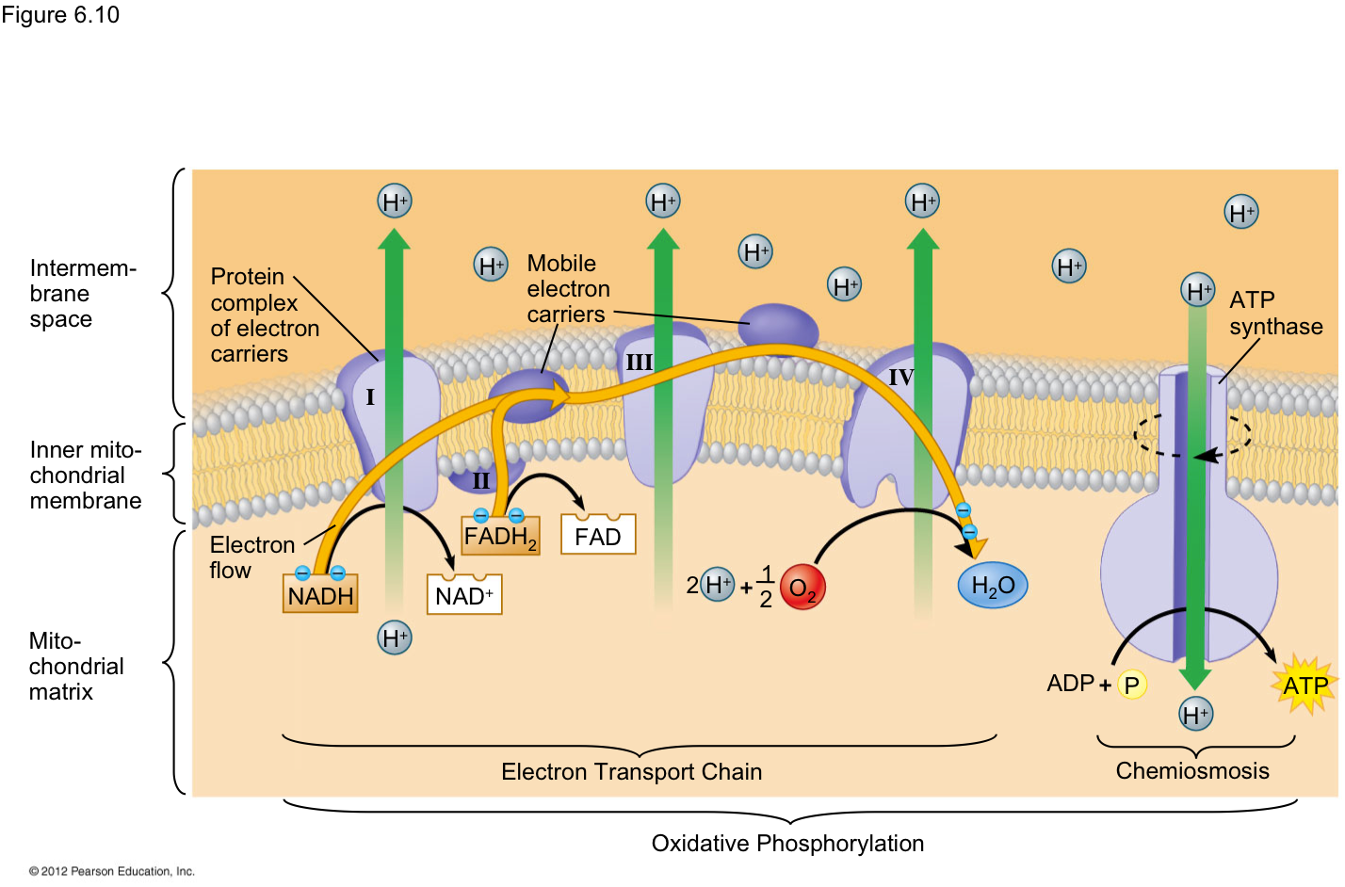
Oxidative Phosphorylation
We have 4 ATP so far from Glycolysis and the Citric Acid Cycle
Electron transport happens in the cristae of the mitochondria

Slide 27
Electron transport chain
A series of redox reactions with the help of proteins, hydrophobic electron carriers, cytochromes.
Electrons also come from FADH₂
There is no ATP made directly during the release of energy from electrons

Slide 28
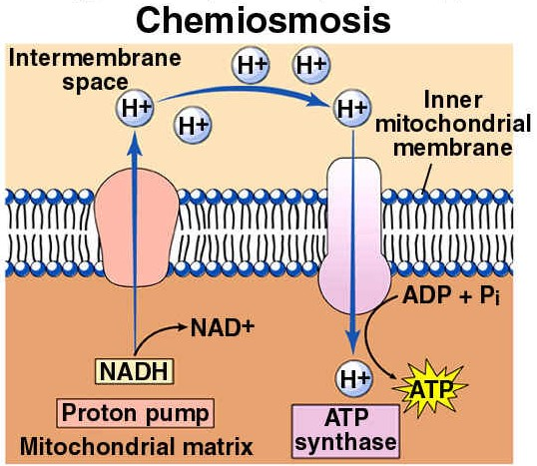
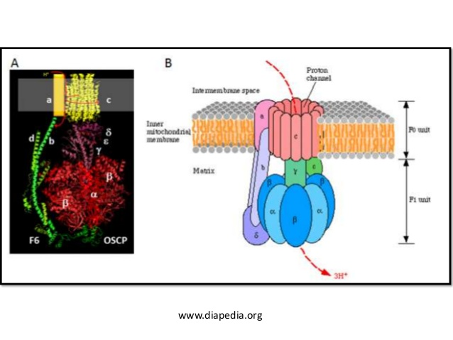
Chemiosmosis
ATP synthase protein, with the energy from H ions activate catalytic sites that synthesis ATP from ADP and Phosphate
ATP Synthase is a large polypeptide with multiple bonding sites,

