Slide 1
Cell Metabolism
Summary of chemical reactions in a cell

Slide 2
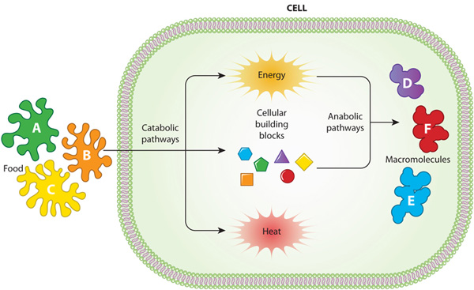
Metabolic Pathways
One molecule follows a pathway catalyzed by specific enzymes to result in a certain product

Slide 3
Energy
Kinetic Energy: energy of motion
Thermal Energy: kinetic energy associated with random movement of molecules
Heat: The transfer of thermal energy
Potential Energy: non-kinetic energy
Chemical Energy: potential energy stored in bonds

Slide 4
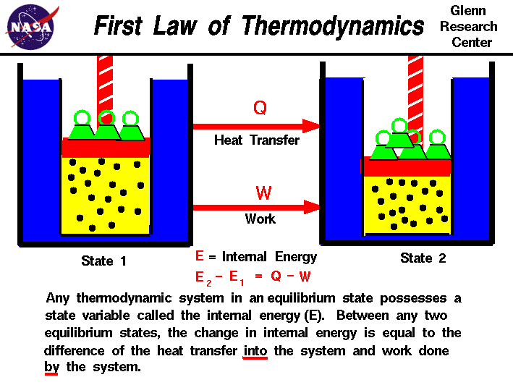
Thermodynamics

Slide 6
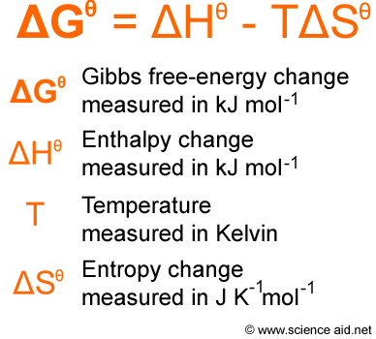
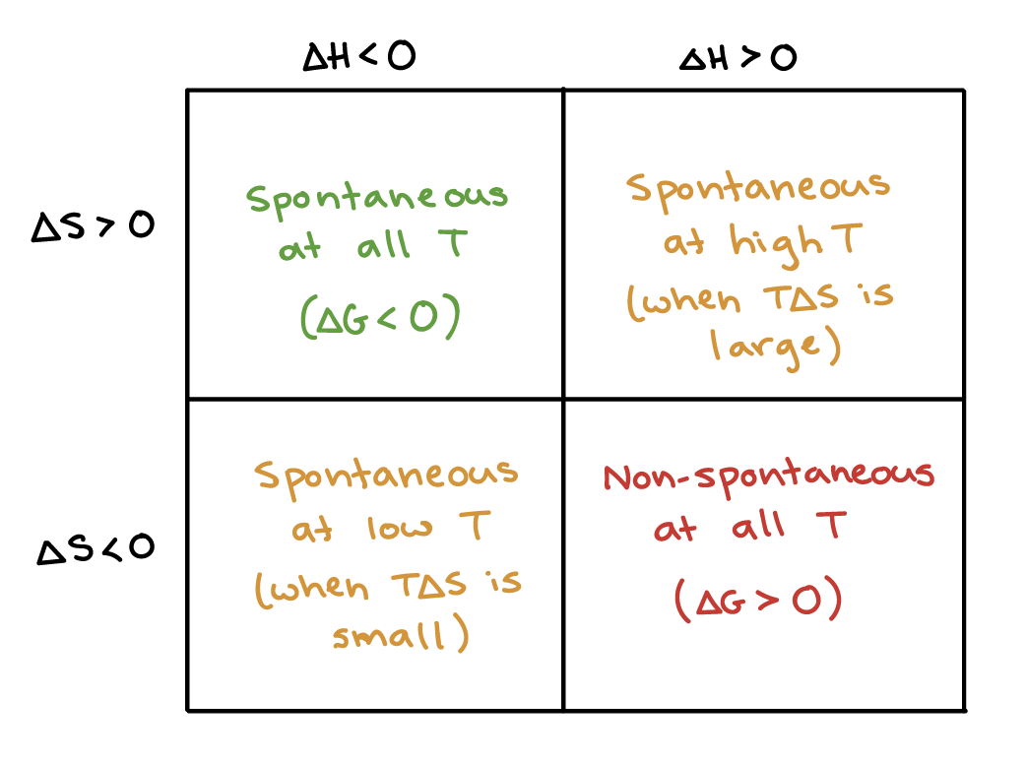

Slide 7
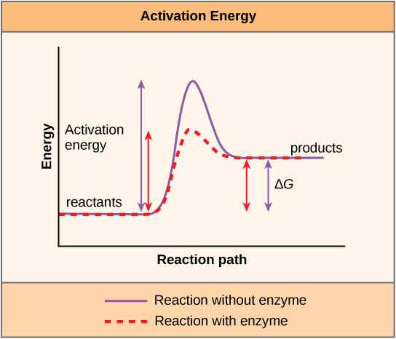

Slide 8
Exergonic
Endergonic
Releases Free Energy
G decreases
Change in G is negative
Spontaneous
Ex: Cellular Respiration
Absorbs Free Energy
G increases
Change in G is positive
Requires Energy

Slide 10
Cellular Work
Cells create polymers through endergonic reactions
(CHEMICAL WORK)
Cells pump substances across membranes
(TRANSPORT WORK)
Cells contract cilia or muscle cells
(MECHANICAL WORK)

Slide 11
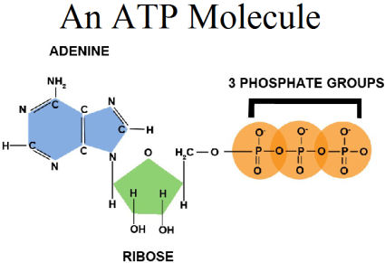
ATP

Slide 12
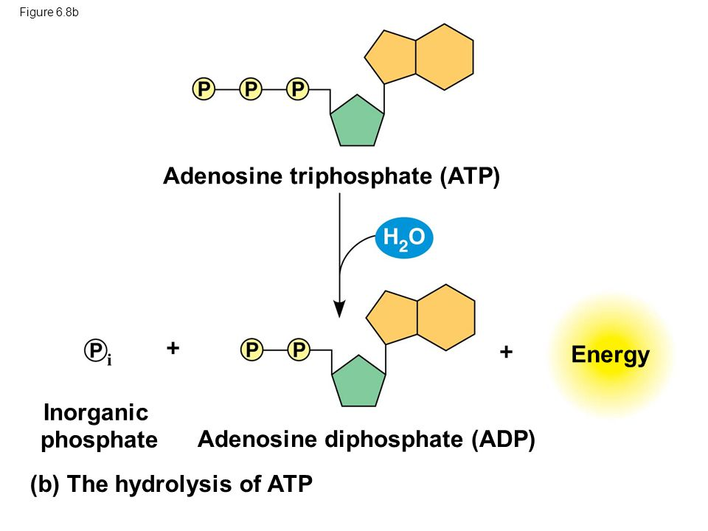
Hydrolysis
Bonds between phosphates of ATP are broken with the addition of water
Hydrolysis releases energy in the form of a chemical change
Bonds are not strong- the energy comes from the ATP and water molecules themselves

Slide 13
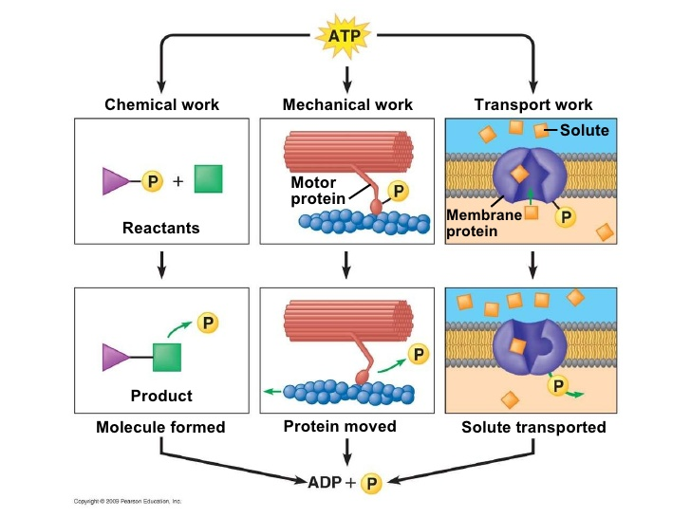

Slide 14
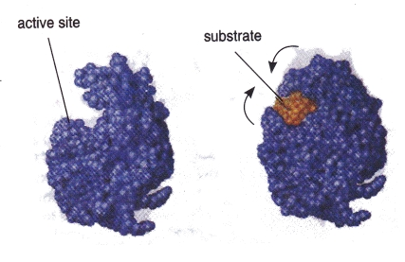
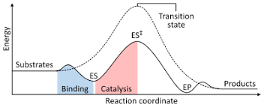
Enzymes

Slide 15
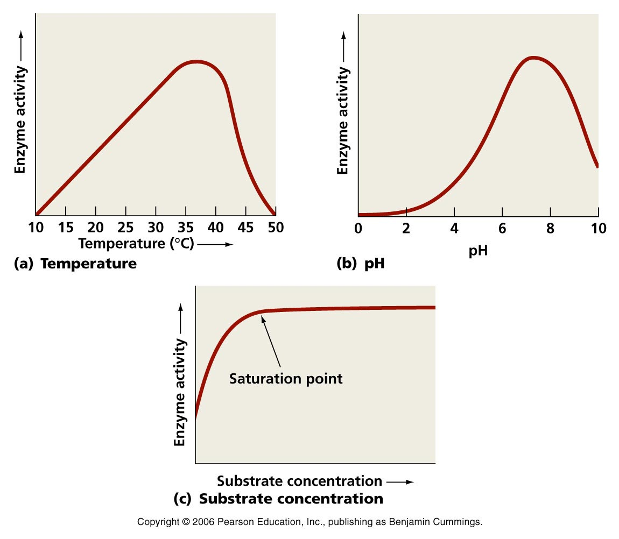
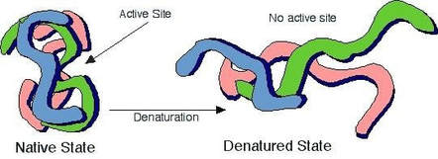

Slide 16
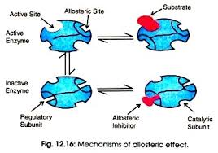
Allosteric Activators and Inhibitors
Allosteric regulation: one part of the protein binding region controls another area o the protein
The enzyme will function in different forms depending on whether an activator or inhibitor is bound to the protein

Slide 17
