Slide 1
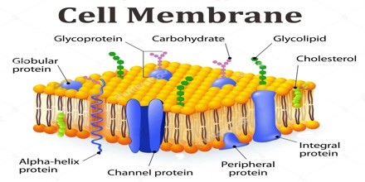

Slide 2
Eukaryote Relatedness
Structural evidence supports the relatedness of all eukaryotes.
Cytoskeleton
Membrane-bound organelles
mitochondria and/or chloroplasts WITH circular DNA
Linear chromosomes
Chromatin (DNA + Protein)
Endomembrane systems, including the nuclear envelope

Slide 3
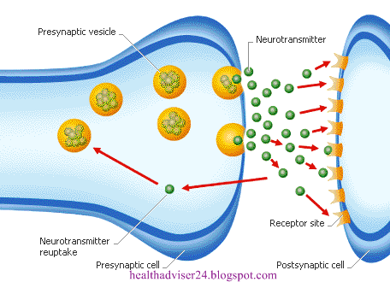
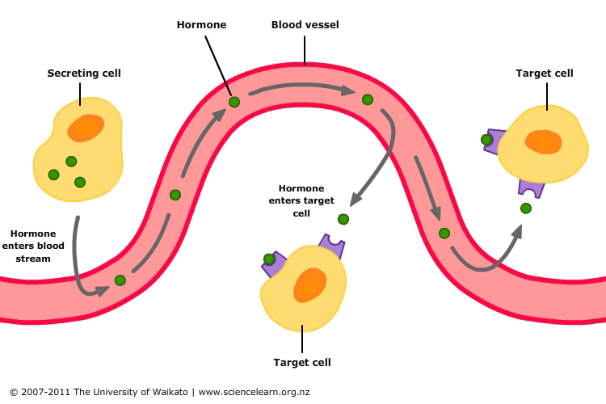
Four Functions of the Plasma Membrane
Containment and separation of cell interior
Material exchange – selectively permeable
Information detection
Receptors
Glycoproteins
Glycolipids
Movement
Proteins pull or pinch membrane for cells to move
Pseudopods – cytoplasmic extensions for movement/ingestion in white blood cells

Slide 4
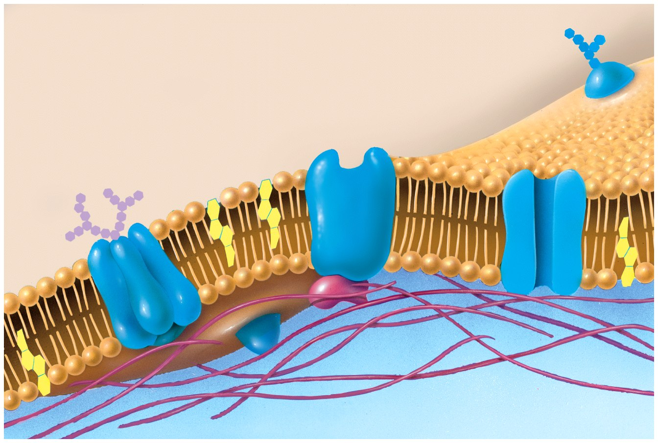
extracellular fluid (outside)
carbohydrate
receptor
protein
glycoprotein
phospholipid
bilayer
protein
recognition protein
binding
site
transport
protein
phospholipid
cholesterol
pore
protein filaments
cytosol (inside)
Figure 5-1 Biology: Life on Earth 8/e ©2008 Pearson Prentice Hall, Inc.
Notes:
FIGURE 5-1 The plasma membrane
The plasma membrane is a bilayer of phospholipids that form a fluid matrix in which various proteins (blue) are embedded. Many proteins have carbohydrates attached to them, forming glycoproteins. Three of the five major types of membrane proteins are illustrated here: recognition, receptor, and transport proteins.

Slide 5
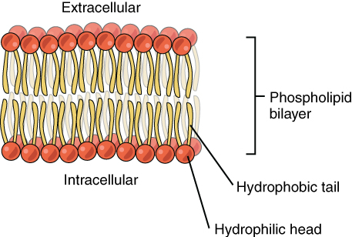

Slide 6
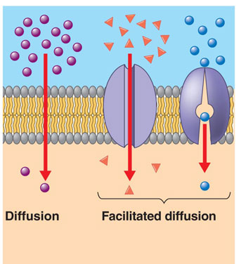
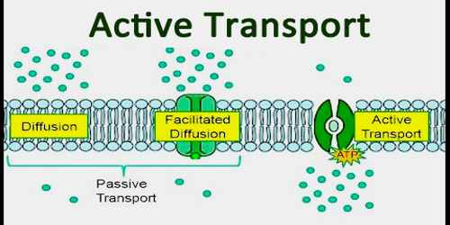
Types of Movement

Slide 7
Passive Transport (NO ENERGY)
Does not require the input of metabolic energy; the net movement of molecules is from high concentration to low concentration.
Plays a primary role in the import of resources and the export of wastes.
Diffusion: movement of material from high to low concentration across the lipid bilayer

Slide 8
Diffusion
Movement of molecules from an area of high concentration to an area of lower concentration.
Factors that affect the rate of diffusion: size of molecules, size of pores in membrane, temperature, pressure, and concentration.

Slide 9
Selective permeability is a direct consequence of membrane structure
Substances that freely pass across the lipid bilayer:
Small uncharged polar molecules (urea)
Small nonpolar molecules, such as N2 , O2, and CO2 across the.

Slide 10
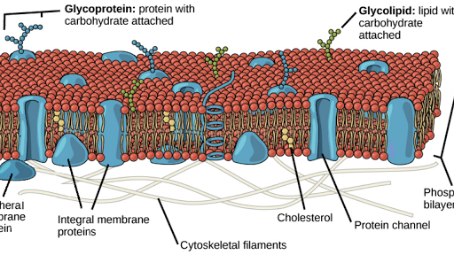

Slide 11
Facilitated Diffusion:
diffusion of charged and polar molecules through a membrane
Uses protein channels or carrier proteins without energy expenditure
Hydrogen ion channels, potassium ion channels, glucose carriers
Osmosis:
Diffusion of water from high concentration to low concentration
Water molecules move DOWN their osmotic potential gradient
Water potential is expressed as a negative value
Lower potential (more negative) is more concentrated
Water flows from a high potential (less negative) to a lower potential (more negative)
solution “A” Ψ = -2.55 solution “B” Ψ = -7.82
Which Solution will GAIN water from the other solution?
“B”

Slide 12
Facilitated Diffusion
Substances that require embedded channel proteins
Hydrophilic substances such as large polar molecules, proteins, and all ions (H⁺ Na ⁺ OH⁻ )
Ions attract water and become hydrated (and large)
Water moves across membranes and through channel proteins called aquaporins.

Slide 13
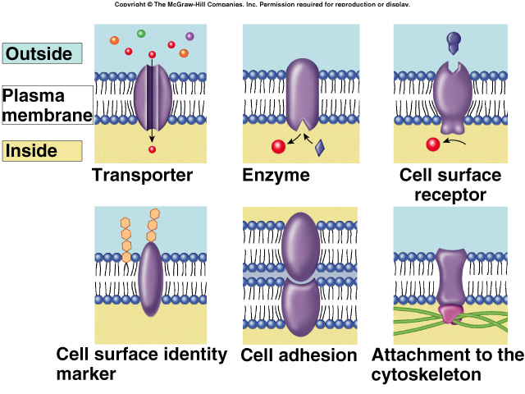
Plasma Membrane Proteins
PROTEINS CAN MOVE IN THE MEMBRANE, TOO!

Slide 14
Membrane transport proteins
Channel protein
Form a channel or pore to permit transport of substances based upon size and charge
Carrier protein
Bind to molecules and change shape to transport across the membrane
Specific to shape and chemical properties of molecules being transported
Many channel and carrier proteins are ligand-gated
A specific molecule called a ligand must bind to the protein to permit passage of the molecules being transported
A ligand is a molecule that binds to a protein
Example: neurotransmitters

Slide 15
Channel protein

Slide 16
Carrier protein

Slide 17
Cell recognition protein

Slide 18
Receptor protein

Slide 19
Enzymatic protein
G-protein animation 3
G-PROTEIN ANIMATION 2
Example of Enzymatic activity associated with a membrane:
G-protein cascade

Slide 20
Permeability of the Cell Membrane-
Differentially Permeable

Slide 21
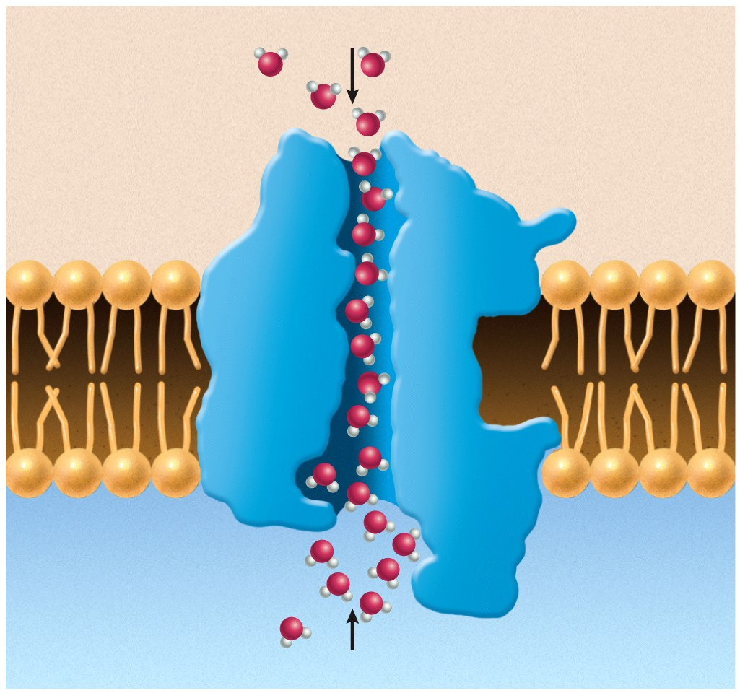
extracellular
fluid
water
aquaporin
channel
cytosol
water
Figure E5-2b Biology: Life on Earth 8/e ©2008 Pearson Prentice Hall, Inc.
Notes:
FIGURE E5-2b Function and structure of aquaporin
(b) Aquaporin consists of proteins that form a narrow pore (seen here in cross-section) in which charged amino acids interact with water molecules, promoting their movement through in either direction while repelling other substances.

Slide 22
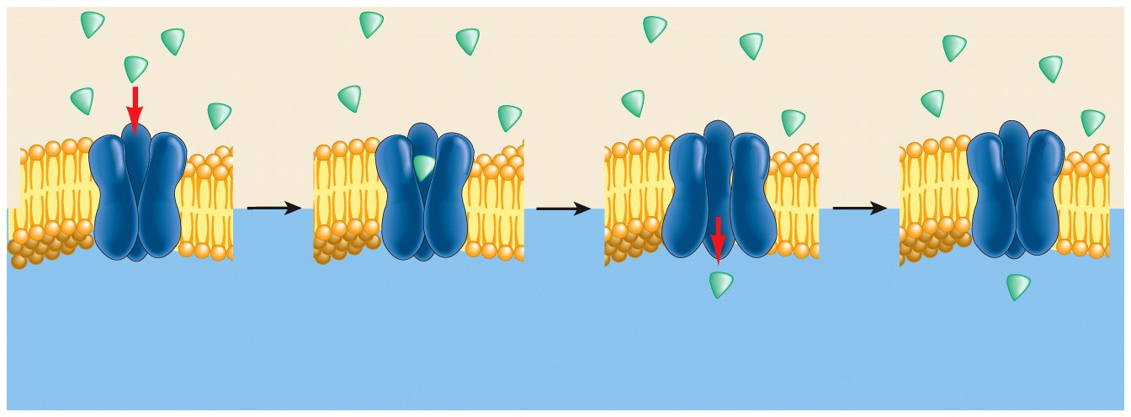
(c) Facilitated diffusion through a carrier protein
carrier
protein
amino acids,
sugars, small
proteins
(extracellular fluid)
(cytosol)
1 Carrier protein
has binding site
for molecule.
2 Molecule
enters binding
site.
3 Carrier protein
changes shape,
transporting
molecule across
membrane.
4 Carrier protein
resumes original
shape.
Figure 5-7c Biology: Life on Earth 8/e ©2008 Pearson Prentice Hall, Inc.
Notes:
FIGURE 5-7c Diffusion through the plasma membrane
(c) Facilitated diffusion through a carrier protein.

Slide 23
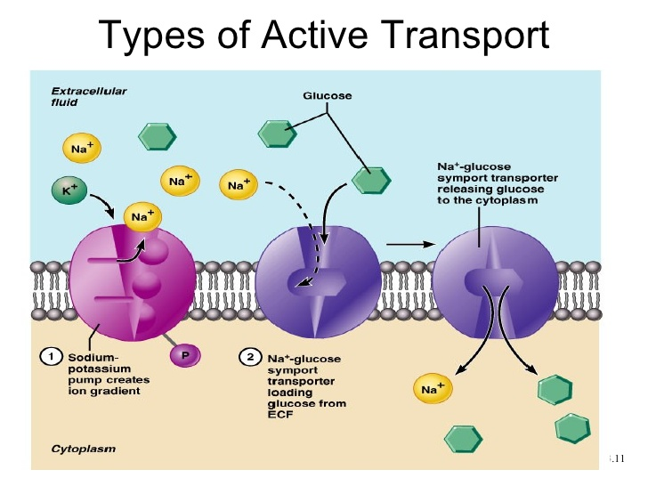
Active Transport

Slide 24
Requires free energy to move molecules from regions of low concentration to regions of high concentration.
Move against the gradient
Free energy (often provided by ATP) is used by proteins embedded in the membrane to “move” molecules and/or ions across the membrane and to establish and maintain concentration gradients.
Membrane proteins are necessary for active transport.
Sodium Potassium Pump (Na⁺/K⁺)
Pumps 3 sodium ions out and 2 potassium ions in
Results in a standing charge difference across plasma membrane
ALL cells have Na⁺/K⁺ pumps
Why do we need a charge difference?
The potential energy in the charge difference is used to move other molecules across the membrane
Glucose transport

Slide 25
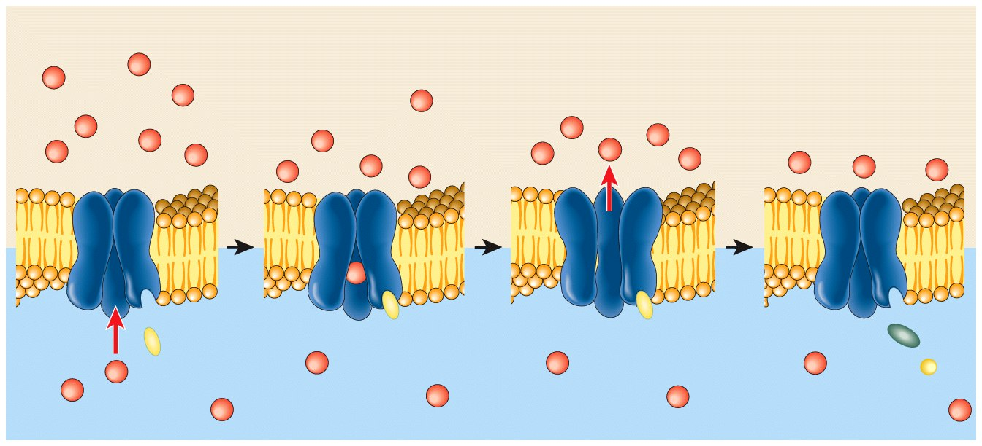
1 The transport protein
binds both ATP and Ca²⁺.
2 Energy from ATP
Changes the shape of
the transport protein
and moves the ion
across the membrane.
3 The protein releases
the ion and the remnants
of ATP (ADP and P) and
closes.
(extracellular fluid)
ATP
ADP
ATP
Ca²⁺
(cytosol)
P
recognition
site
ATP
binding
site
Figure 5-12 Biology: Life on Earth 8/e ©2008 Pearson Prentice Hall, Inc.
Notes:
FIGURE 5-12 Active transport
Active transport uses cellular energy to move molecules across the plasma membrane against a concentration gradient. A transport protein (blue) has an ATP binding site and a recognition site for the molecules to be transported, in this case calcium ions (Ca²⁺)Notice that when ATP donates its energy, it loses its third phosphate group and becomes ADP + P.

Slide 26
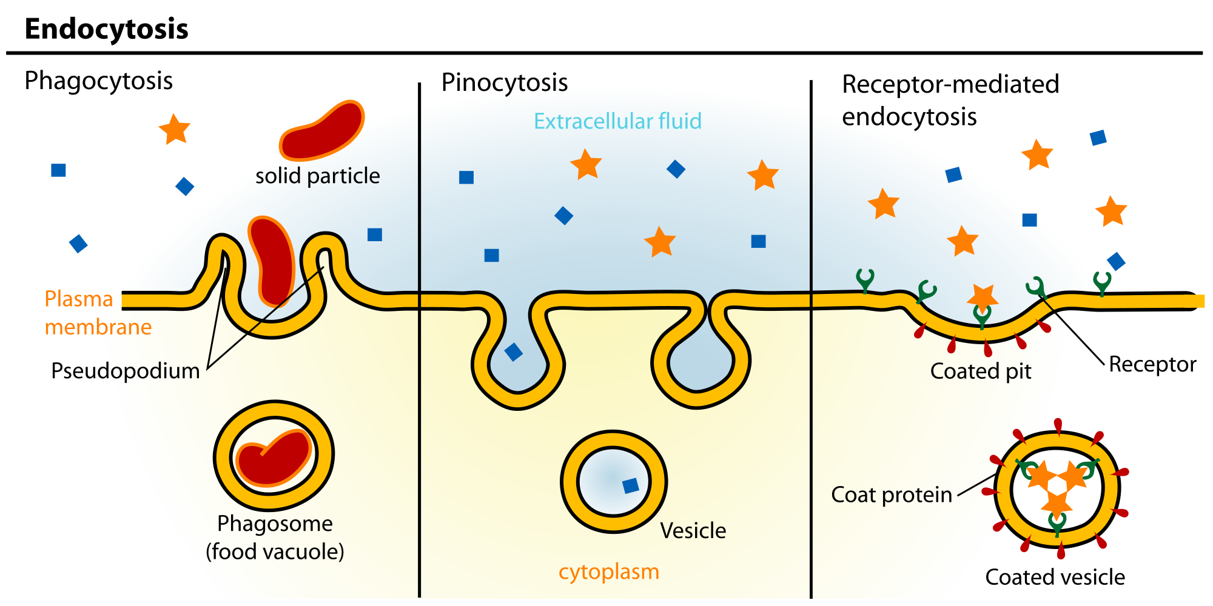

Slide 27
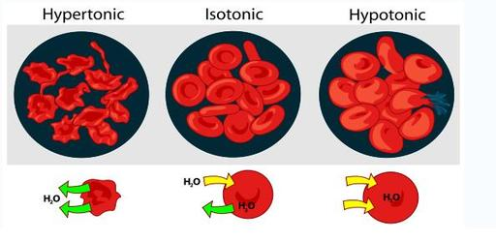
Cytoplasm is a solution of water and solids
(solutes dissolved in the water).
Water moves into and out of cells because of the different concentrations of the solutes.
Different kinds of cells react differently depending on the solution they are in.
Below are examples of red blood cells in different types of solutions and shows what happened to the red blood cells.

Slide 28
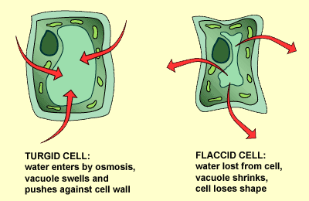
PLANT CELLS
Hypotonic Solution
Hypertonic
Solution
Turgor Pressure builds in the cell and causes osmosis to stop
because of the rigid cell wall.
Plants will wilt when cells
lose water through osmosis.

Slide 29
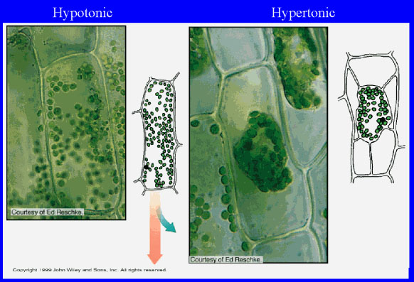
ELODEA CELLS
As viewed under the microscope

