Slide 1
Cell cycle
Chapter 12

Slide 2
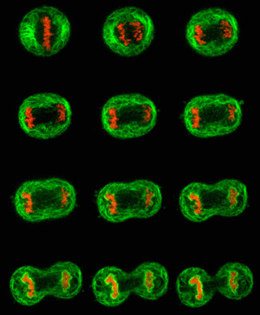

Slide 3
cell division
Prokaryotic and Single cellular Eukaryotic Reproduction
Growth and Development post fertilization
Tissue Repair

Slide 4
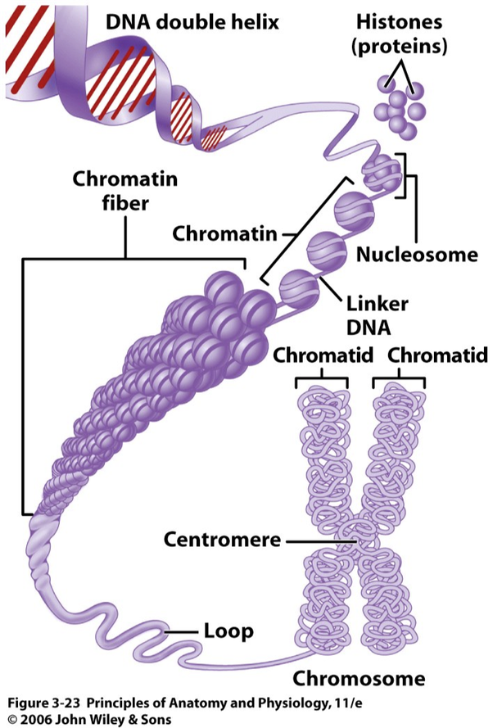
Cellular Components
Chromosomes made up of DNA and proteins (which have codes that are genes) throughout the molecule
Chromatin- proteins and DNA that make chromosomes
Genome- cell’s genetic information
Chromatids - replicated strands of a chromosome
Centromere -narrowing “waist” of sister chromatids

Slide 5
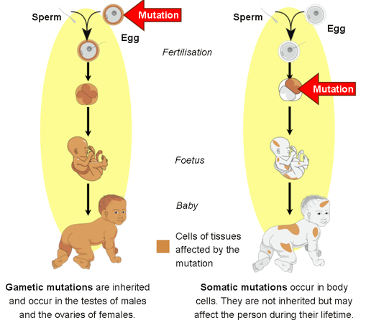
Cell Types
Somatic: body cells – Diploid (full number of chromosomes)
Gamete: sex cells
Haploid (half the number of chromosomes)
https://www.pathwayz.org/Node/Image/url/aHR0cHM6Ly9pLmltZ3VyLmNvbS9rZEVqWFRPLnBuZw==

Slide 6
Cell cycle
The cell cycle is a complex set of stages that is highly regulated with checkpoints, which determine the ultimate fate of the cell.
1. Interphase consists of three phases:
    growth
    synthesis of DNA
    preparation for mitosis
2. The cell cycle is directed by internal controls
or checkpoints.
    Internal and external signals provide stop-and-go signs at the checkpoints.

Slide 7
~ 10 trillion cells in body all from one cell by mitosis.
  Erythrocytes (RBC) made one million per second
Cell division (mitosis)
  Single celled = more individuals
  Multi-celled = growth, differentiation and repair.
2 basic function
  Duplicate the cell
  Ensure daughter cell has complete copy DNA
The basic steps are
  Duplicate the DNA
  Divide the chromosomes into two complete sets
  Divide the cell into two daughter cells
Same for Prokaryotes and Eukaryotes

Slide 8
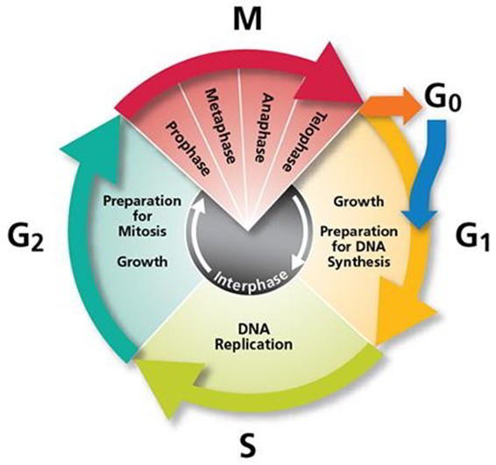
https://www.earthslab.com/wp-content/uploads/2017/01/011417_1550_TheCellCycl1.jpg

Slide 9
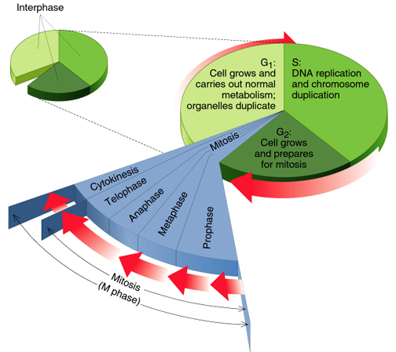

Slide 10
Cell cycle
Cell has a “life cycle”
cell is formed from
a mitotic division
cell grows & matures
to divide again
cell grows & matures
to never divide again
G₁, S, G₂, M
liver cells
G₁→G₀
epithelial cells,
blood cells,
stem cells
brain / nerve cells
muscle cells
Notes:
10

Slide 11
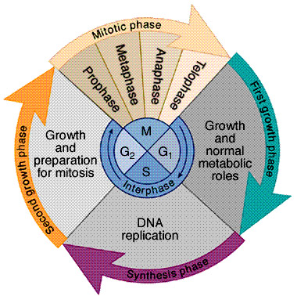
Interphase (longest stage of cell’s life)
Divided into 3 phases:
  G₁ = 1st Gap
    cell doing its “everyday job”
    cell grows
  S = DNA Synthesis
    copies chromosomes
  G₂ = 2nd Gap
    prepares for division
    cell grows (more)
    produces organelles,
    proteins, membranes
G₀
signal to divide
Notes:
11

Slide 12
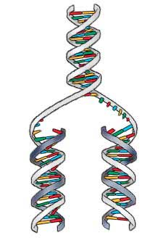
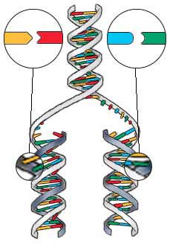
S-Phase of Interphase
Dividing cell replicates DNA
  must separate DNA copies correctly to 2 daughter cells
    human cell duplicates ~3 meters DNA
    each daughter cell gets complete
    identical copy
    error rate = ~1 per 100 million bases
      3 billion base pairs in mammalian genome
      ~30 errors per cell cycle
        mutations (to somatic cells)

Slide 13
Cell Cycle regulation
Mitosis-promoting factor (MPF)
Action of platelet-derived growth factor (PDGF)
Cancer results from disruptions in cell cycle control
Cyclins and cyclin-dependent kinases control the cell cycle.

Slide 14
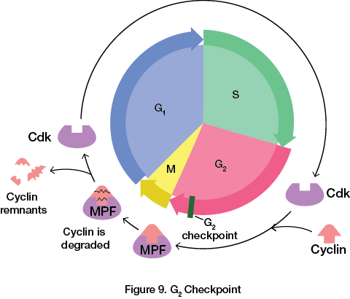
https://www.flinnprep.com/Assets/images/The_Cell_Cycle_Figure_9A.png

