Slide 1
Cell communication

Slide 2
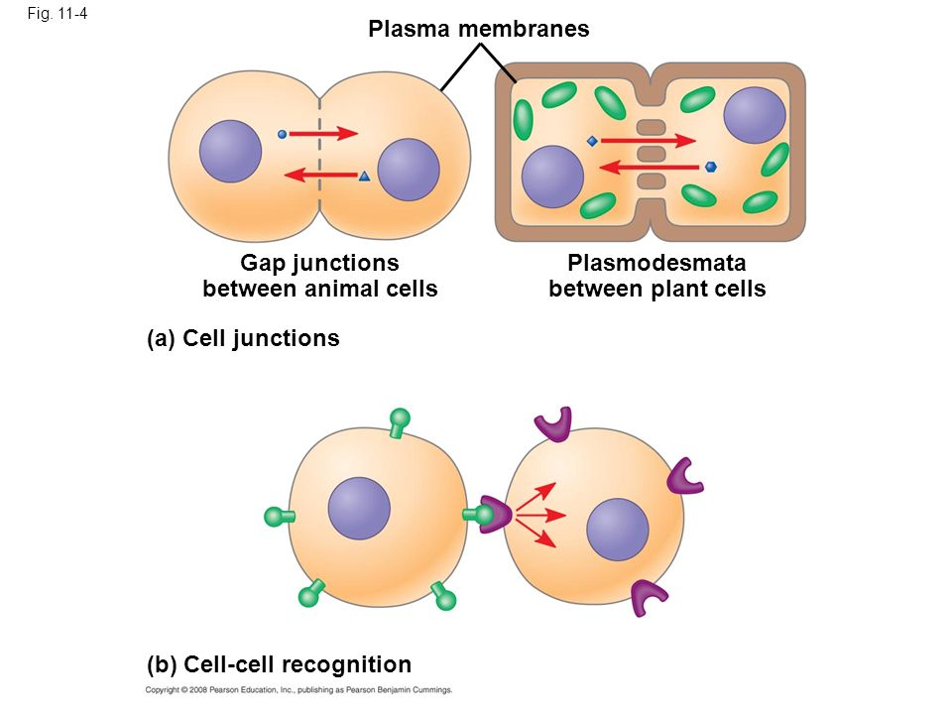
Cell Communication Conserved in Evolution
Shape specific signal molecules and receptors
Ex mating of yeast
Signal Transduction Pathway
series of steps that changes the cell
Found in prokaryotes, eukaryotes, yeast, bacteria
Quorum Sensing in bacteria- Biofilms
Long distance signaling in multicellular organisms
EX: Paracrine, synaptic and endocrine signals

Slide 3
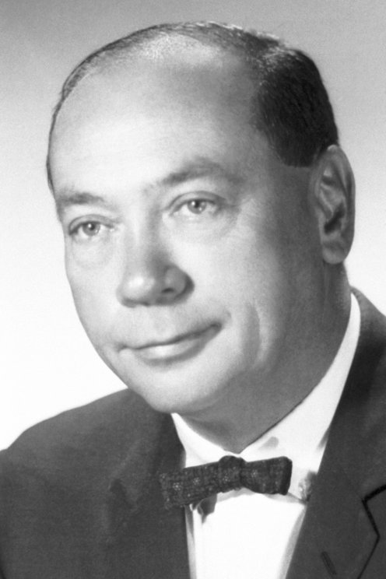
Stages of Cellular Signaling
Earl Sutherland studied how adrenaline (norepinephrine) breaks down glycogen for respiration (Fight or Flight)
Step 1: Reception: a chemical signal must be detected by a receptor protein molecule
Step 2: Transduction: The signal molecule changes the receptor protein causing a specific cellular response- Signal Transduction Pathway
Step 3: Response: The cell responds in a specific way to maintain homeostasis
https://www.google.com/url?sa=i&source=images&cd=&ved=0ahUKEwj48uehlJreAhXQm-AKHao8AH8QMwg8KAAwAA&url=https%3A%2F%2Fwww.nobelprize.org%2Fprizes%2Fmedicine%2F1971%2Fsutherland%2Ffacts%2F&psig=AOvVaw13p34gBfW8EIn89mYGehRl&ust=1540301472087846&ictx=3&uact=3

Slide 4
https://www.google.com/url?sa=i&source=images&cd=&cad=rja&uact=8&ved=2ahUKEwj38YyulpreAhWudN8KHROcCNIQjRx6BAgBEAU&url=http%3A%2F%2Fvaydile.euforic.co%2Fg-protein-coupled-receptors%2F&psig=AOvVaw24O_2FK36J0WxrDNxJCN2a&ust=1540302025048495

Slide 5
G Protein Receptors (GPCR) G Protein Couple Receptor
Similar in structure within eukaryotes
A single polypeptide with 7 transmembrane alpha helices
Loops in protein form binding sites (outside the cell) and G protein on the inside
Diverse in function
Embryonic development, smell, taste
Many diseases are a result off malfunctions of G proteins
Cholera
Pertussis
botulism

Slide 6
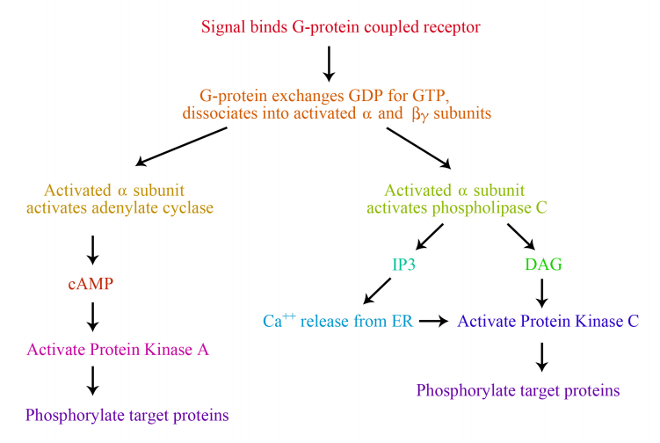
https://www.google.com/url?sa=i&source=images&cd=&cad=rja&uact=8&ved=2ahUKEwilg8nflZreAhUSmeAKHQnWBXoQjRx6BAgBEAU&url=https%3A%2F%2Fbio.libretexts.org%2FTextMaps%2FBiochemistry%2FBook%253A_Biochemistry_Free_and_Easy_(Ahern_and_Rajagopal)%2F08%253A_Signaling%2F8.4%253A_G-protein_Coupled_Receptors_(GPCRs)&psig=AOvVaw2jxXhFRdBX8jGZDX3QbKzZ&ust=1540301862731596

Slide 7
GPCR
GDP (Guanine Di or Tri Phosphate- similar to ADP/ATP) binds to G protein (inactive)
A signal molecules binds to the receptor, the G protein with the help of an enzyme, changes shape, causing GTP to replaces GDP and activating the protein
G protein now leaves the receptor, binds to the enzyme and triggers the next cellular response (similar to ligands)
Shape changes are temporary as the G protein is also GTPase which hydrolyzes GTP to GDP + Pi

Slide 8
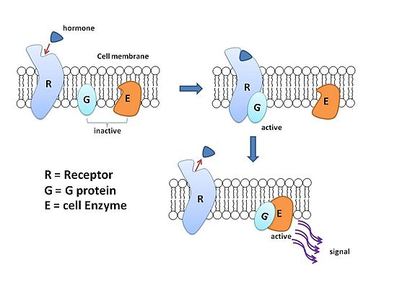
https://upload.wikimedia.org/wikipedia/commons/thumb/8/8e/G_protein.jpg/550px-G_protein.jpg

Slide 9
Receptor Tyrosine Kinase
Plasma membrane enzymatic protein
Transfers phosphate groups
Transfers a phosphate group from ATP to tyrosine on a substrate protein
RTK’s are used to activate multiple pathways
Cell growth and reproduction
Different from GPCR’s (only one pathway)

Slide 10
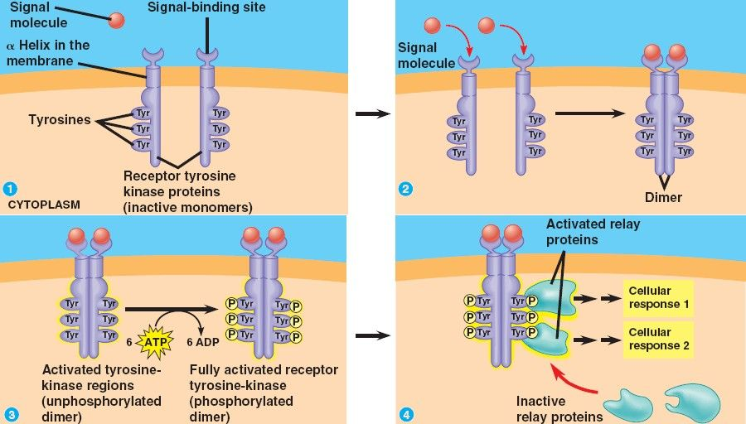
http://bio1151b.nicerweb.net/Locked/src/Locked/media/ch11/11_07bTyrosineKinases.jpg

Slide 11
RTK
Receptors are monomers, each with its own ligand-binding site
Signaling molecule binds to two receptor monomers, forming a dimer
Dimerization activates the RTK region of the monomer and adds a phosphate from ATP to the tail of a tyrosine
Now that it is active, relay proteins inside the cell can recognize the receptor and a signal transduction pathway ensues

Slide 12
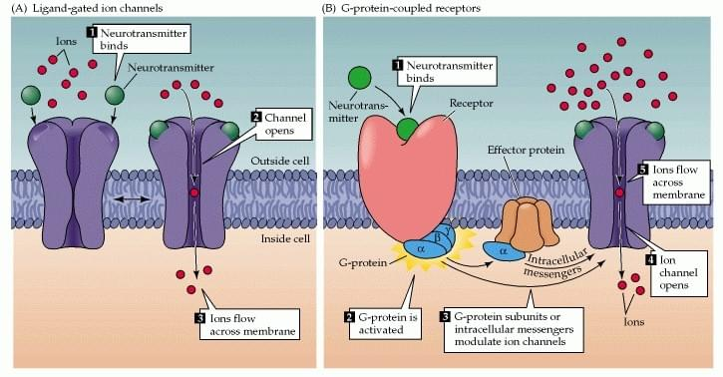
https://www.google.com/url?sa=i&source=images&cd=&cad=rja&uact=8&ved=2ahUKEwiq4tKh76LeAhWCTt8KHX6sAvAQjRx6BAgBEAU&url=https%3A%2F%2Fwww.creative-biostructure.com%2Fcustom-mempro%25E2%2584%25A2-pentameric-ligand-gated-ion-channels-services-45.htm&psig=AOvVaw1Q4Da_Oj2w-X2zN2w0QWWN&ust=1540600757935323

Slide 13
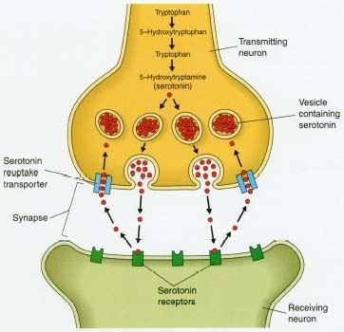
Ion Channel Receptors
A signaling molecule binds as a ligand which changes the shape of the receptor protein and the gate opens or closes
A ligand binds to a specific site on the transmembrane protein
The gate opens and the channel opens for ions to flow through
When the ligand leaves, the receptor closes
Neurotransmitters
Transfer across the synapse of two neurons
Bind to the receiving cell
An electrical signal flows through the neurons (affecting ioin gated channels)

Slide 14
Intracellular Receptors
Found in cytoplasm or nucleus of cells
Successfully passed through the membrane by being small and/or hydrophobic (ex: steroid and thyroid hormones
Binds with hormone-receptor complex and changes the shape causing a response turning on genes
DNA→ mRNA → Ribosome → Protein
Proteins called transcription factors control which genes are turned on
Transduction pathway ensues

Slide 15
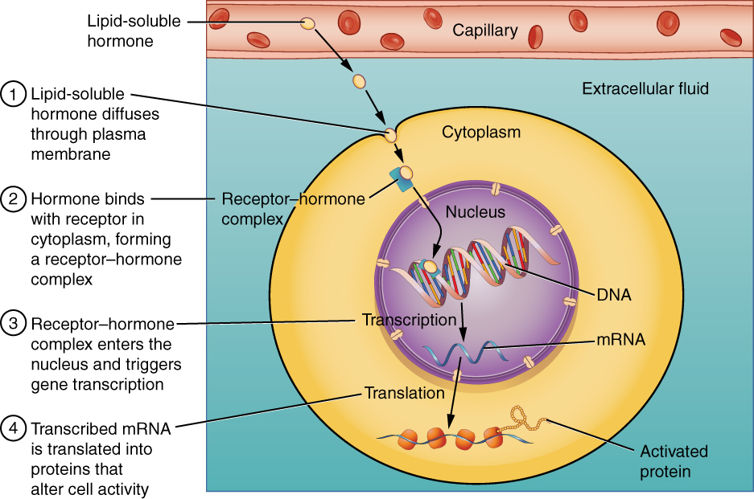
http://cnx.org/resources/f45222d95593c5d576b75d69d74eaec0/1803_Binding_of_Lipid-Soluble_Hormones.jpg

Slide 16
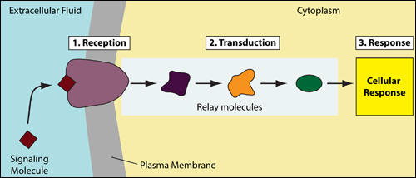
Transduction Pathways
Multi-steps pathways signaling steps one to the next
https://pharmaceuticalintelligence.files.wordpress.com/2014/08/signaltransduction_simple.jpg

Slide 17
Phosphorylation and Dephosphorylation
Adding or removing phosphate groups through a series of steps
Protein phosphates enzymes that rapidly remove
Cyclic AMP or cAMP
Cyclic adenosine monophosphate
Made from ATP by adenylyl cyclase
Assists in G protein signaling pathways

Slide 19
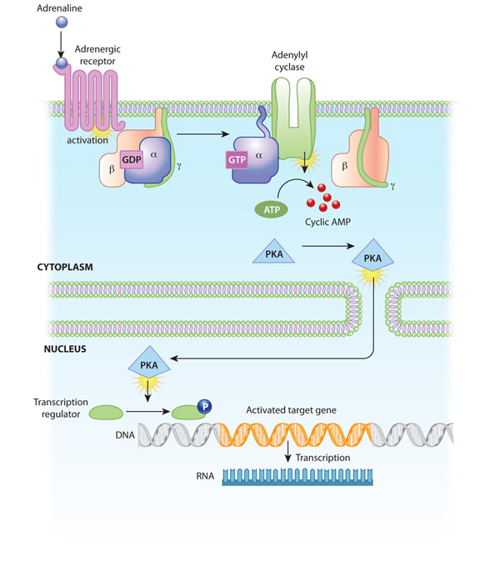
An example of signal transduction cascade involving cyclic AMP
The binding of adrenaline to an adrenergic receptor initiates a cascade of reactions inside the cell. The signal transduction cascade begins when adenylyl cyclase, a membrane- bound enzyme, becomes activated by G-protein molecules associated with the adrenergic receptor. Adenylyl cyclase creates multiple cyclic AMP molecules, which fan out and activate protein kinases (PKA, in this example). Protein kinases can enter the nucleus and affect transcription.
© 2010 Nature Education All rights reserved.

Slide 20
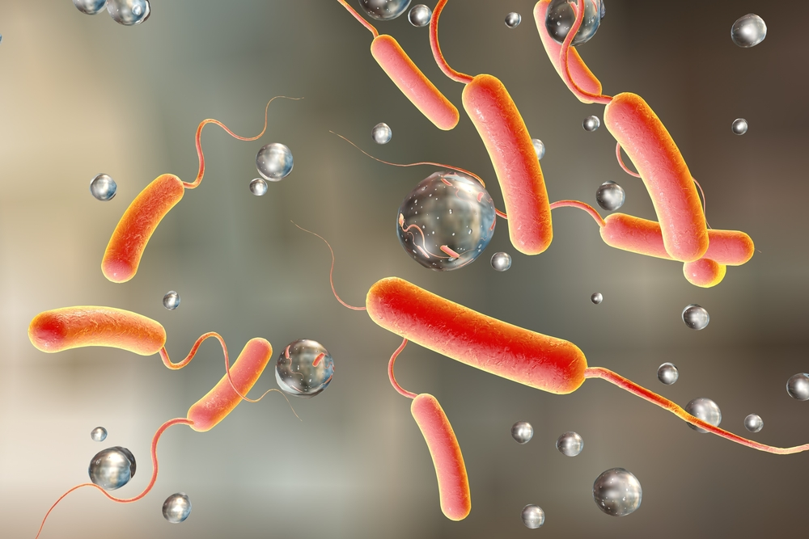
Cholera
Bacteria form a biofilm producing a toxin on the small intestine
The toxin is an enzyme that modifies a G protein responsible for salt and water secretion
GTP does not become GDP, resulting in high concentrations of cAMP, causing a disruption in salt and water homeostasis and dehydration
https://www.rdmag.com/article/2017/05/cdc-recommends-cholera-vaccine-us-travelers

Slide 21
Importance of Calcium
Ca²⁺ used as a messenger
Muscle cell contraction
Cell division
Plant cell greening
Secondary messenger in GPCR and RTK
Concentration higher in extra cellular fluid cytoplasm therefore they are actively transported into the ER
Moves into the mitochondria through chemiosmosis when levels in cytosol are high
Secondary messengers
IP₃- inositol triphosphate
DAG0 diacylglycerol

Slide 22
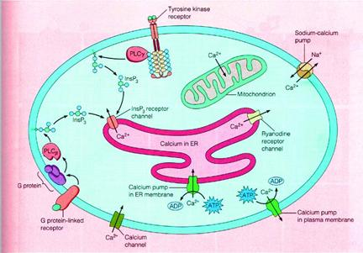
http://www.sivabio.50webs.com/ip13.jpg

Slide 23
Cellular Response
Reactions occur when specific genes/proteins are turned on or off
Synthesis through gene expression
Occurs in nucleus or cytoplasm
Signaling pathway tend to increase the cellular response
Specific points along pathway provide regulation/control
Scaffolding proteins enhances the productivity of the pathway or can act as a relay protein
Pathways can branch out- ex: Wiskott-Aldrich syndrome

Slide 24
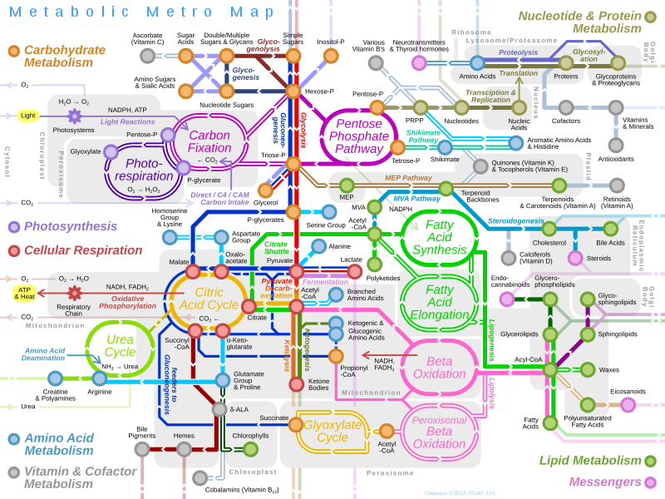
https://upload.wikimedia.org/wikipedia/commons/6/6e/Metabolic_Metro_Map.svg

Slide 26
Cellular Pathway Endings
Apoptosis: programmed cell death
Organelles break up DNA to protect neighboring cells from damage
Most pathways signaled by outside ligand from a neighboring cell
Ligand binds and activates the caspases that carry out apoptosis
Caspases are proteins that control cell deaths
15 different types of caspases in mammals
Cytochrome C from the ETC in the mitochondria acts as a caspase
Cell death can come from internal signals
DNA with irreplaceable damage
Rough ER with mutated protein folding

Slide 27
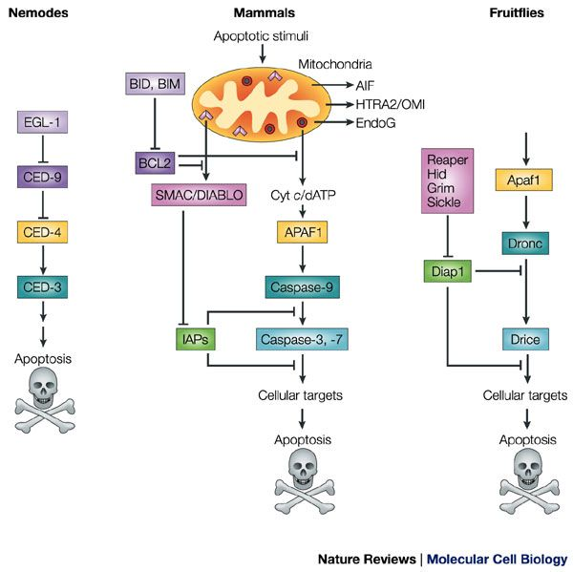
Similarities between organisms show early development in eukaryotes
Failure of apoptosis in mammals could result in webbing of digits

Slide 28
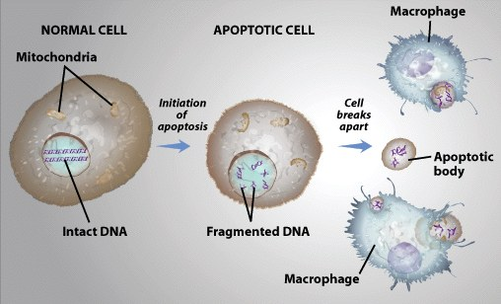
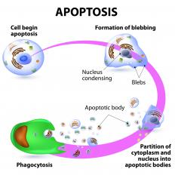
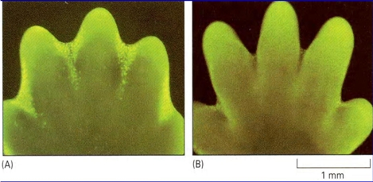
https://images.wisegeek.com/small/diagram-of-apoptosis.jpg
https://www.google.com/url?sa=i&source=images&cd=&cad=rja&uact=8&ved=2ahUKEwig97W8qqfeAhUMmeAKHa1pDwoQjRx6BAgBEAU&url=https%3A%2F%2Fsites.duke.edu%2Fapep%2Fmodule-3-alcohol-cell-suicide-and-the-adolescent-brain%2Fexplore-more%2Fto-be-or-not-to-be-apoptosis%2F&psig=AOvVaw1g4Q0tNVViC5FxojnN3S1y&ust=1540754002811030
http://classes.kumc.edu/som/cellbiology/processes/celldeath/images/nr46.jpg

Slide 29
https://image.slidesharecdn.com/apoptosis-160704105022/95/apoptosis-16-638.jpg?cb=1467629556

