Slide 1
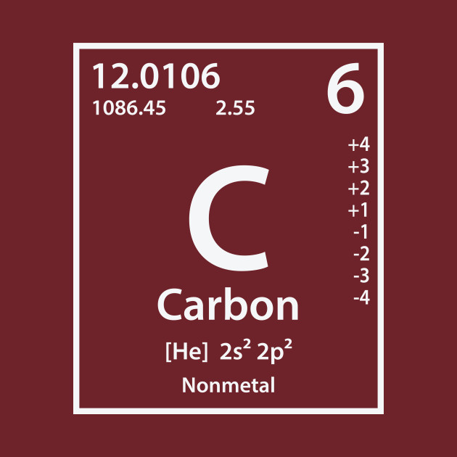
Carbon

Slide 2
Carbon is organic
Organic molecules are composed of N, CHOPS
Nitrogen
Carbon
Hydrogen
Oxygen
Phosphorus
Sulfur
In order to be classified as organic, a molecule must have both Carbon and Hydrogen

Slide 3
Macromolecules
Carbon and hydrogen atoms combine with a variety of other organic elements to create organic macromolecules
Carbohydrates
Lipids
Proteins
Nucleic Acids

Slide 4
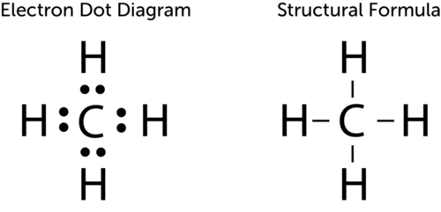
Why Carbon?
Carbon has 6 electrons, 2 in the first orbital and 4 in its outer most shell, allowing for the opportunity to either gain or lose electrons
Carbon will share its electrons creating strong covalent bonds
These bonds can either be single or double bonds
Single bonded carbon creates molecules in a tetrahedral shape
Ex: Methane
Carbon-Carbon double bonds create a flattened structure
Ex: Ethene

Slide 5
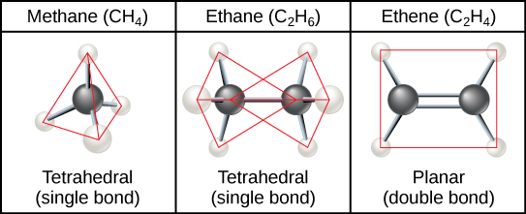

Slide 6
Carbon Skeletons and Hydrocarbons
Because carbon can form the most amount of bonds (4 valence electrons = 4 bonds), it can take a variety of forms (skeletons)
Hydrocarbons
Molecules made up of carbon and hydrogen
Ex: Petroleum
Fossil Fuel with high energy (lots of bonds!)

Slide 7
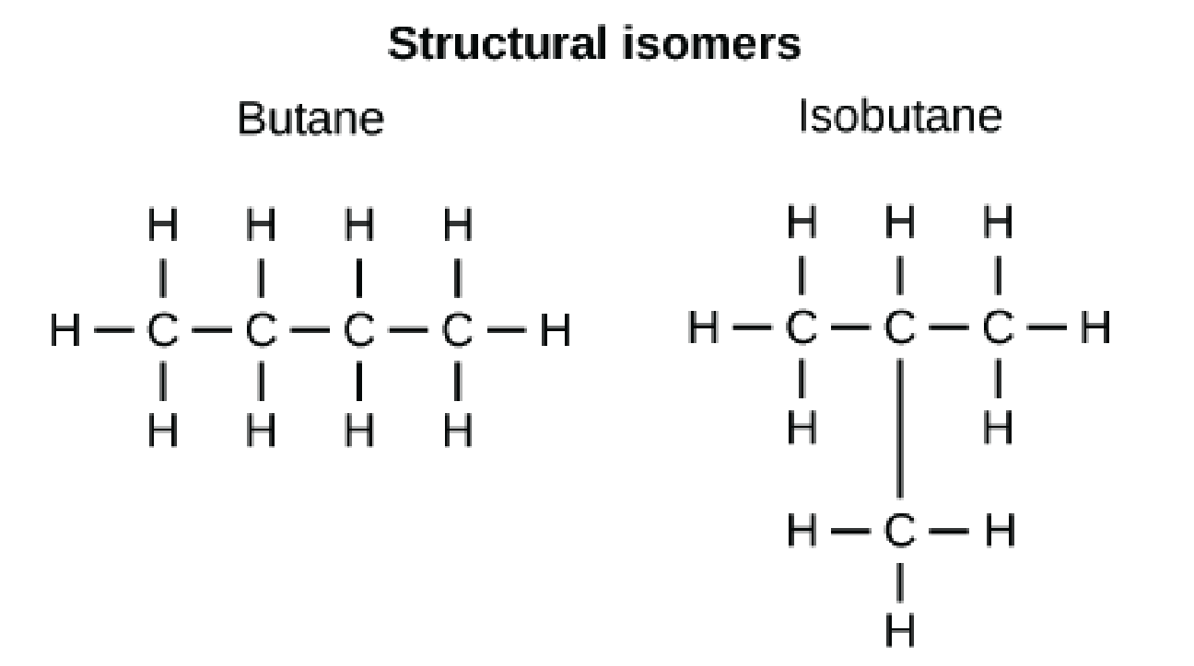
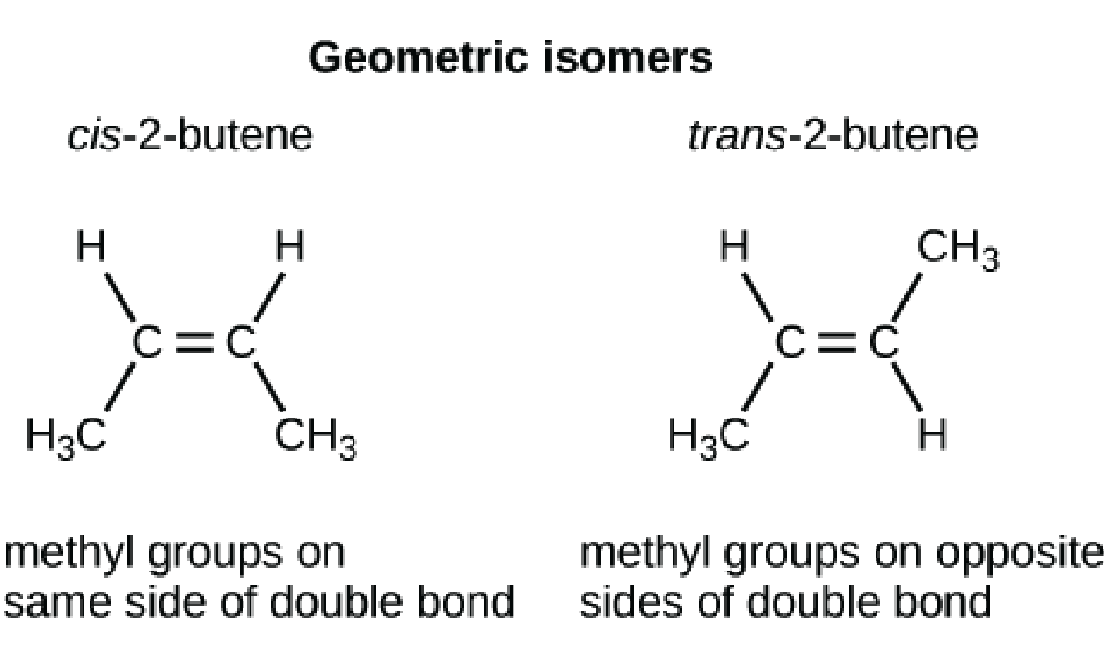
Isomers
Variations in arrangement of the same numbers and types of atoms (think ACT and CAT)
Structural Isomers
Differ in the covalent bonds between the atoms
Cis-Trans Isomers
Differ in the arrangement around a double bonded Carbon
Cis- same side
Trans- Opposite sides

Slide 8
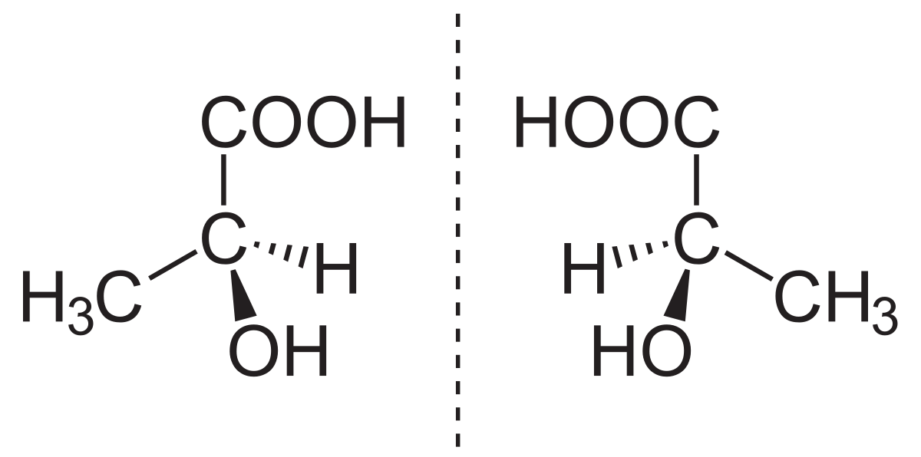
Enantiomers
Asymmetrical carbon atom arrangement variations resulting in mirror images
Pharmaceutical importance because geometrical shape is important for drug effectiveness

Slide 9
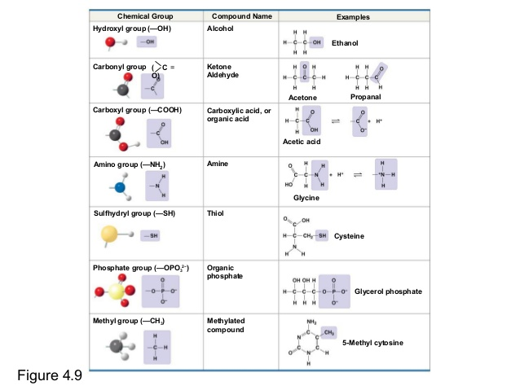
Chemical Groups

Slide 10
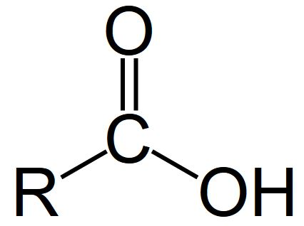
Hydroxyl Groups
Alcohols
Carbon bonded to an OH (hydroxyl group)
Typically end in “ol”
Easily dissolve in Water

Slide 11
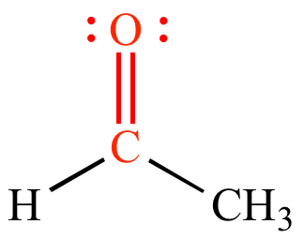
Carbonyl Group
Carbon double bonded to an oxygen
Tend to have strong odors
Ketones
Carbonyl group within a carbon skeleton
Aldehydes
Carbonyl groups at the end of the skeleton

Slide 12
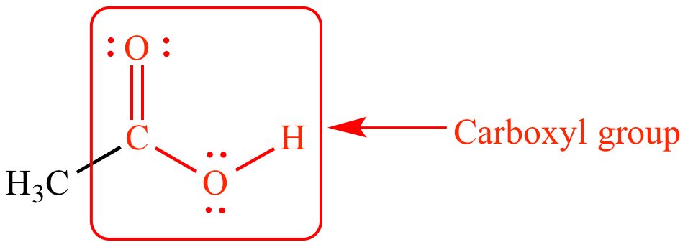
Carboxyl Groups
Carbon double bonded to an oxygen and single bonded to an OH
Think both a carbonyl and hydroxyl group
Easily release H+ ions thus creating an acidic solution
EX: Acetic Acid- Vinegar

Slide 13
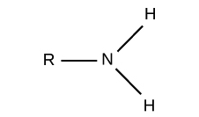
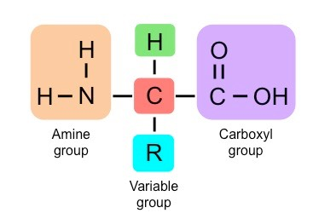
Amino Group
Nitrogen bonded to two hydrogens
Called an Amine
Key part of amino acids
Weak Bases

Slide 14
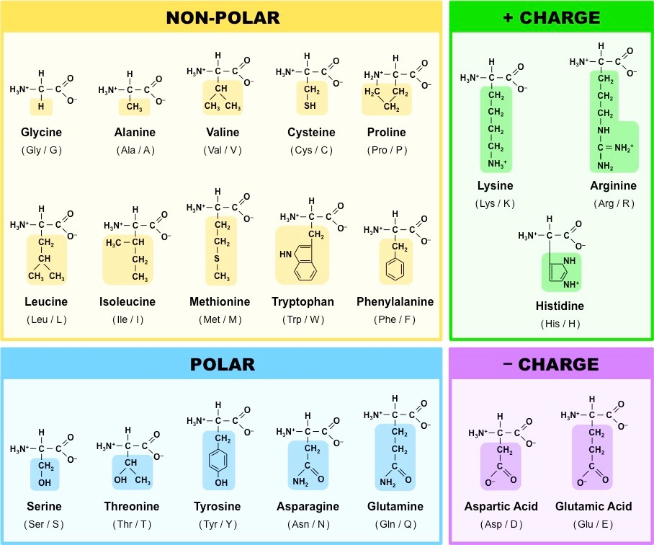

Slide 15
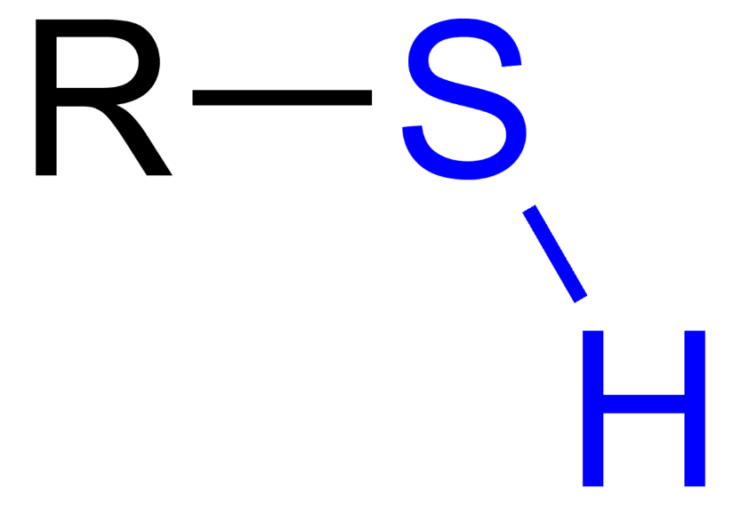
Sulfhydrl Group
Carbon bonded to a sulfur and hydrogen
Typically referred to as “thiols”
Responsible for the rotten egg, garlic and skunk smell

Slide 16
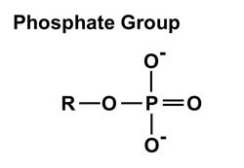
Phosphate Group
Carbon bonded to an oxygen, the a phosphate with three other oxygen molecules
Highly acidic due to charged oxygens
Very reactive due to charges and therefore allows for energy transfer through ATP (Adenosine Triphosphate)

Slide 17
Methyl Group
Carbon bonded to three hydrogens
Methylated compounds affect hormone structure/function and gene expression

Slide 18
Building and Breaking Down Carbon Compounds
Building Compounds: DEHYDRATION SYNTHESIS
Putting compounds together with the removal of a water molecule
Breaking down compounds: Hydrolysis
Adding water to split compounds

