Slide 1
Carbohydrates

Slide 2
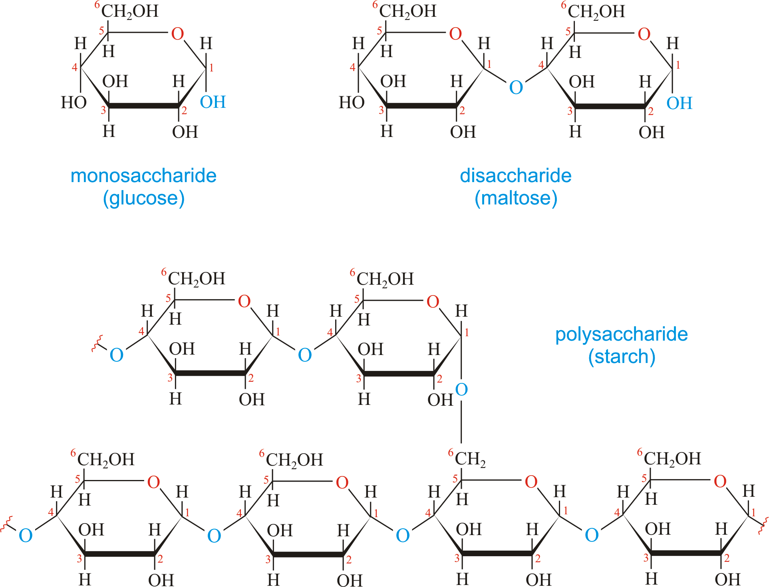
Macromolecule
Monomer- one molecule
Polymer- two or more of the same molecule bonding together

Slide 3
Reactions
DEHYDRATION SYNTHESIS
De-Without
Hydro- Water
Synthesis put together
HYDROLYSIS
Hydro- water
Lysis-Break

Slide 4
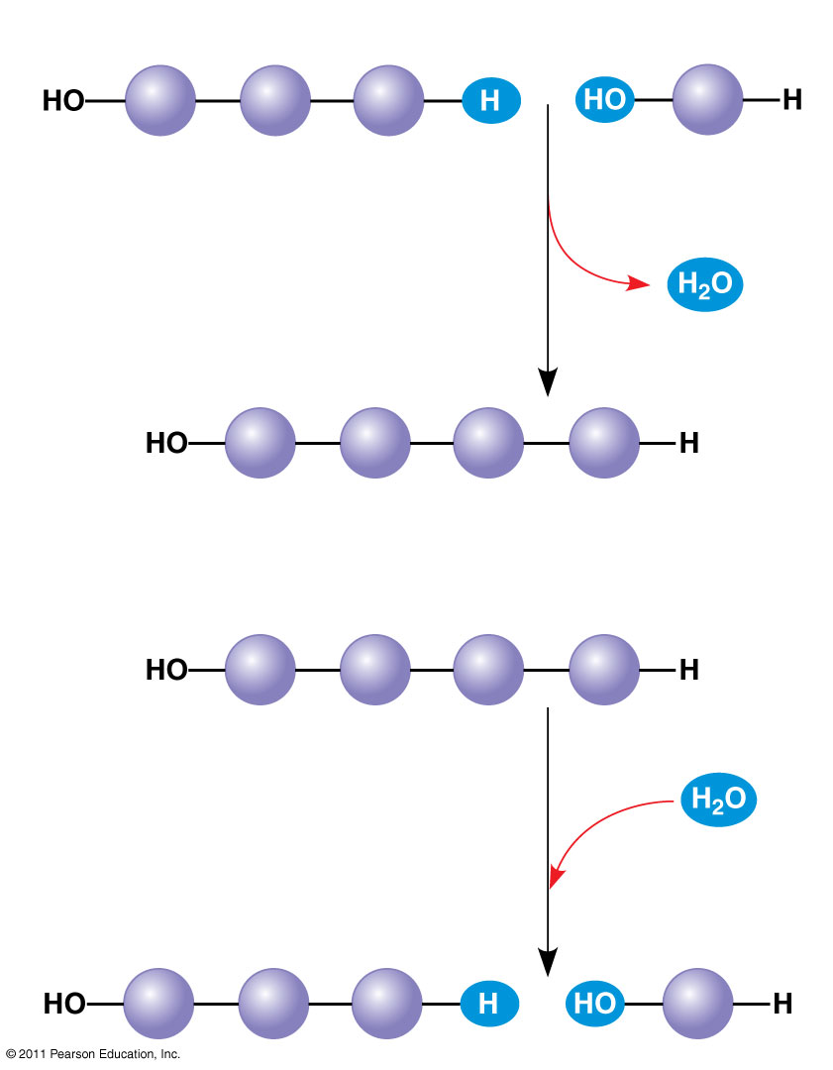
Figure 5.2
(a) Dehydration reaction: synthesizing a polymer
1
2
3
Short polymer
Unlinked monomer
Dehydration removes a water molecule, forming a new bond.
1
2
3
4
Longer polymer
(b) Hydrolysis: breaking down a polymer
1
2
3
4
Hydrolysis adds a water molecule, breaking a bond.
1
2
3
Notes:
Figure 5.2 The synthesis and breakdown of polymers.

Slide 5
Case Study
Low Carbohydrate Diets
People who eat less carbohydrates lose weight within days of eating minimal carbohydrates
Often times, when carbohydrates are reintroduced, the weight loss is reversed
WHY???

Slide 6
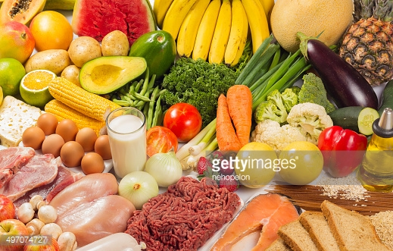
Carbohydrates
Three categories of carbohydrates
Monosaccharides
Disaccharides
Polysaccharides
Used as energy
Make up cell walls as cellulose

Slide 7
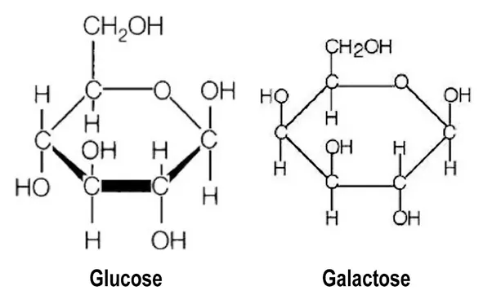
Monosaccharaides
C:H:O occurs in a 1:2:1 ratio
Can be either an Aldehyde (aldose) or a Ketone (Ketose)
Depending on double bonded oxygen location
Most carbohydrates end in OSE
Most form Ring shapes
Spacial arrangement of atoms determines how the molecule behaves

Slide 8
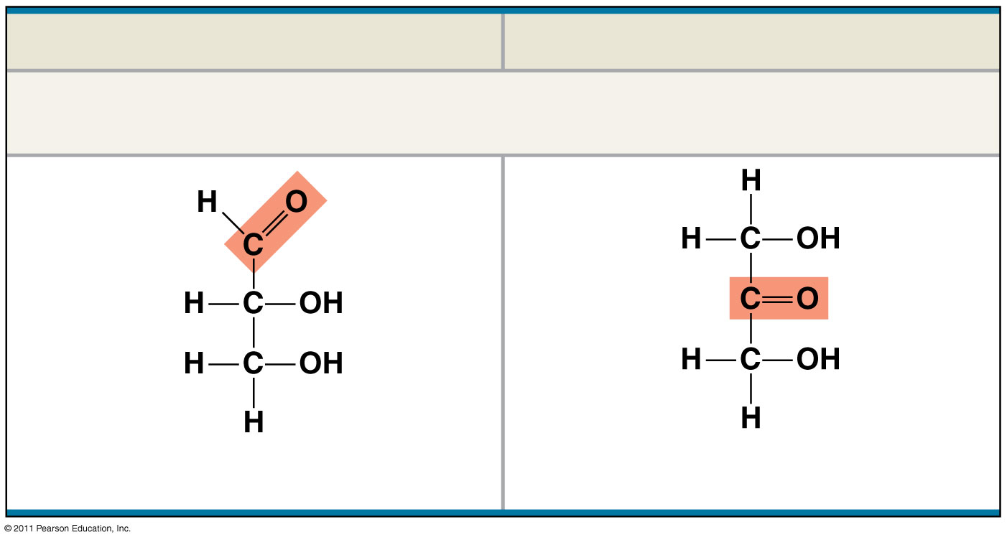
Figure 5.3a
Aldose (Aldehyde Sugar)
Ketose (Ketone Sugar)
Trioses: 3-carbon sugars (C₃H₆O₃)
Glyceraldehyde
Dihydroxyacetone
Notes:
Figure 5.3 The structure and classification of some monosaccharides.

Slide 9
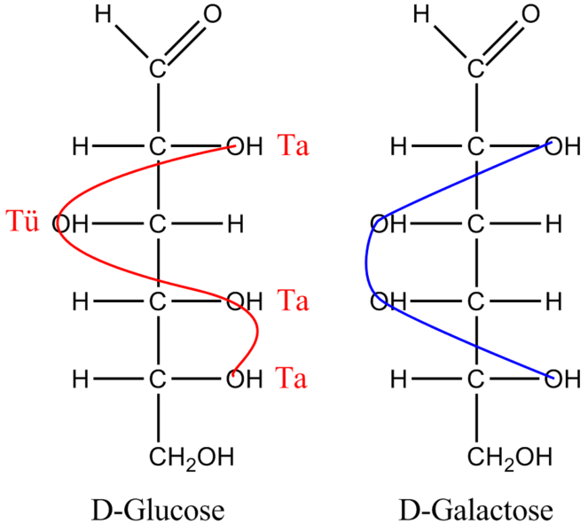
Glucose vs. Galactose

Slide 10
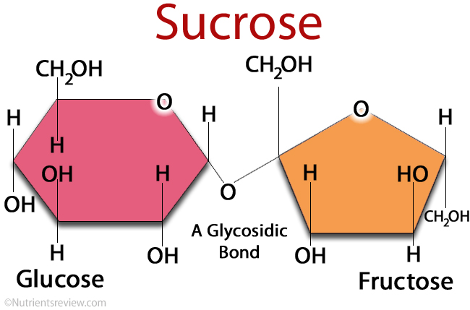
Disaccharides
Two monomers (monosaccharides) bonded by a glycosidic linkage (covalent bond between two simple sugars)
Sucrose (table sugar) is the most common made from fructose and glucose
Glucose and Galactose = Lactose

Slide 11
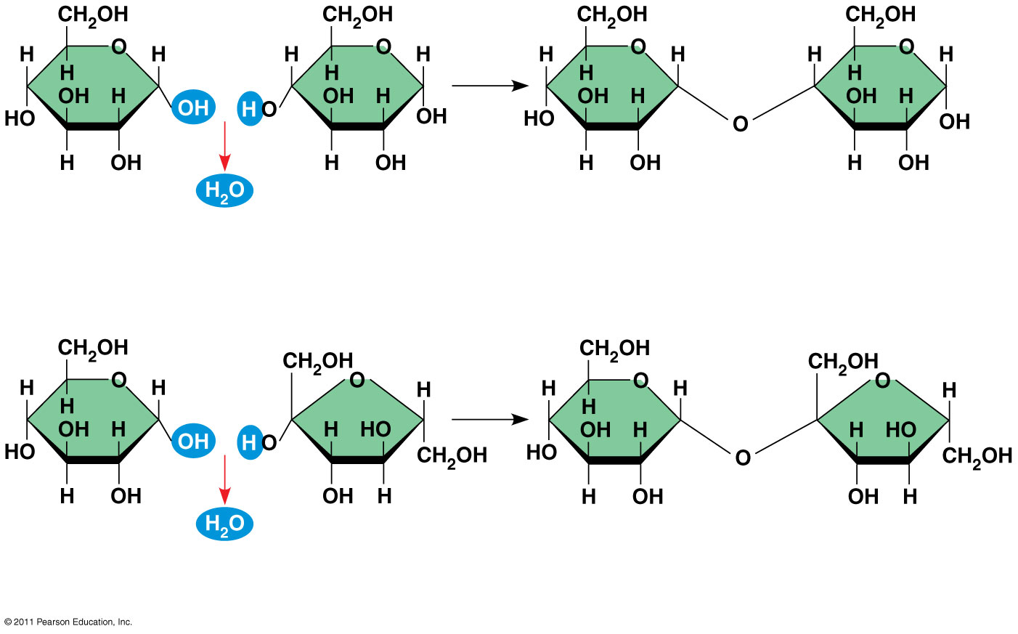
Figure 5.5
1–4 glycosidic linkage
1
4
Glucose
Glucose
Maltose
(a) Dehydration reaction in the synthesis of maltose
1–2 glycosidic linkage
1
2
Glucose
Fructose
Sucrose
(b) Dehydration reaction in the synthesis of sucrose
Notes:
Figure 5.5 Examples of disaccharide synthesis.

Slide 12
Polysaccharides
Macromolecules or polymers
Can be used as storage material
Starch is made up of many glucose molecules
Shape: Helical due to Carbon bonding location
Branched or unbranched
Plants store surplus starch as granules within chloroplasts and other plastids
The simplest form of starch is amylose

Slide 13
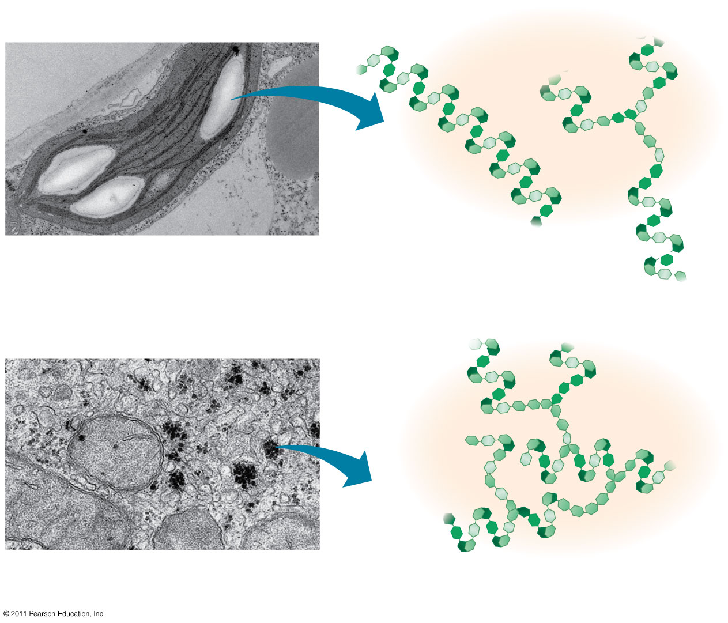
Figure 5.6
Chloroplast
Starch granules
Amylopectin
Amylose
(a) Starch: a plant polysaccharide
1 μm
Mitochondria
Glycogen granules
Glycogen
(b) Glycogen: an animal polysaccharide
0.5 μm
Notes:
Figure 5.6 Storage polysaccharides of plants and animals.

Slide 14
Case Study: Weight Loss
What does it take to lose excess weight?

Slide 15
Structural Polysachharides
Cellulose
Tough material that makes up cell walls of plant cells
Most organic compound on Earth
Different configuration from Starch
Structure controls Function
More difficult to digest than starch because of enzyme shape

Slide 16
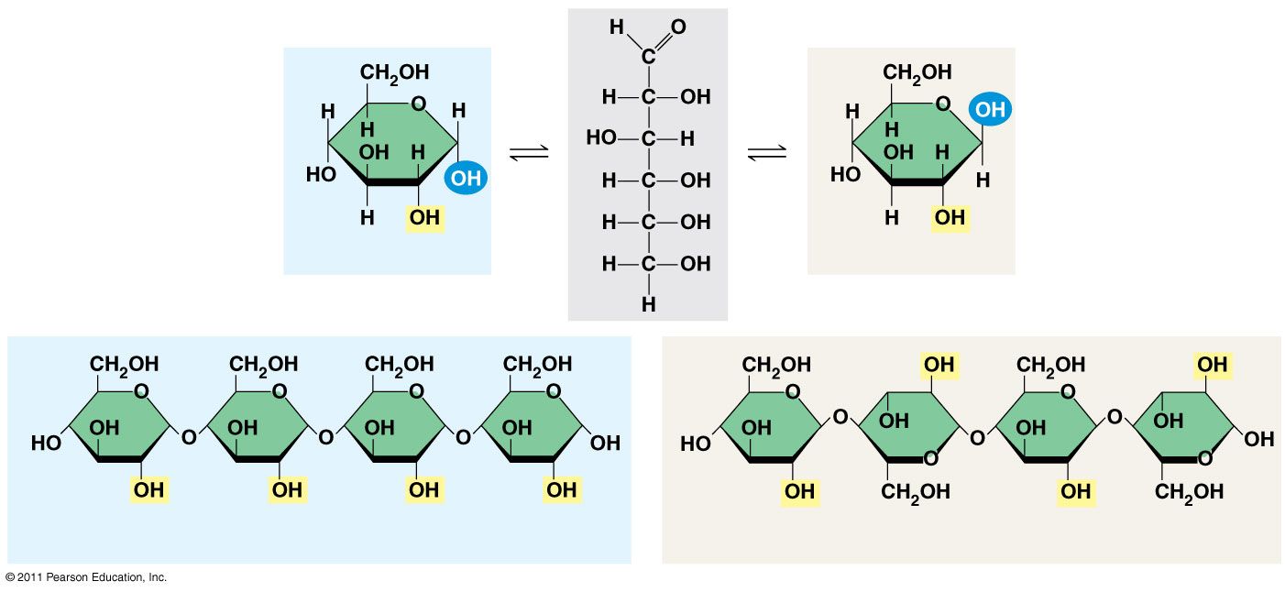
Figure 5.7
(a) α and β glucose ring structures
4
1
4
1
α Glucose
β Glucose
1
4
1
4
(b) Starch: 1–4 linkage of α glucose monomers
(c) Cellulose: 1–4 linkage of β glucose monomers
Notes:
Figure 5.7 Starch and cellulose structures.

Slide 17
Polymers with α glucose are helical
Polymers with β glucose are straight
In straight structures, H atoms on one strand can bond with OH groups on other strands
Parallel cellulose molecules held together this way are grouped into microfibrils, which form strong building materials for plants
© 2011 Pearson Education, Inc.

Slide 18
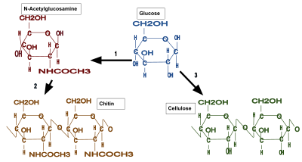
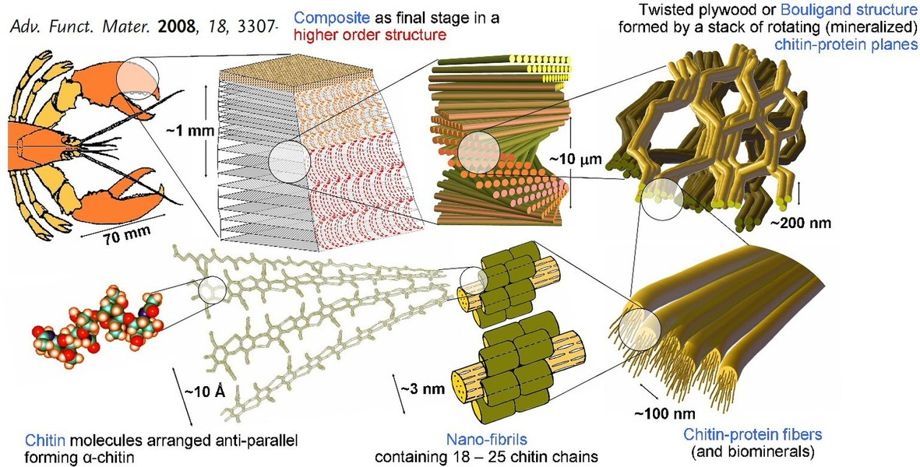
Chitin
Structural polysaccharide
Exoskeleton of arthropods

