Slide 1
Biotechnology
DNA tools

Slide 2
Vocabulary
Nucleic Acid Hybridization: pairing of one strand of nucleic acids to their complimentary strand
Genetic Engineering: manipulation of genes for practical purposes
DNA Sequencing: Determining the complete nucleotide sequence of DNA
DNA Cloning: preparing identical copies of DNA
Plasmid: small circular DNA in bacteria
Recombinant DNA: Plasmids with original DNA and inserted DNA
Gene Cloning: Production of multiple copies of single genes
Cloning Vector: DNA molecules carrying foreign DNA into a host
Restriction Enzymes: Enzymes which cut DNA at specific sequences (restriction site)

Slide 3
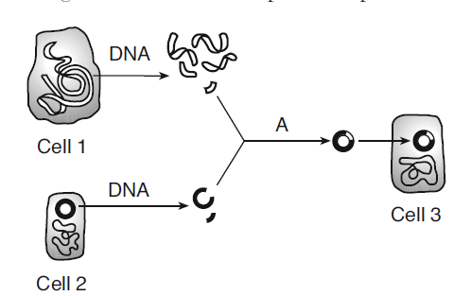
Making Recombinant DNA
Human insulin gene – cut out using restriction enzymes
Human Cell
Recombinant DNA
Bacterial Cell
Bacterial cell that produces human insulin
Bacterial plasmid cut with SAME restriction enzyme as human gene

Slide 4
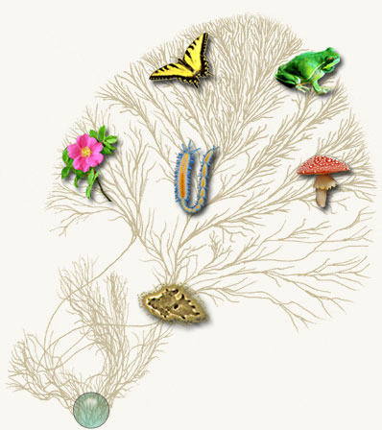
1st Through Genetic Evolution
- Natural Selection, “Survival of the Fittest”
- Random Genetic Variation
- Genetic Drift: random fluctuations in allele freq.

Slide 5
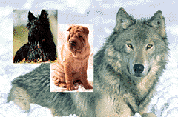
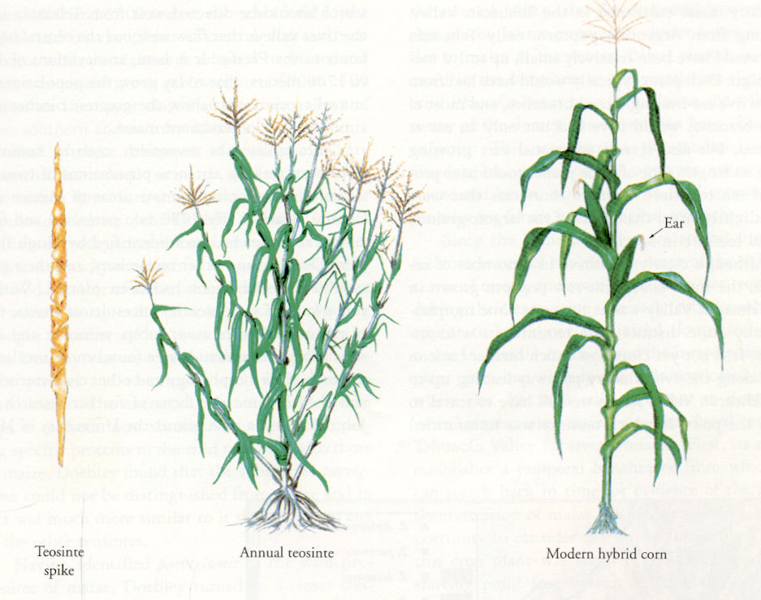
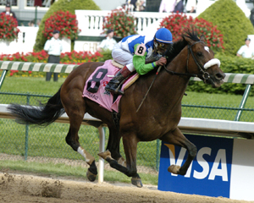
2nd Through Selective Breeding
- Breeding different combinations of plants repeatedly to encourage sought-after characteristics and breed out the less desirable ones
- Choosing variations of characteristics desired for breeding stock

Slide 6
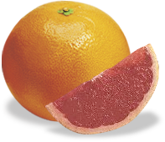
3rd Through Radiation Mutation
Golden Promise Barley (1956)
Created via gamma ray exposureused by specialist distillers of fine beers, including some organic beers.
Rio Red (1968)
The most popular red grapefruit, created by exposing grapefruit buds to thermal neutron radiation at Brookhaven National Lab in 1968
Calrose 76 (1976)
Rice created by treating seeds with gamma rays from cobalt-60, created shorter higher yielding plants

Slide 7
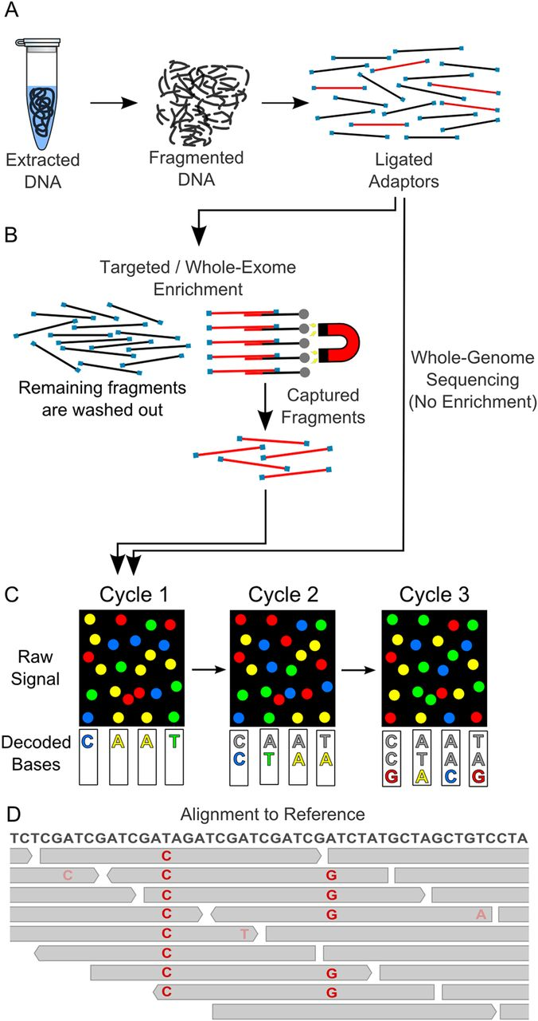
Next-Generation
Dideoxy Chain Method
DNA is broken into fragments and isolated
Polymerase Chain Reactions copies each fragment
Each copy attaches to the bead and placed om a well
Solutions with each nucleotide are washed and a flash of light occurs when the correct nucleotide is added
DNA is denatured to single strands
Synthesis of DNA begins at the 3’ end of the primer and continues until the tagged nucleotides attach
Different sized strands are separated in a gel
https://adc.bmj.com/content/archdischild/99/3/284/F1.large.jpg?download=true
https://www.jenabioscience.com/images/8bd31f7cad/sanger_seq.gif

Slide 8
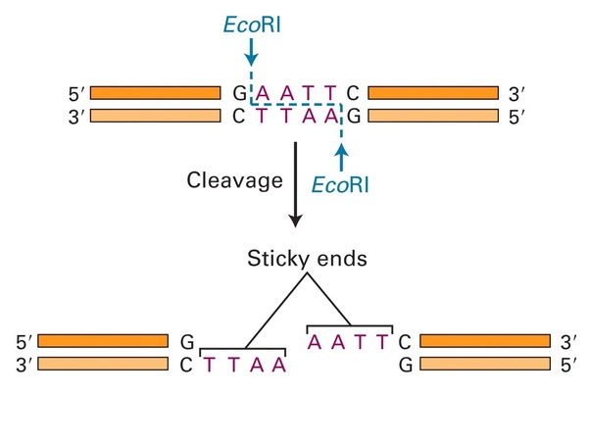
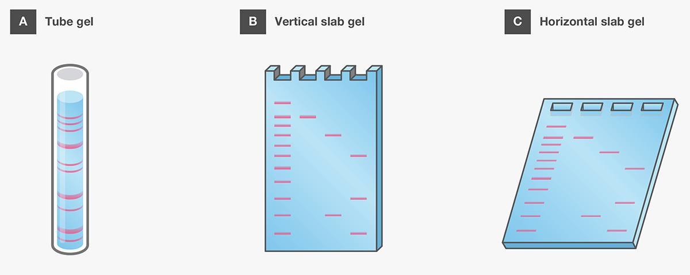
https://qph.fs.quoracdn.net/main-qimg-96c7e458319dc575ebe0e25a63a49c31
https://www.thermofisher.com/content/dam/LifeTech/global/life-sciences/Cloning/Images/Nucleic-acid-gel-electrophoresis-fig-4.png

Slide 9
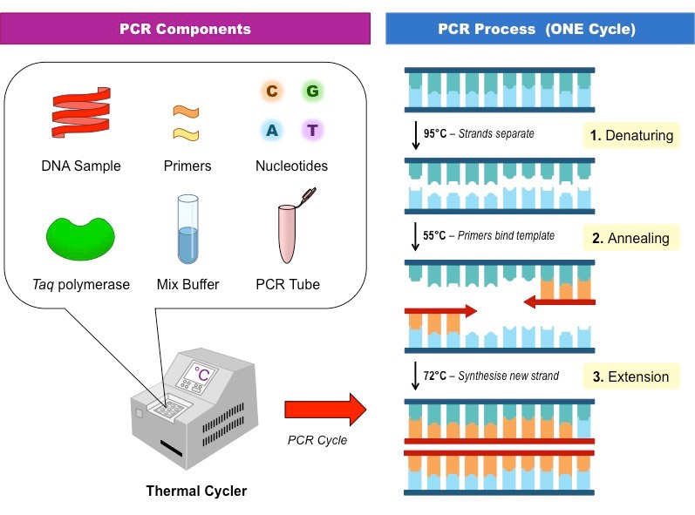
PCR Polymerase Chain Reaction
GOAL: make billions of copies of a specific target DNA segment
Procedure:
DNA is denatured
Annealing (hydrogen bonds reform)
Taq polymerase (heat stabilized) extends the DNA strand
https://blogs.baylor.edu/cili-cure-spring2017/files/2017/04/pcr-components_med-2672qsy.jpg

Slide 10
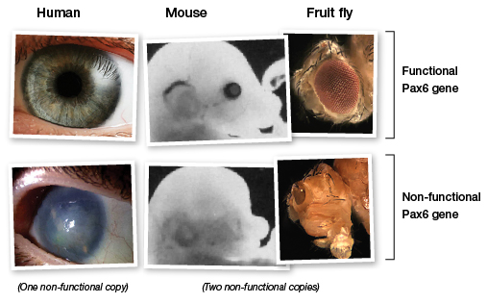
https://learn.genetics.utah.edu/content/selection/toolkit/pax6.jpg

Slide 11
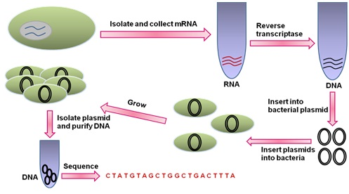
RT- PCR (Reverse Transcriptase PCR)
mRNA → DNA with the help of retrovirus reverse transcriptase
Poly dT acts as a primer on the poly A tail (start of the cDNA)
cDNA is when mRNA is degraded and complimentary DNA is synthesized by DNA polymerase
cDNA lacks introns and is used in protein expression in bacteria
https://nptel.ac.in/courses/102103045/module3/lec11/images/k1.jpg

Slide 12
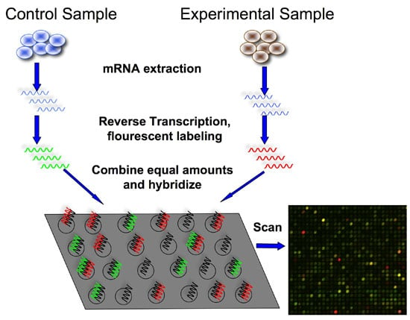
DNA Microarray
Single stranded DNA for different genes is fixed on a grid
cDNA binds to corresponding sequences
Tagged cDNA will glow in a scanner allowing scientists to see which genes are expressed
https://bitesizebio.com/wp-content/uploads/2011/07/cDNA-microarray-experiment.jpg

Slide 13
Gene Expression
In Vitro Mutagenesis
Mutations are introduced into a cloned gene to knock out normal copies
RNA interference (RNAi)
Double stranded RNA breaks down mRNA or translation
Genome-Wide Association Studies
Test for genetic markers such as a Single Nucleotide Polymorphism
https://nptel.ac.in/courses/102103017/module32/images/3.png

Slide 14
DNA Microarrays are used to
Investigate gene function - gene expression
Investigate gene structure - sequence variability or resequencing
Nucleus
Proteins
DNA
RNA
Cell membrane
Nucleus
tttaagctatcgtcatctga
DNA
http://www.affymetrix.com
Notes:
Optional slide. Use to discuss other microarray applications.

Slide 15
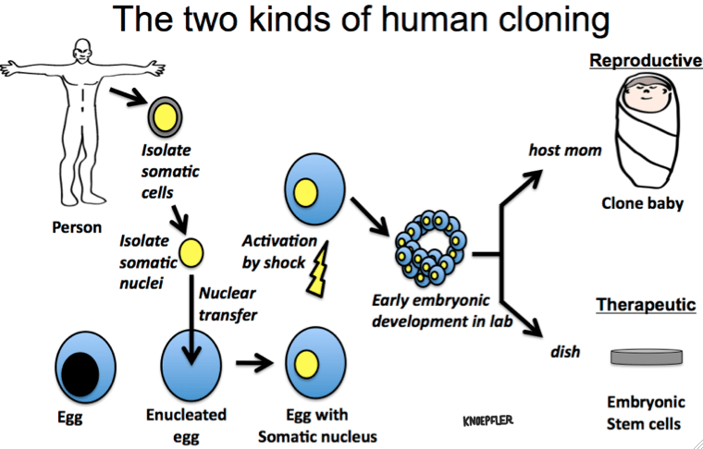
Cloning
https://i2.wp.com/www.ipscell.com/wp-content/uploads/2013/05/Knoepfler-art-Human-Cloning.png

Slide 16
Cloning
Stem Cell unspecialized cell that can reproduce indefinably and differentiate based on different environmental conditions
Cloning began in 1950’s with Carrot plants
Clones have been made of amphibians and mammals as well
Clones are not always the same
CC (color and personality)
Epigenetic changes in chromatin
Possible Methylation

Slide 17
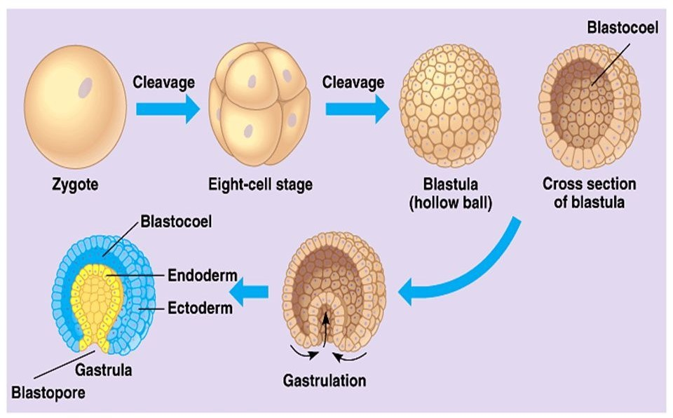
https://i1.wp.com/orbitbiotech.com/wp-content/uploads/2018/04/embryonic-development-Orbit-Biotech-Training.jpg?fit=960%2C596&ssl=1

Slide 18
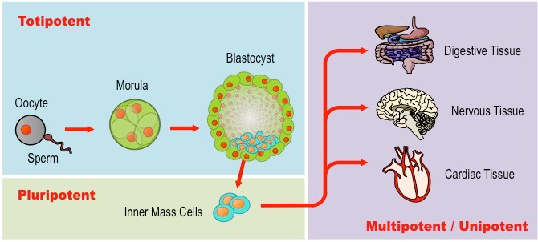
Stem Cells
Blastula Stage cells can become any type of cell
Adult Stem Cells become limited cells (such as blood cells)
http://ib.bioninja.com.au/_Media/stem-cells_med.jpeg

Slide 19
DNA and Biotechnology Uses
PCR-
used to diagnose genetic disorders such as DMD, Cystic Fibrosis etc.
Detect predisposition for cardiac disease, cancer, Alzheimers
Gene Therapy
Use of a retrovirus with corrected RNA to infect bone marrow
Use of non-retrovirus virus to treat other disorders such as degenerative blindness
Drug Creation
HGH, TPA and insulin
Transgenic animals
Taking proteins from one organism and putting them in another

Slide 20
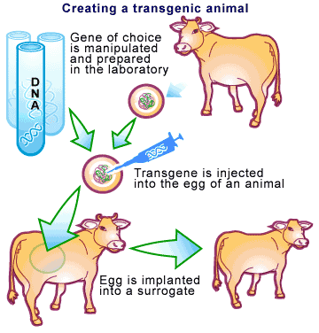
http://bioanimals.weebly.com/uploads/6/0/9/0/6090975/6684003_orig.gif

Slide 21
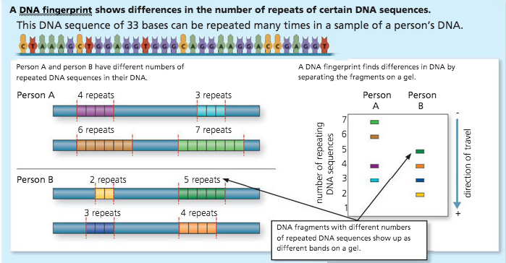
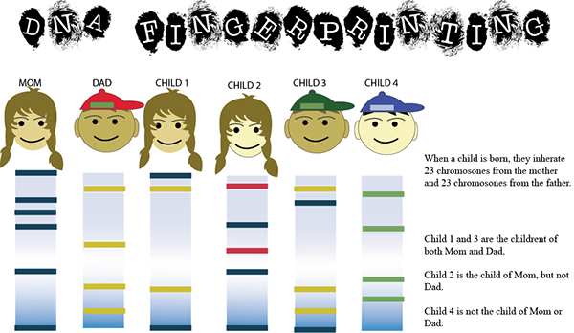
Forensic Analysis
DNA Fingerprinting-
Gel Electrophoresis
STR short tandem repeats
Both methods use PCR to amplify DNA
https://s3.amazonaws.com/user-media.venngage.com/994669-786a0d26256ff954bf673adf4000e896.png
https://mir-s3-cdn-cf.behance.net/project_modules/disp/92edc710908733.560ed6a13f515.png

Slide 22
Crispr/Cas9
What is CRISPR?
Clustered Regularly Interspaced Short Palindromic Repeats
A bacterial immune system that has been modified for genome engineering
Natural function of CRISPR/Cas9 complex:
Binds to DNA sequences and cleaves viral DNA from bacterial DNA

Slide 23
