Slide 1
Bacteria, Protista and fungi

Slide 2
prokaryotes
Chapter 27

Slide 3
Prokaryote Life
Can withstand harsh environments (extremophiles)
Can move between aquatic and land environments easily
Are small, mostly single celled, well organized (remember large SA:V ratio)
All have a cell wall- prevention from osmotic changes **Salt helps to prevent bacteria from reproduction**
Bacteria cell walls contain peptidoglycan, archaea contain polysaccharides and proteins
GRAM STAIN
Gram Positive: simpler cell wall bacteria with large amounts of peptidoglycan, can be resistant to antibiotics due to virulent strains, such as MRSA
Gram Negative: more structurally complex cell walls but less peptidoglycan, tends to be more resistant to antibiotics because it’s outer membrane has more toxic lipids (which also cause fever and shock)

Slide 4
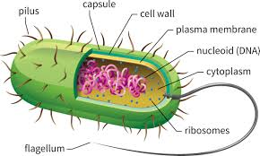
Prokaryote structure
Fimbriae (proteins) that enable bacteria to attach to surfaces and colonize
Chemotaxis is moving toward or away from a stimulus
Flagella tail like structure (analogous to eukaryotic flagella)
Recall that prokaryotic DNA is smaller in BP and found in plasmids

Slide 5
Bacterial Reproduction
Bacteria through binary fission (mitotic cell division) and therefore reproduce rapidly
HORIZONTAL GENE TRANSFER
Transformation- uptake of foreign DNA by bacteria which can change the genotype and phenotype
Transduction- Bacteriophages transfer DNA from one cell to another
Conjugation- DNA transferred between bacteria that are physically joined
F Factor the genes that form the pili

Slide 6
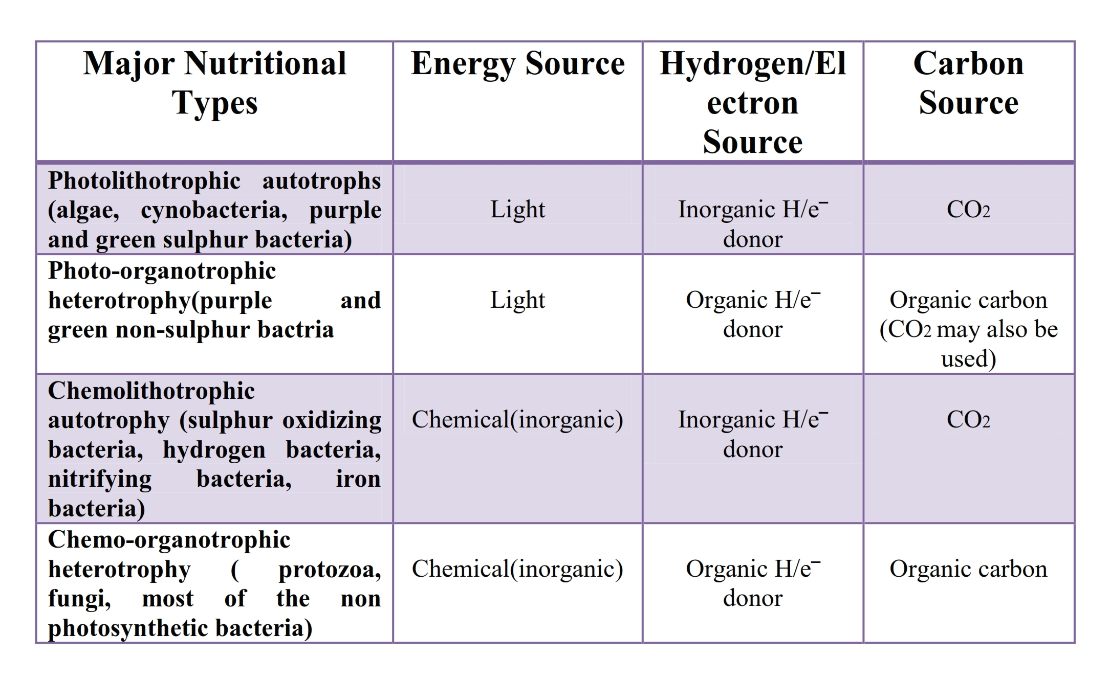
http://www.simplynotes.in/wp-content/uploads/2016/06/Nutritional_Types-1_001.jpg

Slide 7
Types of Prokaryotes
Obligate aerobes- must use oxygen for cellular respiration
Obligate anaerobes- poisoned by oxygen, either use fermentation or anaerobic respiration
Nitrogen Fixation- bacteria that convert atmospheric nitrogen (N2) to ammonia (NH3)
Biofilms- different species of bacteria working together and causing colonies to grow
Extremophiles
Halophiles live in high salt environments
thermophiles live in very hot environments

Slide 8
Protista
Chapter 28

Slide 9
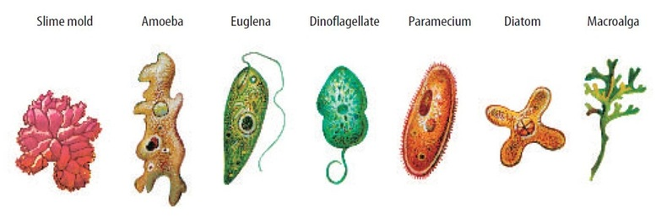
Protists: Unicellular Eukaryotes
* Most eukaryotes are unicellular protists*
Defined Nucleus and membrane bound organelles
Endosymbiosis: cell living within a cell
http://biology4isc.weebly.com/uploads/9/0/8/0/9080078/9334070.jpg?778

Slide 10
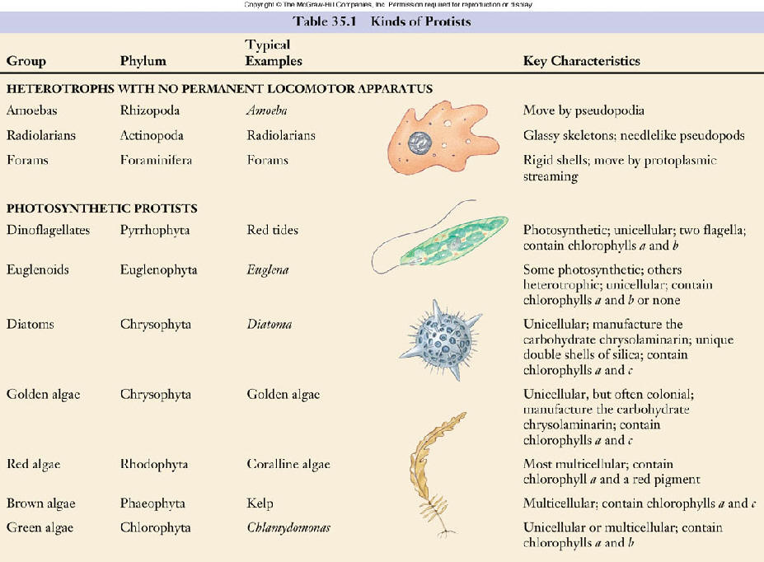
http://faculty.southwest.tn.edu/rburkett/classi33.jpg

Slide 11
https://slideplayer.com/slide/6823410/23/images/9/Supergroup%3A+Excavata+Characteristics+of+Excavata%3A.jpg
https://slideplayer.com/slide/6823410/23/images/14/Supergroup%3A+SAR+SAR+Starmenopila+Alveolata+Rizaria.jpg
https://slideplayer.com/slide/6823410/23/images/30/Supergroup%3A+Archaeplastida.jpg
https://slideplayer.com/slide/9354909/28/images/23/Supergroup+Unikonts+Recently+proposed%2C+extremely+diverse+supergroup.jpg

Slide 12
Fungi
Chapter 31

Slide 13
Fungi
Fungi are not plants! They are Heterotrophs
Fungi use enzymes to absorb nutrients
Can be unicellular (yeast) or multicellular
Multicellular fungi contain hyphae, a network of filaments made up of cell walls surrounding cells
Cell walls are strengthened by chitin, a strong flexible polysaccharide
https://s3-us-west-2.amazonaws.com/courses-images/wp-content/uploads/sites/1094/2016/11/03154355/OSC_Microbio_05_03_hyphae.jpg

Slide 14
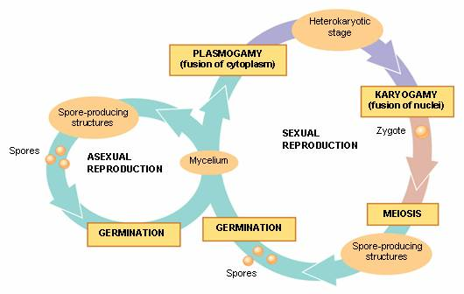
Fungi relationships and reproduction
Mycorrhizae the symbiotic relationship among plant roots and fungi
Ectomycorrhizal- form sheaths around the root
Arbuscular – branching hyphae and pushing into root cell
Reproduction
Sexual: Hyphae release pheromones and extend toward each other, the connection is called plasmogamy,
Asexual: Molds – haploid spores
https://mb0804mycology.files.wordpress.com/2008/08/sexual-and-asexual-reproduction.jpg

Slide 15
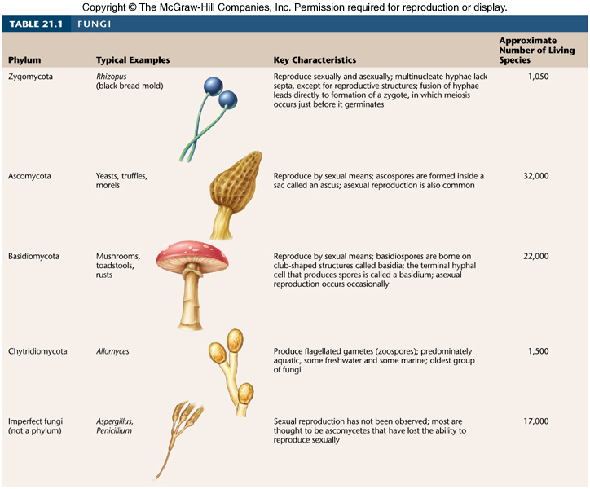
http://www.zo.utexas.edu/faculty/sjasper/images/t21.1.jpg

Slide 16
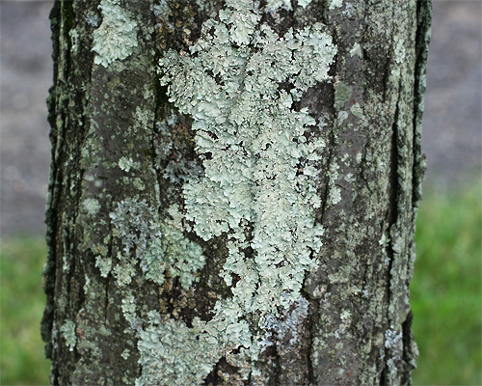
Fungi play Important roles
Fungi derived from the Protista clade opisthokonts, (some early ancestors show evidence of flagella)
Fungi are decomposers, recycling organic nutrients, enabling plant growth (more during ecology)
Endophytes, also live inside plants without causing harm (similar to mycorrhizal fungi)
Lichen, a symbiotic relationship between a photosynthetic microorganisms and a fungus, also found in succession
Fungi can also cause harm- mostly in plants, but also in animals such as a yeast infection
Penicillium, a mold, is also an antibiotic used by humans
https://njaes.rutgers.edu/fs1205/fs1205-main-2.jpg

