Slide 1
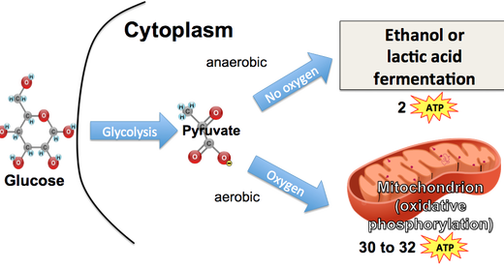
Anaerobic Respiration and fermentation

Slide 2
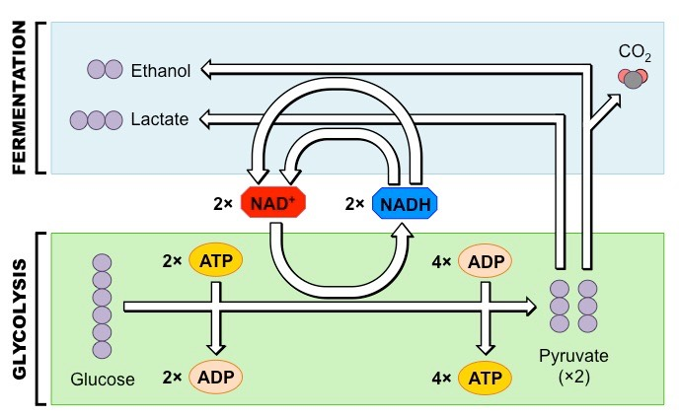
What happens when there is no oxygen?
Recall:
Oxygen is electronegative and is the reason behind the electron transport chain
Anaerobic Respiration: Cellular respiration without oxygen present- LESS ATP
Prokaryotes and organisms with limited oxygen do not use oxygen as their final acceptor at the end of the electron transport chain (ex: sulfate ions)

Slide 3
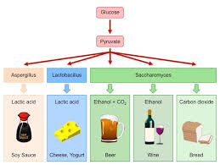
Fermentation
An extension of glycolysis
Low generation of ATP
Two types
Lactic Acid Fermentation
Alcohol Fermentation

Slide 4
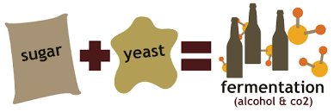
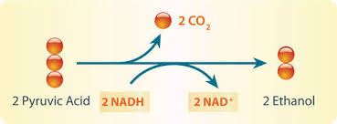
Alcohol Fermentation
Pyruvate is converted to ethanol
Yeast and bacteria carry out alcohol fermentation

Slide 5
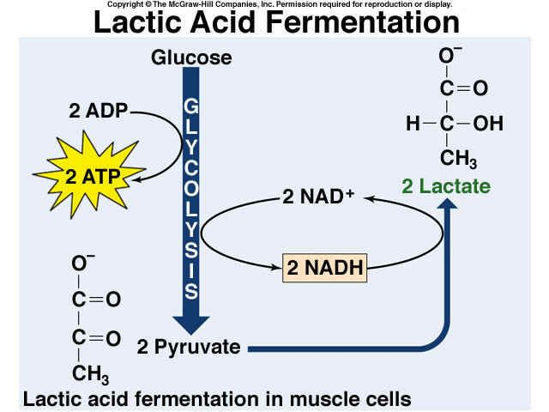
Lactic acid fermentation
Pyruvate reduces to lactate by NADH and carbon dioxide is not released
Fungi and Bacteria use this (Dairy industry)
Humans during exercise

Slide 6
Aerobic
Anaerobic
Fermentation
Electron transport chain is final e- acceptor
32 ATP
Glycolysis
Final e- acceptor is an organic molecule
2 ATP
Final e- acceptor js another e- molecule (not oxygen)

